Slide 1
THE SENSIVITY OF MECHANICAL PROPERTIES OF AISI 4140 STEEL TO CHANGES IN COMPOSITION
Multiscale Materials Informatics and Innovation
Dr L. SCOTTI , S. SUPANEKAR , Dr M. ANDERSON, Prof. H. C. BASOALTO-IBARRA , and Prof. D. COGSWELL
Multiscale materials informatics and innovation (M2i2)
Department of Materials Science and Engineering
University of Sheffield

Slide 2
Contents
Motivation behind the work
Definition of uncertainty
Description of the model
Material
Thermodynamics calculations
Model parameter calibration
Uncertainty propagation of mobilities scatter on the yield stress and flow stresses
Uncertainty propagation of plastic variation on the yield stress and flow stresses
Discussion
Conclusions
Notes:
The challenges is to have validated, reliable results, and to known the uncertainty affecting them.
To do so we believe that this can be achieved through a physics-based computational approach which discloses the understaning of fundamental mechanism and the cause-effect between macroscale and microscale behaviour.

Slide 3
Motivation
Challenge: Qualitative prediction for materials design and qualification process
This required meaningful Validation of the model:
Understand the reliability of the model prediction is essential
How we can capture the uncertainty in the process (i.e. variation in microstructure and properties)
Approach: a physics-based computational framework will:
Qualitative understanding of fundamental mechanisms controlling materials behaviour
Understand the cause-effect relations between macroscale behaviour and the lower scale mechanisms (including microstructure)

Slide 4
Uncertainty
DEFINITION: Uncertainty refers to the spread of values that could be reasonably attributed to a measured quantity.
CLASSIFICATION:
Natural uncertainty (NU) – refers to inherent random variability in the material structure or behaviour. NU are specified through a probability distribution;
Model parameter uncertainty (MPU) - arises from insufficient or inaccurate information about the parameters with considerable influence on the response of the model. This type of uncertainty can be reduced by obtaining more data or more precise experiments/measurements; (sensitivity to model parameters)
Model structure (MSU) - results from incomplete physics of the problem, incorrect assumptions or simplifications, and/or numerical inaccuracies;
Propagated uncertainty (PU) - uncertainty that can be propagated along a chain of computational models to generate variations (scatter) in the final outputs

Slide 5
Model: Crystallographic slip rate
Viscoplastic framework consists of
micro scale models to calculated the shear strain rate considering
Thermally activated jerky-glide
Dislocations slip events and dislocation vacancy interactions
Mobilities effect
Crystal plasticity model at the macroscale level inferred with shear strain rate

Slide 6
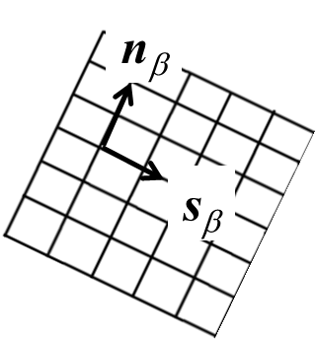
Model: CP formulation summary
Plastic velocity gradient
$$L^{P}= \sum_{α=1}^{n}{\dot{γ} s_{α}⨂n_{α}}$$
Find $F^{P}$ by solving the following ODE
$${\dot{F}}^{P}=L^{P} ⋅F^{p}$$
Elastic distortions $F^{E}$ determined from
$$F=F^{E}.F^{P}$$
Stress tensor
$$σ= ℂ : \frac{1}{2}\left({F^{E}}^{T}F^{E} −I\right)$$
Updating slip and normal vectors
$$s_{α}= F^{E}{{.s}_{α}}_{0}$$
$$n_{α}= {n_{α}}_{0}{{.F}^{E}}^{−1}$$
Objectivity
$$\dot{σ}=\check{σ} +W⋅σ−σ⋅W$$
$$\check{σ}=ℂ :(D−D^{P})$$
where $D$ and $W$ are rate of stretch and spin tensors.

Slide 7
Materials
AISI 4140 is a hypo-eutectoid low alloy steel (%C <0.85):
with ferrite stabilizer Cr and Mo to increase hardenability.
Addition of Mn to improve strength
It is used in structural applications taking advantages of its good ductility and toughness as well as high strength.
It is forged in the Austenitic state at temperatures between 1100 and 1200° C, and then slowly cooled.
The mechanical behaviour depends on the chemical segregation through its impact on microstructures following the heat treatment.

Slide 8
4140 CALPHAD diffusivities
wt.% | Al | C | Cr | Cu | Fe | H | Mn | Mo | Ni | P | S | Si | Sn | V
min | 0.015 | 0.38 | 0.9 | 2.5E-3 | bal | 2E-6 | 0.75 | 0.2 | 2.5E-3 | 1.5E-4 | 1.5E-4 | 0.15 | 2.5E-4 | 3E-4
max | 0.035 | 0.43 | 1.1 | 0.25 | bal | 0.0002 | 1 | 0.25 | 0.25 | 0.015 | 0.015 | 0.35 | 0.025 | 0.03
Approach: Monte Carlo mobility calculations of the composition sampled with a uniform probability from each alloying element composition range.
Tools: Thermo-Calc with TCFE12 and MOBFE7 database
$$D_{v}=D_{v0}\exp\left(−\frac{Q_{0}}{R_{g}T}\right)$$
This calculation assesses the predicted composition dependence of the diffusivities to explore the potential impact of composition variation within a component. These predictions require further experimental validation.
Activation energy
Diffusivity coefficient

Slide 9
Interstitial elements
Carbon
Hydrogen

Slide 10
Example Substitutional
Aluminium
Due to the challenge of determining the thermodynamic factor present when measuring diffusivities, the composition dependence and uncertainty may be larger.
Nickel

Slide 11
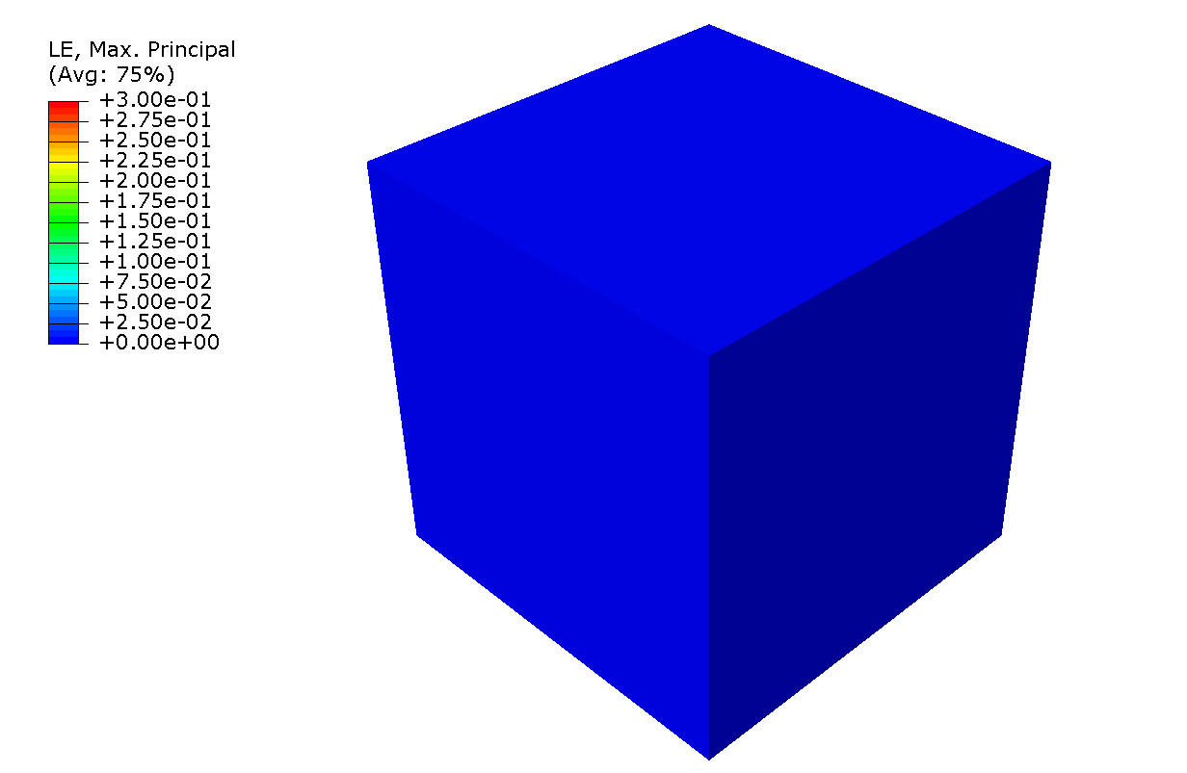
Model Calibration
Initial parameter set derived from theory.
This is a useful property of the theory – other constitutive models have empirical parameters and suffer non-uniqueness, i.e., there is a large number of parameter combinations that equally well represent the data.
Fine-tuning of parameters to improve model representation of datasets.
$$ρ_{m} (1/m)$$ | $$b (m)$$ | $$D_{v0} ({m^{2}}/s)$$ | $$Q_{0}(J/{mol})$$ | $$P^{+}$$ | $$P^{−}$$ | $${D_{v0}}^{J}({m^{2}}/s)$$ | $${Q_{0}^{J}}_{}(J/{mol})$$ | $${P_{j}}^{+}$$ | $${P_{j}}^{−}$$ | $$λ_{p}$$
$${10}^{8}−{10}^{12}$$ | $${2.54 10}^{−10}$$ | $${6.7 10}^{−5}$$ | $${280 10}^{3}$$ | $${ 10}^{−6}−0.1$$ | $${ 10}^{−6}−0.1$$ | $${5 10}^{−5}$$ | $${300 10}^{3}$$ | $${ 10}^{−6}−0.1$$ | $${ 10}^{−6}−0.1$$ | $${10}^{−9}−{10}^{−7}$$
$${10}^{11}$$ | $${2.54 10}^{−10}$$ | $${6.7 10}^{−5}$$ | $${280 10}^{3}$$ | $$0.01$$ | $$0.1$$ | $${5 10}^{−5}$$ | $${300 10}^{3}$$ | $${ 10}^{−6}$$ | $${ 10}^{−6}$$ | $${10}^{−7}$$

Slide 12
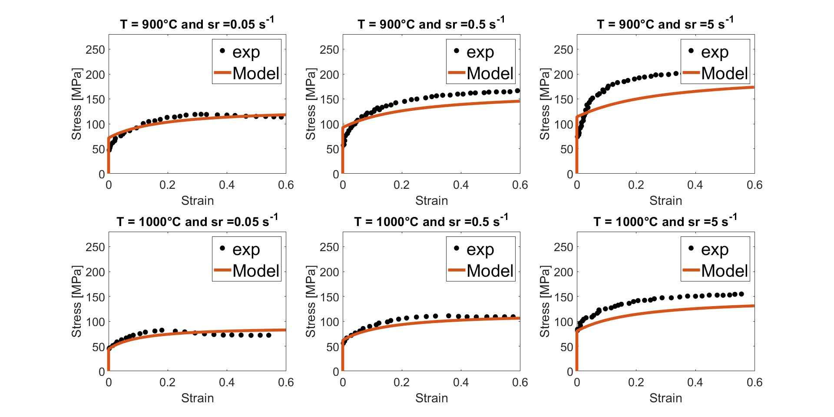
Calibration macro response
[1]
[1]
[1]
[1]
[1]
[1]
[1] Kim, S. I., Y. Lee, and S. M. Byon. "Study on constitutive relation of AISI 4140 steel subject to large strain at elevated temperatures." Journal of Materials Processing Technology 140.1-3 (2003): 84-89.

Slide 13
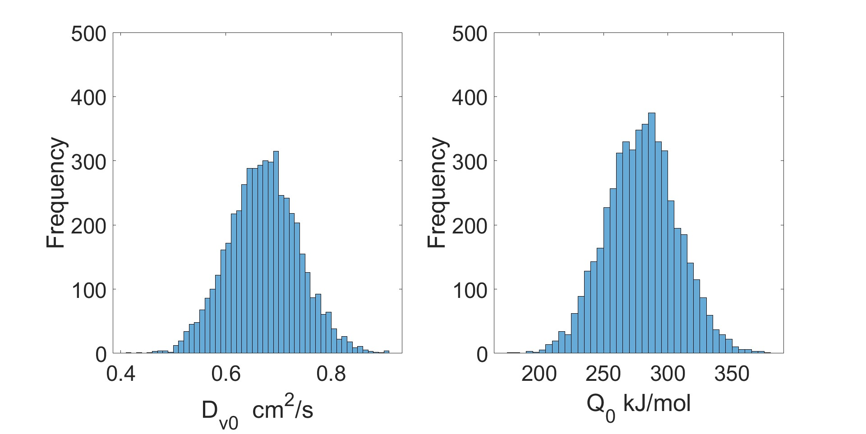
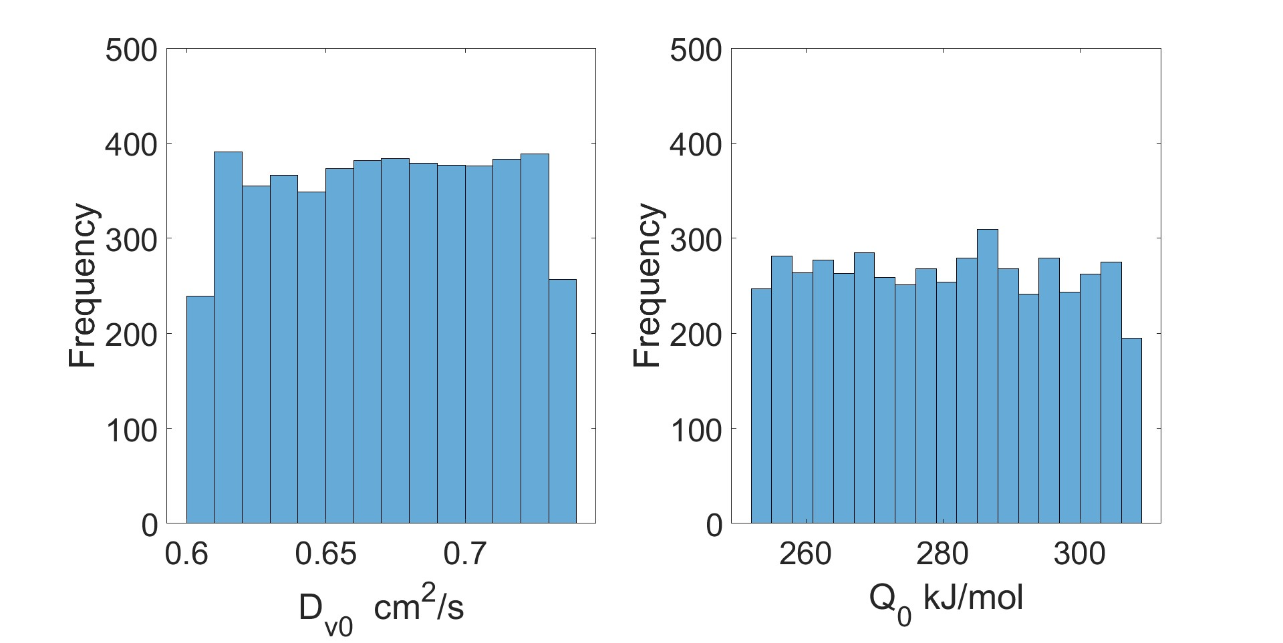
UQ: mobilities
Model error from the Calphad methodology estimated to be 10% to the predict diffusion coefficient and activation energy.
Normal distribution
Uniform distribution

Slide 14
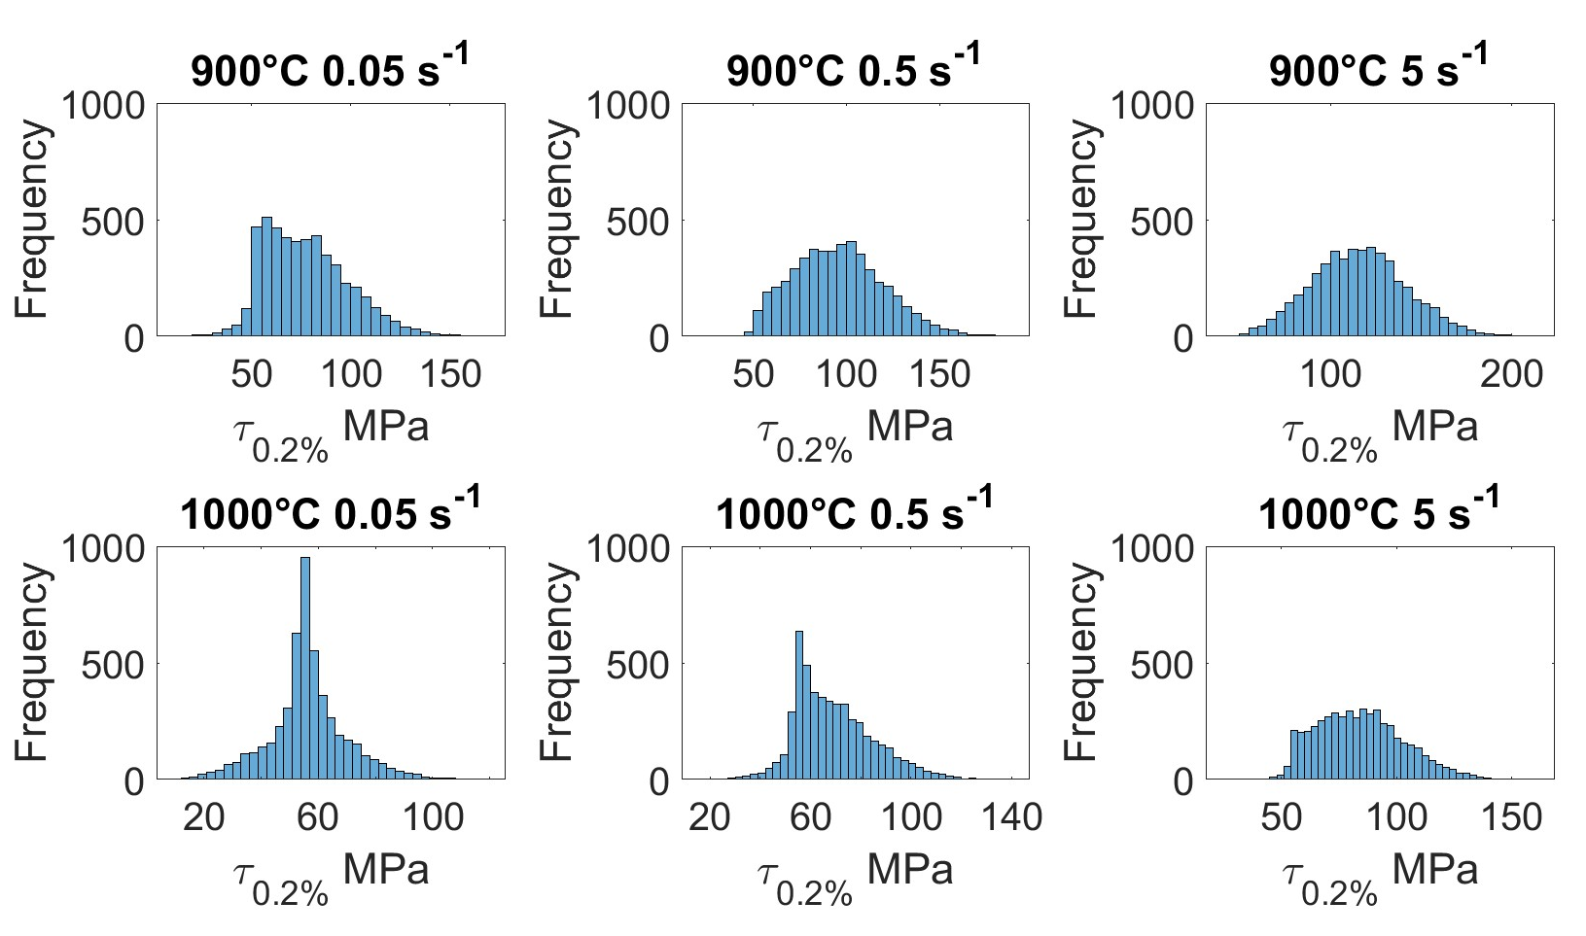
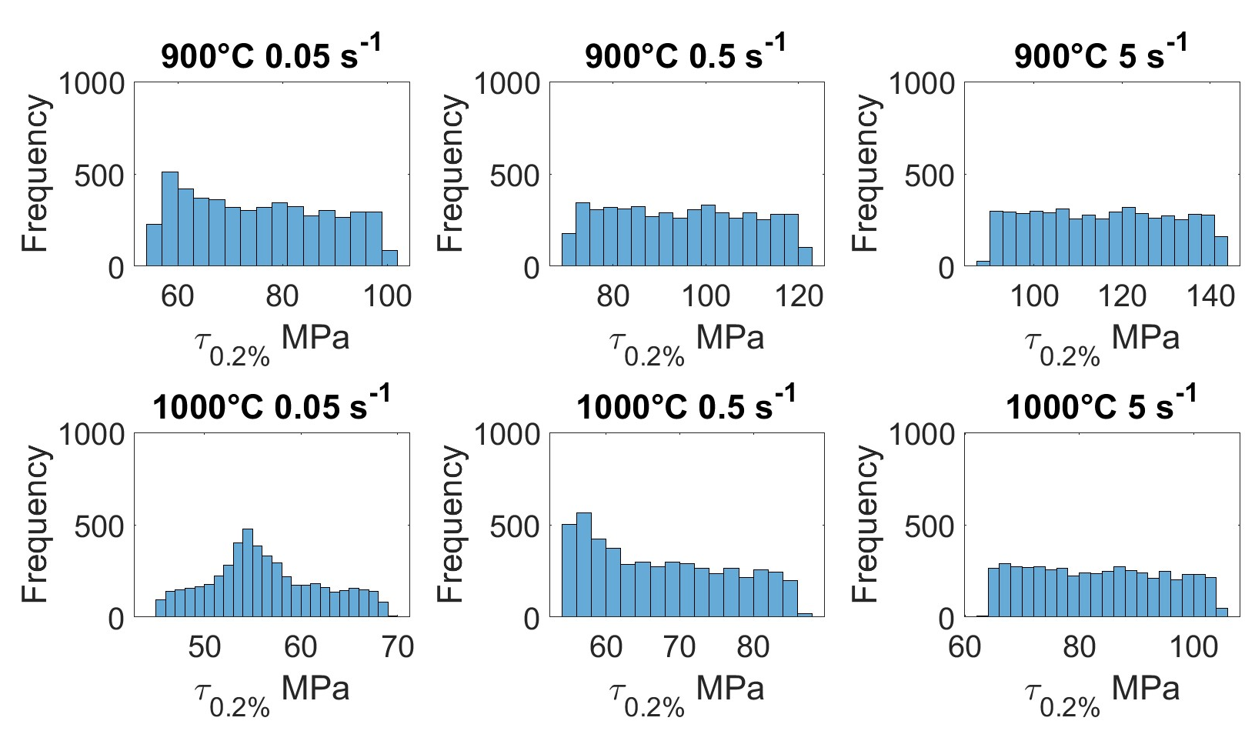
UP: mobilities to yield stress
Normal distribution
Uniform distribution

Slide 15
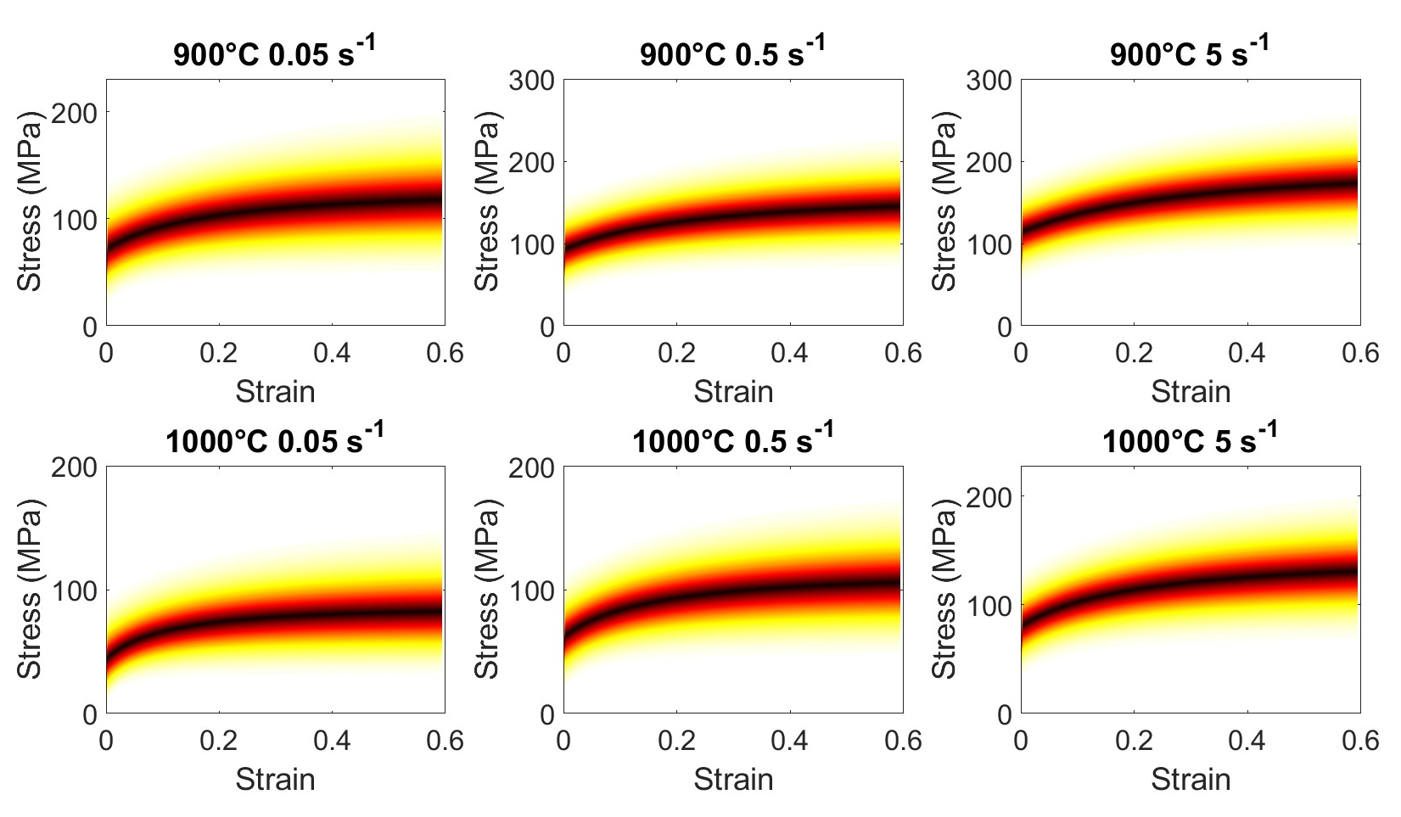
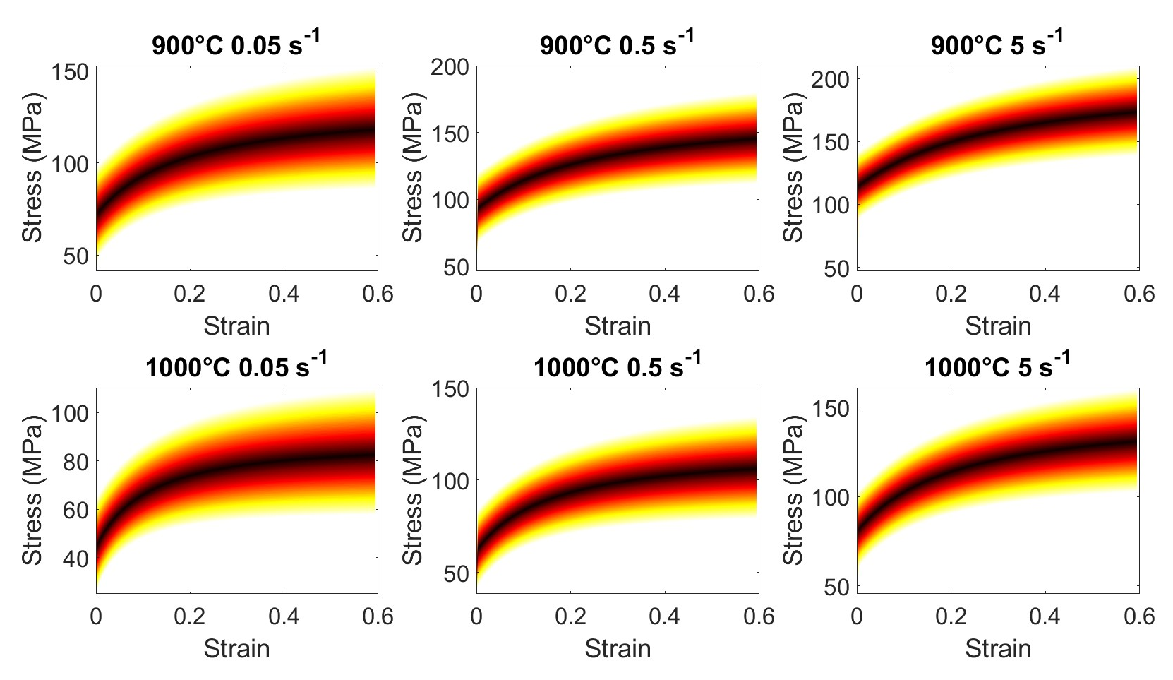
UP: mobilities to flow stress
Normal distribution
Uniform distribution

Slide 16
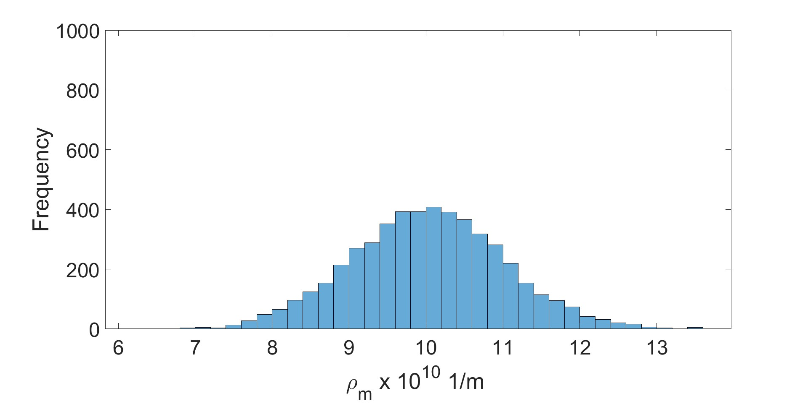
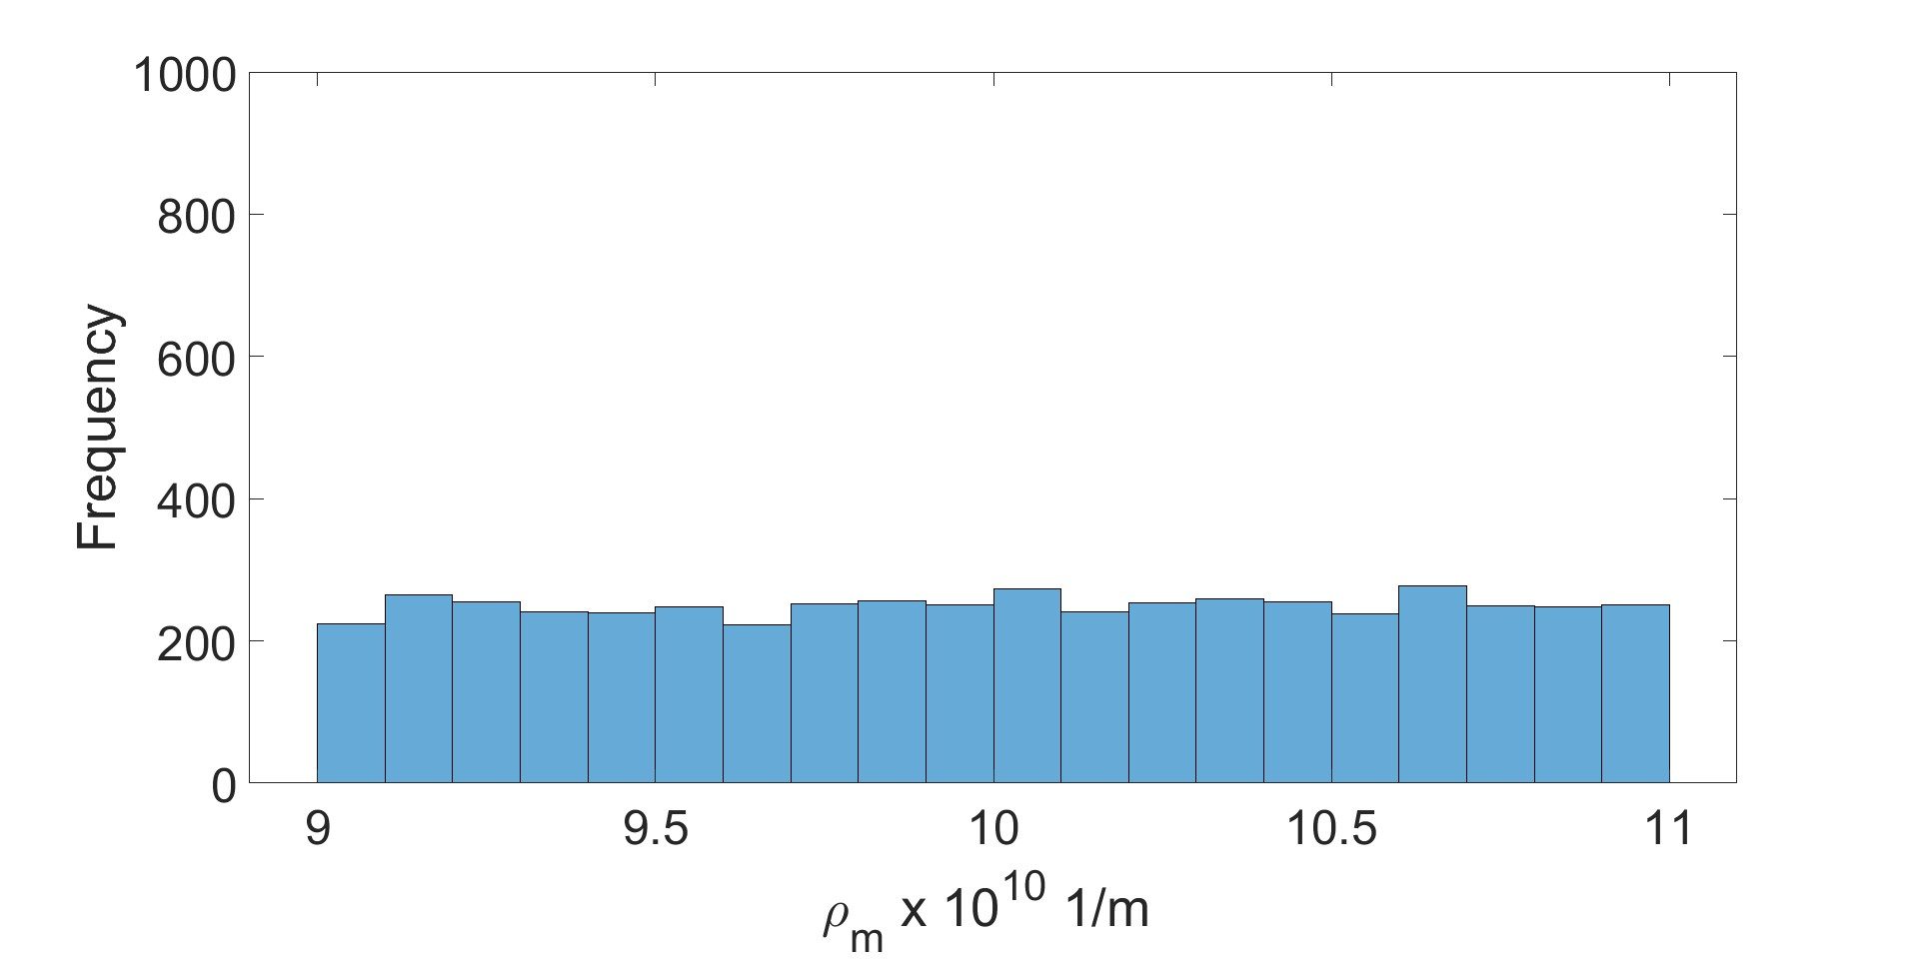
UQ: initial dislocation density
Normal distribution
Uniform distribution

Slide 17
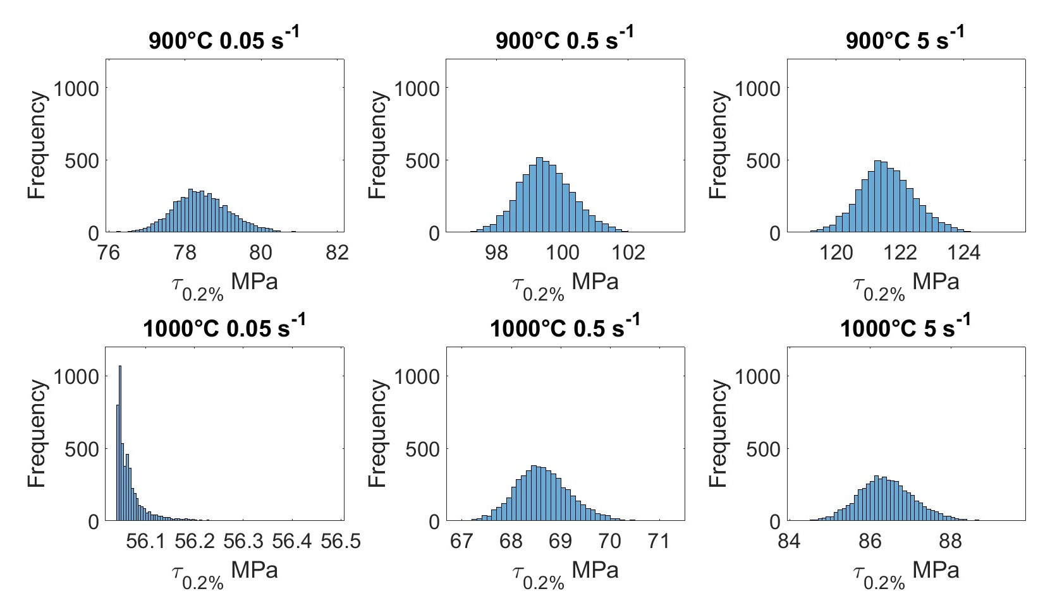
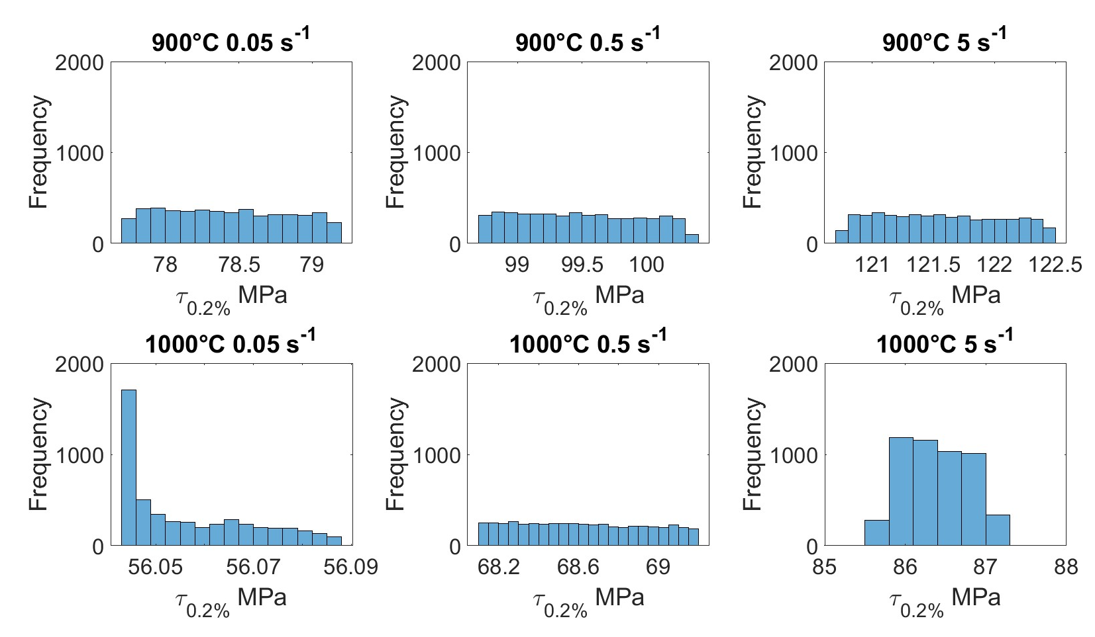
UP: initial dislocation density to yield stress
Normal distribution
Uniform distribution

Slide 18
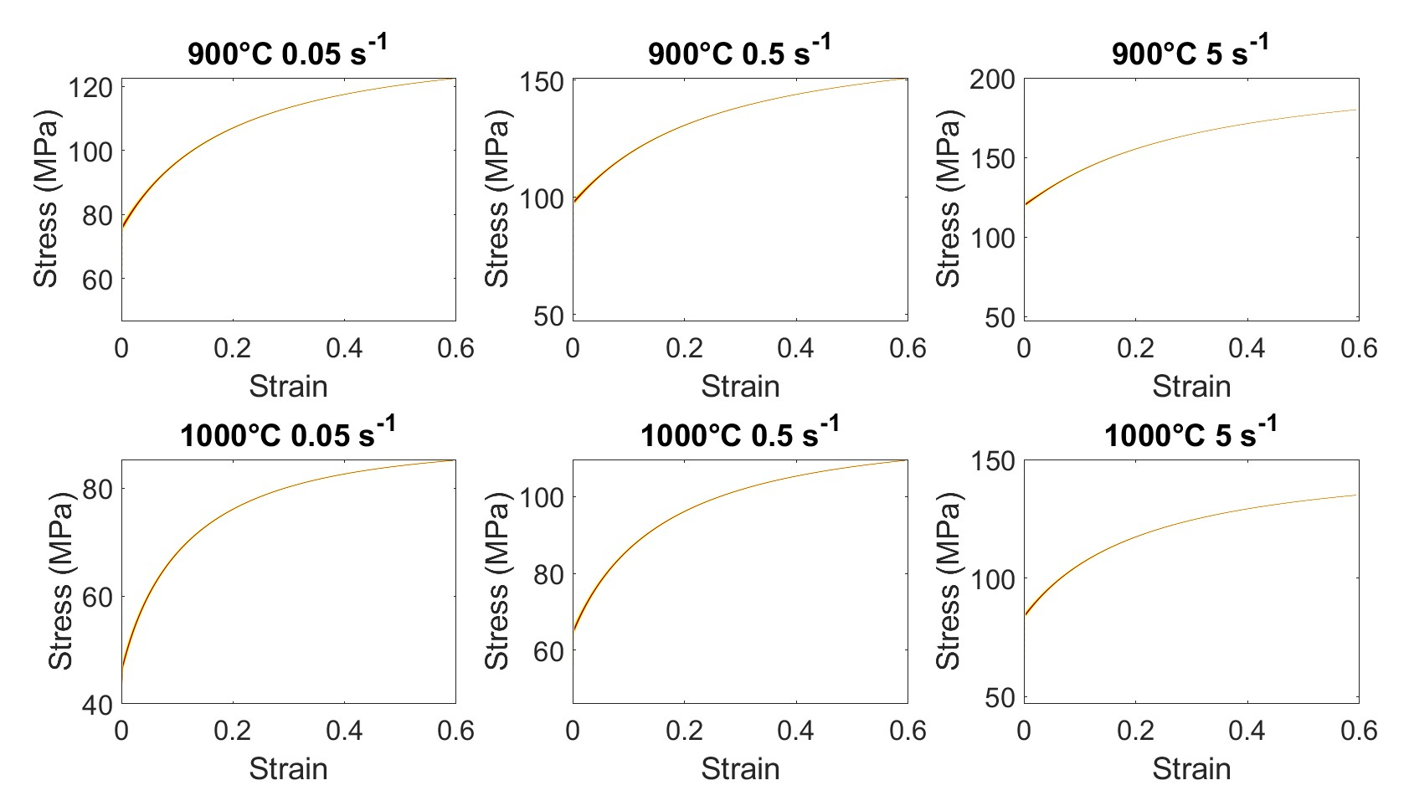
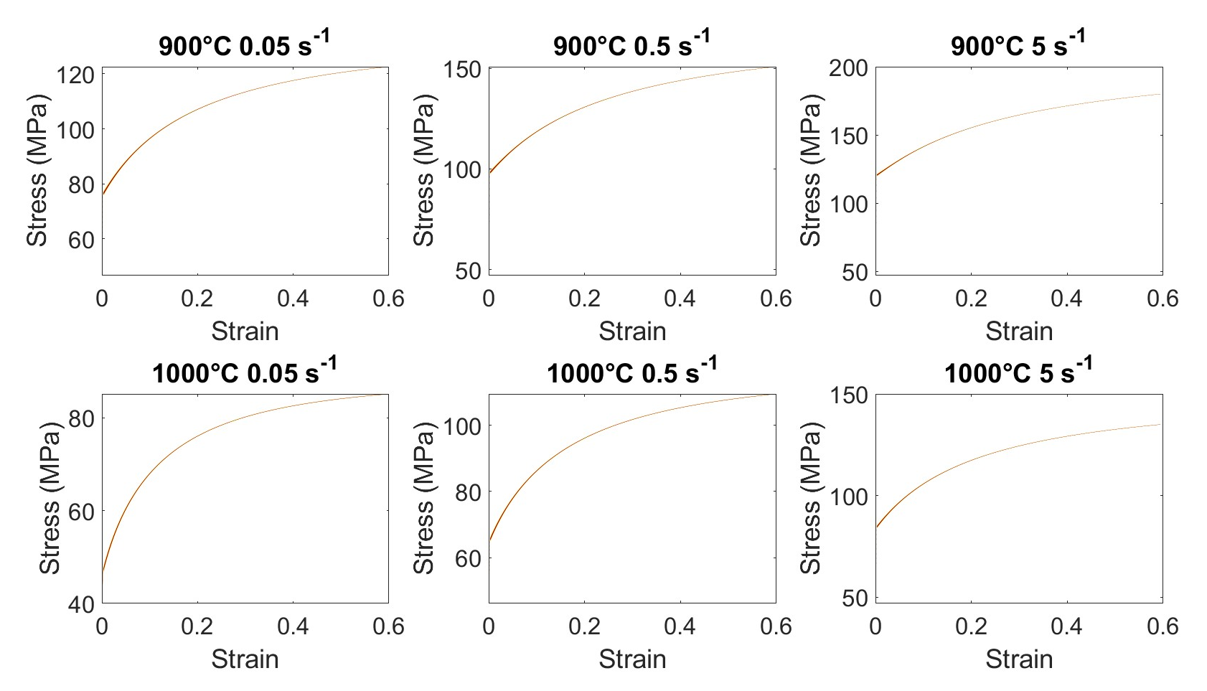
UP: initial dislocation density to flow stress
Normal distribution
Uniform distribution

Slide 19
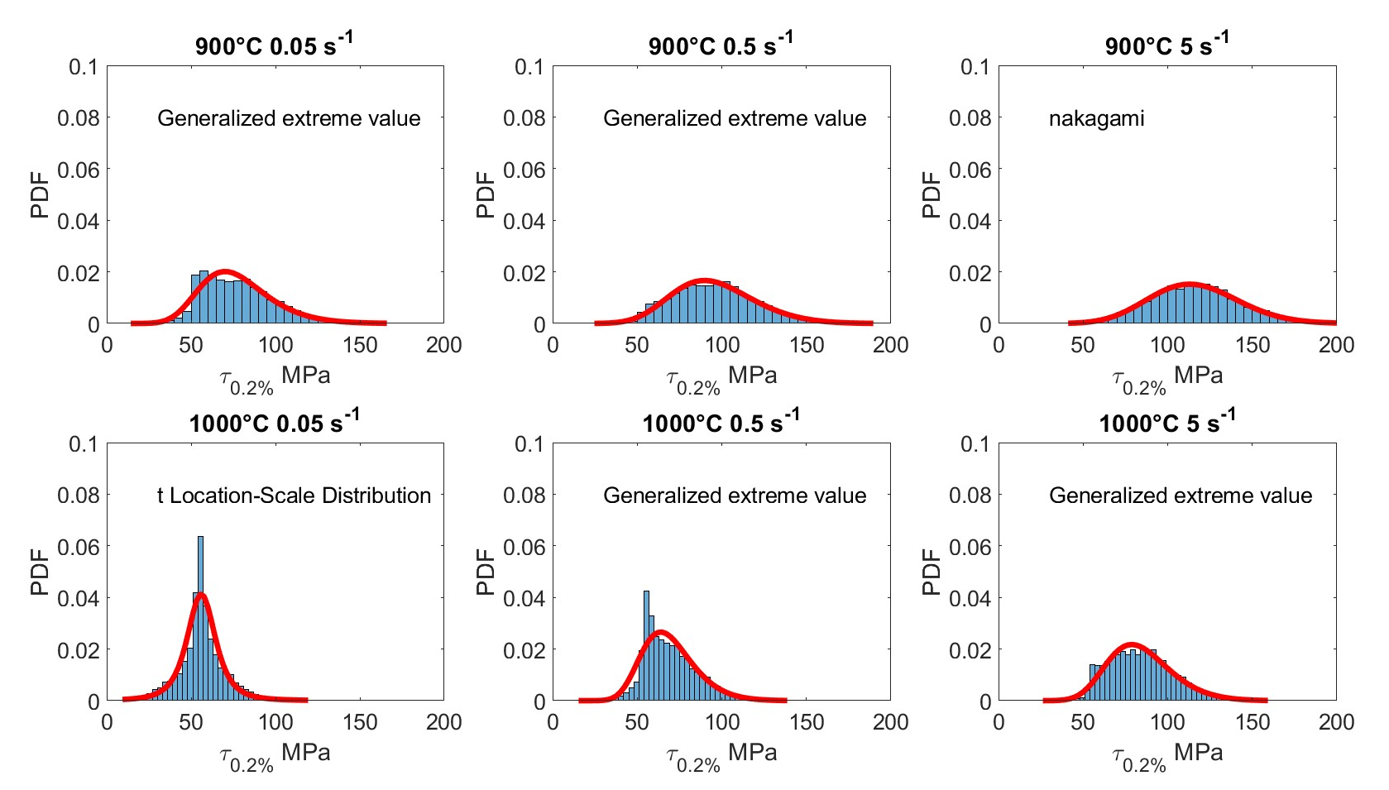
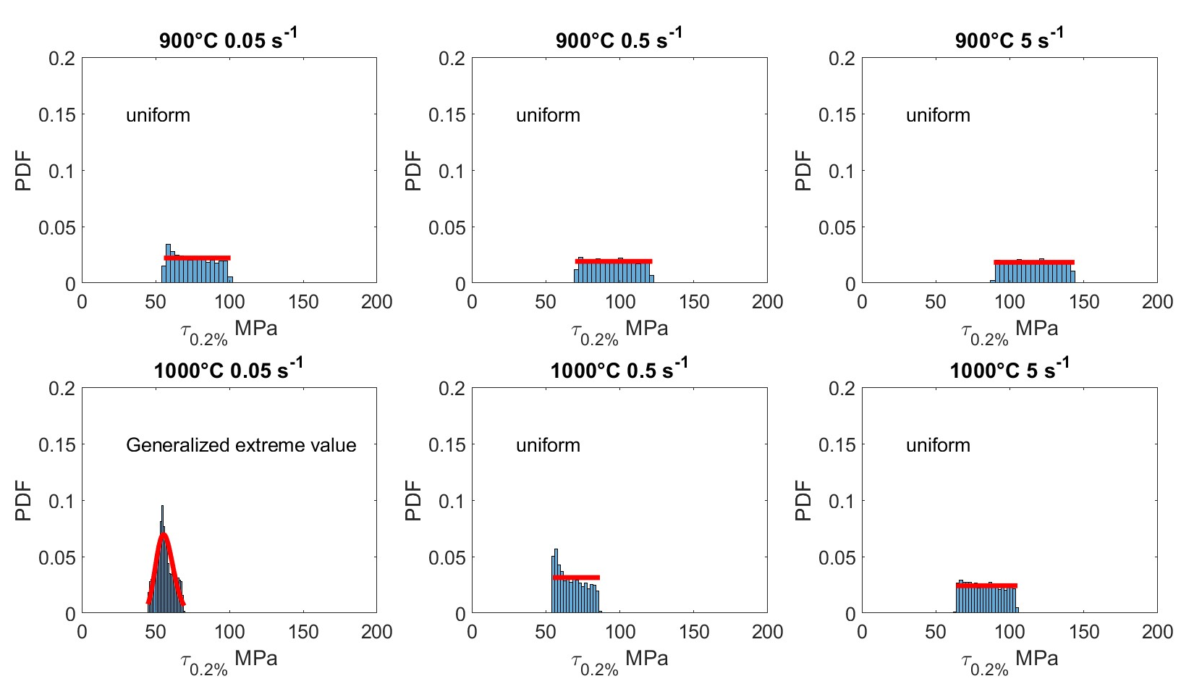
Discussion
Best fitted pdf of YS scatter from mobilities variation
Normal distribution
Uniform distribution
The final distribution function may not be always the same

Slide 20
Conclusions
The effect of the natural uncertainties of material parameters on the materials behaviour was examined:
mobility uncertainty are derived from process-induced composition scatter.
Plastic variations derived from heterogeneous thermomechanical histories.
UP will result in a different distribution of the materials properties.
Natural uncertainties are important because they lead to the observed scatter the materials behaviour
To link the property scatter to the natural uncertainties we need physics-based model.
Physic model are able to predict the propagated uncertainty.
Future work is to extend this work to creep and fatigue

Slide 21
Thank you…. Questions?

