Slide 1
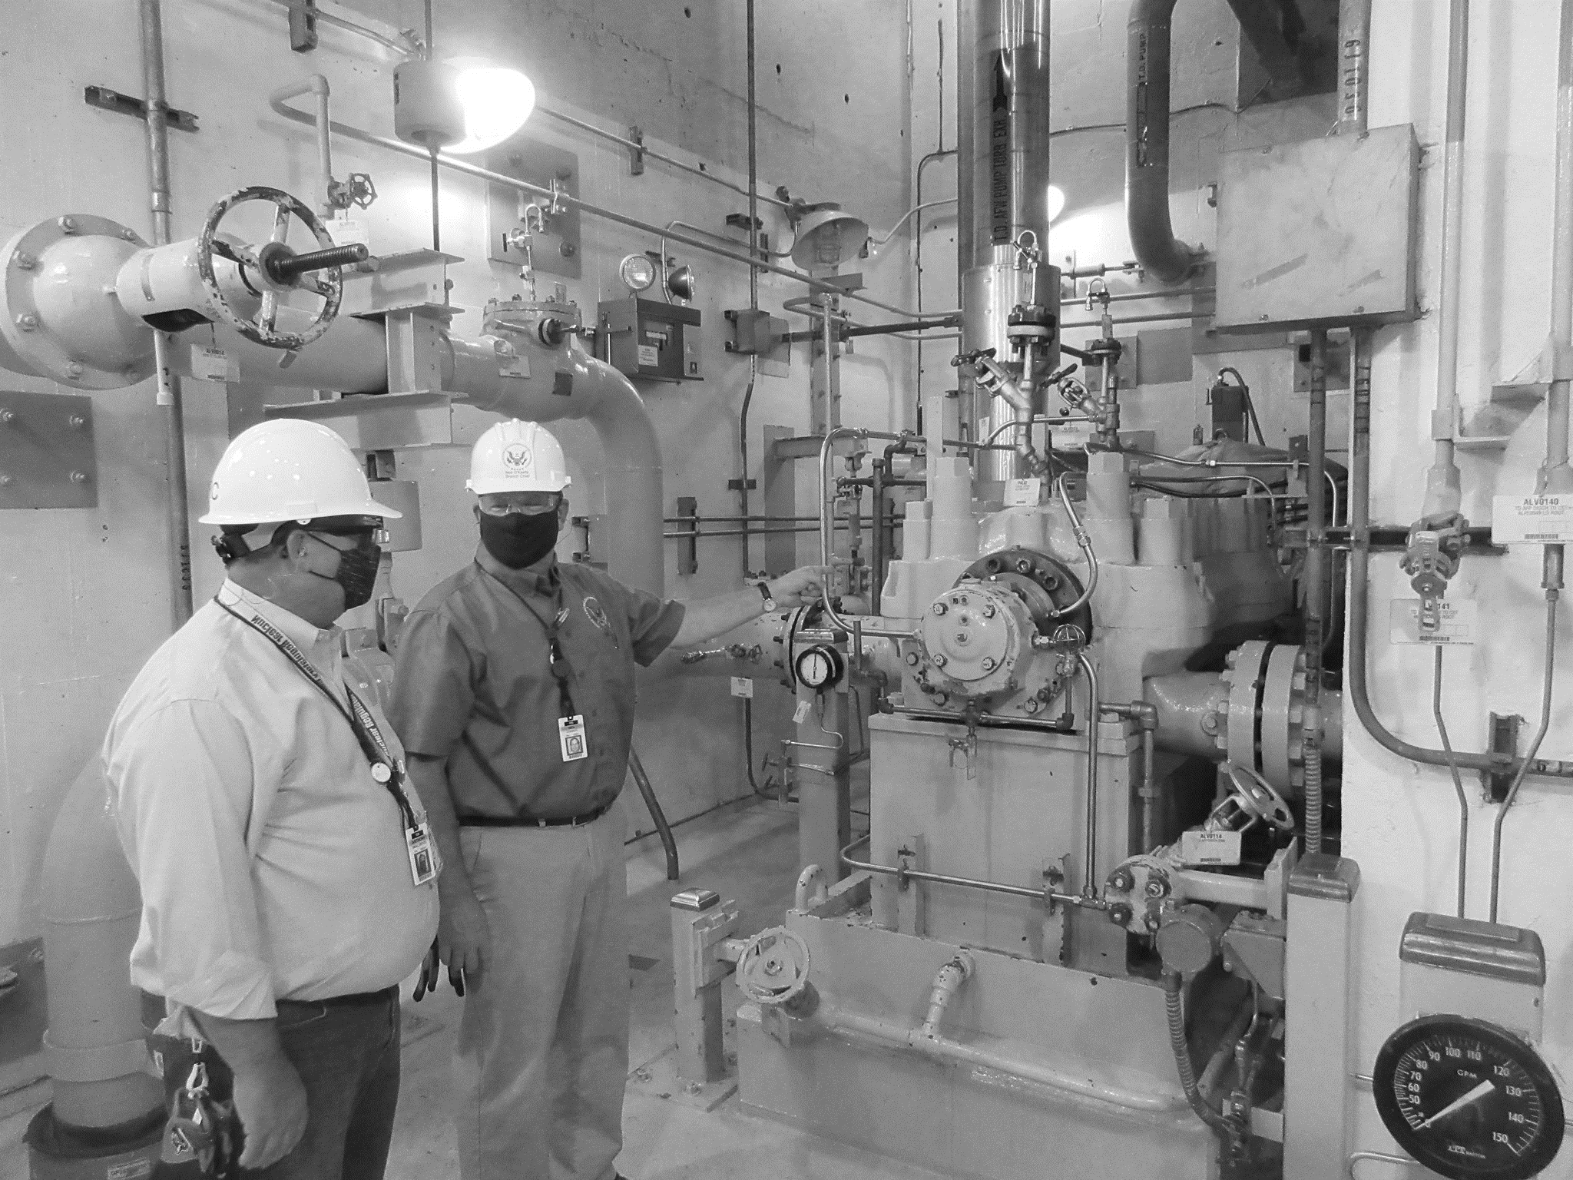

4th International Symposium on Probabilistic Methodologies for Nuclear Applications,
November 1-3, 2022, Leicester, UK
From Single Weld to Power Plant: System-Level Probabilities
C. Sallaberry, F.W. Brust,
E. Twombly, and R. Kurth
Engineering Mechanics Corporation of Columbus
This report was prepared as an account of work sponsored by an agency of the U.S. Government. Neither the U.S. Government nor any agency thereof, nor any of their employees, makes any warranty, expressed or implied, or assumes any legal liability or responsibility for any third party’s use, or the results of such use, of any information, apparatus, product, or process disclosed in this report, or represents that its use by such third party would not infringe privately owned rights. The views expressed in this paper are not necessarily those of the U.S. Nuclear Regulatory Commission.

Slide 2
Outline
> The xLPR code
> Component-specific results to risk-informed insights
> Assumption of independence
> Approach
> Results
> Conclusions

Slide 3


The xLPR Code
Extremely Low Probability of Rupture (xLPR) is a probabilistic fracture mechanics code that simulates the evolution of potential cracks in welds
> Stress-Corrosion Cracking
> Thermal and Mechanical Fatigue
> Crack Initiation
> Leak Rate Calculations
> Residual Stress Effects
> Water Chemistry
> Ultrasonic Inspections
> Seismic Effects
> Mechanical Mitigation
> Models Only Certain Failure Modes
> Limited to Butt-Weld Geometry
> Only Performs Component-Level Analyses

Slide 4
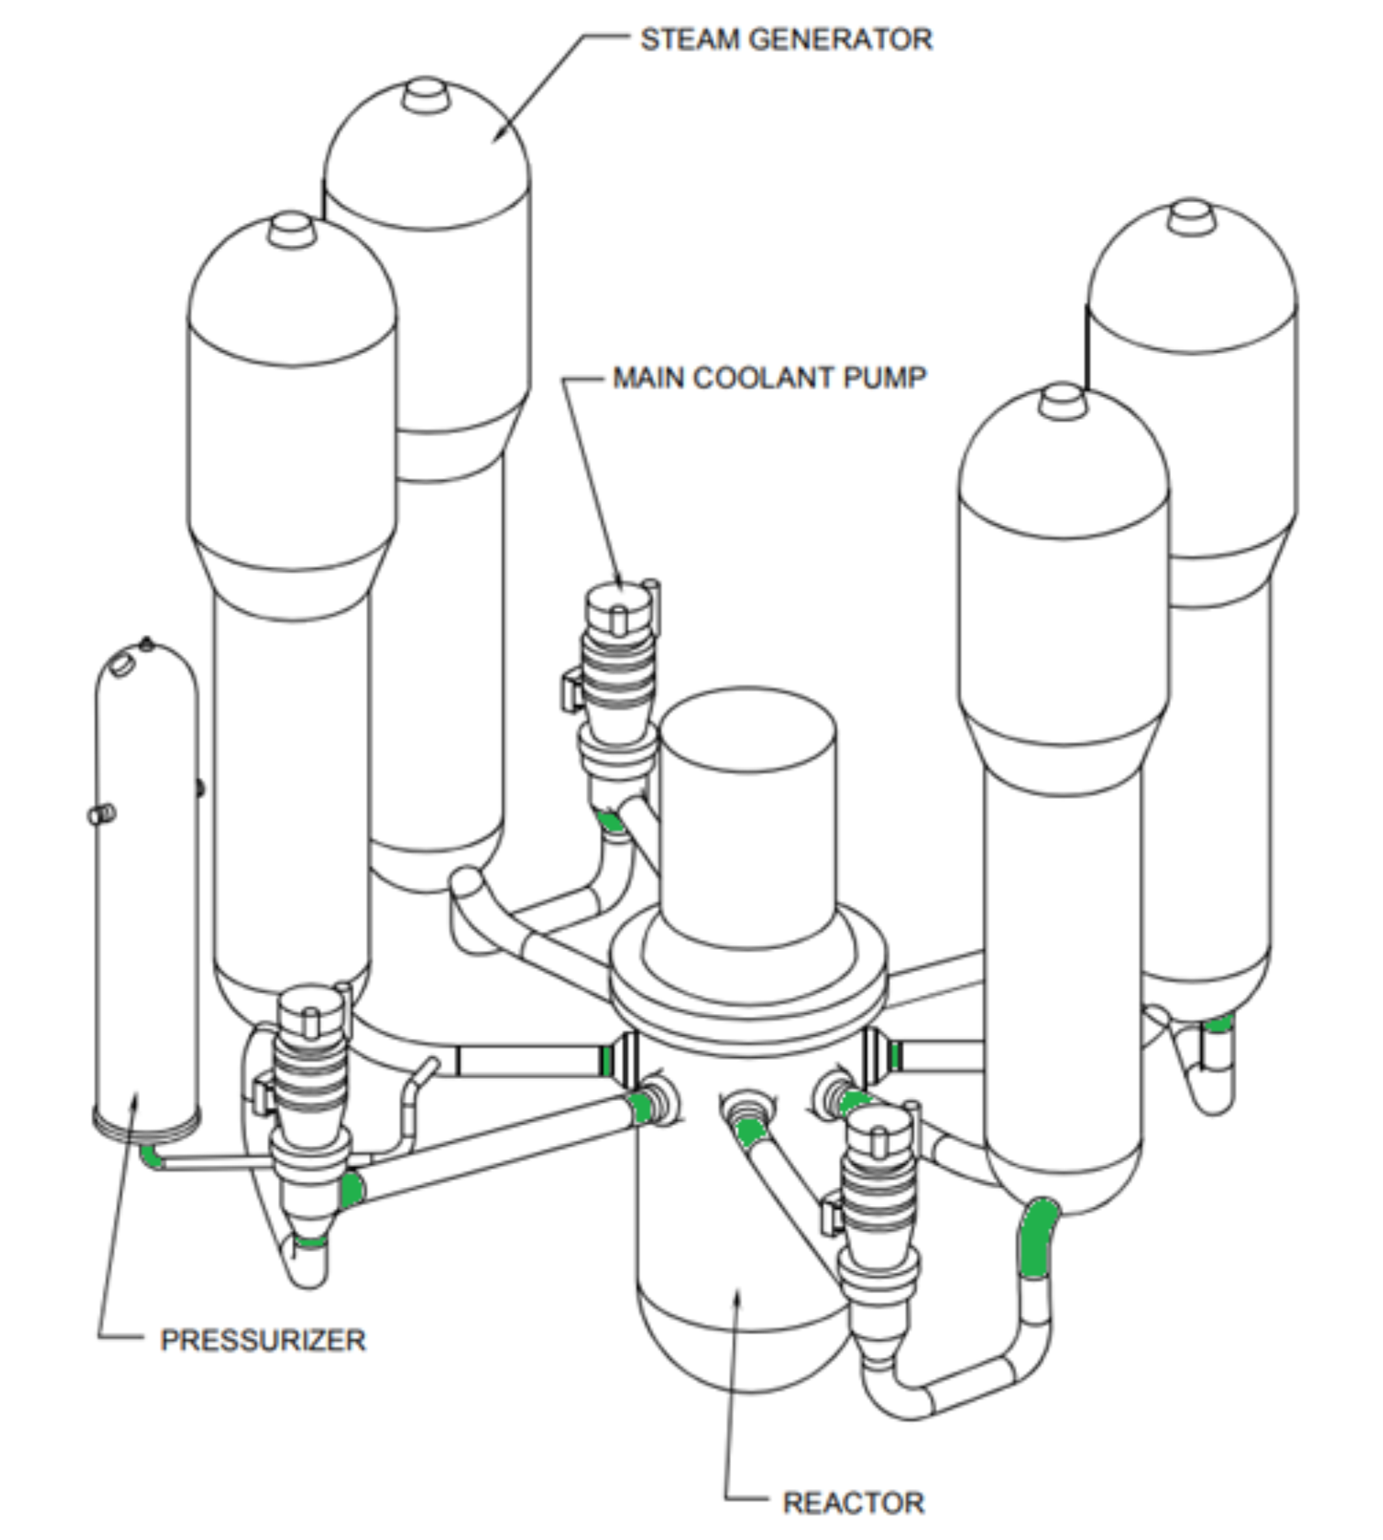
Component-specific Results to Risk-informed Insights
The xLPR code can analyze the individual welds …
But what is the overall plant risk?

Slide 5
Assumption of Independence
> The approach assumes independence among the results from each weld.
> Primary water stress corrosion cracking is the dominant mechanism for crack initiation and growth. It is not applied to all the welds at the same time, like a fatigue transient would be.
> Uncertain material parameters that influence crack initiation and welding residual stresses are not expected to be related among the welds.
> Operating conditions that could affect all the welds (e.g., pressure and temperature) were considered constant in the analysis.

Slide 6
Approach (1/2)
Same Weld Type
The probability of having $x$ events occurring independently in $N$similar welds at time $t$ is:
$$P\left(event=x,t\right)=C_{x}^{N}{p(t)}^{x}.{\left(1−p(t)\right)}^{N−x}$$
, where $p(t)$ is the probability of a single event (xLPR output) occurring at time $t$.
For low $p$(~ < 10⁻³) and $N$ (< 10) values, this is very close to summing the values of $p:$
$$P\left(event=x,t\right)≅x×p(t)$$

Slide 7

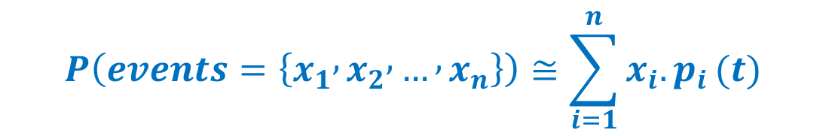
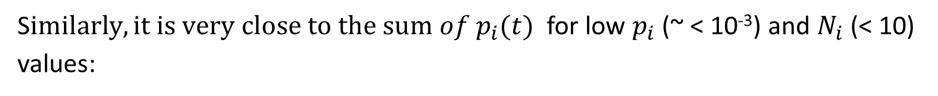
Approach (2/2)
Extension to Different Weld Types
The probability of having $x_{1}$ events occurring o$n N_{1}$welds of type $W_{1}$, $x_{2}$ events on $N_{2}$welds of type $W_{2}$, and so on up to $x_{n}$ events on $N_{n}$welds of type $W_{n}$, is:
$$P\left(events=\left\{x_{1} , x_{2} , … , x_{n}\right\},t\right)=\prod_{i=1}^{k}{C_{x_{i}}^{N_{i}}p_{i}^{x_{i}}(t).{\left(1−p_{i}(t)\right)}^{N_{i}−x_{i}}}$$
S$imilarly, it is very close to the sum of p_{i}(t)$for low $p_{i}$ (~ < 10⁻³) and $N_{i}$ (< 10) values:
$$P\left(events=\left\{x_{1} , x_{2} , … , x_{n}\right\}\right)≅\sum_{i=1}^{n}{x_{i}.p_{i}}(t)$$

Slide 8
Results (1/4)
Westinghouse 4-Loop
Pressurized Water Reactor Bounding Analysis
> 5 reactor vessel outlet nozzle dissimilar metal welds (DMWs) (one used as a substitute for the 4 reactor vessel inlet nozzle DMWs)
> 1 pressurizer surge line nozzle DMW

Slide 9
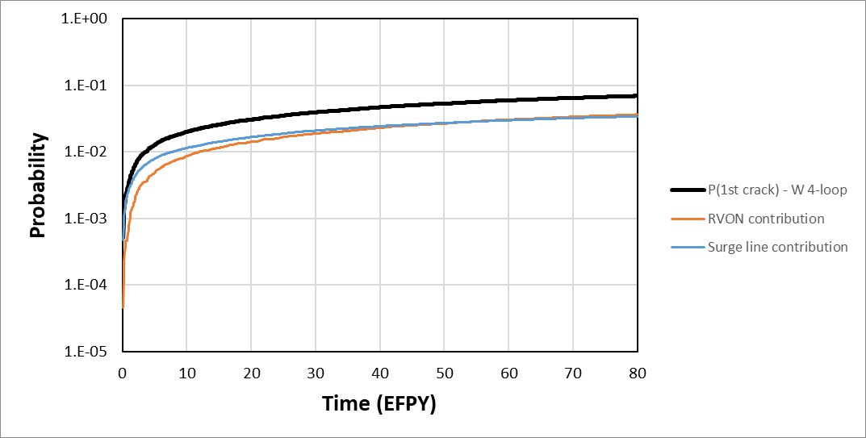
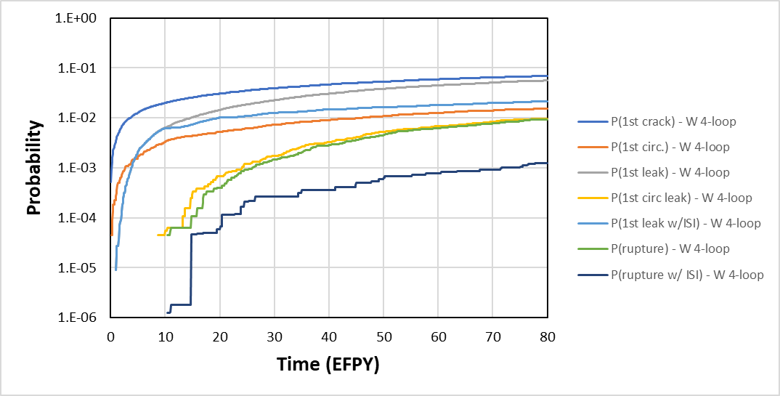
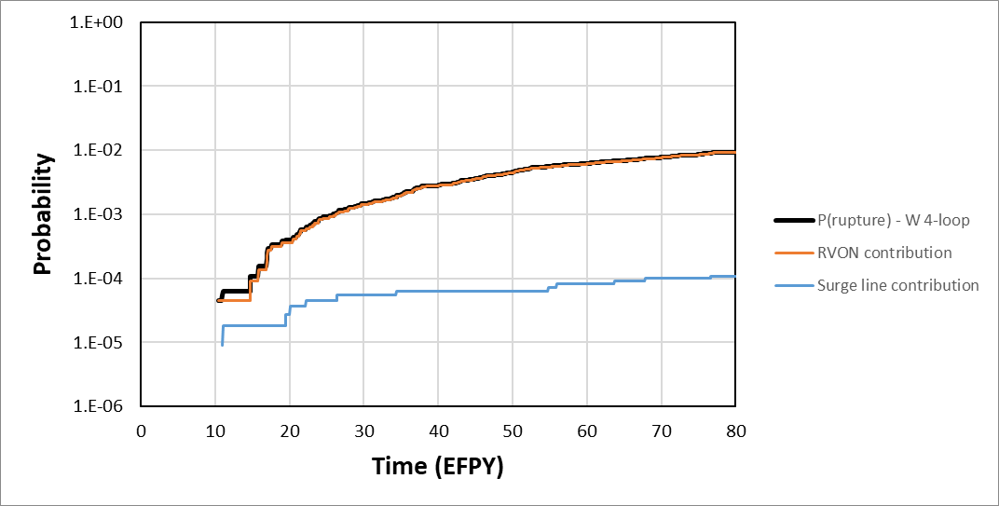
Results (2/4)
Westinghouse 4-Loop
Pressurized Water Reactor Bounding Analysis
There were no occurrences of rupture with leak detection in over 100,000 realizations over 80 years of operation, which demonstrates an extremely low probability of rupture.

Slide 10
Results (3/4)
Combustion Engineering and Babcock and Wilcox
Pressurized Water Reactors Bounding Analysis
> 8 reactor coolant pump inlet nozzle DMWs
> 1 pressurizer surge line nozzle DMW
> 2 hot leg branch line nozzle DMWs
> 4 cold leg branch line nozzle DMWs

Slide 11
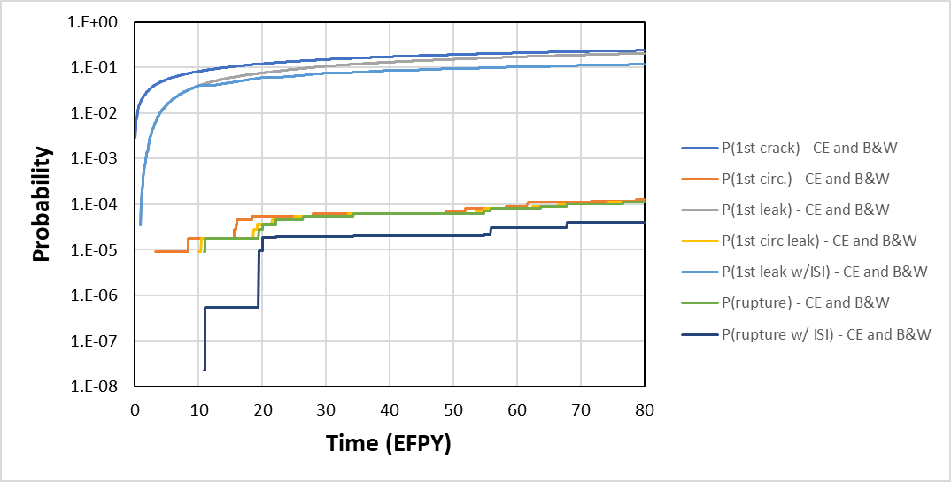
Results (4/4)
Combustion Engineering and Babcock and Wilcox
Pressurized Water Reactors Bounding Analysis
There were no occurrences of rupture with leak detection in over 100,000 realizations over 80 years of operation, which demonstrates an extremely low probability of rupture.

Slide 12
Conclusions
> Estimating plant- or system-level results from component-level (e.g., weld) results is a necessary aspect to support risk-informed decisionmaking.
> The assumption of independence is defensible and simplifies the calculations.
> Some assumptions could be revisited, notably, that leakage or rupture is considered equally consequential for each weld.

Slide 13

References
TLR-RES/DE/REB-2021-14-R1
Probabilistic Leak-Before-Break Evaluations of Pressurized-Water Reactor Piping Systems using the Extremely Low Probability of Rupture Code
ML22088A006

