Slide 1
Probabilistic Control Rod Failure Analysis
Dr Henry Cathcart, Dr James M Finley
Frazer-Nash Consultancy
UA 03, ISPMNA 2022

Slide 2
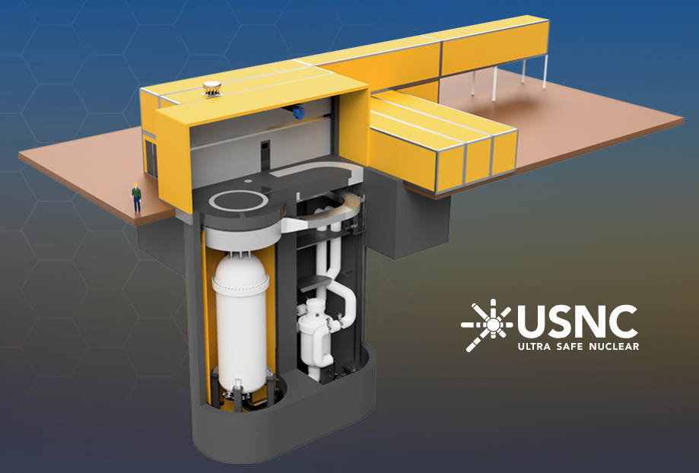
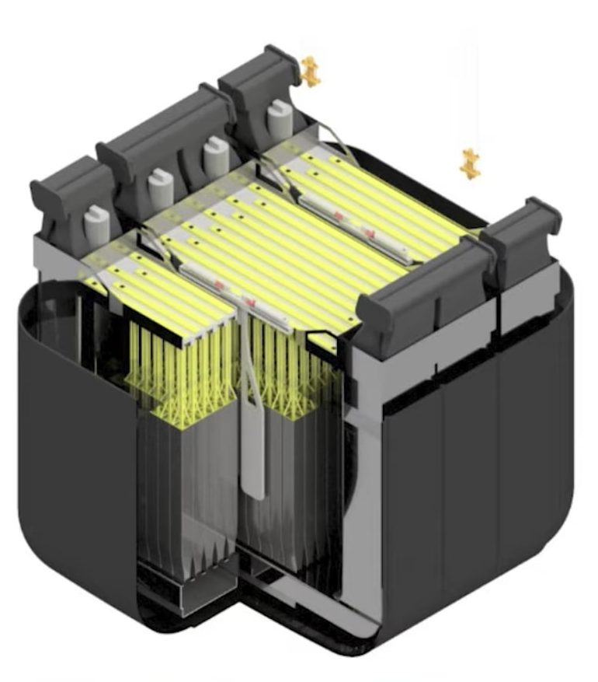
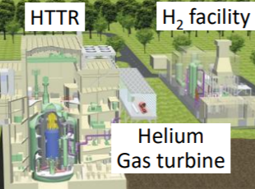
AMRs, SMRs, and the increased focus on structural integrity
Advanced Modular Reactors (AMRs) and Small Modular reactors (SMRs) are a key technology to help reduce carbon emissions worldwide by 2050.
However, a recent report by the Henry Royce Institute and Frazer-Nash highlighted that further research and development is required to overcome structural integrity challenges associated with increased reactor temperatures.
It is therefore important to focus on developing new structural integrity methods to enable us to reduce our greenhouse gas emissions and global warming.
USNC
Moltex
JAEA

Slide 3
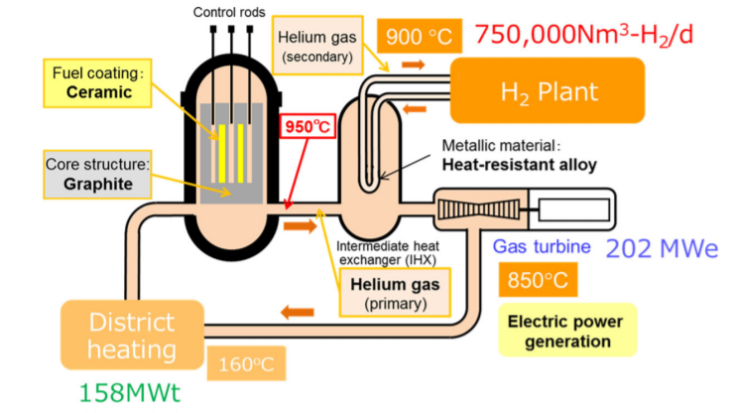
Why probabilistic lifing analysis?
Next generation nuclear reactor designs will likely need to be designed to operate at very high temperatures.
Current lifing methods are deterministic, with knock-downs to account for uncertainty.
Deterministic methods often lead to design conservatism, but also unclear whether optimistic in some cases.
Probabilistic methods can directly account for uncertainty, giving a more accurate solution.

Slide 4
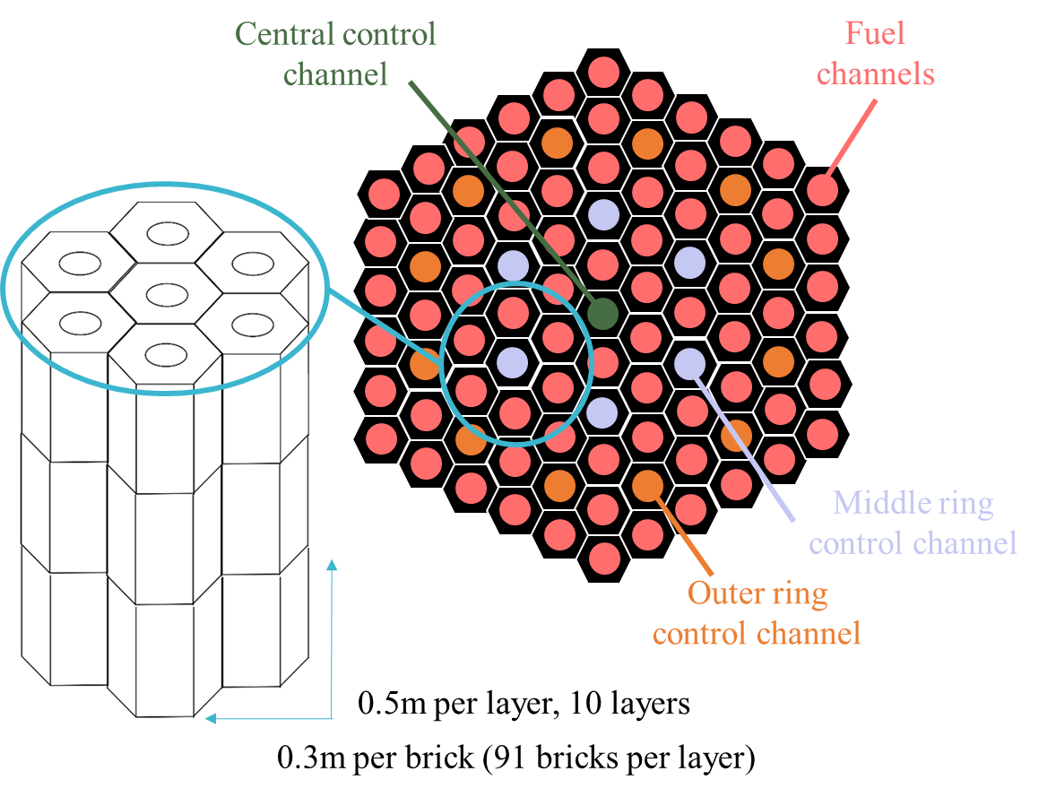
Nominal AMR graphite core
Notes:
Envisaged design for molten-salt AMR graphite core
Tessellation of hexagonal bricks with cylindrical channels
Majority carry working fluid impregnated with fuel
Some reserved for the insertion of control rods

Slide 5
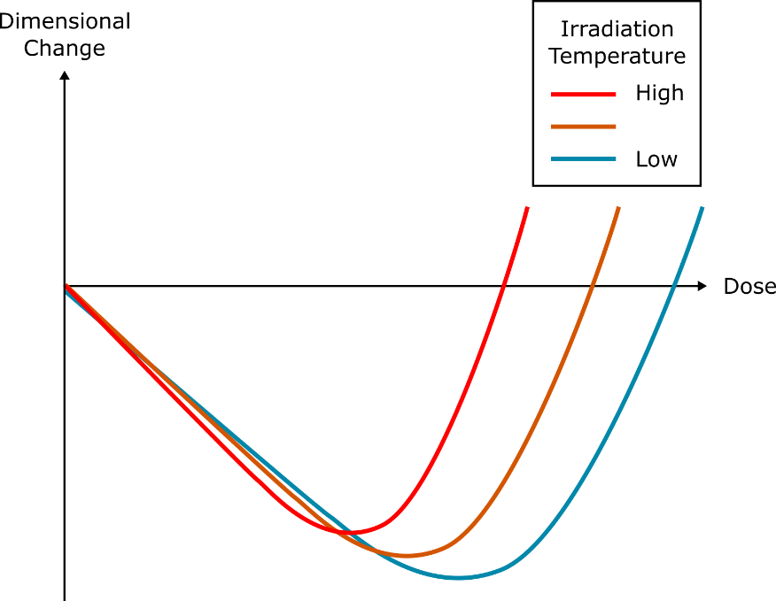
Graphite core failure criterion
r = 40mm
r = 50mm
Notes:
Graphite undergoes dimensional change under irradiation
First shrinkage, then growth
Presents a failure criterion: dimensional change of core prevents control rod insertion
Graphite is a highly variable material, hence each brick will deform differently
Challenging to define a conservative scenario
Probabilistic assessment required

Slide 6
Graphite core failure criterion
r = 40mm
r = 50mm
Graphite is a highly variable material, hence each brick will deform differently
Challenging to define a conservative scenario
Probabilistic assessment required
Notes:
Graphite undergoes dimensional change under irradiation
First shrinkage, then growth
Presents a failure criterion: dimensional change of core prevents control rod insertion
Graphite is a highly variable material, hence each brick will deform differently
Challenging to define a conservative scenario
Probabilistic assessment required

Slide 7
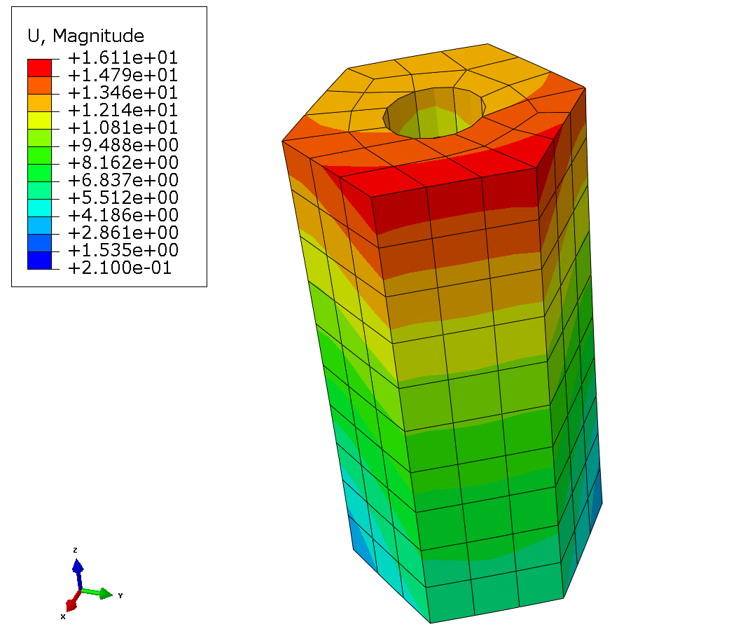
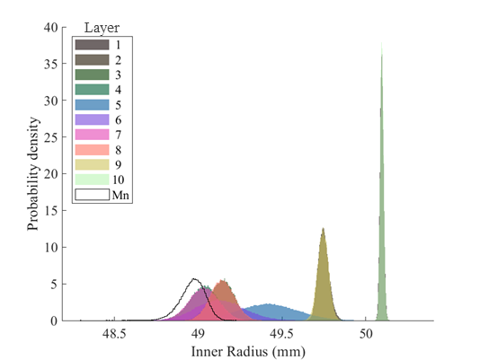
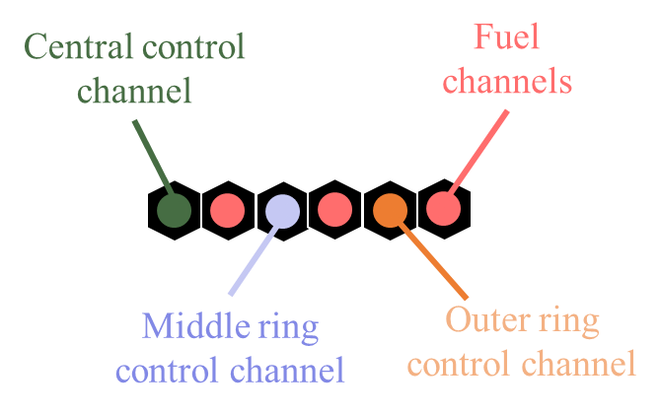
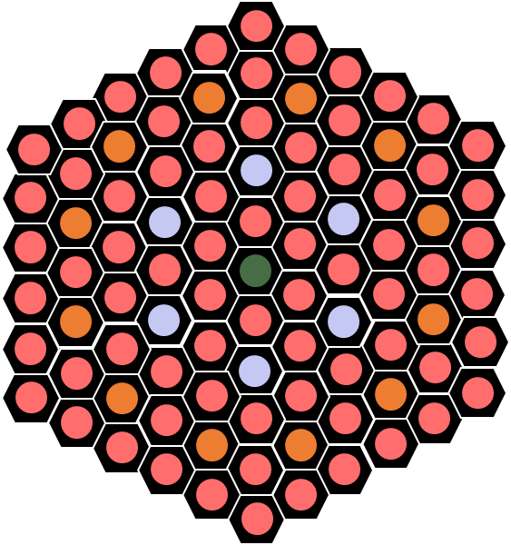
Contents
Deterministic assessment
Probabilistic assessment: single channel
Probabilistic assessment: line of channels
Probabilistic assessment: entire core

Slide 8
Contents
Deterministic assessment
Probabilistic assessment: single channel
Probabilistic assessment: line of channels
Probabilistic assessment: entire core

Slide 9
Deterministic assessment
Performed finite element simulations of single bricks in different core positions

Slide 10
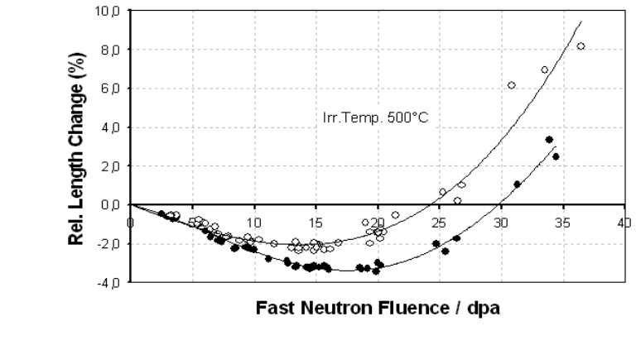
Deterministic assessment
Performed finite element simulations of single bricks in different core positions
Graphite dimensional change model used for AGR safety case, calibrated to test reactor data

Slide 11
Deterministic assessment
Performed finite element simulations of single bricks in different core positions
Graphite dimensional change model used for AGR safety case, calibrated to test reactor data
Rudimentary representative field variables (dose, temperature)

Slide 12
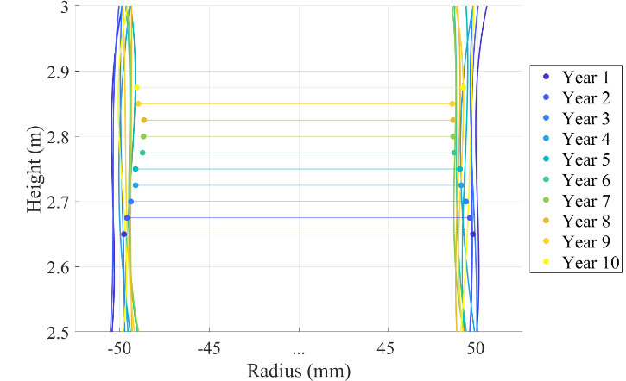
Deterministic assessment results (central channel, layer 6)
Notes:
Results for central brick in Layer 6 (mid-core)
Brick takes on curved shape as graphite deforms under dose gradient
Radius of channel reduces, then increases throughout life

Slide 13
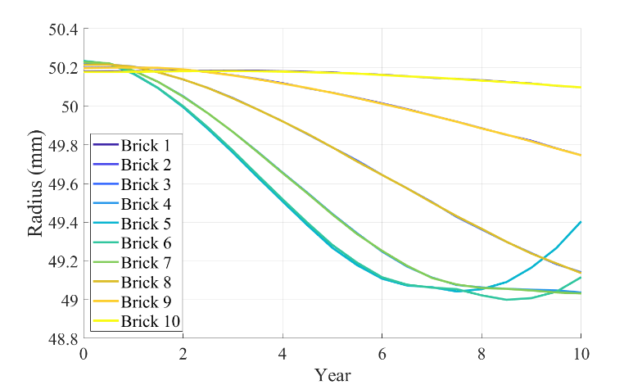
Deterministic assessment results (central channel, layer 6)
Notes:
For central brick, minimum radius behaviour across layers
Variation between layers in central channel, but none get close to nominal 40mm limit
Reactor control failure does not occur after 10 years (minimum radius > 40mm)

Slide 14
Contents
Deterministic assessment
Probabilistic assessment: single channel
Probabilistic assessment: line of channels
Probabilistic assessment: entire core

Slide 15
Probabilistic assessment: single channel
Surrogate model constructed from interpolation of discrete FE calculations
Probabilistic results produced using Monte Carlo
x₃
x₁
x₂
DOI=10.3389/fmech.2021.675511

Slide 16
Probabilistic assessment: single channel
Surrogate model constructed from interpolation of discrete FE calculations
Probabilistic results produced using Monte Carlo
Epistemic uncertainties varied per channel:
Dose
Temperature
x₃
x₁
x₂
DOI=10.3389/fmech.2021.675511

Slide 17
Probabilistic assessment: single channel
Surrogate model constructed from interpolation of discrete FE calculations
Probabilistic results produced using Monte Carlo
Epistemic uncertainties varied per channel:
Dose
Temperature
Aleatory uncertainties varied by brick:
Shrinkage rate
Turn-around dose
Initial dimensions
x₃
x₁
x₂
DOI=10.3389/fmech.2021.675511

Slide 18
Probabilistic assessment results: single channel (10 years)
Notes:
5% confidence interval for inner radii never drops below 40mm for any brick layer in the central channel.
Low probability of reactor control failure when a single control channel considered.

Slide 19
Contents
Deterministic assessment
Probabilistic assessment: single channel
Probabilistic assessment: line of channels
Probabilistic assessment: entire core

Slide 20
Probabilistic assessment: line of channels
Probabilistic assessment for isolated channel shows no failures
Whole core geometry will undergo complex alterations as every channel will deform differently
Linear tessellation algorithm used to aggregate uncertainties in a line of channels
Channels are simply pushed together in a line until layers in neighbouring channels are touching.
Different layers will feature bricks of different sizes, reducing the minimum radii of the channels

Slide 21
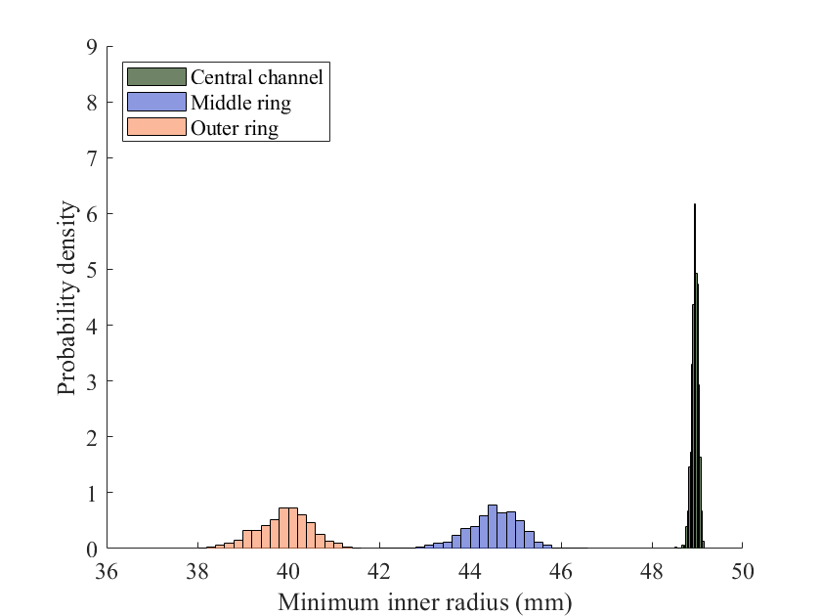
Probabilistic assessment: line of channels
Aleatory uncertainties vary by brick, epistemic uncertainties vary by channel
Notes:
Roughly 50% of the outer control channels lead to reactor control failure after 10 years.
5% confidence interval for middle ring channel is close to the 40mm inner radii limit, but does not indicate reactor control failure.
Central channel is unlikely to lead to reactor control failure.

Slide 22
Probabilistic assessment: effect of epistemic uncertainty
Aleatory uncertainties vary by brick, epistemic uncertainties vary by channel
Notes:
Roughly 50% of the outer control channels lead to reactor control failure after 10 years.
5% confidence interval for middle ring channel is close to the 40mm inner radii limit, but does not indicate reactor control failure.
Central channel is unlikely to lead to reactor control failure.

Slide 23
Probabilistic assessment: effect of epistemic uncertainty
Aleatory uncertainties vary by brick, epistemic uncertainties vary by channel
Aleatory and epistemic uncertainties vary by brick
Notes:
Roughly 50% of the outer control channels lead to reactor control failure after 10 years.
5% confidence interval for middle ring channel is close to the 40mm inner radii limit, but does not indicate reactor control failure.
Central channel is unlikely to lead to reactor control failure.

Slide 24
Contents
Deterministic assessment
Probabilistic assessment: single channel
Probabilistic assessment: line of channels
Probabilistic assessment: entire core

Slide 25
Probabilistic assessment: entire core
Whole core geometry will undergo complex alterations as every channel and brick layer will deform differently
Algorithm for core tessellation used to predict core shape under probabilistic brick deformation
Assumes core restraints press bricks together

Slide 26
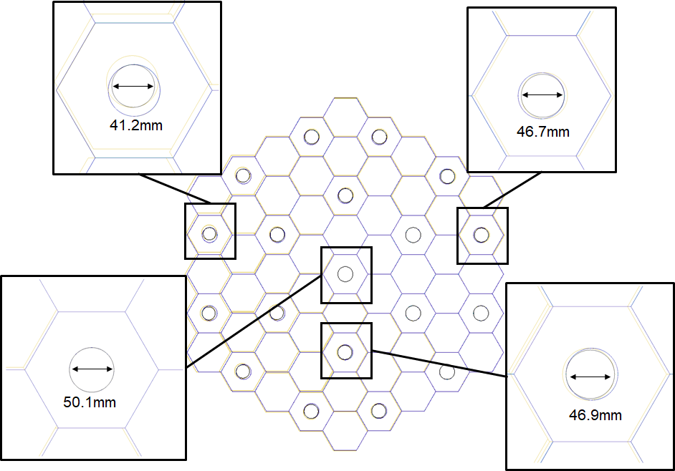
Probabilistic assessment: entire core
Notes:
Bricks become misaligned due to deformation varying:
Deterministically, by layer and core position
Probabilistically
Therefore channel radii can be less than the worst brick

Slide 27
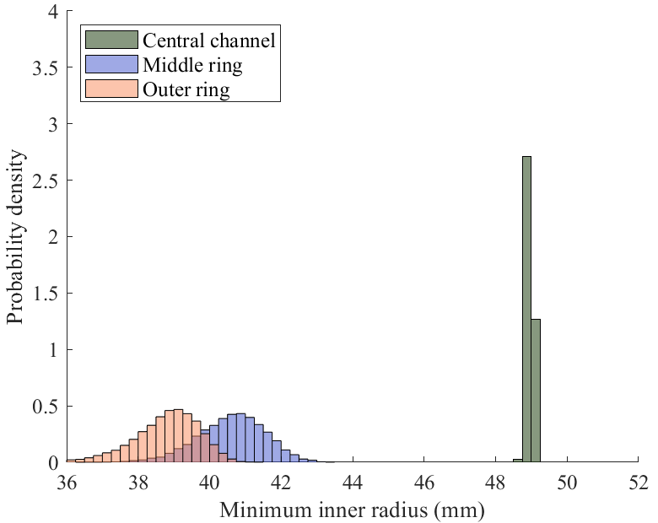
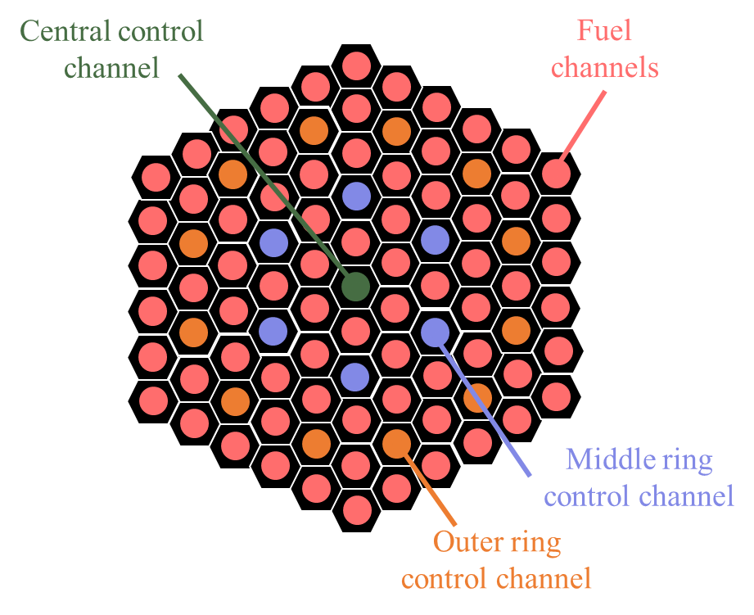
Probabilistic assessment results: entire core (10 years)
Notes:
Both middle ring and outer ring yield a significant number of cases where reactor control failure is likely to occur after 10 years.
Minimum radii are generally less than when linear tessellation is used, but general trends are similar.
Central channel remains unlikely to lead to reactor control failure.

Slide 28
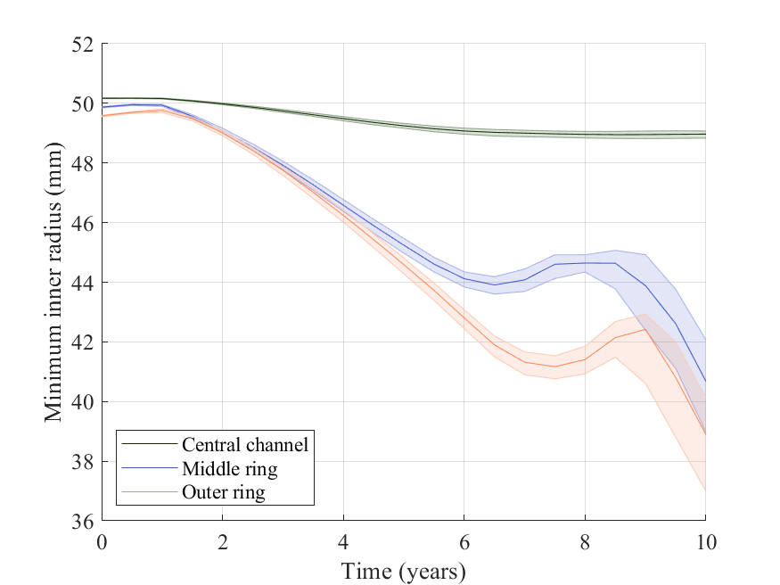
Probabilistic assessment results: entire core over time
Notes:
5th percentile of minimum radii indicate reactor control failure in outer ring control channels after just 9 years.
5th percentile of minimum radii lead to reactor control failure in middle ring channels after 9.5 years.
Reactor control failure unlikely in central channel after 10 years.

Slide 29
Conclusions

Slide 30
Conclusions
The dimensional change of graphite bricks in a nominal molten salt reactor may lead to reactor control failure.

Slide 31
Conclusions
The dimensional change of graphite bricks in a nominal molten salt reactor may lead to reactor control failure.
Deterministic analysis of a single control rod indicates that reactor control failure will not occur.

Slide 32
Conclusions
The dimensional change of graphite bricks in a nominal molten salt reactor may lead to reactor control failure.
Deterministic analysis of a single control rod indicates that reactor control failure will not occur.
A probabilistic analysis of a single central control rod also indicates that reactor control failure is unlikely.

Slide 33
Conclusions
The dimensional change of graphite bricks in a nominal molten salt reactor may lead to reactor control failure.
Deterministic analysis of a single control rod indicates that reactor control failure will not occur.
A probabilistic analysis of a single central control rod also indicates that reactor control failure is unlikely.
However, when the aggregation of uncertainties is considered via tessellation of the core channels, reactor control failure is predicted in 50% of cases after 10 years.

Slide 34
Thank you
Dr Henry Cathcart
Group Leader
Frazer-Nash Consultancy
h.cathcart@fnc.co.uk

