Slide 1
Monte Carlo Defect Tolerance Assessment of a Plant Weld for Increased Life
ISPMNA 2022
Ben Pellereau, Technical Specialist
November 2022
© 2022 Rolls-Royce plc The information in this document is the property of Rolls-Royce plc and may not be copied or communicated to a third party, or used for any purpose other than that for which it is supplied without the express written consent of Rolls-Royce plc.
This information is given in good faith based upon the latest information available to Rolls-Royce plc, no warranty or representation is given concerning such information, which must not be taken as establishing any contractual or other commitment binding upon Rolls-Royce plc or any of its subsidiary or associated companies.

Slide 2
01
Background

Slide 3
Description of Component
Background
Ferritic forging/tube
Multi-stage weld between a forging and a tube:
Weld buttering deposited on tube OD and weld prep
PWHT carried out on buttering
Tube inserted through forging
Weld completed (no PWHT)
Assessment was part of consideration of re-using old part
New part would have no crevice and full PWHT, but manufacturing could take longer than refurbishment
Crevice
Weld
Buttering

Slide 4
Historic Justification
Background
Postulated defects in multiple locations
Corner (rad-axi)
Weld defect and weld/buttering interface (rad-axi, axi-circ)
Buttering/forging interface (rad-axi, axi-circ)
Main forging (rad-axi)
Deterministic assessment against target RF_{K} (1 or 1.4)
Supporting probabilisitic assessments for low RF_{K}
Weld and interface positions
Probabilistic assessment region

Slide 5
02
Probabilistic Assessment

Slide 6
σ_{th}
Define initial defect
Sample depth and position
Sample ligament size
‘Snap through’ (ductile or brittle approach)
Sample material properties
WRS (normal dist. of σ_{y})
Calculate end of life SIF
Identify outcome
Determine crack front length
Defect present in weld and/or buttering?
Crack growth rate
Toughness – temperature dependent (master curve transition and upper shelf)
Combine pressure, fit-up, thermal and WRS
R6 FAD-based K_{I} to K_{J}
Simple SIF, K_{I} = Yσ√[πa]
Compare K_{J} with K_{c} & K_{d}
Report result
Sum failures and divide by number of simulations
Factor to define primary / secondary interaction
Probabilistic Assessment Overview
temp
K_{c} < K_{J} < K_{d} → cleavage failure, no tearing
K_{d} < K_{c} < K_{J} → cleavage after tearing
K_{d} < K_{J} < K_{c} → tearing, no cleavage
Otherwise, no failure
Distribution on T₀
Distribution on K_{d}

Slide 7
Defect Distribution
Assessment Overview
PDF of defect size
75% chance of defect in weld
12.5% chance of defect in buttering
Size from 2 parameter Weibel distribution with maximum
Defined based on expert elicitation
Benchmark against defects in deterministic assessment:
Uniform distribution for ligament: 0 to 20% of crack depth
Cut-off @ 5mm

Slide 8
03
Initial Results

Slide 9
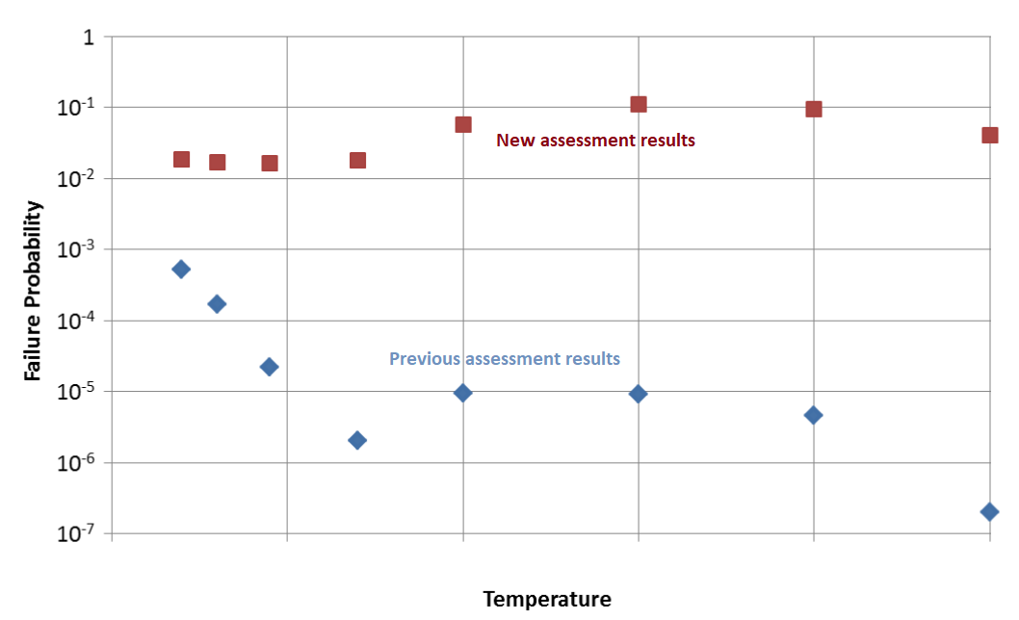
Crack Growth Fitting - Original
4 orders of magnitude
Why so different?

Slide 10
Crack Growth Fitting - Original
Initial Results
Deterministic growth law:
$\frac{da}{dN}=D∙{∆K}^{n}$
Assume that K is proportional to √a
Re-format FCG law as:
$\frac{da}{dN}=E∙a^{\frac{n}{2}}$
Use deterministic growth calcs using mean and 95% bound to determine mean and standard deviation of E (log-normal)
Log mean varied with location, log sd assumed constant
E only obtained for rad-axi defects, assumed same for axi-circ

Slide 11
Crack Growth Fitting – New Assessment
Initial Results
Initially same approach taken
Growth rate 2.2-3.5x faster
~2x the number of transients
Growing into region where growth rate ramps up
Defects chosen for FCG calc not necessarily typical of those that caused failures
FCG relationship therefore overly conservative for many of the sampled defects
Original life
Additional life

Slide 12
Impact on Results
final defect size
acceptable defect size
Initial Results
Previous assessment:
Defects close to failing, but this wasn’t known due to binary output
Reduction in K_{mat} due to ageing
New assessment:
Extra growth tips edge cases into failure
Increased growth results in many more cases failing, even with smaller defects
initial defect sizes

Slide 13
04
Revised Assessment

Slide 14
Crack Growth Fitting – New Assessment
Revised Assessment
For project timescale needed a “simple” but powerful fix!
Additional parameter added – E refitted as a function of a_{initial}
E values obtained for both defect orientations
Range of defect sizes used (previously just 1)
Location | Radial-axial | Axial-circ
Tube interface | E ~constant | E increases with a
Forging interface | E decreases with a | E decreases with a

Slide 15
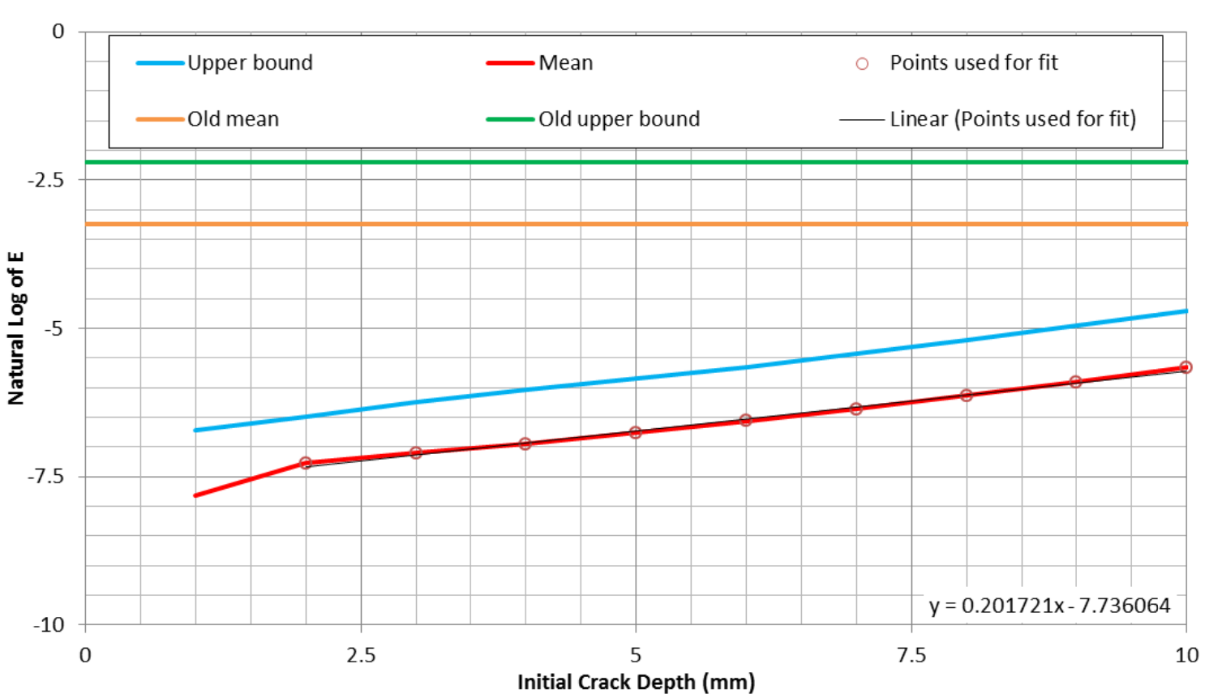
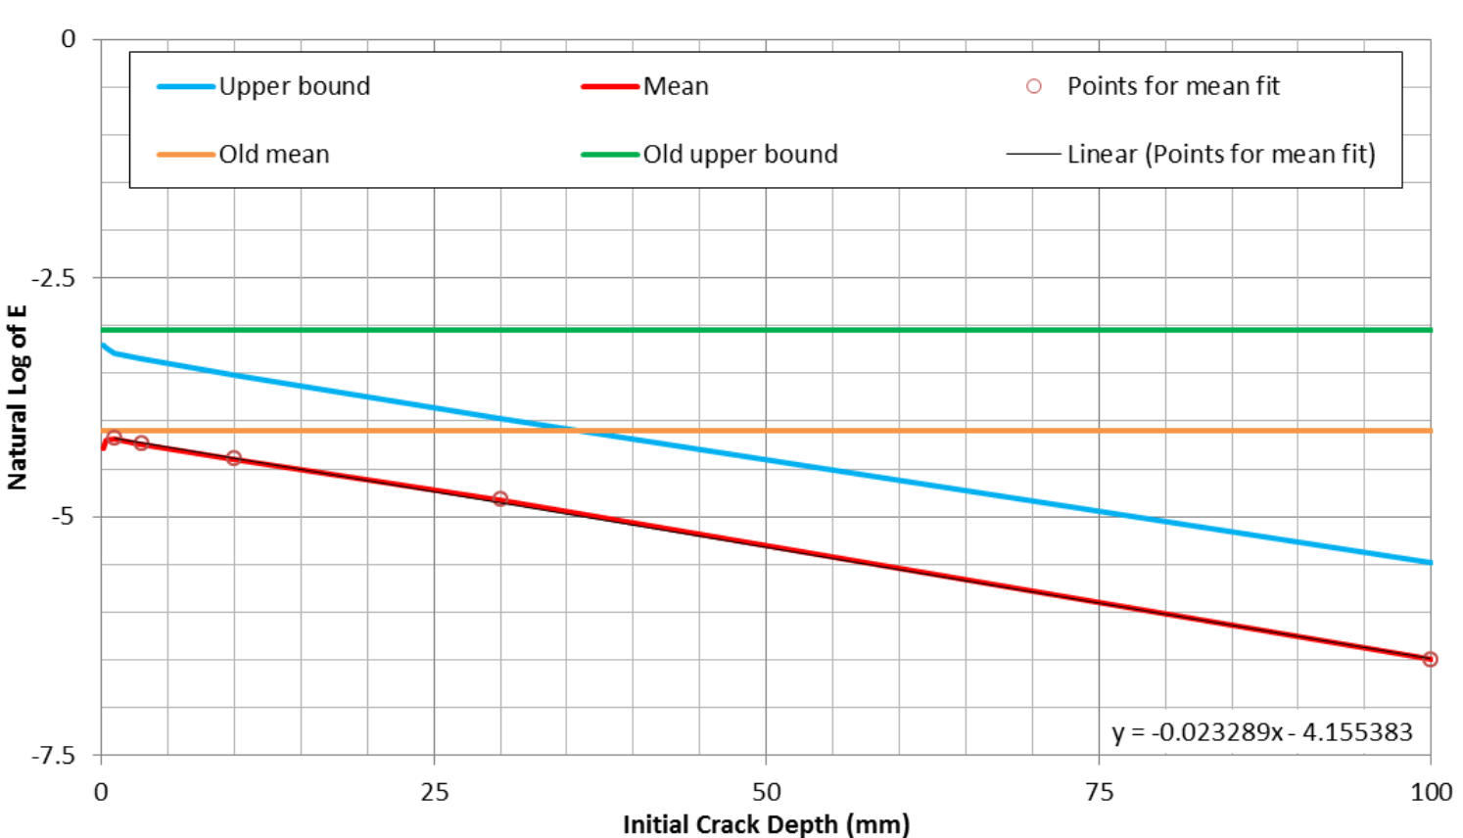
Revised Assessment
Couple of examples of the results shown
Difference between green/orange and blue/red lines shows conservatism in previous approach – noting log scale

Slide 16
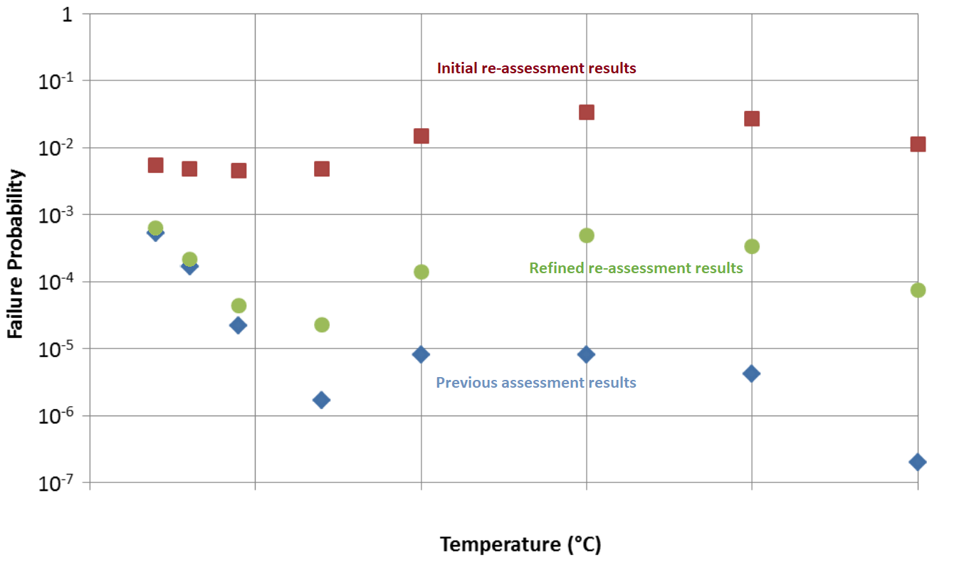
Crack Growth Fitting - Original

Slide 17
05
Conclusions

Slide 18
Key Lessons Learned
Conclusions
Simplified models are often needed in probabilistic assessments
However:
Small changes to inputs may invalidate associated assumptions
In models with binary output, cliff edges are hard to predict
Sensitivity studies are key to confirming model suitability

Slide 19
Copy here

