Slide 1
(PM_06) Application of Advanced Importance Sampling Methods for Probabilistic Fatigue Crack Growth Evaluation
4th International Symposium on Probabilistic Methodologies for Nuclear Applications
November 1-3, 2022 / Leicester, UK
Changsik Oh (csoh2011@kins.re.kr)
Sangmin Lee (sangmin.lee@kins.re.kr)
Korea Institute of Nuclear Safety

Slide 2
I
Introduction
II
Problem Definition
III
Results and Comparison
III
Conclusions

Slide 3
Introduction

Slide 4
Background
Variance Control
Controlling variance is important to obtain accurate estimates of the system’s performance
The more we know the system, the better variance reduction methods work
The amount of information depends on problems, analysis tools, skills of engineers, etc.
In the first simulation stage, we always have a hard time gathering information about the system
There may be several options for the first simulation stage
A pilot simulation can be helpful to get information for the second-stage simulation
Analytical methods such as FORM, SORM, etc. can be useful
The Adaptive variance reduction method can be a good estimator
Ultimately, iterative simulations will be necessary

Slide 5
Background
Importance Sampling
Importance sampling is a fundamental method to dramatically reduce variance of the estimate
It may be able to reduce variance by the order of millions
It often requires a small sample size → low computing cost
Importance sampling is very efficient for very low probability problems
Probabilistic fracture mechanics (PFM) problems often have the features as followings:
Very low probability of Quantity of Interest (QoI)
Propagation of input uncertainty
High computing cost

Slide 6
Objectives
The long-term goal is to find and improve importance sampling schemes for developing Probabilistic Fracture Mechanics Code
Understanding the theory and implementation
Test & modification
Optimization
The objective of this study is to improve understanding of importance sampling methods used in other research fields
Multiple importance sampling
Adaptive multiple importance sampling
Population Monte Carlo

Slide 7
Problem Definition

Slide 8
Problem Definition
Object
A stainless steel pipe with a single crack
Aging mechanism
Fatigue crack growth of an unfound flaw
Main parameters (1/2)
Pipe geometry
12 inch schedule 160
Initial crack shape
Circumferential elliptical surface crack
Fatigue crack growth curve
pc-PRAISE model
Stainless stees
Stainless stees
When $∆K>∆K_{th}$
$$\frac{da}{dN}=A{\left(\frac{∆K_{I}}{{\left(1−R\right)}^{1/2}}\right)}^{n}$$
$$R=\frac{K_{I,min}}{K_{I,max}}$$

Slide 9
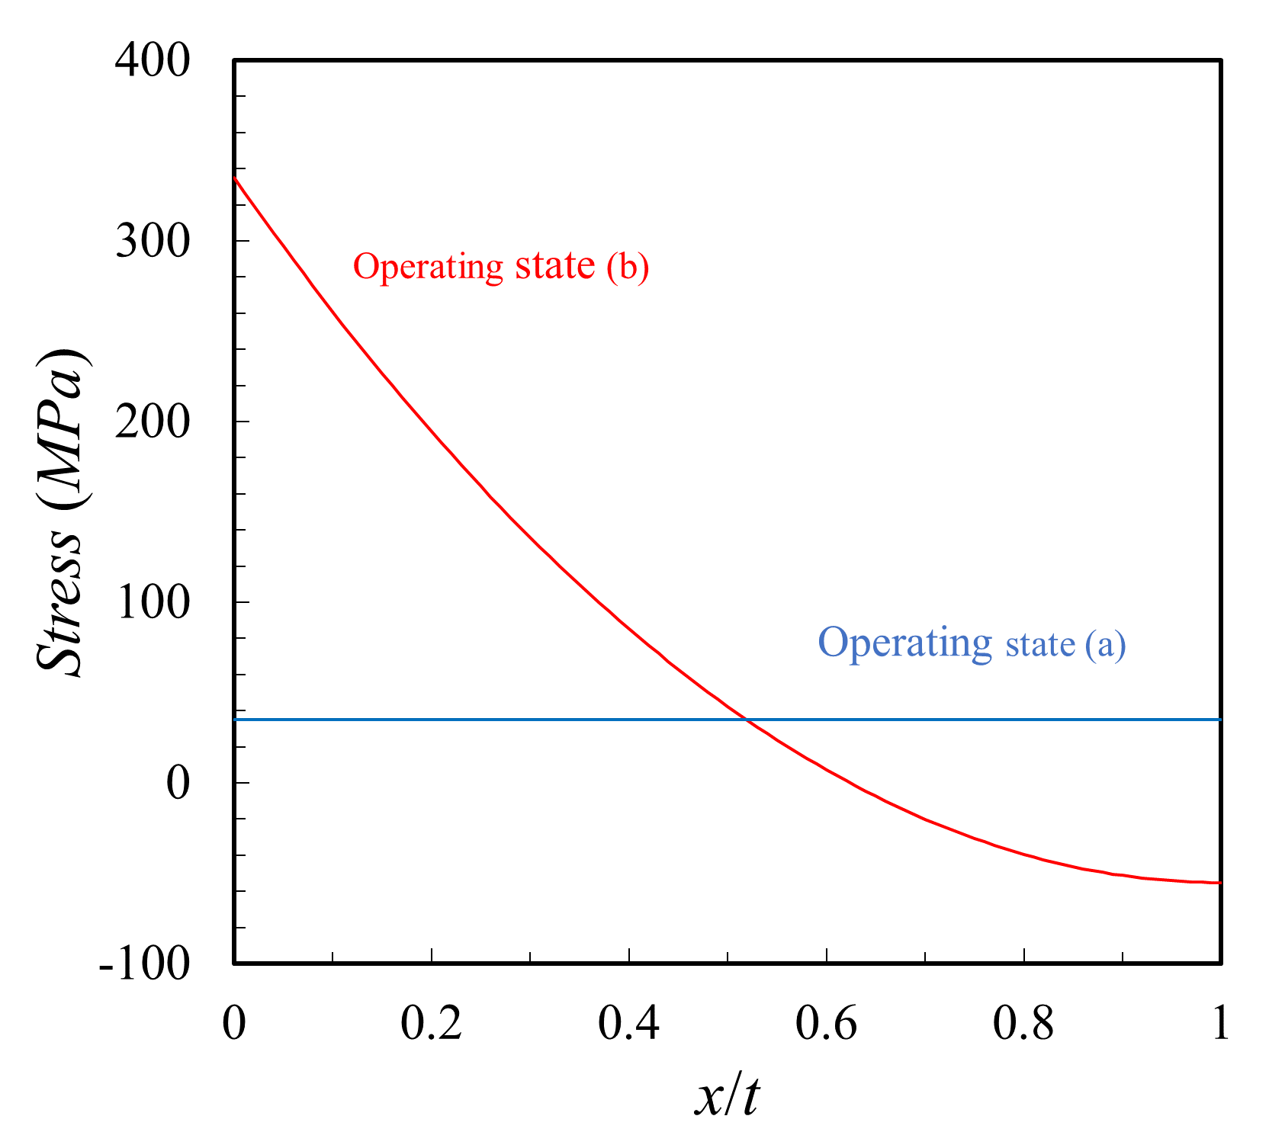
Problem Definition
Main parameters (2/2)
Fatigue Loads
Operating state (a): only internal pressure
Operating state (b): internal pressure + thermal load
Definition of through-wall
the crack depth reaches 95% of the thickness
Stress intensity factor solution
ASME BPVC Section XI Appendix A (2019 Ed.)
Weight function method
Discretization of stress profile

Slide 10
Problem Definition
(Independent) Random Variables
Random Variables | Distribution | mean | Std. dev. | CV*
Pipe inside radius, R_{i} [mm] | Constant | 162 | - | -
Pipe thickness, t [mm] | Constant | 36 | - | -
Crack depth, a [mm] | Lognormal | 0.5 | 0.1 | 0.2
Crack half-length, c [mm] | Lognormal | 0.5 | 0.3 | 0.6
FCG coefficient, A [mm/cycle/MPa√m] | Lognormal | 1.59E-10 | 7.95E-11 | 0.5
FCG exponent, n | Constant | 4.0 | - | -
Threshold K, K_{th} [MPa√m] | Constant | 0.0 | - | -
Peak value of stress profile, S_{a,max} [MPa] | Normal | 300 | 30 | 0.1
Internal pressure, P [MPa] | Normal | 15.5 | 0.5 | 0.032
*: Coefficient of variable, CV = standard deviation / mean

Slide 11
Problem Definition: Analysis Method
Monte Carlo Simulation
Sampling Method
Simple Random sampling (SRS)
Latin Hypercube sampling (LHS)
Variance Reduction Method
Simple importance sampling (SIS)
Multiple importance sampling (MIS)
Adaptive importance sampling (AMIS)
Population Monte Carlo (PMC)
Miscellaneous
No. of simulation: 20
Time increment: 1 month

Slide 12
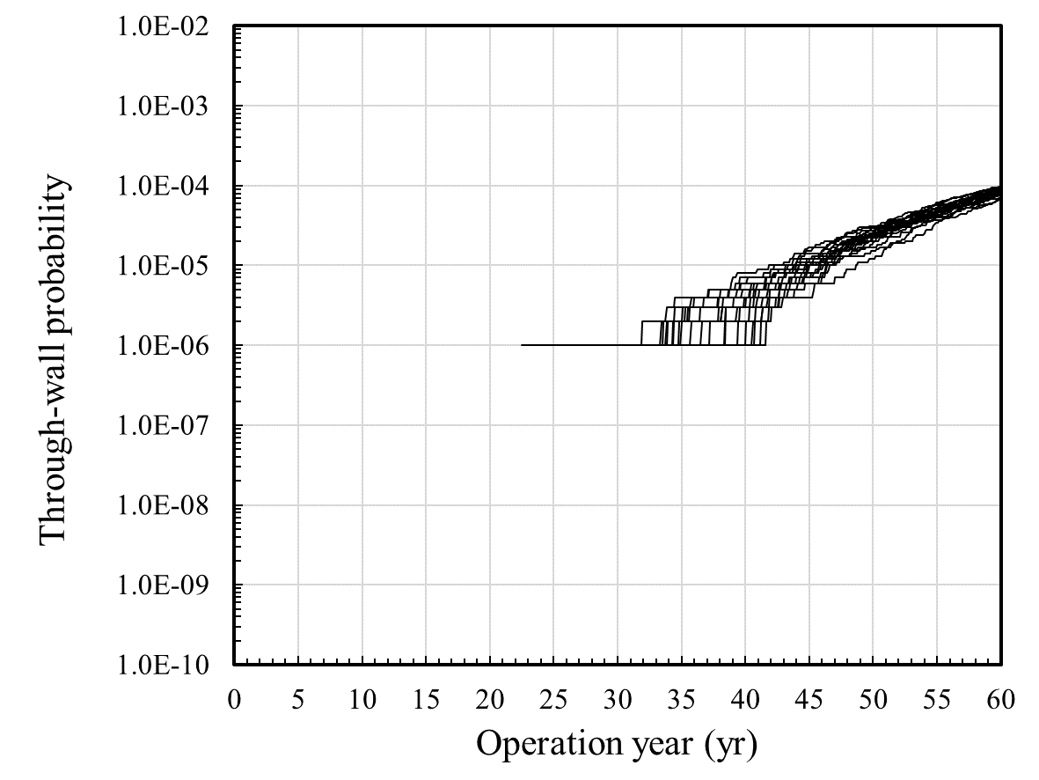
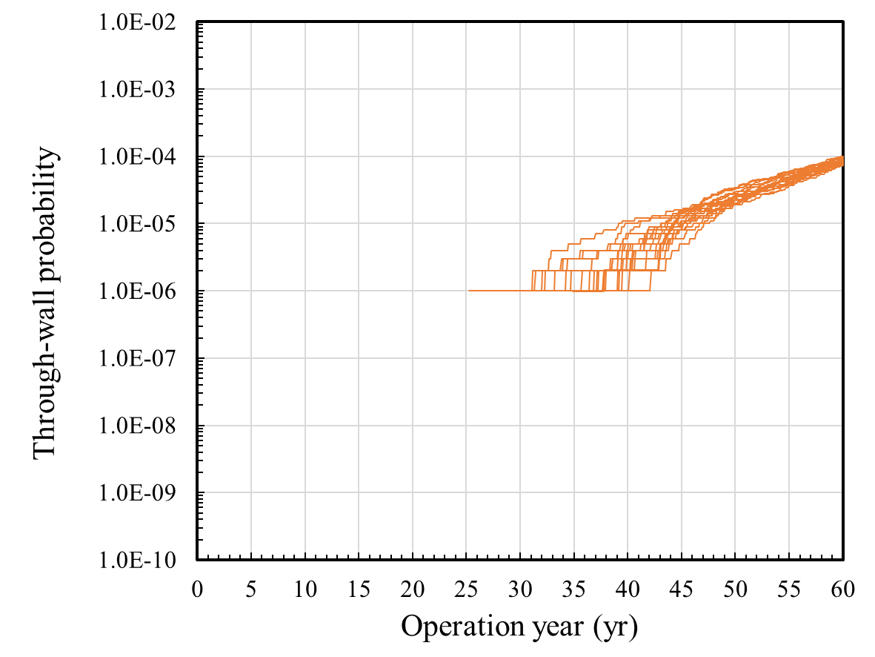
Problem Definition: Reference Cases I
Simple Random Sampling (SRS) & Latin Hypercube Sampling (LHS)
Sample size: 10⁶ (repetition: 20)
Higher calculation cost as increasing no. of sampling
Results of LHS looks like those of SRS
Performance in variance reduction decreases as sample size increases
SRS: (8.53×10⁻⁵, 8.67×10⁻⁶) @ 60 year, Coefficient of Variance (CV) = 0.102
LHS: (8.53×10⁻⁵, 7.37×10⁻⁶) @ 60 year, Coefficient of Variance (CV) = 0.086
Sample size of 10⁶ is not sufficient to estimate very low probabilities
SRS
LHS

Slide 13
Problem Definition: Reference Cases II
Recap of Simple Importance Sampling (SIS)
The most fundamental method for variance reduction by concentrating samples on a specific region of interest
Proposal should be proportional to the integrand → Need good knowledge on the target distribution in advance
$$p_{f}=E_{f}\left[I\left(x\right)\right]=\int{I\left(x\right)f\left(x\right)dx}=\int{\left[I\left(x\right)\frac{f\left(x\right)}{g\left(x\right)}\right]g\left(x\right)dx}=E_{g}\left[I\left(x\right)\frac{f\left(x\right)}{g\left(x\right)}\right]$$
$${Var}_{g}\left[I\left(x\right)\frac{f\left(x\right)}{g\left(x\right)}\right]=\int{{\left(I\left(x\right)\frac{f\left(x\right)}{g\left(x\right)} − p_{f}\right)}^{2}g\left(x\right)dx}$$
$∴g\left(x\right)\sim$ $I\left(x\right)f\left(x\right)$

Slide 14
Problem Definition: Reference Cases II
Set-up
Proposal distribution: student t distribution (mode 3)
Shifting & scaling using normalization, t⁵(3, μ, σ=σ_{RV})
Cases
SIS-1: set the mean of proposal to be the same as the mean of RVs
SIS-2: SIS-1 + increasing sample size
SIS-3: set the mean of proposal to be around the target distribution
SIS-4: set the mean of proposal to fit the target distribution
$$X^{′}\sim t\left(3\right);X=μ+σX′$$
Case | No. of samples | Mean of proposals
 | N | a | c | A | S_{a,max} | P
SIS-1 | 1,000 | 0.5 | 0.5 | 1.59E-10 | 300 | 15.5
SIS-2 | 10,000 | 0.5 | 0.5 | 1.59E-10 | 300 | 15.5
SIS-3 | 1,000 | 0.8 | 1.4 | 3.98E-10 | 390 | 17
SIS-4 | 1,000 | 0.556 | 0.846 | 6.448E-10 | 369 | 15.58

Slide 15
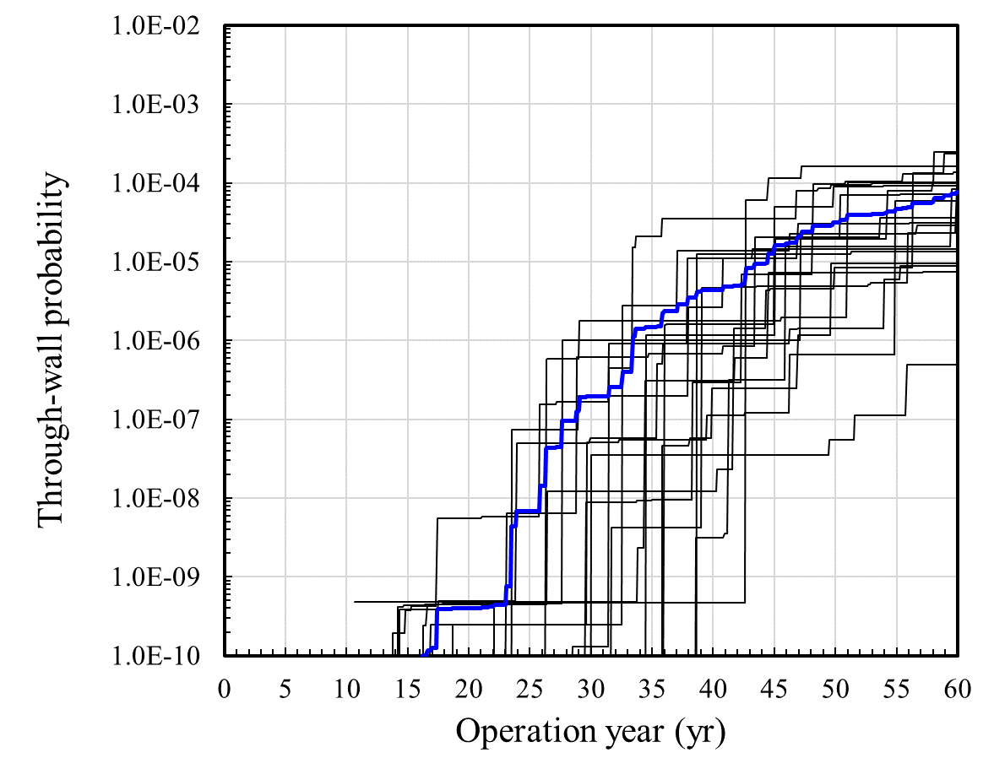
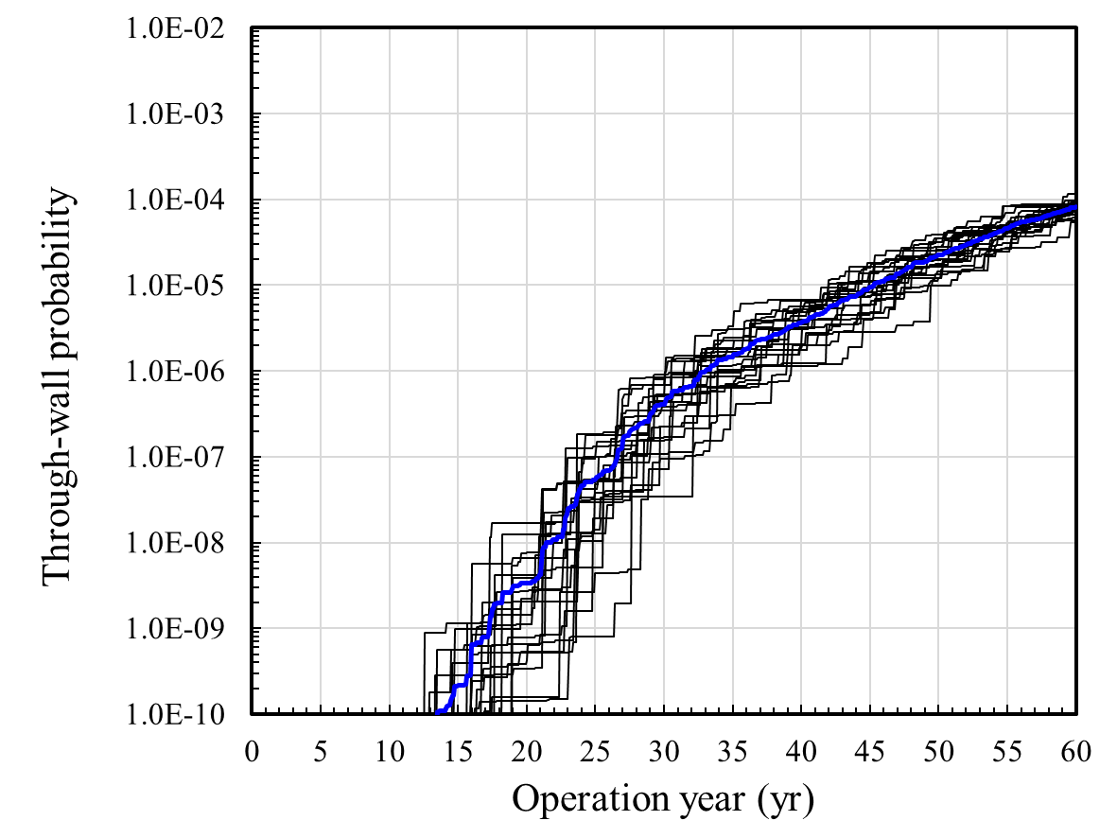
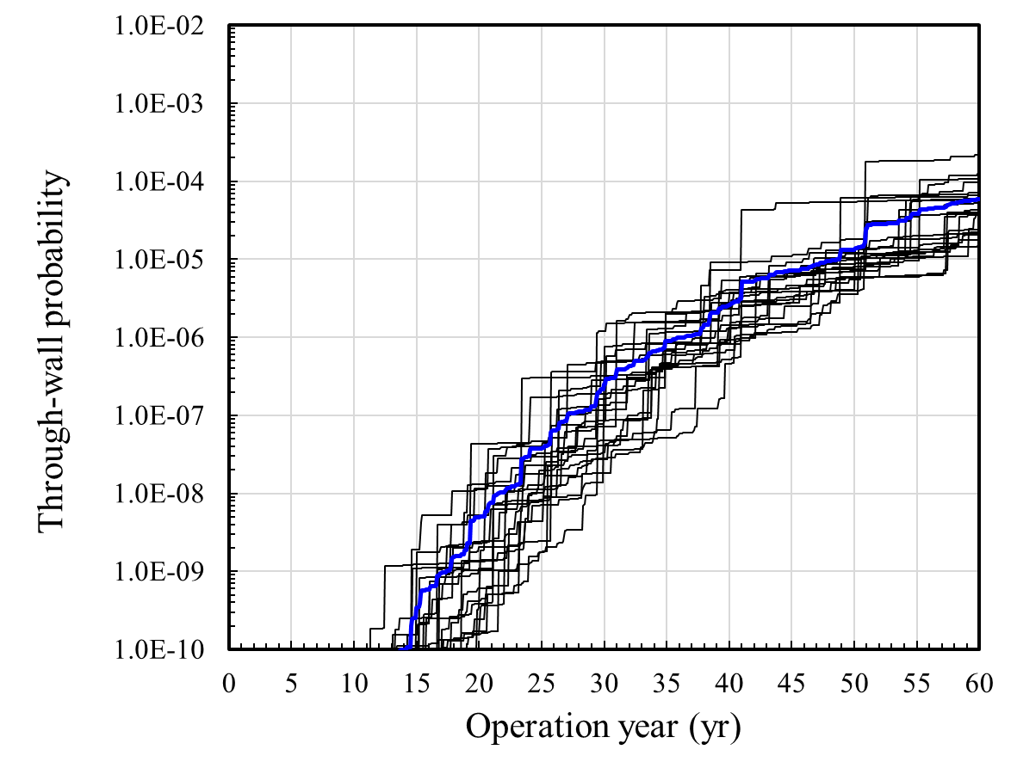
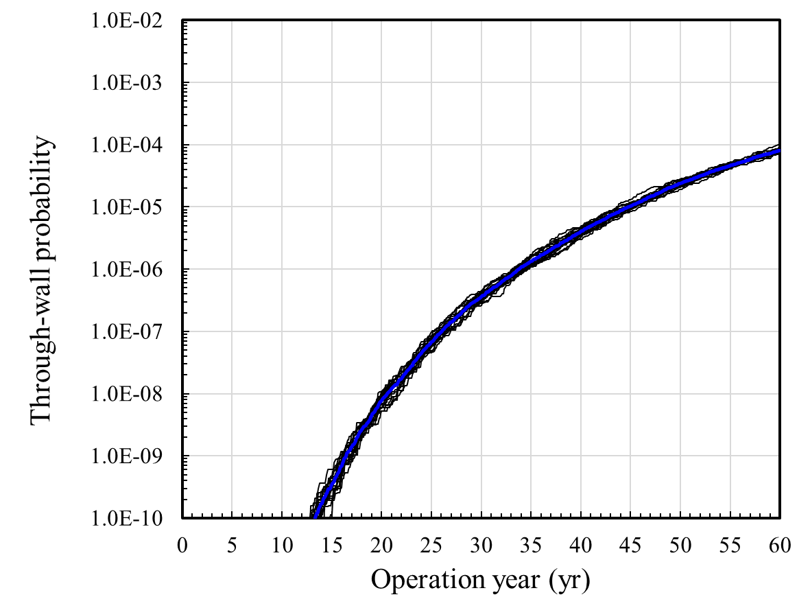
Problem Definition: Reference Cases II
SIS-1: set the mean of proposal to be the same as the mean of RVs
SIS-2: SIS-1 + increasing no. of simulation
SIS-3: set the mean of proposal to be around the MPP
SIS-4: set the mean of proposal to fit the MPP
Results (SRS+SIS)
Location of the proposal is important
Variance decreases as the proposal gets close to the target distribution
(7.61×10⁻⁵,7.23×10⁻⁵) @60yr
Increasing sample size
(8.12×10⁻⁵,1.54×10⁻⁵) @60yr
SRS_SIS-1
SRS_SIS-2
Large variance
Decreasing variance as increasing samples
Very large variance
SRS_SIS-3
SRS_SIS-4
Large variance
Comparable to SIS-2
Very small variance
Decreasing variance as moving to MPP
(5.87×10⁻⁵,4.89×10⁻⁵) @60yr
Moving to target
(8.09×10⁻⁵,6.30×10⁻⁶) @60yr

Slide 16
Problem Definition: Reference Cases II
Results (SRS+SIS)
Contribution of random variables
FCG coefficient & fatigue stress have a greater impact on the estimate than the other random variables
SIS-1: set the mean of proposal to be the same as the mean of RVs
SIS-4: set the mean of proposal to fit the MPP
< SIS-4 >
Samples in red & blue are mixed
: probability density distribution of RVs
: samples in case of failure
: samples in case of safe
< SIS-1 >
The border between red & blue samples is clear
Proposal for SIS-1 should have a thicker tail

Slide 17
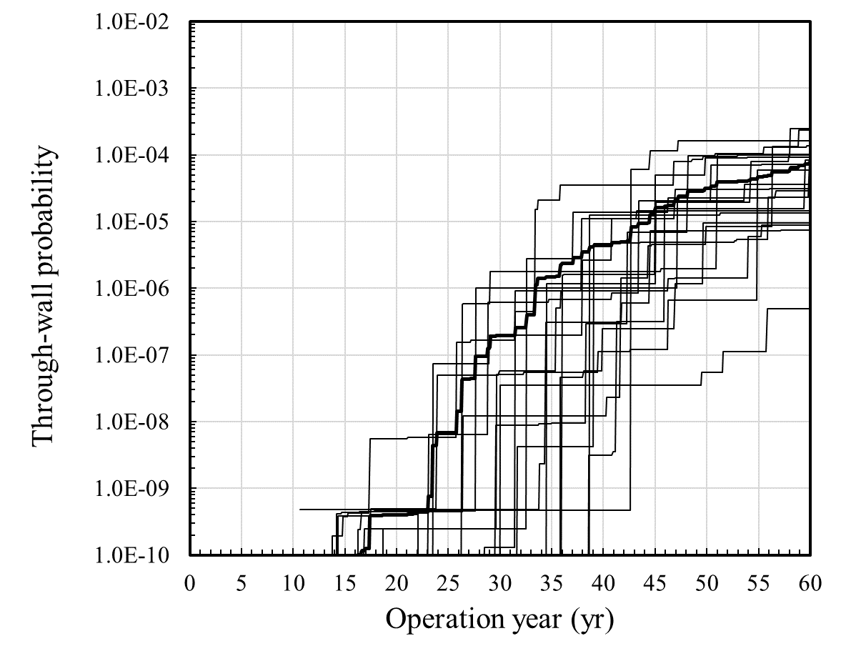
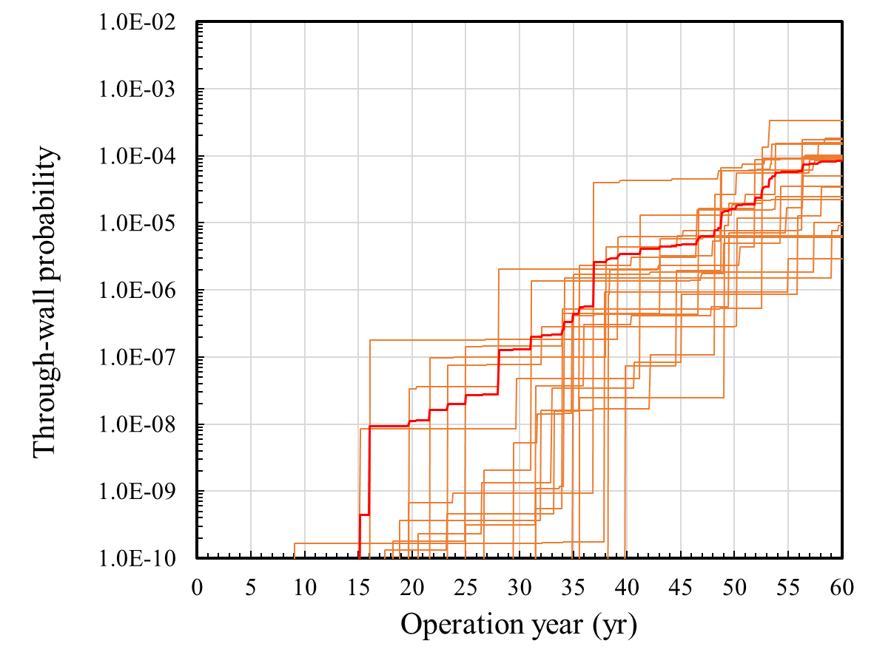
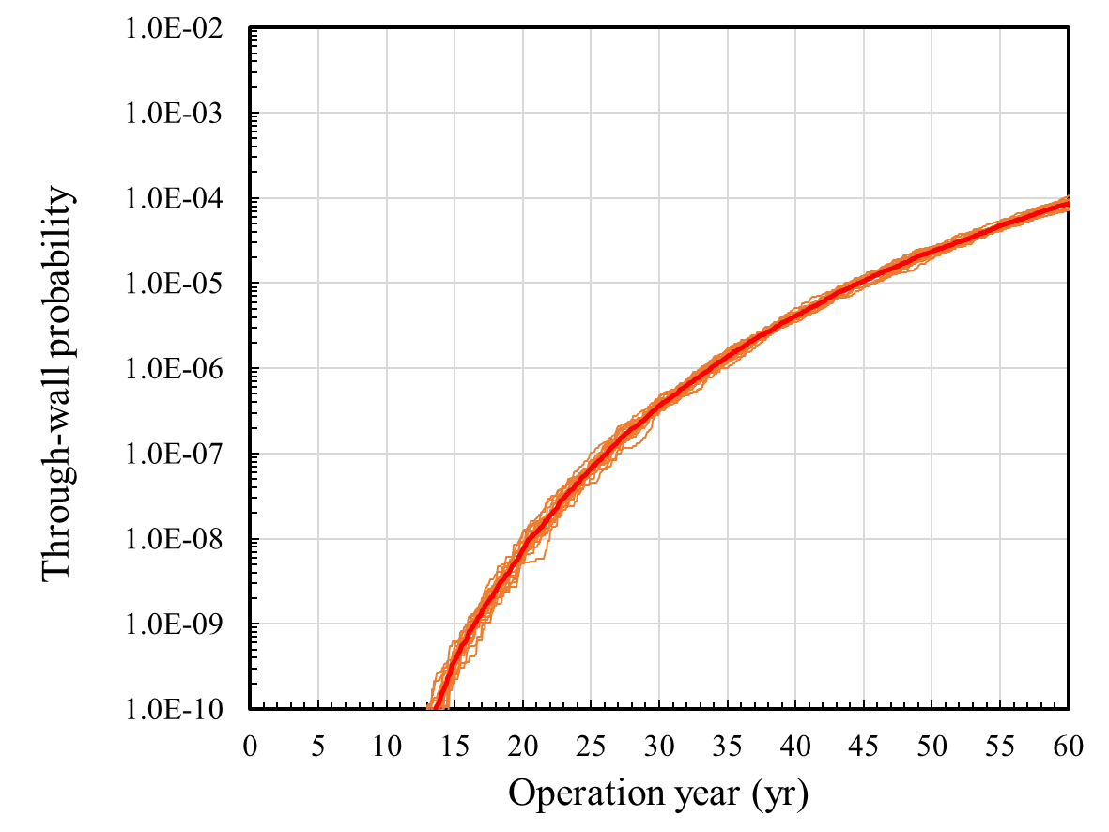
Problem Definition: Reference Cases II
SIS-1: set the mean of proposal to be the same as the mean of RVs
SIS-4: set the mean of proposal to fit the MPP
Results (LHS + SIS)
Results of LHS+SIS are comparable to those of SRS+SIS
SS_SIS-1
LHS_SIS-1
SRS: (7.61×10⁻⁵, 7.20×10⁻⁶) @60yr
LHS: (7.44×10⁻⁵, 8.14×10⁻⁶) @60yr
SS_SIS-4
LHS_SIS-4
SRS: (8.09×10⁻⁵, 6.30×10⁻⁶) @60yr
LHS: (8.56×10⁻⁵, 8.91×10⁻⁶) @60yr
※ MCS/LHS: 8.53x10⁻⁵ @60yr

Slide 18
Results and Comparison

Slide 19
Results: Multiple Importance Sampling
Recap of Multiple Importance Sampling (MIS)*
Deterministic-Mixture (DM): a whole mixture distribution of pre-defined proposal distributions (normally one sample from one proposal)
Balance heuristic: effective method for weighting proposals
$${\hat{p}}_{f}=E_{f}\left[I\left(x\right)\right]=\sum_{i=1}^{M}{\frac{1}{N_{i}}\sum_{j=1}^{N_{i}}{w_{i}^{g}\left(X_{i,j}\right)I\left(X_{i,j}\right)\frac{f\left(X_{i,j}\right)}{g_{i}\left(X_{i,j}\right)}}}$$
< Balance heuristic >
$$w_{i}^{g}\left(x\right)=\frac{N_{i}g_{i}\left(x\right)}{\sum_{k}{N_{k}g_{k}\left(x\right)}}$$
< Deterministic-mixture >
$${\hat{p}}_{f}=\sum_{i=1}^{M}{\sum_{j=1}^{N_{i}}{I\left(X_{i,j}\right)\frac{f\left(X_{i,j}\right)}{\sum_{k}{N_{k}g_{k}\left(x\right)}}}}=\sum_{i=1}^{M}{\sum_{j=1}^{N_{i}}{I\left(X_{i,j}\right)\frac{f\left(X_{i,j}\right)}{\frac{1}{N}\sum_{k}{g_{k}\left(x\right)}}}}$$
$$where N=\sum_{k}{N_{k}}, N_{k}=1$$
*: E. Veach, 1997, “Robust Monte Carlo Methods for Light Transport Simulation,” Ph.D. thesis, Stanford University

Slide 20
Results: Multiple Importance Sampling
Set-up
Proposal distribution
Student-t distribution (mode=3), t⁵(3, μ_{i}, σ_{i}=σ_{RV})
Mixture of M proposals evenly distributed within the pre-specified space
Cases
MIS-1: set the mixture proposal distribution to cover wide range of area
MIS-2: MIS-1 + reducing no. of proposal by 1/10
MIS-2: MIS-1 + reducing no. of proposal by 1/100
MIS-4: set the mixture proposal distribution to cover narrow range of area around the target distribution
※ Total samples = M x N_{i} = 1,000
Case | No. of proposal | Samples per proposal | Mean of proposals (min./max.)
 | M | N_{i} | a | c | A | S_{a,max} | P
MIS-1 | 1000 | 1 | 0.5 / 1.5 | 0.5 / 3.5 | 1.59E-10 / 1.75E-9 | 300 / 600 | 15.5 / 20.5
MIS-2 | 100 | 10 | 0.5 / 1.5 | 0.5 / 3.5 | 1.59E-10 / 1.75E-9 | 300 / 600 | 15.5 / 20.5
MIS-3 | 10 | 100 | 0.5 / 1.5 | 0.5 / 3.5 | 1.59E-10 / 1.75E-9 | 300 / 600 | 15.5 / 20.5
MIS-4 | 100 | 10 | 0.5 / 0.6 | 0.8 / 0.9 | 5.00E-10 / 8.00E-10 | 300 / 400 | 15 / 16
DM

Slide 21
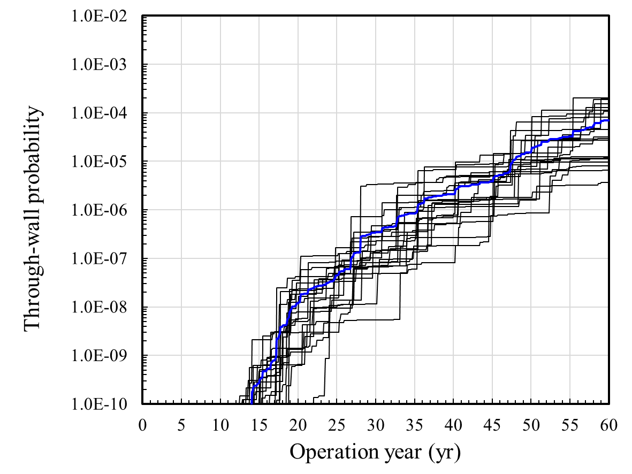
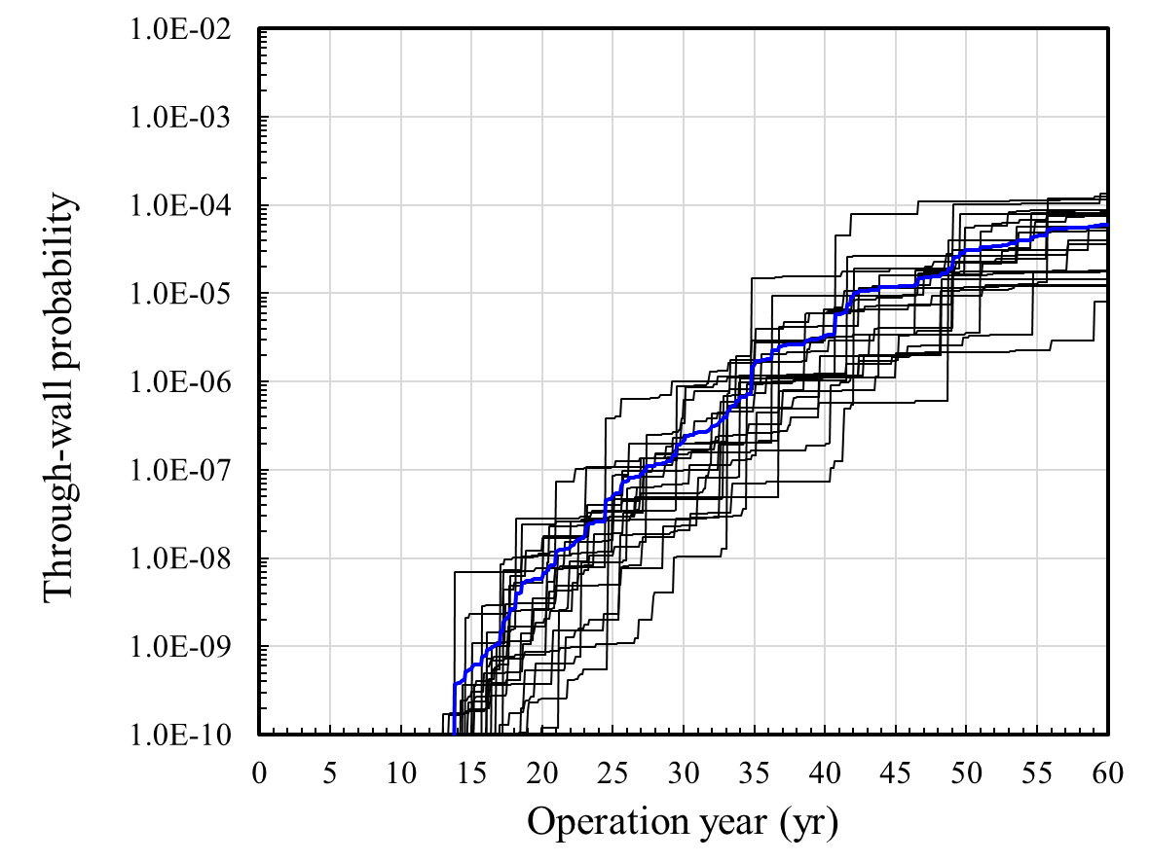
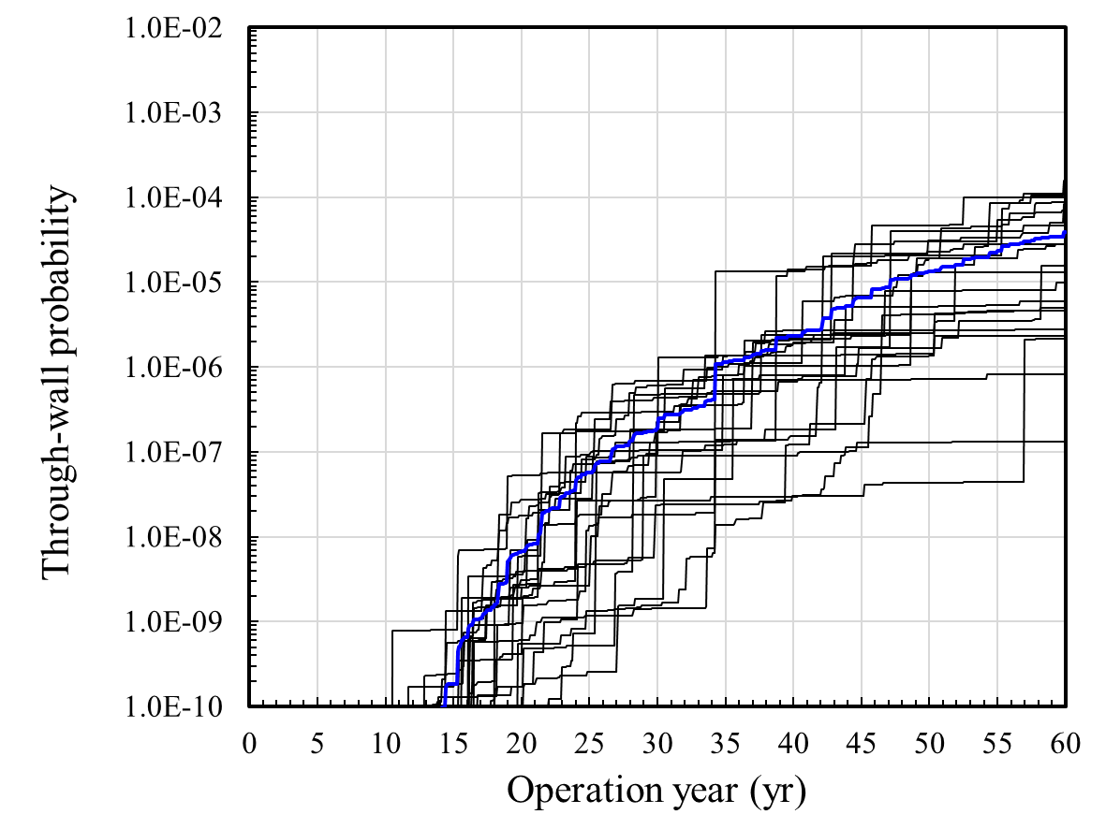
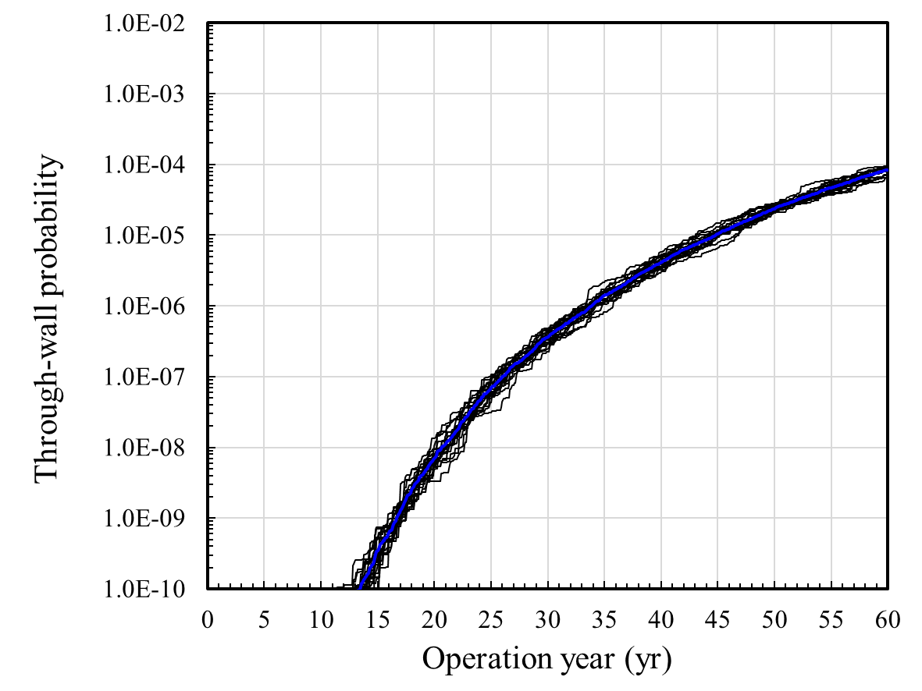
Results: Multiple Importance Sampling
MIS-1: set the mixture proposal to cover wide range of samples
MIS-2: MIS-1 + reducing no. of proposal by 1/10
MIS-2: MIS-1 + reducing no. of proposal by 1/100
MIS-4: set the mixture proposal to cover narrow range around the MPP
Results (1/2)
Variance decreases as the proposal gets close to the target distribution
Samples away from the target distribution could increase variance
The range of the mixture distribution should be as narrow as possible
(6.88×10⁻⁵,7.09×10⁻⁵) @60yr
1/10 proposals
(5.96×10⁻⁵,3.95×10⁻⁵) @60yr
MIS-1
MIS-2
1/100 proposals
MIS-3
MIS-4
(3.85×10⁻⁵,4.6×10⁻⁵) @60yr
※ MCS/LHS: 8.53x10⁻⁵ @60yr
(8.38×10⁻⁵,9.27×10⁻⁶) @60yr

Slide 22
Results: Multiple Importance Sampling
Results (2/2)
How the balance heuristic works:
Samples from a good proposal distribution should greatly contribute to the calculation of the estimate.
Samples from a bad proposal distribution should be ignored in the calculation of the estimate.
Structural defects:
Samples in (A) region from the bad proposal distribution in red have weights on the estimate as much as those from a good proposal distribution
Samples in (B) region from the good proposal distribution in blue don’t contribute to the estimate
(A)
$w_{2}^{}\left(x\right)=\frac{g_{2}\left(x\right)}{g_{1}\left(x\right)+g_{2}\left(x\right)}$ $\frac{I\left(x\right)f\left(x\right)}{g_{2}\left(x\right)}=\frac{I\left(x\right)f\left(x\right)}{g_{1}\left(x\right)+g_{2}\left(x\right)}$
(B)
$w_{1}^{g}\left(x\right)=\frac{g_{1}\left(x\right)}{g_{1}\left(x\right)+g_{2}\left(x\right)}$

Slide 23
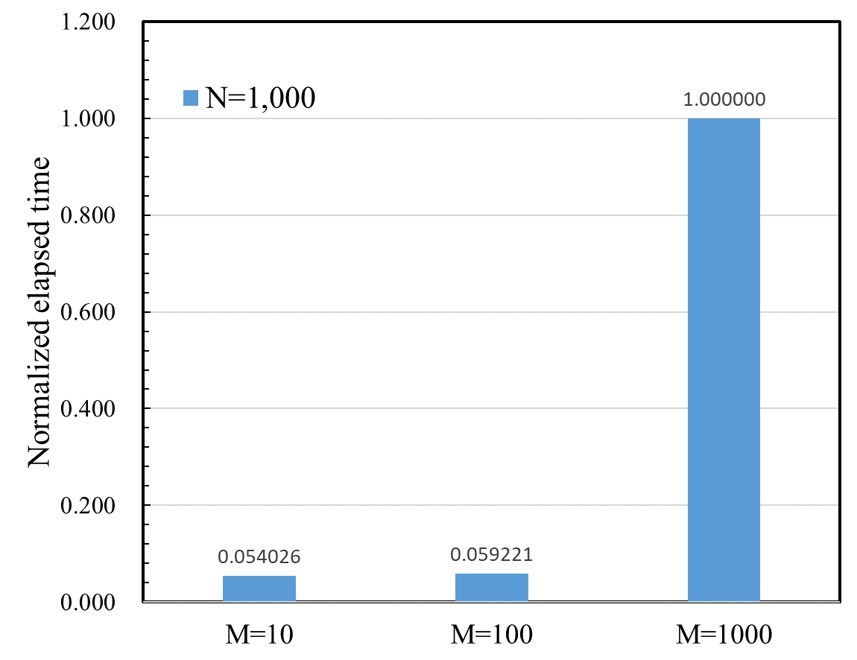
Results: Multiple Importance Sampling
Summary
Deterministic-mixture scheme has no advantage in PFM analysis → requiring high computational cost, but just little variance reduction
Rough knowledge on MPP in advance
Poor samples could increase variance
The range of the mixture proposal distribution should be as narrow as possible
No. of proposal distributions need to be optimized considering accuracy and computing cost
x18

Slide 24
Results: Adaptive Multiple Importance Sampling
Recap of Adaptive Multiple Importance Sampling (AMIS)*
The proposal distribution adapted by updating both its mean & standard deviation based on all the past samples & proposal distributions
It often requires a small sample size because importance weights from all the past samples and proposal distributions continue to be updated
Sampling @ t :
$$X_{i}^{t}\sim g^{t−1}\left(x;μ^{t−1},σ^{t−1}\right)$$
$π\left(X_{i}^{t}\right)$= $I\left(X_{i}^{t}\right)$ $f\left(X_{i}^{t}\right)$
Calculating importance weight:
$$s_{i}^{t}=\sum_{j=0}^{t}{N_{j}g^{j−1}\left(X_{i}^{t}\right)}; w_{i}^{t}=\frac{π\left(X_{i}^{t}\right)}{{s_{i}^{t}}/{\sum_{j=0}^{t}{N_{j}}}}$$
Updating the past weights:
$$s_{i}^{k}←s_{i}^{k}+N_{k}g^{t−1}\left(X_{i}^{k}\right); w_{i}^{k}←\frac{π\left(X_{i}^{k}\right)}{{s_{i}^{k}}/{\sum_{j=0}^{t}{N_{j}}}}$$
Estimating new proposal:
$$μ^{t}=\frac{\sum_{j=0}^{t}{\sum_{i=1}^{M}{w_{i}^{j}X_{i}^{j}}}}{\sum_{j=0}^{t}{\sum_{i=1}^{M}{w_{i}^{j}}}}; {\left(σ^{2}\right)}^{t}=\frac{\sum_{j=0}^{t}{\sum_{i=1}^{M}{w_{i}^{j}\left(X_{i}^{j}−μ^{t}\right){\left(X_{i}^{j}−μ^{t}\right)}^{T}}}}{\sum_{j=0}^{t}{\sum_{i=1}^{M}{w_{i}^{j}}}}$$
*: J.M. Cornuet, J.M. Marin, A. Mira and C.P. Robert, 2011, “Adaptive Multiple Importance Sampling,” Scandinavial Journal of Statistics, 39(4), 798-812

Slide 25
Results: Adaptive Multiple Importance Sampling
Set-up
Proposal distribution
Student-t distribution (mode=3), t⁵(3, μ_{i}, σ_{i}=σ_{RV})
Cases
AMIS-1: set the initial mean of proposal to be the same as the mean of RVs
AMIS-2: set the initial mean of proposal to be within the target distribution
AMIS-3: set the initial proposal to be far away from the target distribution
AMIS-4: AMIS-3 + increasing sample size by 10 (total samples = 10,000)
※ Total samples = T x N_{i} = 1,000
Case | No. of iteration | Samples per new proposal | Initial mean of proposals
 | T | N_{i} | a | c | A | S_{a,max} | P
AMIS-1 | 25 | 40 | 0.5 | 0.5 | 1.59E-10 | 300 | 15.5
AMIS-2 | 25 | 40 | 1.32 | 6.86 | 1.51E-09 | 450 | 18
AMIS-3 | 25 | 40 | 0.271 | 0.081 | 3.45E-11 | 210 | 14
AMIS-4 | 100 | 100 | 0.271 | 0.081 | 3.45E-11 | 210 | 14

Slide 26
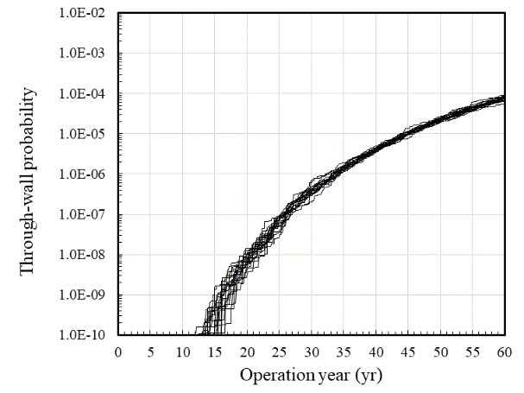
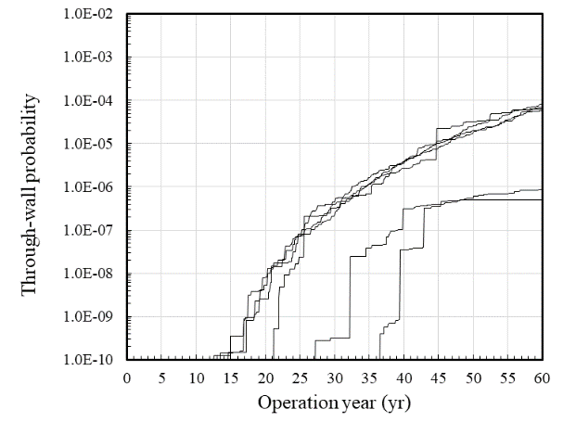
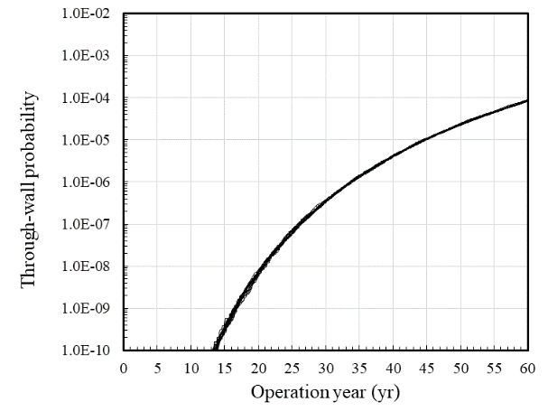
Results: Adaptive Multiple Importance Sampling
AMIS-1: set the initial mean of proposal to be the same as the mean of RVs
AMIS-2: set the initial mean of proposal to be within the target distribution
AMIS-3: set the initial mean of proposal to be far away from the mean of RVs
AMIS-4: AMIS-2 + increasing no. of samples by 10 (total samples = 10,000)
Results
Initial location of the proposal distribution is important
Little knowledge on the target distribution in advance
(7.68×10⁻⁵,8.55×10⁻⁶) @60yr
Moving to target
(7.13×10⁻⁵,1.16×10⁻⁵) @60yr
AMIS-1
AMIS-2
Location: Mean
Small variance
Location: same direction
Small variance
AMIS-3
AMIS-4
Location: opposite direction
Very large variance
Very small variance
Decreasing variance as increasing samples
Increasing sample size
1 simulation failed to converge!
(1.38×10⁻⁵,2.84×10⁻⁵)@60yr
(8.42×10⁻⁵,2.65×10⁻⁶) @60yr
※ MCS/LHS: 8.53x10⁻⁵ @60yr

Slide 27
Results: Adaptive Multiple Importance Sampling
Summary
Useful to obtain information on the target distribution
Initial proposal distribution is fitted to the target distribution after a certain amount of iterations
Unlike other adaptive methods, the variance of the proposal is also updated
Little knowledge on the target distribution in advance
Initial location of the proposal distribution is important
Poor initial proposal distribution might not be able to converge the estimate
Sufficient iterations are necessary to converge the parameters of the proposal

Slide 28
Results: Population Monte Carlo
Recap of Population Monte Carlo (PMC)*
Samples are generated from importance proposals depending on the previous generated samples
Importance proposals can be improved by iteration
Their mean values are updated by resampling from the previous generated samples in respect to their importance weights
<Proposals @ t>
Set proposals @ t :
$$g_{i}^{t}\left(x;μ^{t},σ^{t}\right)$$
1 sample from 1 proposal @ t :
$$X_{i}^{t}\sim g_{i}^{t}\left(x;μ^{t},σ^{t}\right)$$
Calculating importance weight & normalizing:
$$ρ_{i}^{t}=\frac{π\left(X_{i}^{t}\right)}{q_{i}^{t}\left(X_{i}^{t}\right)}$$
$${, \tilde{ρ}}_{i}^{t}=\frac{ρ_{i}^{t}}{\sum_{k}{ρ_{k}^{t}}}$$
Resampling n values from with replacement:
$$X_{i}^{t}$$
$${\hat{X}}_{i}^{t}\sim X_{i}^{t}\left({\tilde{ρ}}_{i}^{t}\right)$$
<Proposals @ t+1>
Updating proposals:
$$g_{i}^{t+1}\left(x;{\hat{X}}_{i}^{t},σ^{t}\right)$$
*: O. Cappe, A. Guillin, J. M. Marin and C.P. Robert, 2004, “Population Monte Carlo,” Journal of Computational and Graphical Statistics, 13(4), 907-929

Slide 29
Results: Population Monte Carlo
Set-up
Proposal distribution
Student-t distribution (mode=3), t⁵(3, μ_{i}, σ_{i}=σ_{RV})
Cases
PMC-1: set initial proposals to cover wide range of area
PMC-2: PMC-1 + increasing sample size by 10 (total samples = 10,000)
PMC-3: set initial proposals to cover narrow range of area
PMC-4: PMC-3 + increasing sample size by 10 (total samples = 10,000)
※ Total samples = T x N_{i} = 1,000
Case | No. of iteration | Samples per proposal | Mean of proposals (min./max.)
 | T | N_{i} | a | c | A | S_{a,max} | P
PMC-1 | 50 | 20 | 0.5 / 1.5 | 0.5 / 3.5 | 1.59E-10 / 9.54E-10 | 300 / 600 | 15.5 / 20.5
PMC-2 | 50 | 200 | 0.5 / 1.5 | 0.5 / 3.5 | 1.59E-10 / 9.54E-10 | 300 / 600 | 15.5 / 20.5
PMC-3 | 50 | 20 | 0.5 / 0.6 | 0.8 / 0.9 | 5.00E-10 / 8.00E-10 | 300 / 400 | 15 / 16
PMC-4 | 50 | 200 | 0.5 / 0.6 | 0.8 / 0.9 | 5.00E-10 / 8.00E-10 | 300 / 400 | 15 / 16

Slide 30
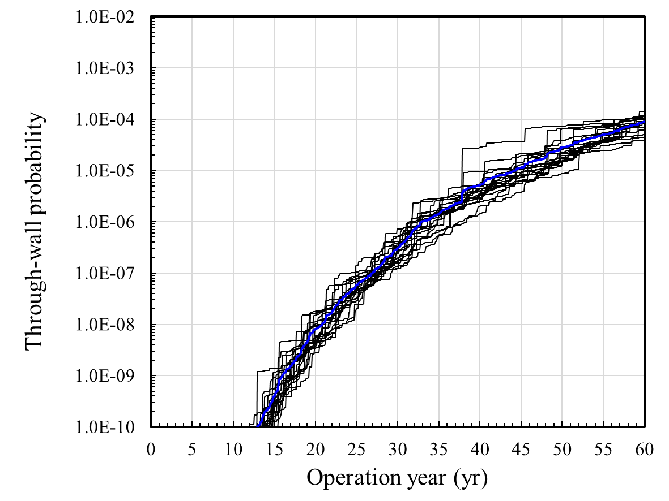
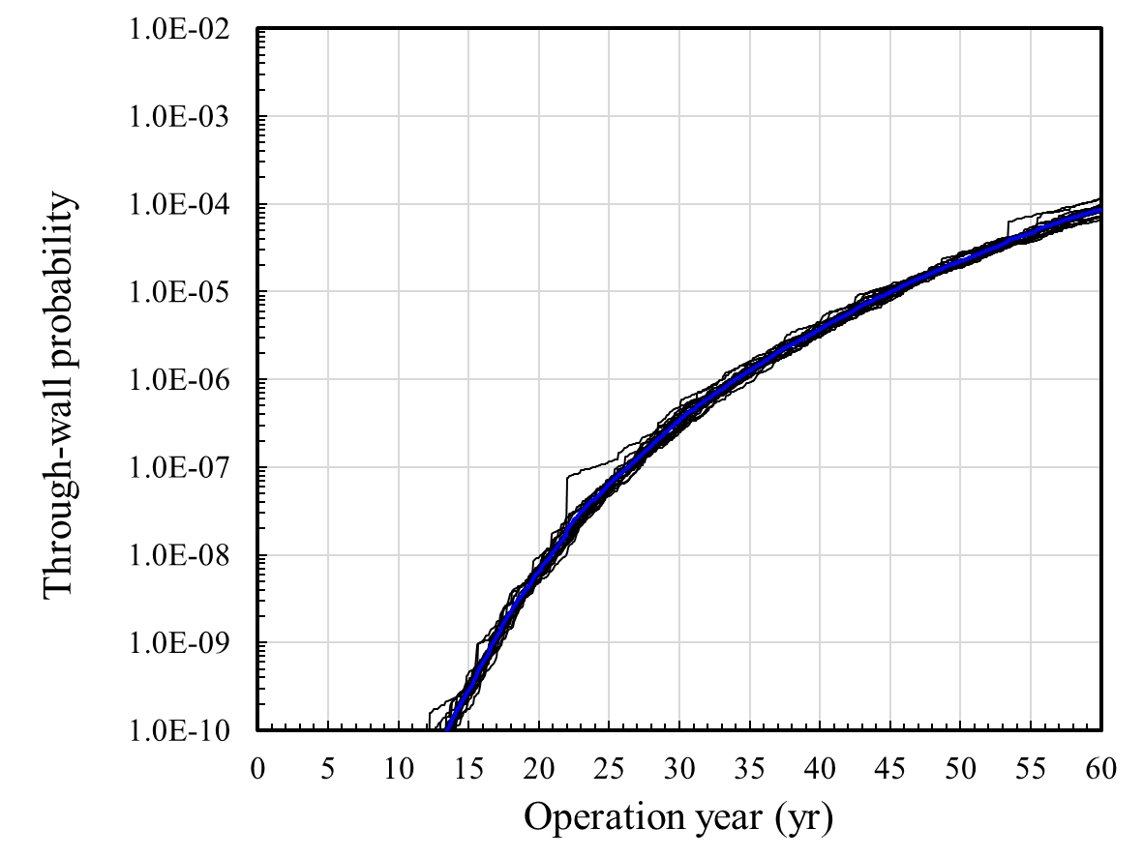
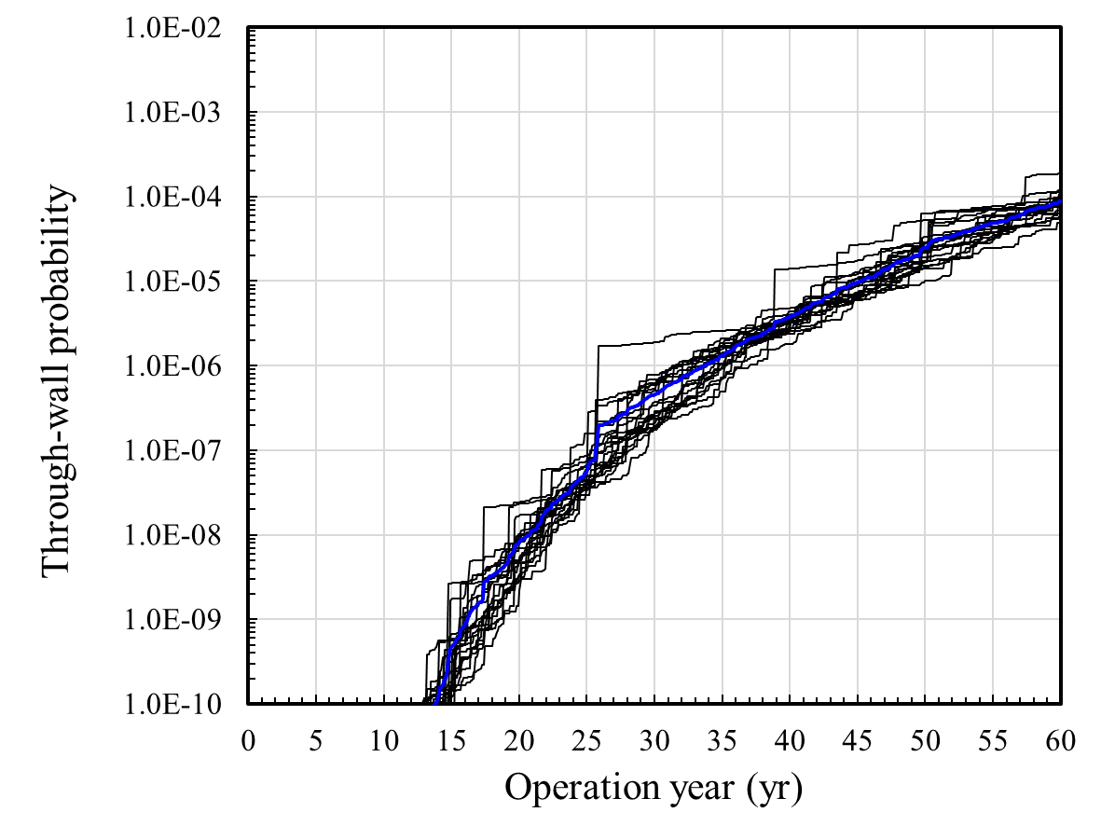
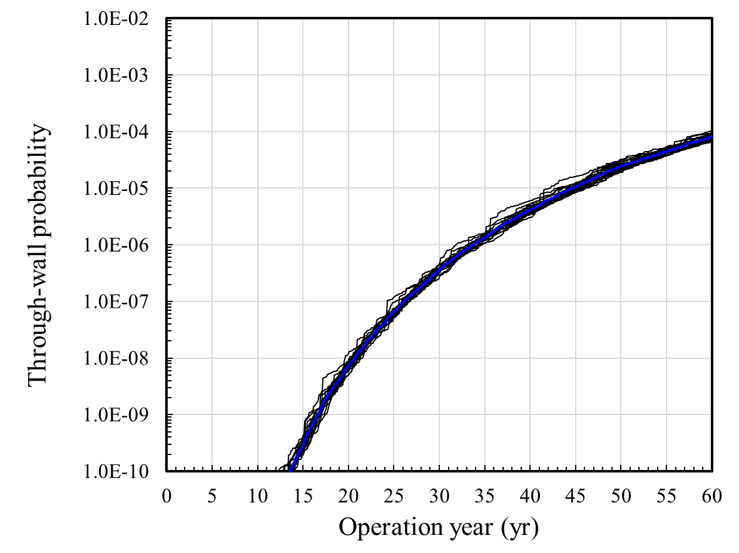
Results: Population Monte Carlo
PMC-1: set initial proposals to cover wide range of space
PMC-2: PMC-1 + increasing no. of samples by 10 (total samples = 10,000)
PMC-3: set initial proposals to cover narrow range of space around MPP
PMC-4: PMC-3 + increasing no. of samples by 10 (total samples = 10,000)
Results
Initial proposals should be distributed to cover the target distribution
Need sufficient samples for small variance
Increasing samples (x10)
(8.99×10⁻⁵,2.45×10⁻⁵)@60yr
(8.61×10⁻⁵,1.30×10⁻⁵)@60yr
PMC-1
PMC-2
Large variance
Very small variance
Decreasing variance as increasing samples
PMC-3
PMC-4
Very small variance
Decreasing variance as increasing samples
Large variance
Increasing samples (x10)
(8.76×10⁻⁵,3.19×10⁻⁵)@60yr
(8.07×10⁻⁵,9.30×10⁻⁶)@60yr
※ MCS/LHS: 8.53x10⁻⁵ @60yr

Slide 31
Results: Population Monte Carlo
Summary
Useful to obtain information on the target distribution
Initial proposal distributions are adapted by resampling means from the previous information
Results are less sensitive to the range of location of the proposal distributions if they can cover the target distribution
The first simulation is important to obtain meaningful information about the target distribution
Initial proposals should be distributed to cover the target distribution
Poor knowledge on the target distribution often requires widely distributed initial distribution → It leads to increase of computational cost (large number of samples and iterations)

Slide 32
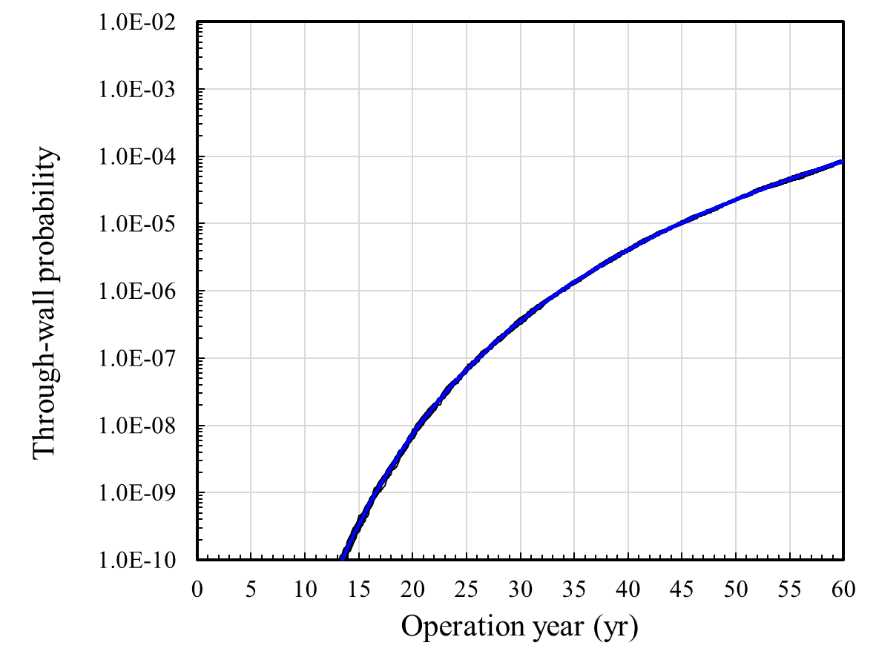
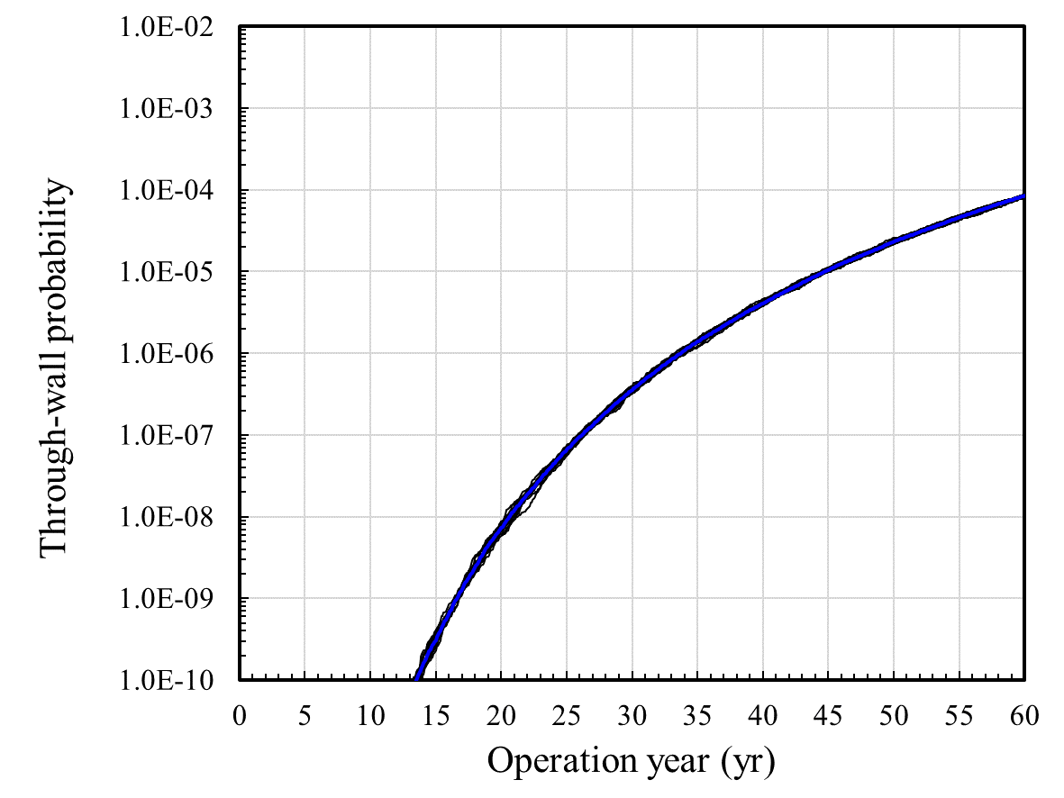
Comparison: Variance
SIS
N=10,000
Comparison of Variance
Convergence speed of AMIS is fastest
CV @ 60 year: AMIS < MIS < PMC
Results of MIS is comparable to those of SIS
MIS
N=10,000
AMIS
N=10,000
PMC
N=10,000
Method | Mean | Std. Dev. | CV
SIS | 8.48×10⁻⁵ | 2.39×10⁻⁶ | 0.028
MIS | 8.45×10⁻⁵ | 2.44×10⁻⁶ | 0.029
AMIS | 8.45×10⁻⁵ | 1.58×10⁻⁶ | 0.019
PMC | 8.07×10⁻⁵ | 9.30×10⁻⁶ | 0.115

Slide 33
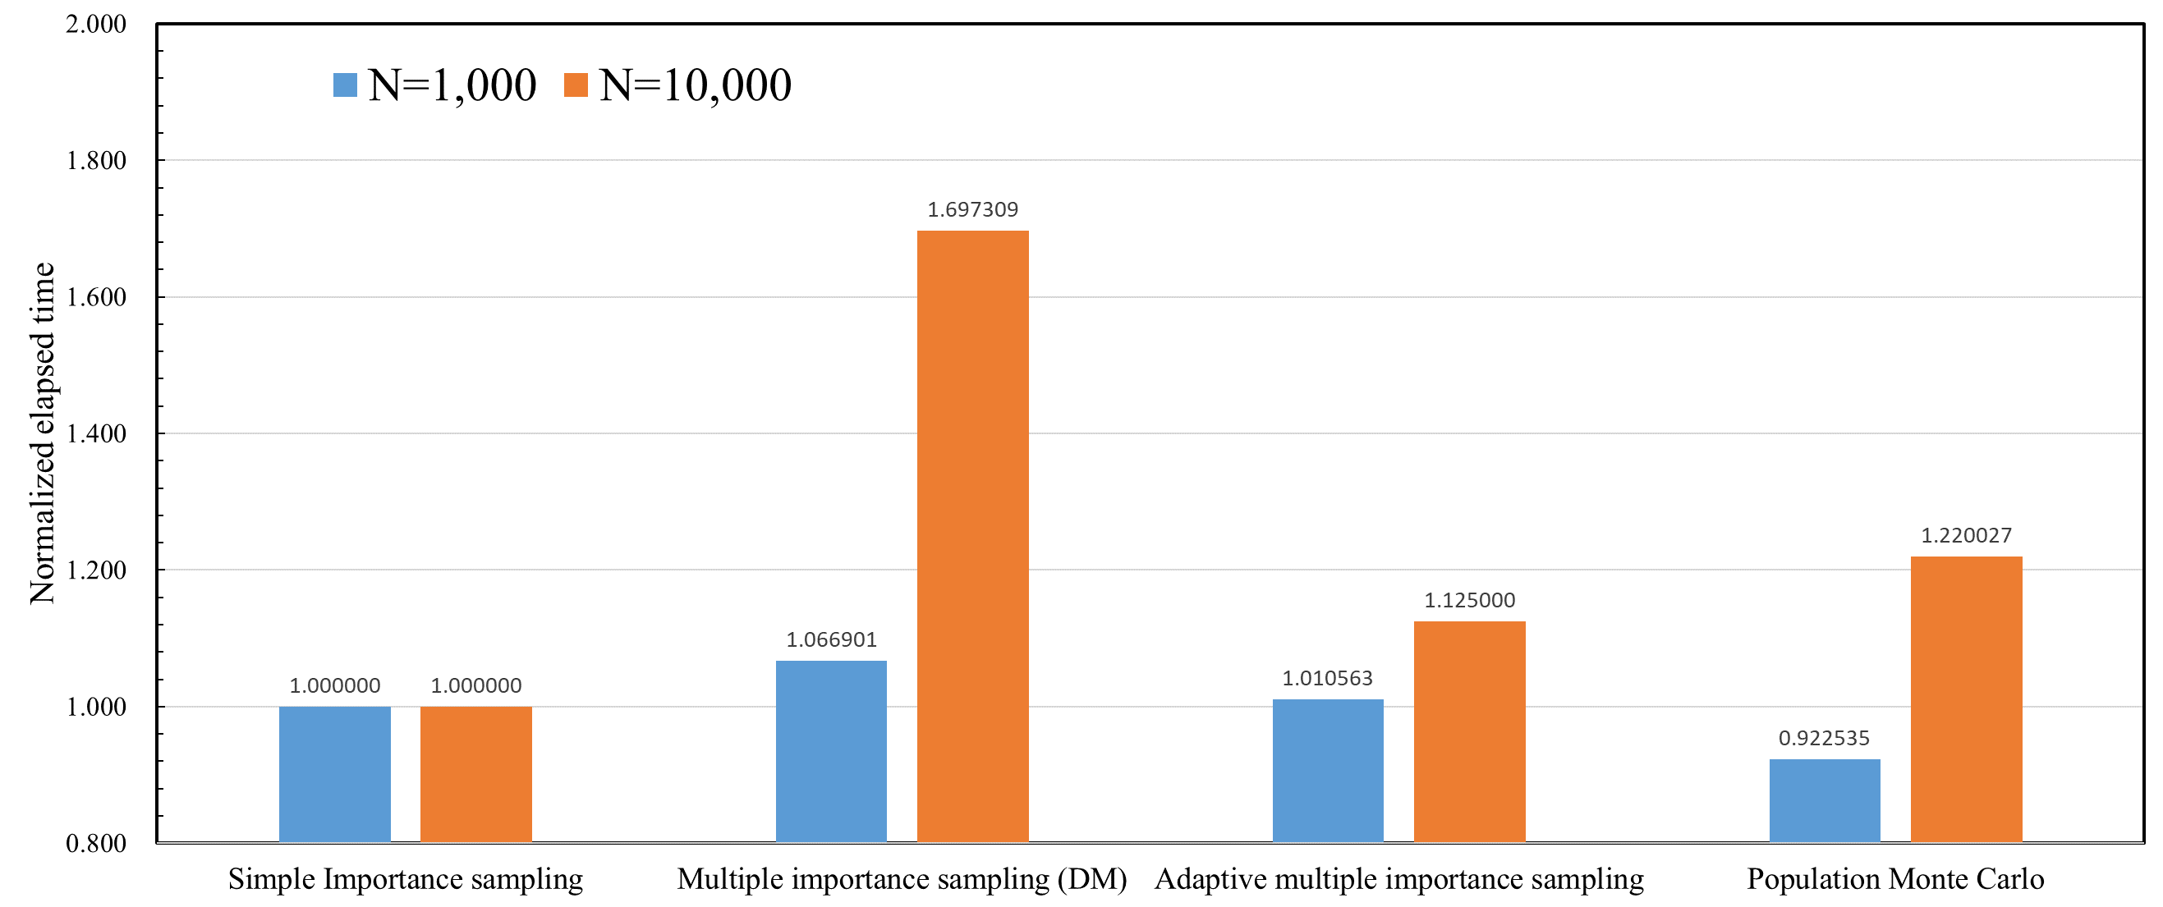
Comparison: Computing Time
Comparison of Computing Time
Elapsed time: MIS > PMC > AMIS @ N=10,000
AMIS and PMC are comparable to SIS → The computational cost of uncertainty propagation is more expensive than those of their complex sampling scheme
Elapsed time is proportional to the sample size
As increasing sample size, computing time using MIS increases exponentially
Computational cost of importance weights for all samples with respect to all proposals is expensive

Slide 34
Future Work
Generally, PFM problems have a chain of QoIs such as through-wall, leak rates and rupture.
MIS or PMC could be a good estimator for multi QoIs because the proposals (or samples) are widely distributed → It will require a larger sample size than that for a single QoI
AMIS looks like a good estimator for a single QoI because its proposal distribution is fitted to a single target distribution
When other distribution of QoIs are close to the target distribution, their variance would also be reduced
Iterative simulations for different QoIs with different proposals would be required
Comparison of importance sampling methods for estimating multi QoIs will be performed in the future
As the system becomes complex, importance sampling methods might be able to show different performances

Slide 35
Conclusions

Slide 36
Conclusions
Three different importance sampling methods were investigated via through-wall probability estimation of a pipe subjected to fatigue
Selecting proposal distributions is the most important to improve the performance of importance sampling methods
Using multiple proposal distributions is more efficient to infer the information of the system, especially when the prior knowledge is not available
Adaptive methods reduce the effort in selecting proposal distributions
Complex sampling schemes are unlikely to be a problem in PFM analysis
The computational costs of deterministic models seem to be the most expensive

Slide 37
Conclusions
There is no one-size-fits-all method
Sampling methods should be chosen considering the complexity of a problem, computational cost, etc.
Replicating simulations using various methods will be very helpful in understanding the system and obtaining reliable results

