Slide 1
PIPER-CASS:
Software Structure and Design
Probabilistic Code for Evaluation of Integrity of Cast Austenitic Stainless Steel Piping Components in PWRs
DJ Shim: EPRI
Kevin Fuhr, Markus Burkardt, Matt Wolfson, Glenn White, and Chris Casarez: Dominion Engineering, Inc.
ISPMNA
November 1-3, 2022
Leicester, UK

Slide 2
Table of Contents
Overview
PIPER-CASS Design
Code Structure and Modules
Key Features
Benchmarking versus xLPR
Conclusions

Slide 3
Overview
Because of the CASS material microstructure, Ultrasonic Testing (UT) technology applied to CASS components is not currently capable of meeting the PDI qualification standards that have been developed for other piping materials, particularly with regards to:
  Detection of axial flaws and
  Depth-sizing of circumferential flaws
In addition, thermal embrittlement of aged CASS material results in degraded material toughness, reducing acceptable flaw sizes
In 2019, EPRI began a project using probabilistic fracture mechanics (PFM) to evaluate the effect of these limitations
  Work to support development of a Supplement 9 to ASME Boiler and Pressure Vessel, Section XI, Appendix VIII and alternatives to Section XI, IWB-2500 inspection requirements for CASS piping components

Slide 4
PIPER-CASS Design
PIPER-CASS (Piping Integrity Probabilistic Evaluation for Reactors – Cast Austenitic Stainless Steel) is custom PFM software developed by EPRI
  Evaluates PWR CASS piping integrity in the presence of one or more flaws having axial or circumferential orientation
  Simulates fatigue flaw growth, coalescence of neighboring flaws, transition to through-wall flaw geometry, inspection, and flaw stability
  Each realization represents one piping segment
  Separately considers stability under loads for each Section XI Service Level
PIPER-CASS refines and extends many of the submodels of the xLPR program, leveraging xLPR test cases and focusing on material properties specific to CASS
  Correlation of material toughness and strength parameters due to thermal aging
  Addition of elastic-plastic fracture mechanics (EPFM) stability modules for part-depth flaws

Slide 5
PIPER-CASS Design
Analysis code is organized into several independent modules
Framework calls the modules and manages the data flow, multiprocessing, and random sampling
Code (framework and modules) is written in single language (Python) to facilitate development, debugging, deployment, and testing
Single-loop Monte Carlo is appropriate given available input data and applicable acceptance criteria
Parallel computation structure (multiprocessing) to utilize available CPUs, including cloud computing
Random sampling from over 40 distributions, with the capability to shift, scale, and truncate continuously variable distributions

Slide 6
Code Structure and Modules
Overall Structure
Overall PIPER-CASS Code Structure
PIPER-CASS Time Loop Structure
Where feasible, realization- and time-invariant values are precalculated and saved to a variable before entering time loop
Unified structure
  Single input file and single command to perform entire run, including thermal transient gradient stress and other preprocessing
Performance optimized through vectorized calculations, 64-bit architecture, and parallelized structure
  Performance bottlenecks investigated with profiling and debugging in IDE
Automated test suite with over 750 unit test cases to verify code deployment and codebase changes
Independent seeds are passed to each worker

Slide 7
Code Structure and Modules
Module Summaries (1/4)
Module Name | Description | Similarity to xLPR
Materials | Models the probabilistic and correlated nature of material properties including strength and toughness | Significantly different; PIPER-CASS includes relationships reflecting nature of variability in CASS material properties, including correlation among YS, UTS, and toughness
Loading | Determines the stresses due to steady-state loading | Same models
Transients | Models the occurrence and temperature/pressure driven stresses from plant transients (precalculated) | Same models, with extended functionality; In PIPER-CASS, automatically run by program, and additional inputs provide greater flexibility when defining operating transients (e.g., arbitrary number of transients with different flow rates and thermal solver time steps)
Stress | Calculates stresses and loading applicable to growth and stability | Same models

Slide 8
Code Structure and Modules
Module Summaries (2/4)
Module Name | Description | Similarity to xLPR
Stress Intensity Factor | Performs the calculation of stress intensity factors by universal weight function method (precalculated for transient loadings) | Same models
Crack Growth | Calculates growth of flaws due to fatigue | Same model for CASS fatigue
Crack Transition | Models flaw evolution from part-depth to through-wall | Same models
Crack Coalescence | Models interaction of multiple coplanar flaws (IWA-3330 proximity rules applied) | Same models

Slide 9
Code Structure and Modules
Module Summaries (3/4)
Module Name | Description | Similarity to xLPR
Axial Stability | Performs net section collapse (NSC) and elastic plastic fracture mechanics (EPFM) stability checks on axially oriented flaws (like xLPR, stability is checked independently for each flaw) | Same NSC and TW EPFM models, with extended functionality; PIPER-CASS has improved numeric solver and adds part-through-wall crack EPFM stability model (see below)
Circumferential Stability | Performs NSC and EPFM stability checks on circumferentially oriented flaws; multiple flaw stability of all co-planar flaws by NSC | Same NSC and TW EPFM models, with extended functionality; PIPER-CASS has improved numeric solver and adds part-through-wall crack EPFM stability model (work now in progress)
The applied J-integral curves are non-smooth due to changing coefficients from lookup tables
Consequently, the EPFM criteria for critical crack size may be satisfied at multiple convergence points, or a Newton-Raphson solver may fail to converge
PIPER-CASS addresses this challenge by implementing a jump-search algorithm to improve convergence and to ensure the smallest crack length satisfying the EPFM criteria is returned as the critical crack length

Slide 10
Code Structure and Modules
Module Summaries (4/4)
Module Name | Description | Similarity to xLPR
Inspection | Models the detection and sizing of flaws by NDE; models modified deterministic flaw acceptance evaluation, accounting for limited depth-sizing capability | Same probability of detection (POD) curves; Simulation of deterministic flaw acceptance evaluation is entirely new
Simulation Framework | Performs the Monte Carlo analysis (including random sampling and time loop); handles input/output, including numeric results, visualizations, and plain-text logging to file | Entirely new; Implemented in Python instead of GoldSim to avoid limitations of graphical programming (e.g., provides improved performance and version control)
Post-Processing | Automatically saves text files containing results and generates relevant figures | Entirely new; By contrast, xLPR pre-creates some results tables and figures, but they must be manually exported

Slide 11
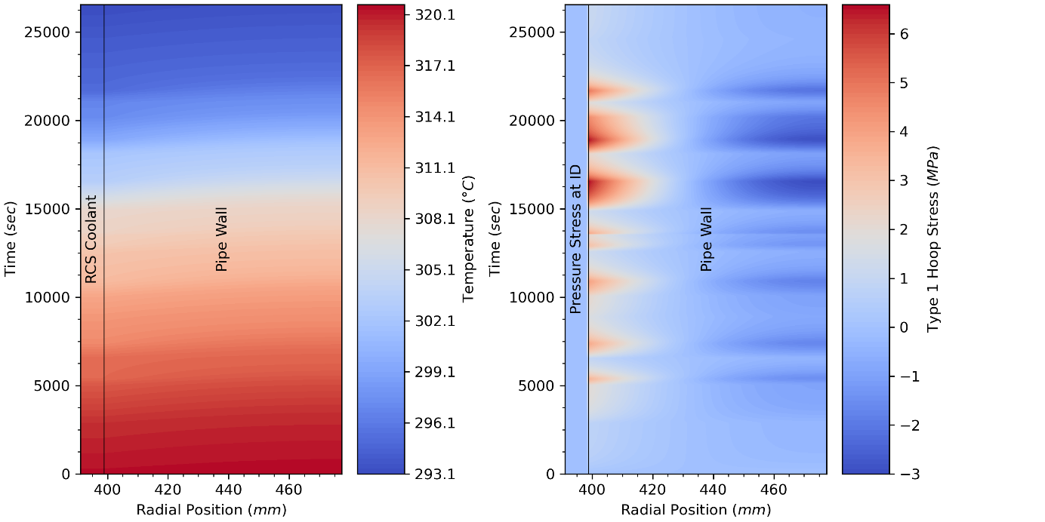
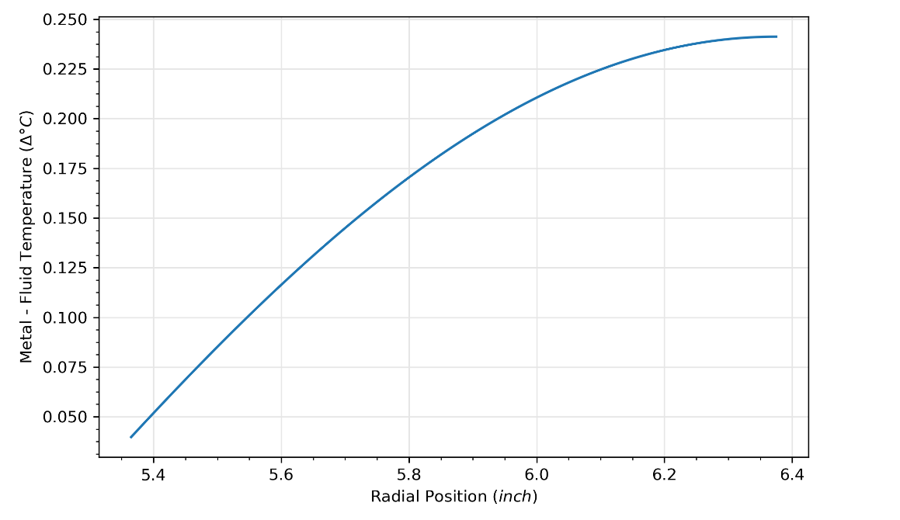
Key Features
Input Validation
Optimized for batch runs of many cases
  Generates summary Excel file of input files, including cell highlighting to denote input differences between cases
Modules contain validation functions to ensure inputs are within allowed ranges and results are sensical
Generates figures showing key intermediate values from material and transient modules

Slide 12
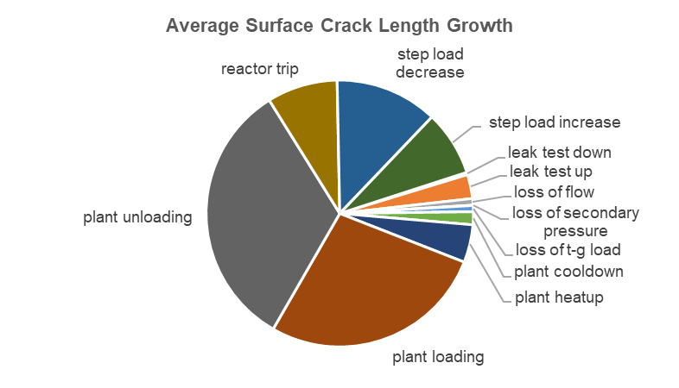
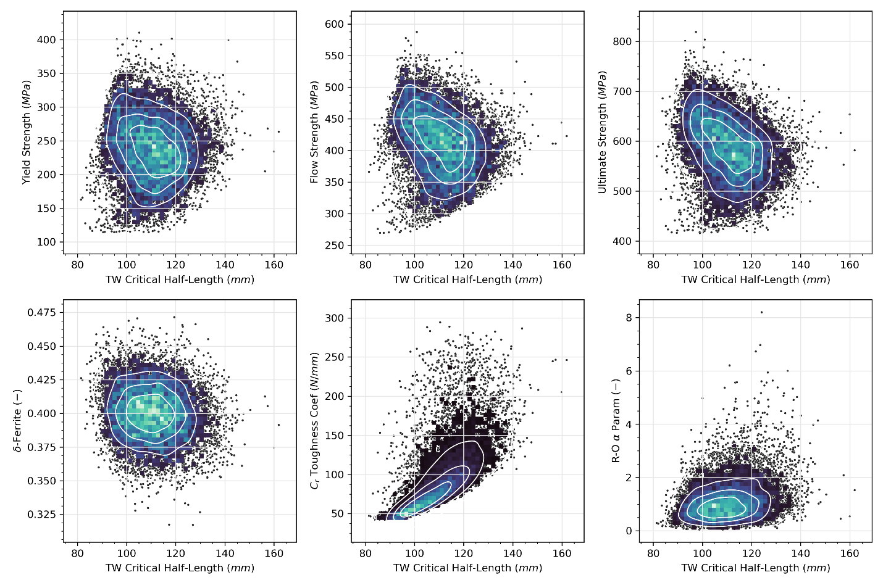
Key Features
Results
Can choose to limit outputs to avoid exhausting disk space on large runs
Final statistical results provided in series of text-based files and auto-generated plots
Text-base output permits automated collection and summarizing of results across many input files

Slide 13
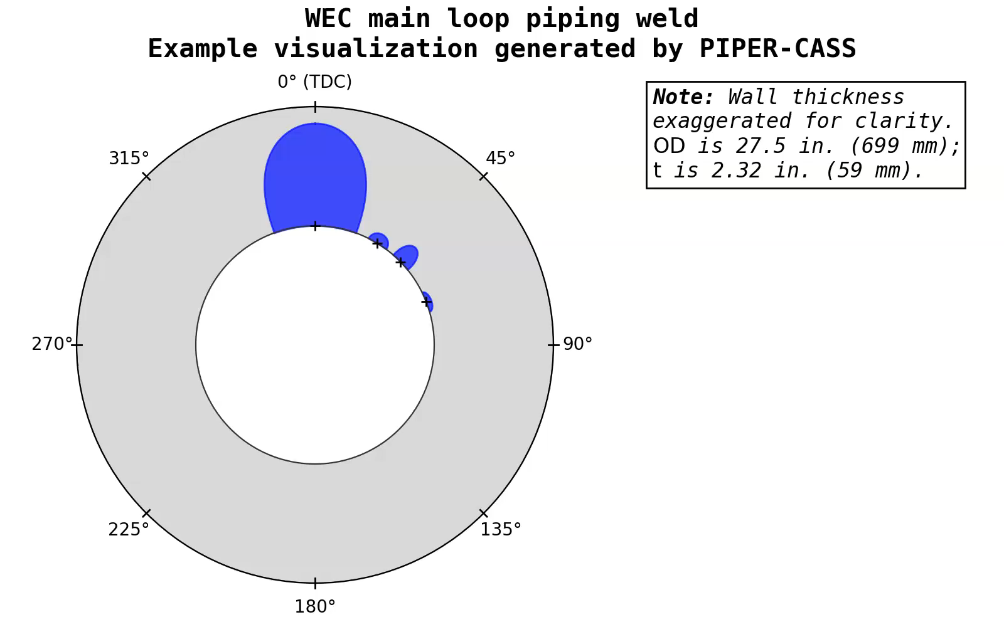
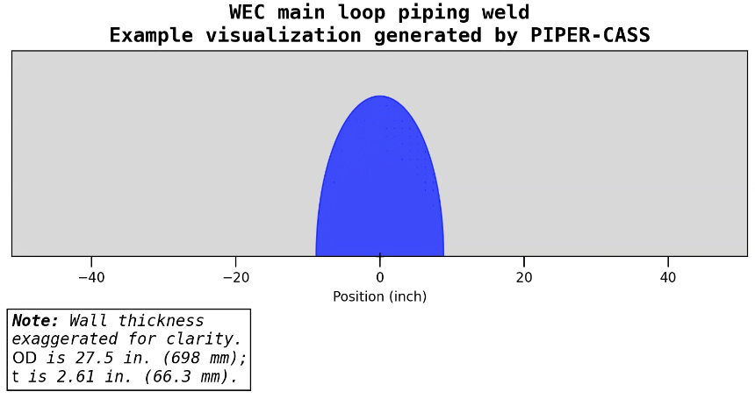
Key Features
Example Visualization of Individual Realization(s)
Realization visualizations available in rich output mode
Video representations can be generated post-hoc for individual realizations
The flaw state of each realization at the final timestep can also be plotted
Axial Flaw Case
Circumferential Flaw Case
Playable Video

Slide 14
Benchmarking versus xLPR
PIPER‑CASS automated test suite implements compatible test cases from xLPR modules
Developed input sets compatible with both xLPR and PIPER-CASS for benchmarking integrated codes
Achieved matching benchmark results
  Differences in submodule test cases dispositioned using debugging mode of IDE, comparing xLPR FORTRAN modules versus PIPER-CASS Python
  Differences in benchmarking dispositioned by halting xLPR at key timesteps to inspect variable values within GoldSim framework; compared to PIPER-CASS values via IDE debugging mode
  Submitted bugs identified in xLPR to xLPR program

Slide 15
Conclusions
Developed PFM code tailored for evaluation of CASS
  Enhanced EPFM stability solver for degraded toughness materials like thermally aged CASS
  Extension of EPFM stability checks to part-through-wall flaws
  Greater flexibility when defining operating transients, with integrated thermal stress solver
  Relationships included to reflect nature of variability in CASS material properties, including additional correlation parameters
Reasonable runtimes for matrix of cases at 10⁶ or 10⁷ realizations achieved using multiprocessing and batch execution, including for cloud computing deployment
Automatic visualizations and plain-text diagnostic/error messages
  Visualizations of results and intermediate values (like transient stress plots)
Unified, text-based code structure facilitates version control and static code reviews
Successfully benchmarked versus xLPR

Slide 16

Questions/Comments/Feedback

