Slide 1
Characterization and Quantification of Uncertainties in Probabilistic Fracture Mechanics with Applications to Probability of Detection and Sizing of Flaws and Cracks
Mohammad Modarres
Presentation at the 3rd International Seminar on Probabilistic Methods for Nuclear Applications
22-24 October 2019
Rockville, Maryland, USA

Slide 2
Topics Covered: Back to Basics!
Definition of Probability and Uncertainty
Interpretation of Uncertainty: Frequentist vs. Bayesian
Uncertainty Representations
Examples in the Context of Probability of Detection (POD) and Sizing Flaws
Conclusion

Slide 3
Definition of Probability: Frequentist or Classical Viewpoint
Frequentist Probability: the relative number of occurrences of an event in a large number of identical and independent trials (i.e., assumes iid datasets).
Works well for an ensemble of repeated events, such as tossing a coin or failures of identical equipment, over many iid trials.
What about probability of unrepeatable events? For example, existence of intelligent life on another planet; or, rare and unidentical events (e.g., SGTR)
Where do we find an ensemble of those planets or steam generators?

Slide 4
Definition of Probability: Subjectivist or Bayesian Viewpoint
Subjectivist Probability: the degree of belief (or certainty) of an individual in the truth of a proposition.
Ideally rational individuals give the same subjective prior probabilities, considering the same information.
Data and information (evidence) objectively combined into posterior probabilities to continuously suppress the subjectivity of the prior.

Slide 5
Confidence Intervals: Classical Uncertainty Interpretation in Estimation
Frequentist confidence interval treats unknown parameters 𝜃 as fixed, and the ensemble (sample of the data) as random.
Interprets the confidence interval as a statistic of the sample.
For example with 95% confidence a frequentist expects 95% of the confidence intervals of the iid redrawn samples of the data would contain the true mean value of 𝜃.
Considering a set of detected flaws, the frequentist says that if for example you generate 99 more iid samples, 95 of those samples will contain the true mean flaw size, and 5 won’t.

Slide 6
Credibility Intervals: Bayesian Uncertainty Interpretation in Estimation
Bayesian interval (probability bounds) treat parameters 𝜃 as random and the data as fixed, and creates marginal distributions of 𝜃 given the dataset (or broadly the evidence).
For example, the 95% Bayesian interval is interpreted as the probability (i.e., 95%) that the true value of 𝜃 falls within the interval, given the dataset (evidence).
Considering the detected flaws and other related information, Rev. Bayes’ says: the likelihood that the interval contains the true model parameter is 95%.
Numerically speaking: the credibility interval (bound) corresponds exactly to the classical confidence interval, if the prior probability is entirely "uninformative”, albeit with different interpretations.

Slide 7
Confidence vs. Credibility Intervals
Let a 95% confidence interval (classical) for the mean flaw size given a random sample be (2.69, 6.04) mm:
  This does not say that 95% of flaws in the sample fall between 2.69 and 6.04 mm!
  Rather we are 95% confident that the average flaw size is between 2.69 and 6.04 mm.
Bayesian interpretation is more natural because we want to make a probability statement regarding the range of the true flaw sizes.

Slide 8
Confidence vs. Credibility Intervals (Cont.)
Confidence and credibility intervals in your uncertainty estimations are close, but mean different things.

Slide 9
Types of Uncertainty (Bayesian Viewpoints)
All uncertainties are epistemic (driven by lack of data and information)!
Some are irreducible despite observation of new information and data; we call them aleatory.
Epistemic uncertainties are reducible with new information and data.

Slide 10
Uncertainties in Probability of Detection Model
1
95%
Epistemic Uncertainty
Estimated through
Bayesian OR Classical
Intervals
mean
5%
POD
Aleatory Uncertainty
in form of a cumulative density
0
Flaw Length

Slide 11
Sources of Uncertainties in PFM
Aleatory Sources
Epistemic Sources
Epistemic Sources
Mathematical form
Model Parameters
Model Error
Model Completeness
Estimate uncertain Input Datasets and Information
Estimate Uncertain Model Outputs

Slide 12

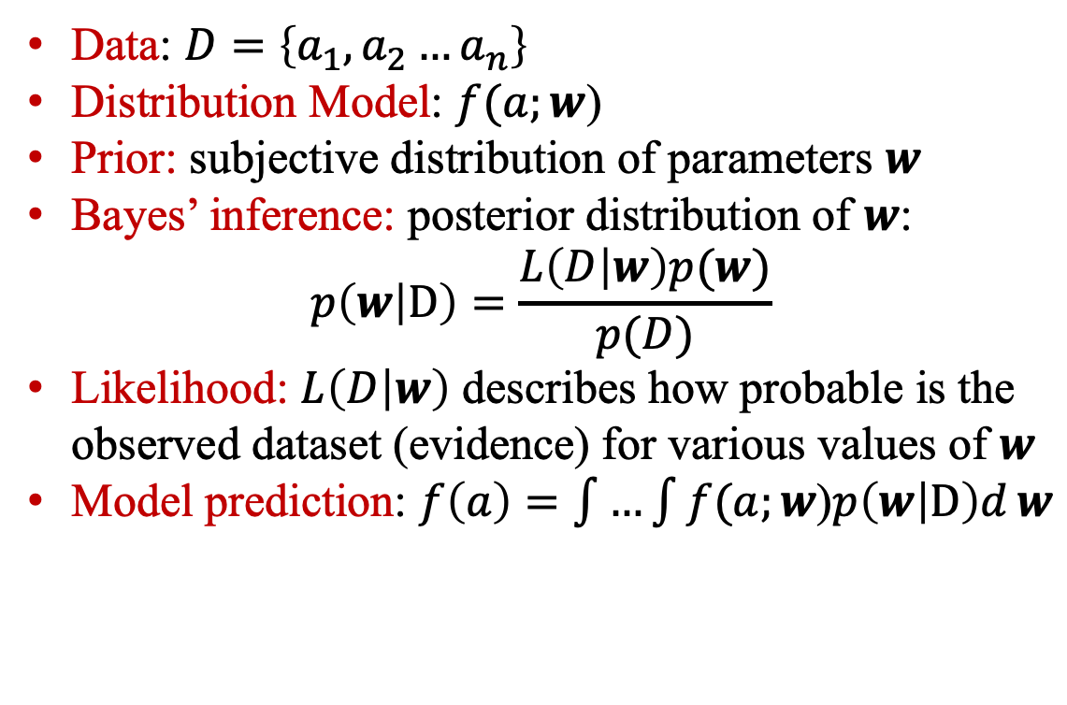
Uncertainty Estimation: MLE and Bayesian
Data: $D=\left\{a_{1}, a_{2}…a_{n}\right\}$
Distribution Model: $f(a;w$)
Prior: subjective distribution of parameters $w$
Bayes’ inference: posterior distribution of $w$:
$$p\left(w | D\right)=\frac{L\left(D | w\right)p(w)}{p(D)}$$
Likelihood: $L\left(D | w\right)$ describes how probable is the observed dataset (evidence) for various values of $w$
Model prediction: $f\left(a\right)=\int{…\int{f(a;w\text{)}p\left(w | D\right)d}}w$
$$ε$$

Slide 13
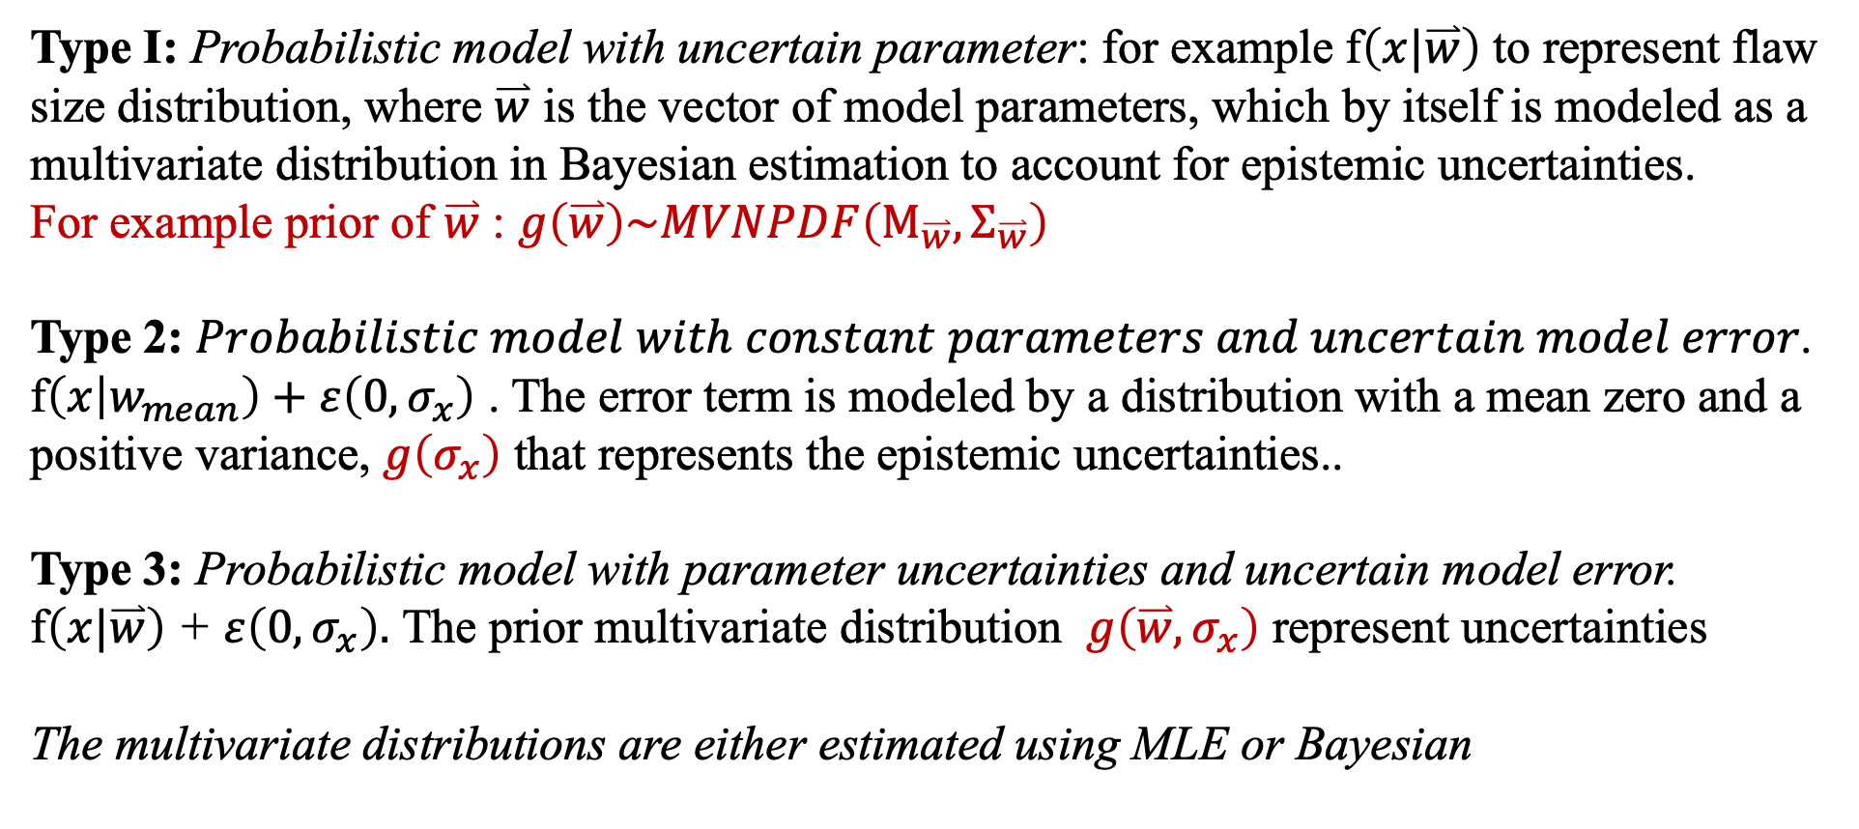
Three Probabilistic Model Development Types
Type I: Probabilistic model with uncertain parameter: for example f$\left(x|\overset{⃑}{w}\right)$ to represent flaw size distribution, where $\overset{⃑}{w}$ is the vector of model parameters, which by itself is modeled as a multivariate distribution in Bayesian estimation to account for epistemic uncertainties.
For example prior of $\overset{⃑}{w}$ : $g\left(\overset{⃑}{w}\right)\sim MVNPDF\left(Μ_{\overset{⃑}{w}},Σ_{\overset{⃑}{w}}\right)$
Type 2: 𝑃𝑟𝑜𝑏𝑎𝑏𝑖𝑙𝑖𝑠𝑡𝑖𝑐 𝑚𝑜𝑑𝑒𝑙 𝑤𝑖𝑡ℎ 𝑐𝑜𝑛𝑠𝑡𝑎𝑛𝑡 𝑝𝑎𝑟𝑎𝑚𝑒𝑡𝑒𝑟𝑠 𝑎𝑛𝑑 𝑢𝑛𝑐𝑒𝑟𝑡𝑎𝑖𝑛 𝑚𝑜𝑑𝑒𝑙 𝑒𝑟𝑟𝑜𝑟.
f$\left(x | w_{mean}\right)+ε\left(0,σ_{x}\right)$ . The error term is modeled by a distribution with a mean zero and a positive variance, $g\left(σ_{x}\right)$ that represents the epistemic uncertainties..
Type 3: Probabilistic model with parameter uncertainties and uncertain model error.
f$\left(x|\overset{⃑}{w}\right)$ + $ε\left(0,σ_{x}\right).$ The prior multivariate distribution $g\left(\overset{⃑}{w},σ_{x}\right)$ represent uncertainties
The multivariate distributions are either estimated using MLE or Bayesian

Slide 14
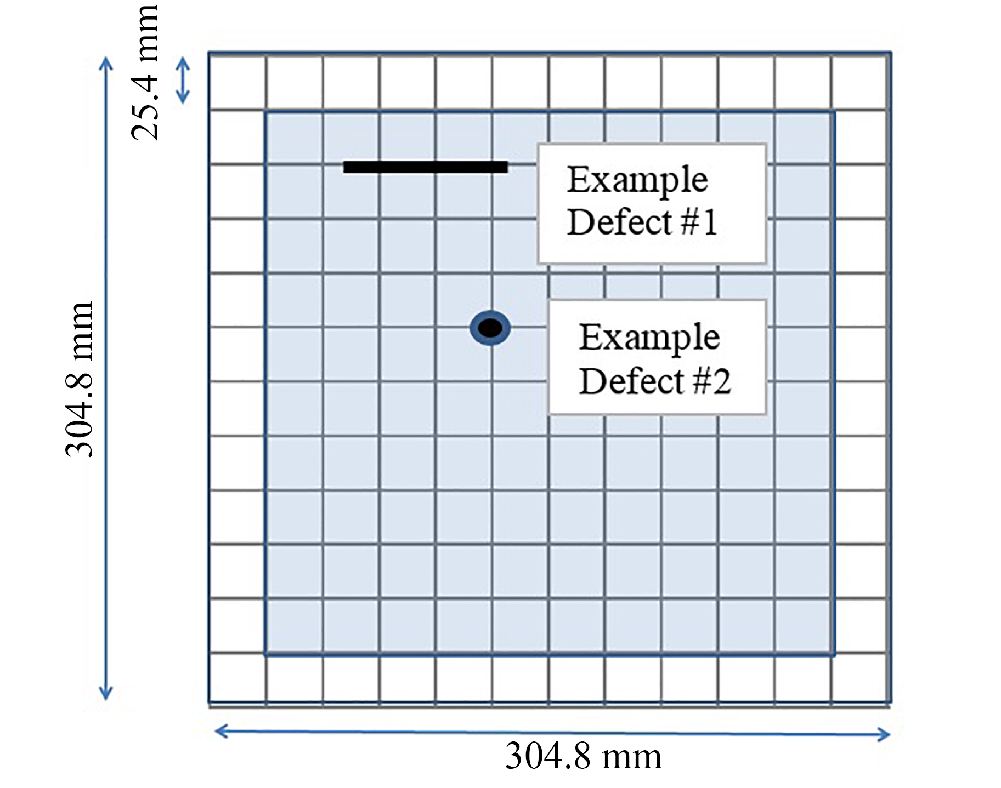
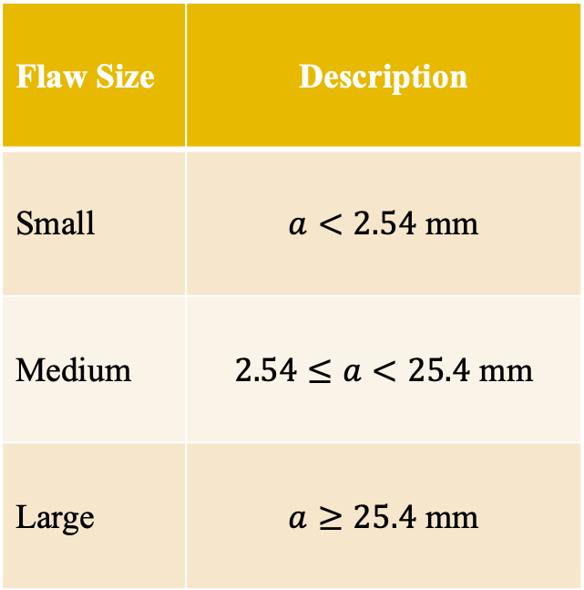
POD: Definition of Data and Terms
Flaw Sizing Classification
Flaw Size | Description
Small | $a<2.54$ mm
Medium | $2.54≤a<25.4$ mm
Large | $a≥25.4$ mm
89 Detected Flaws
17
21
51
A diagram of a test panel with two types/sizes of defects (Barrett, Smith, & Modarres 2018)

Slide 15
Partial List of the Detection and Sizing Data
Test No. | Measured (in) | True (in) | Detected
19 | 2.9 | 2.8 | 1
20 | 0.3 | 2.25 | 1
21 | 4.3 | 4.25 | 1
22 | 0.2 | 0.03 | 1
23 | 0 | 0.03 | 0
24 | 0 | 0.03 | 0
25 | 0.2 | 0.03 | 1
26 | 1 | 1 | 1
27 | 0 | 0.03 | 0
28 | 3.25 | 3.15 | 1
29 | 0.5 | 0.125 | 1
30 | 4 | 4 | 1
31 | 1.5 | 1.4 | 1
32 | 0.25 | 0.25 | 1
33 | 3 | 3 | 1

Slide 16
Distribution of Measured Flaw Sizes

Slide 17
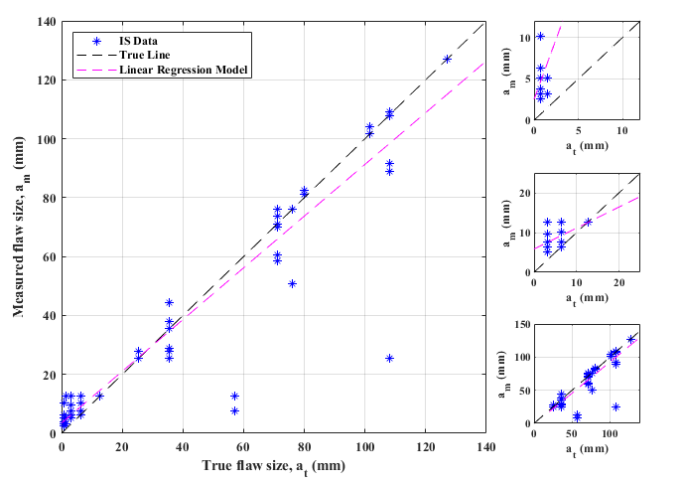
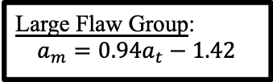
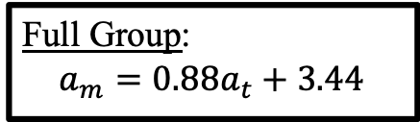
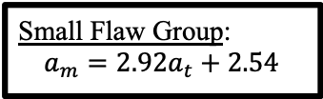
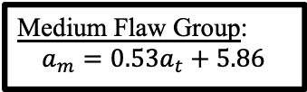
Data Variability Flaw Sizing
Full Group:
$$a_{m}=0.88a_{t}+3.44$$
Small Flaw Group:
$$a_{m}=2.92a_{t}+2.54$$
Medium Flaw Group:
$$a_{m}=0.53a_{t}+5.86$$
Large Flaw Group:
$$a_{m}=0.94a_{t}−1.42$$

Slide 18
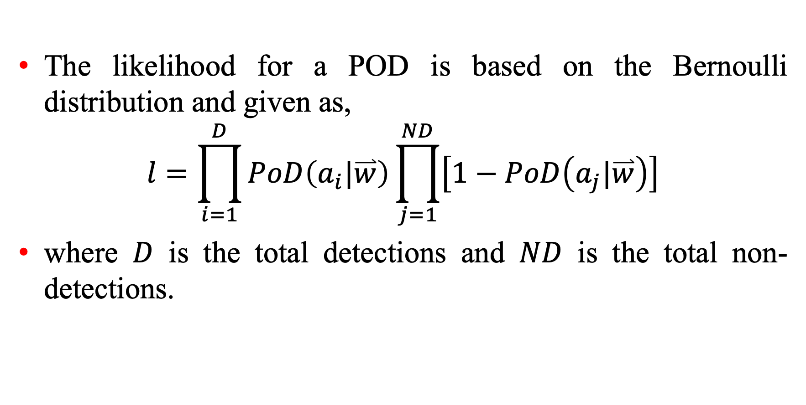
Bayesian Estimation: Likelihood Definition for POD
The likelihood for a POD is based on the Bernoulli distribution and given as,
$$l=\prod_{i=1}^{D}{PoD\left(a_{i}|\overset{⃑}{w}\right)}\prod_{j=1}^{ND}{\left[1−PoD\left(a_{j}|\overset{⃑}{w}\right)\right]}$$
where $D$ is the total detections and $ND$ is the total non-detections.

Slide 19
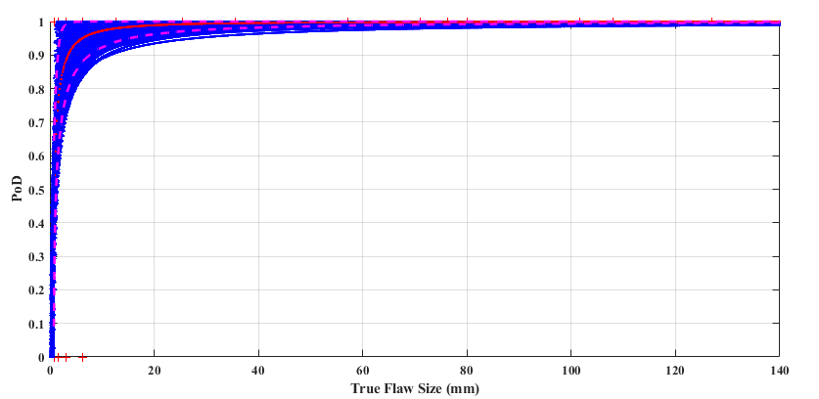
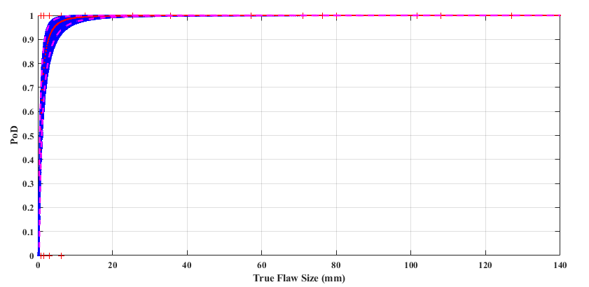
POD Uncertainty: MLE vs. Bayesian Estimates
Lognormal
Type I Model

Slide 20
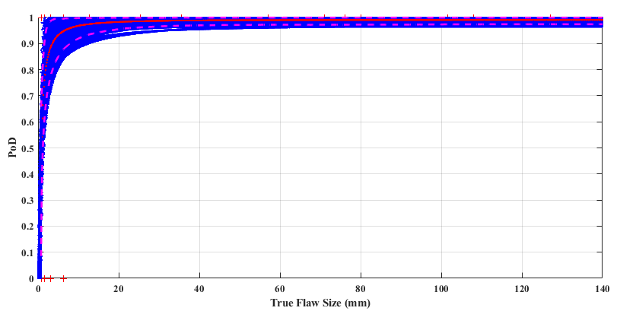
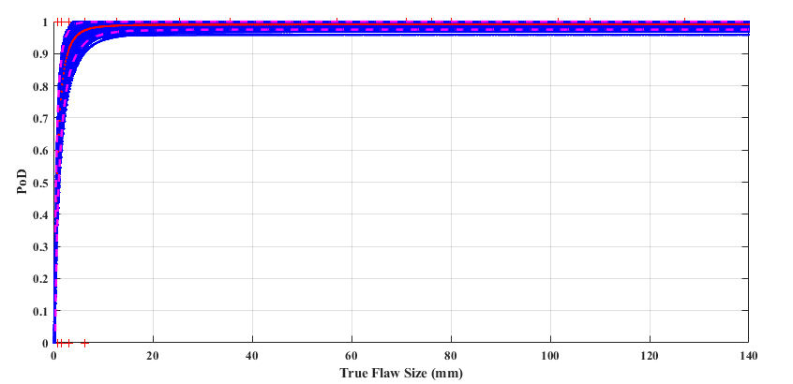
POD Uncertainty: MLE vs. Bayesian Estimates
Lognormal
Type III:
Model &
Parameter

Slide 21
Conclusion
Mix-up in the definition of probability and interpretation of uncertainty in the frequentist vs. Bayesian estimation in engineering applications persists
More work in this area is warranted, if PFM is to be extensively used in regulatory and safety improvement arenas
PFM analysts should better communicate the meaning of their results to stakeholders for better acceptance and credibility

Slide 22
Thank you

