Slide 1
Epistemic and Aleatory Uncertainty Quantification of Fatigue Crack Growth Analysis
John McFarland and Erin DeCarlo
October 23, 2019

Slide 2
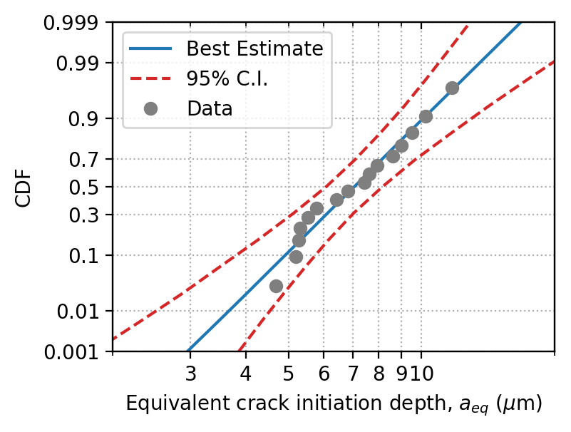

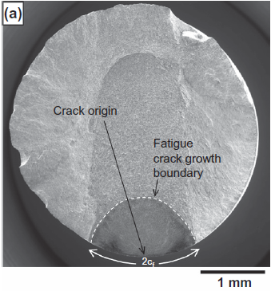
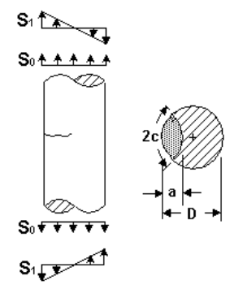
Outline and objectives
Influence of limited data for determining input distributions
Methods for separating and combining epistemic/aleatory uncertainty in probabilistic analysis
  Enhancements to NESSUS® software
Demonstration using probabilistic fatigue crack growth analysis

Slide 3
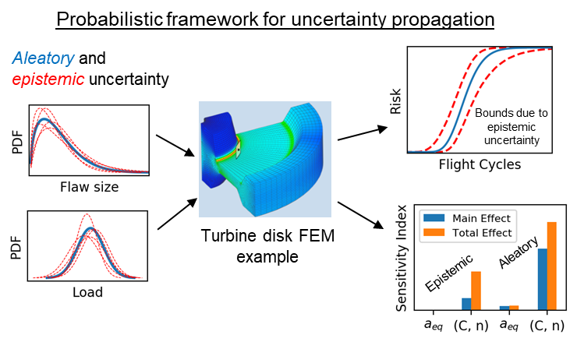
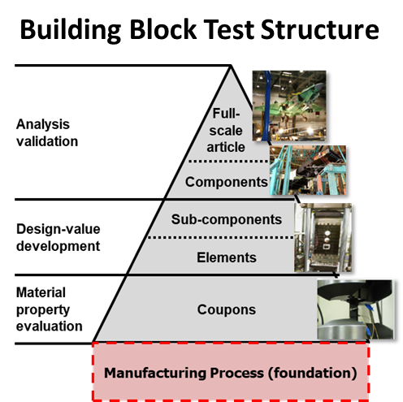
Background and motivation
Two related efforts focused on development of methods and tools for quantification of multiple uncertainty types
2.5-year program with AFRL and turbine engine consortium
  Epistemic and aleatory uncertainty quantification for turbine engine lifing applications
4-year DARPA Open Manufacturing program
  Framework for rapid qualification of new materials and manufacturing processes

Slide 4
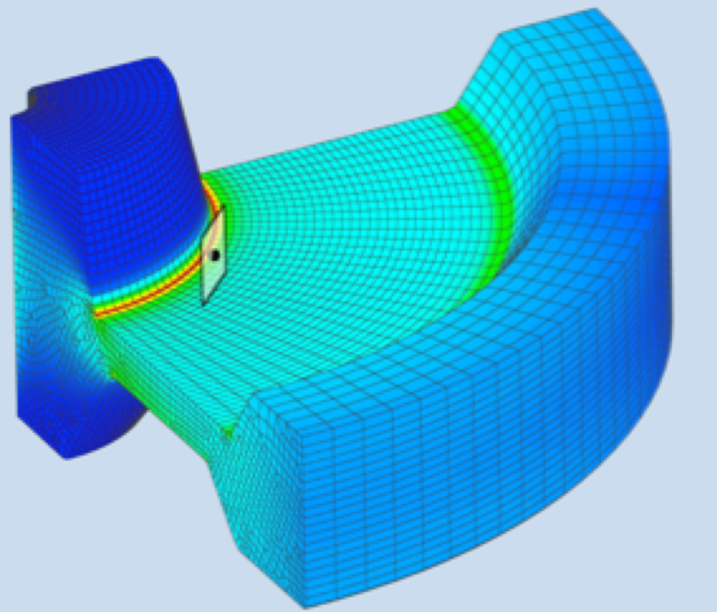
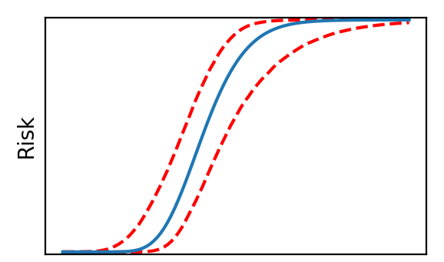
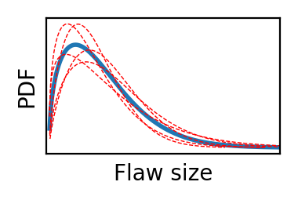
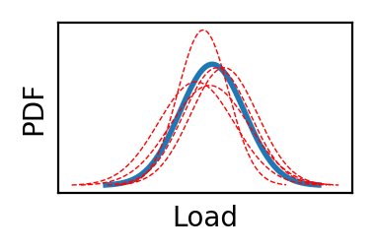
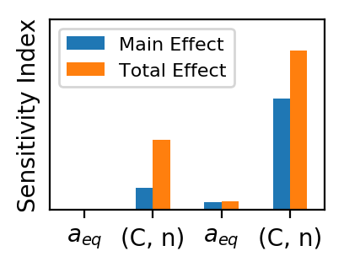
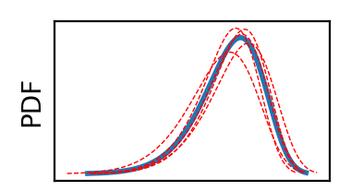
Probabilistic analysis with multiple uncertainty types
Model Inputs
Model
Performance
Uncertainties:
Aleatory (scatter)
Epistemic (knowledge)
Deterministic model
(e.g., life prediction)
Predicted life, with quantified uncertainty and sensitivity
Design life
Bounds due to epistemic uncertainty
Life
Example finite element model
Approach
Aleatory
Probabilistic modeling of inputs to separate aleatory and epistemic uncertainty
Double-loop sampling to propagate inputs through deterministic model
Variance-based sensitivity analysis to identify key drivers for reducible uncertainty
Epistemic
Material Properties
Example variables shown for illustration

Slide 5
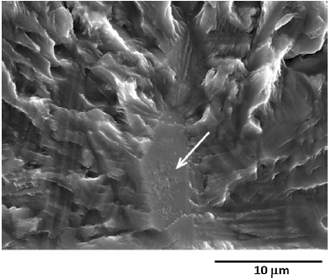
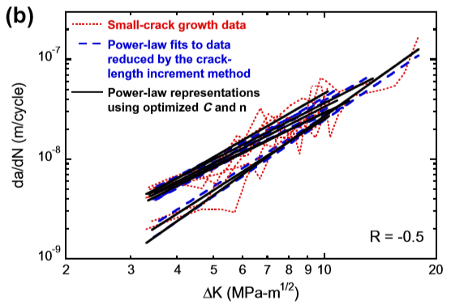
Small fatigue crack growth:
Problem definition
NASGRO K solution for surface crack (SC07)
Published experimental data
  Ti-6Al-2Sn-4Zr-6Mo
  Round-bar geometry with micro-notch
Uncertain variables
  Equivalent crack initiation depth
    Based on 16 experimental measurements
  Crack growth rate parameters (C, n)
    Based on reported C, n values from 7 fatigue tests
Crack growth analysis set up using NASGRO® software
Jha et al. (2013)
(a)
Example crack initiation site
Jha et al. (2013)
S. Jha, R. John, and J. Larsen. Incorporating small fatigue crack growth in probabilistic life prediction: Effect of stress ratio in Ti-6Al-2Sn-4Zr-6Mo. International Journal of Fatigue 51, pp. 83-95, 2013.
Notes:
Small crack behavior of interest because it drives life-limiting behavior and exhibits increased specimen-to-specimen variability

Slide 6
Demonstration goals
Objectives:
  Quantify aleatory and epistemic uncertainty in:
    Initial flaw size
    Crack growth rate parameters (C, n)
  Compute probabilistic response for crack growth life (risk) with quantified confidence
  Quantify relative effects of limited data for flaw size and crack growth rate
Questions:
  Should more data be collected for initial flaw size?
  Should more data be collected for crack growth rate?
NASGRO K solution for surface crack (SC07)
Jha et al. (2013)
(a)
Example crack initiation site
Jha et al. (2013)

Slide 7
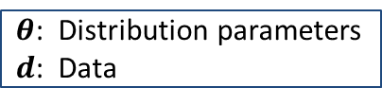
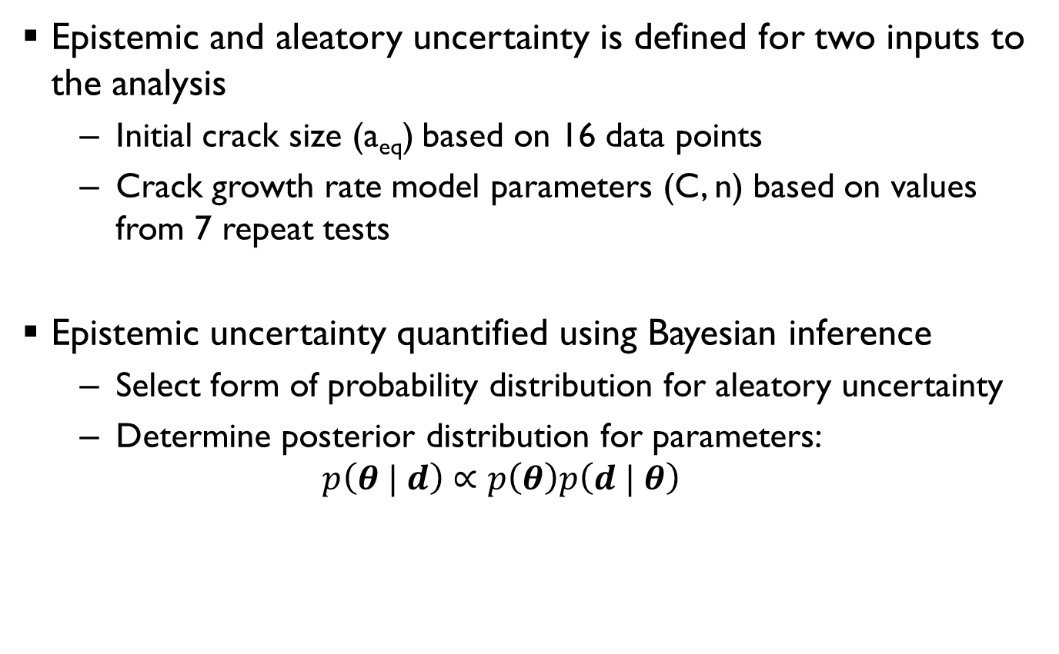
Step 1: Define uncertainty models for inputs
Epistemic and aleatory uncertainty is defined for two inputs to the analysis
  Initial crack size (a_{eq}) based on 16 data points
  Crack growth rate model parameters (C, n) based on values from 7 repeat tests
Epistemic uncertainty quantified using Bayesian inference
  Select form of probability distribution for aleatory uncertainty
  Determine posterior distribution for parameters:
  $p\left(θ | d\right)∝p\left(θ\right)p\left(d | θ\right)$
$θ$: Distribution parameters
$d$: Data
Posterior
Prior
Likelihood

Slide 8
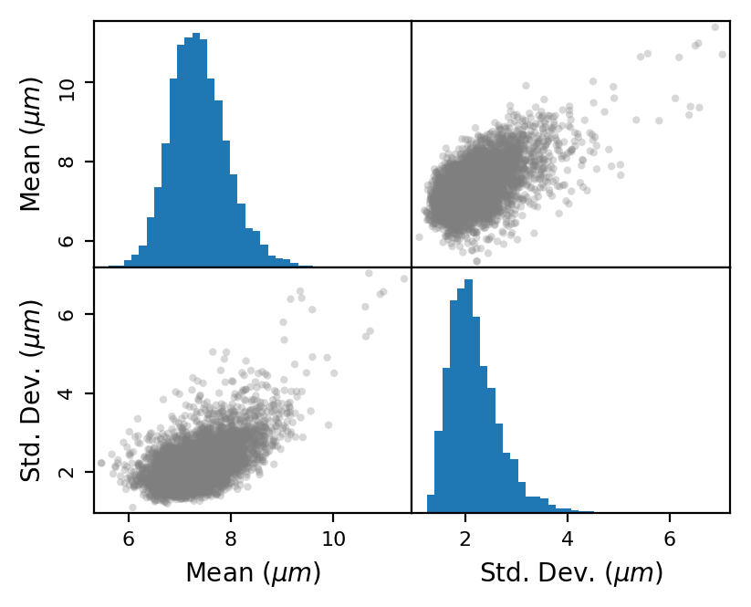
Probabilistic model for initial crack size
Modeled aleatory and epistemic uncertainty based on 16 data points
Used lognormal probability distribution
  Epistemic uncertainty in mean and std. dev. based on available data
Epistemic Uncertainty on a_{eq}
Distribution Parameters
CDF of a_{eq} with Bounds due to Epistemic Uncertainty
Lognormal paper

Slide 9
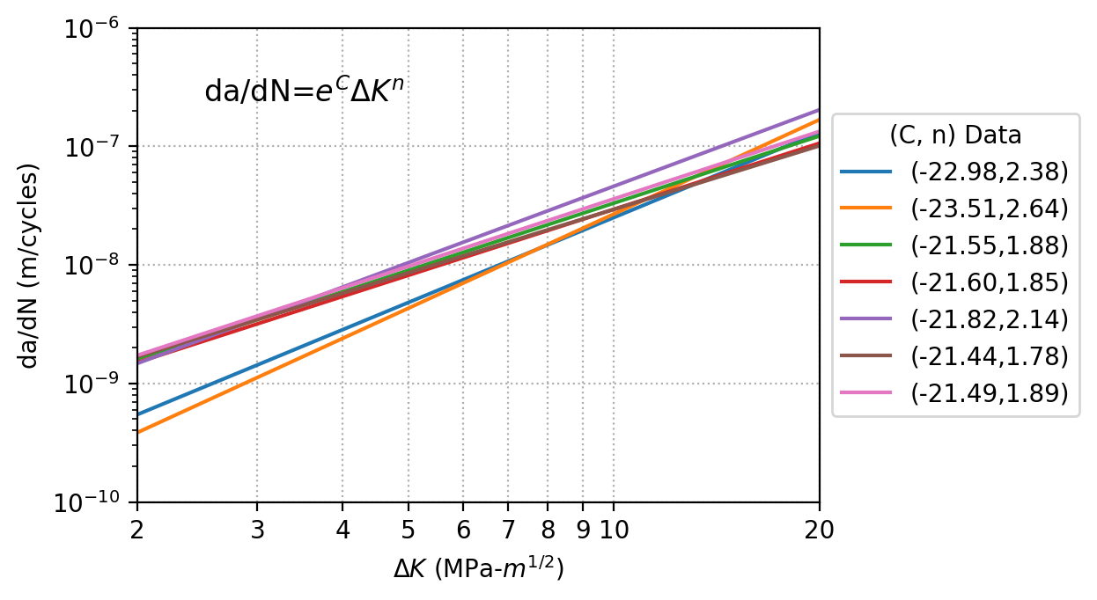
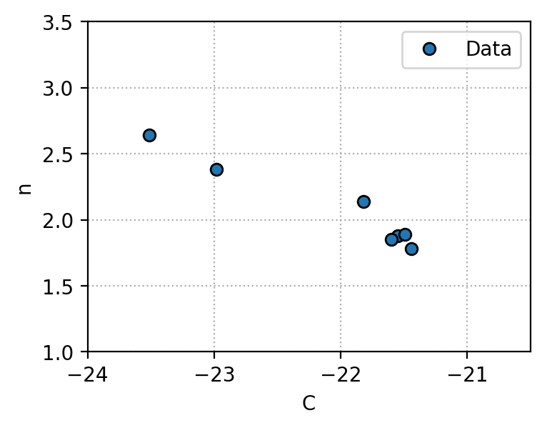
Crack growth rate data
Power-law model used to describe crack growth rate in terms of C and n parameters
Modeled aleatory and epistemic uncertainty in joint distribution for (C,n) based on 7 data points
Used bivariate normal distribution and included uncertainty in correlation coefficient
Power-law representations for results from 7 crack growth tests
Observed scatter in crack growth rate model parameters

Slide 10
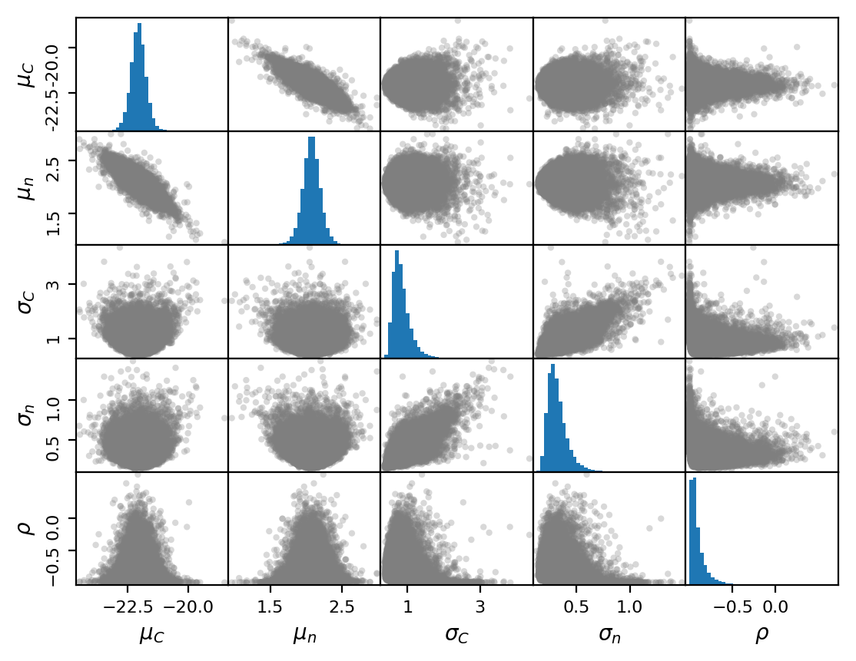
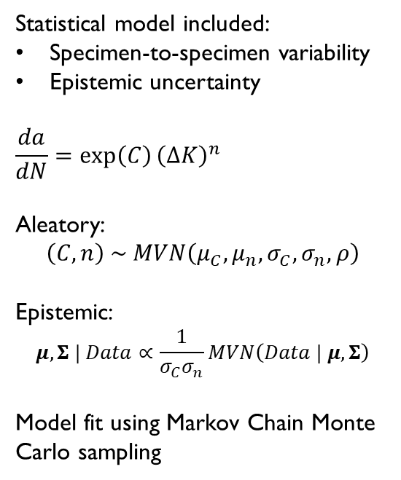
Uncertainty model for crack growth rate
Bayesian inference captured uncertainty in 5 distribution parameters based on observed data
Statistical model included:
Specimen-to-specimen variability
Epistemic uncertainty
$$\frac{da}{dN}=\exp\left(C\right){\left(ΔK\right)}^{n}$$
Aleatory:
$$\left(C,n\right) \sim MVN\left(μ_{C}, μ_{n}, σ_{C}, σ_{n}, ρ\right)$$
Epistemic:
$$μ,Σ | Data∝\frac{1}{σ_{C}σ_{n}}MVN\left(Data | μ, Σ\right)$$
Model fit using Markov Chain Monte Carlo sampling

Slide 11
Step 2: Create response surface model
Fast-running RSM enables large number of calculations needed for nested Monte Carlo and variance decomposition
Steps for RSM creation:
  Identify variables (a_{eq}, C, n)
  Define variable bounds for DOE
  Generate DOE points and run performance model to collect training data
    NESSUS automates this process (in our case, running NASGRO)
  Fit RSM and assess goodness of fit
    NESSUS and/or NESSUS Response Surface Toolkit

Slide 12
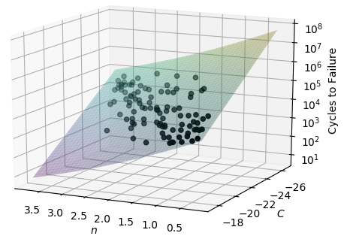
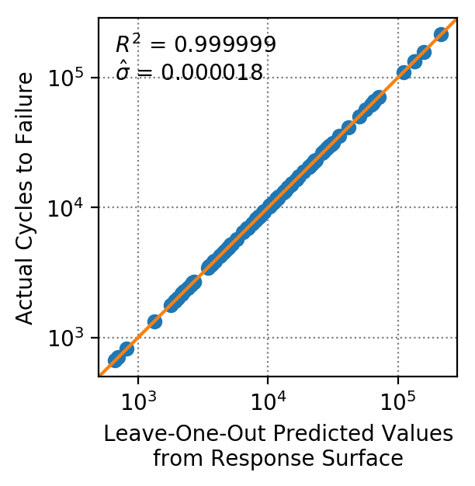
Response surface model
Used NESSUS to interface with NASGRO and perform a DOE with 100 cases
Fit resulting training data to a Gaussian Process model using NESSUS Response Surface Toolkit
RSM predicts cycles to failure based on 3 variables: a_{eq}, C, and n
Leave-one-out cross-validation
2-dimensional RSM slice for a_{eq}= 5μm

Slide 13
Step 3: Uncertainty propagation and sensitivity analysis
NESSUS is used to propagate the uncertainties in the 3 random variables through the response surface model
Predict CDF of crack growth life, with uncertainty bounds
Sensitivity analysis conducted in two ways:
  Sensitivity of probabilistic results (CDF) to epistemic uncertainties (i.e. where to collect more data)
  Relative sensitivity of performance (crack growth life) to aleatory and epistemic components of uncertainty

Slide 14
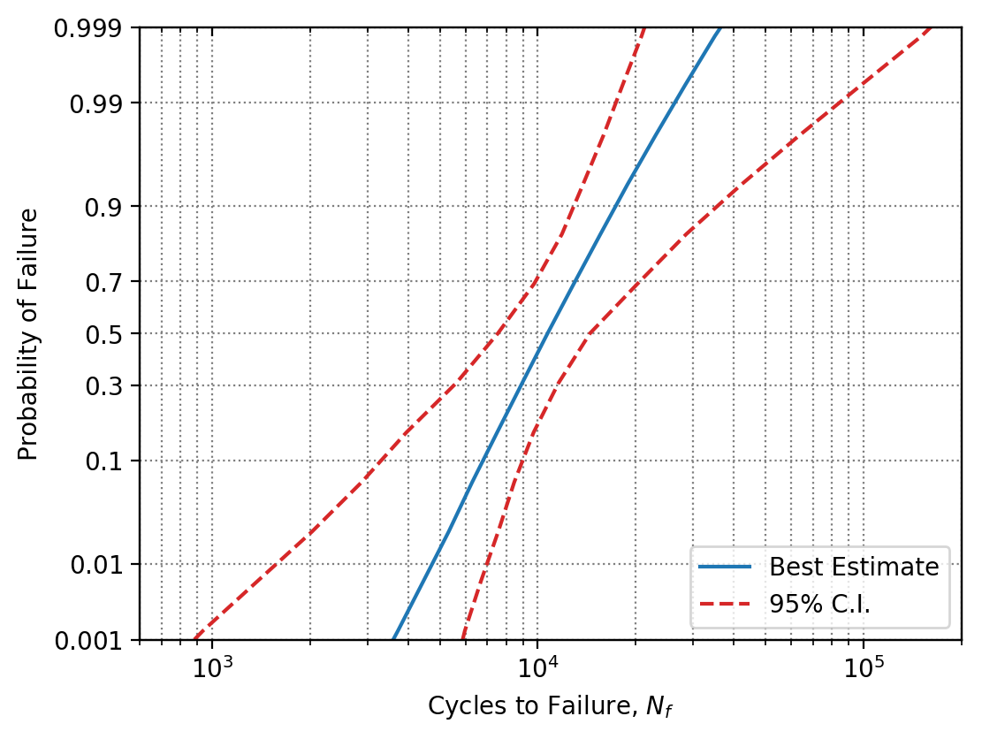
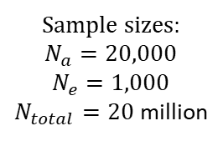
Computed probability distribution for crack growth life, with uncertainty bounds
Lognormal probability paper
Inherent variability in initial crack size and crack growth rate propagated through analysis
Confidence bounds show effect of epistemic uncertainty due to limited data
Sample sizes:
$$N_{a}=20,000$$
$$N_{e}=1,000$$
$N_{total}=20$ million

Slide 15
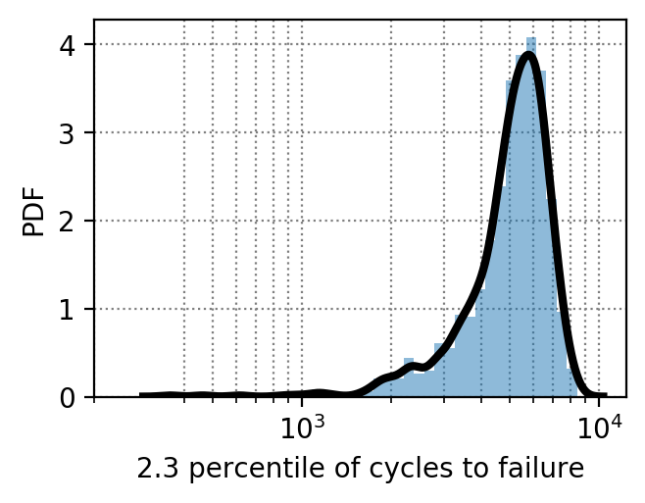

Sensitivity to epistemic uncertainties
What new data should be collected to reduce uncertainty?
NESSUS can isolate the effect of the epistemic uncertainties with respect to any probability point on the CDF
Here, sensitivities computed with respect to the “minus 2 sigma” value of crack growth life
$$N_{f,2.3}=f\left(μ_{a},σ_{a},μ_{C},μ_{n},σ_{C},σ_{n},ρ_{C,n}\right)$$
Crack size
Crack growth rate properties

Slide 16
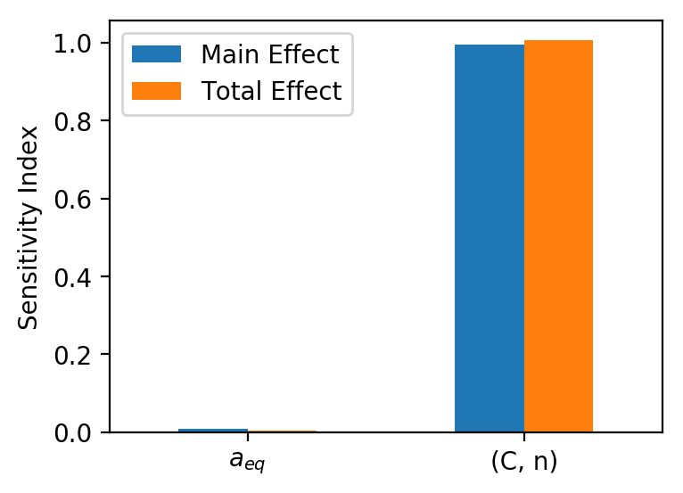
Sensitivity to epistemic uncertainties
What new data should be collected to reduce uncertainty?
Epistemic uncertainty in the crack growth rate parameters is the main driver. Additional data on initial crack size would have negligible impact.
$$N_{f,2.3}=f\left(μ_{a},σ_{a},μ_{C},μ_{n},σ_{C},σ_{n},ρ_{C,n}\right)$$
Crack size
Crack growth rate properties
J. McFarland, Variance decomposition for statistical quantities of interest, Journal of Aerospace Information Systems 12 (1) (2015) 204-218.

Slide 17
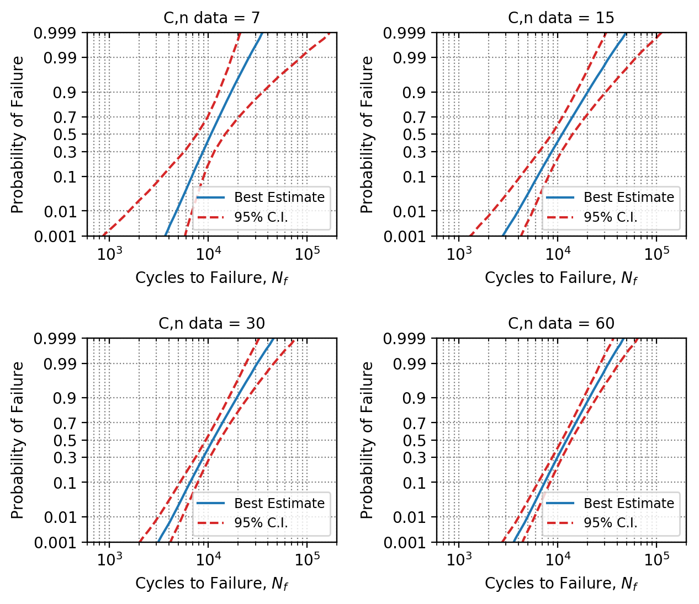
Uncertainty reduction scenario study (1)
(a)
(b)
Demonstration of effect of hypothetical new data for CG rate
(c)
(d)
Validate conclusions from sensitivity analysis that primary source of uncertainty is CG rate

Slide 18
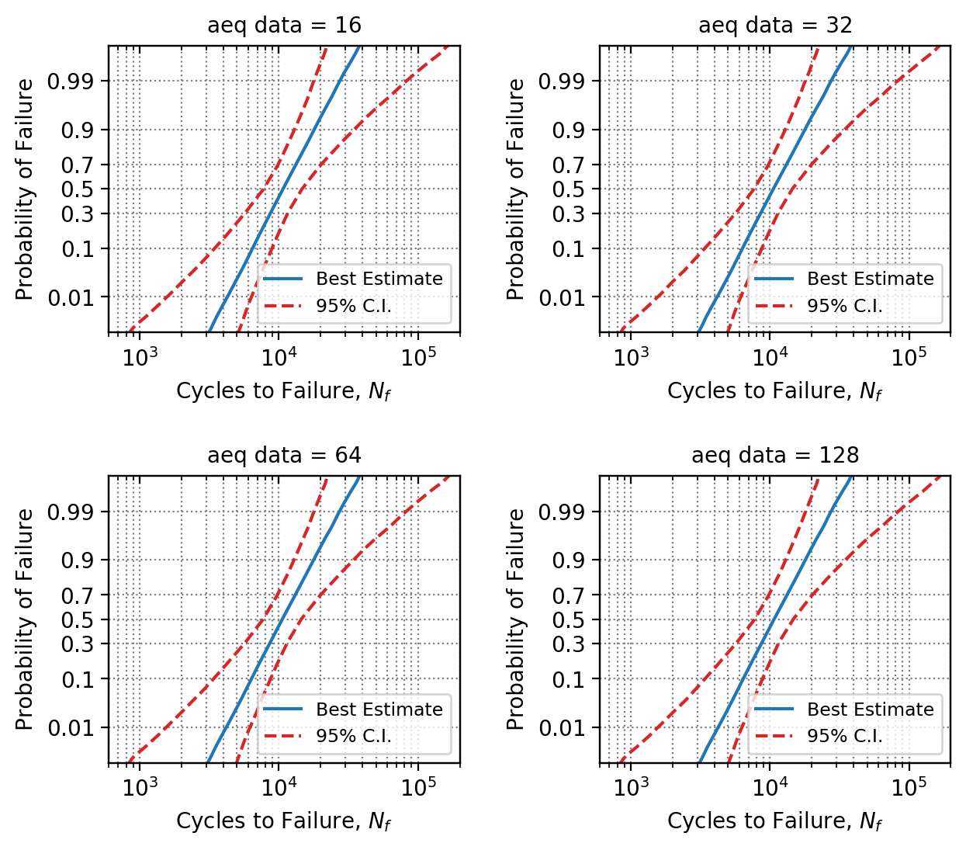
Uncertainty reduction scenario study (2)
(a)
(b)
Demonstration of effect of hypothetical new data for crack size
(c)
(d)
Validate conclusions from sensitivity analysis that epistemic uncertainty in crack size not important

Slide 19
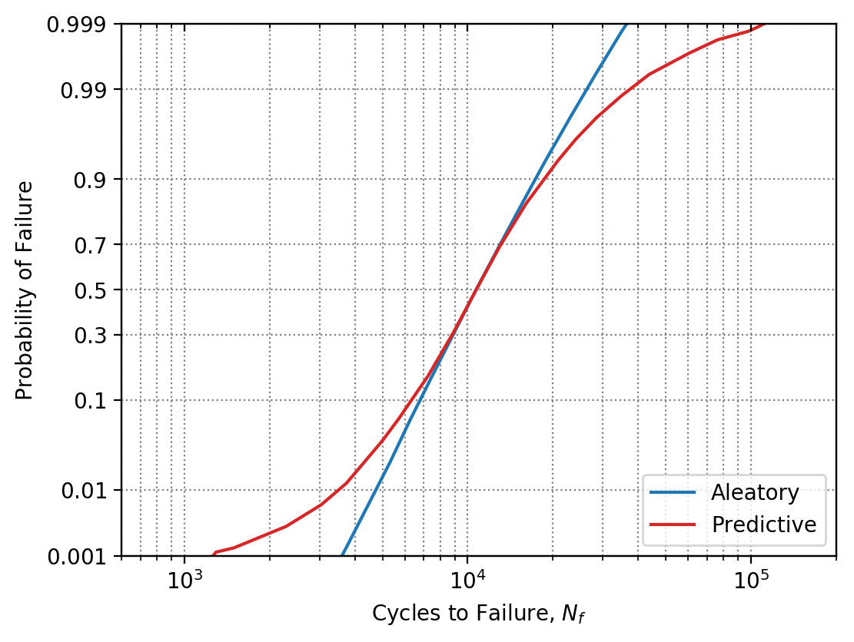

“Predictive” distribution shows combined influence of both uncertainty types
NESSUS can compute a single CDF called the “Predictive distribution”
This CDF reflects the effect of both aleatory and epistemic uncertainties in the crack growth life predictions
Requires only “single-loop” Monte Carlo:
$$N=20,000$$
Combined effect of aleatory and epistemic uncertainty

Slide 20
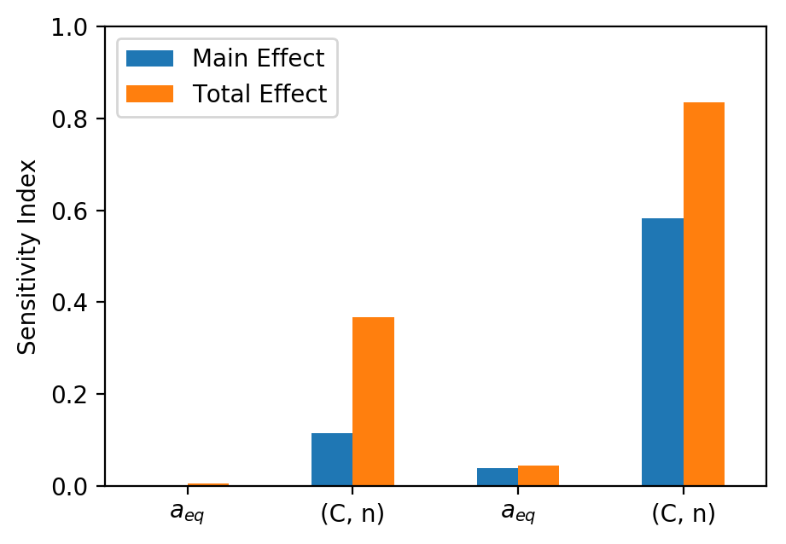
Relative sensitivities of both uncertainty types
NESSUS can also analyze relative contributions of both uncertainty types in predictive distribution
In this example, inherent variability in crack growth rate is primary driver
But, epistemic uncertainty is also contributing
Aleatory
Epistemic
S. Sankararaman, S. Mahadevan, Separating the contributions of variability and parameter uncertainty in probability distributions, Reliability Engineering & System Safety 112 (2013) 187-199.

Slide 21
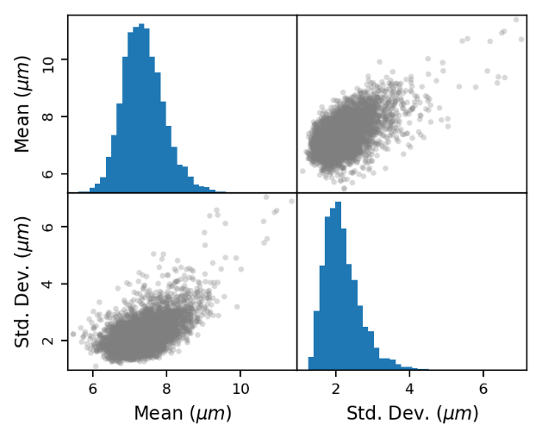


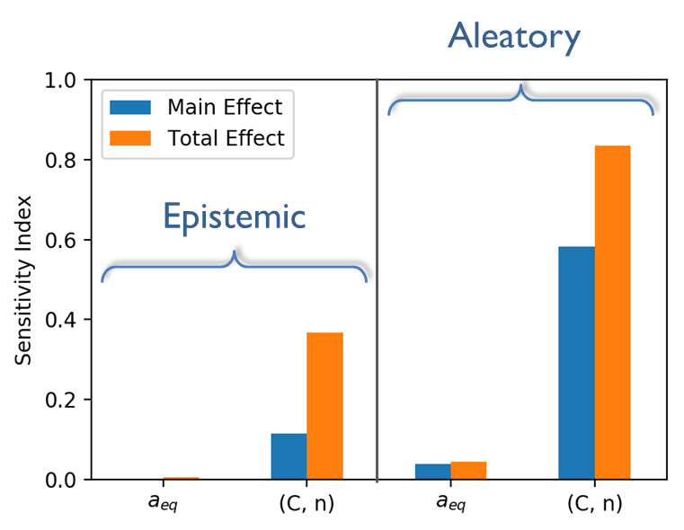
Summary
Probability distribution parameter uncertainty
Integrated computational tools
Initial crack size
Probabilistic results with quantified uncertainty
Novel variance decomposition to separate uncertainty types
Contact: john.mcfarland@swri.org

Slide 22
Appendix

Slide 23
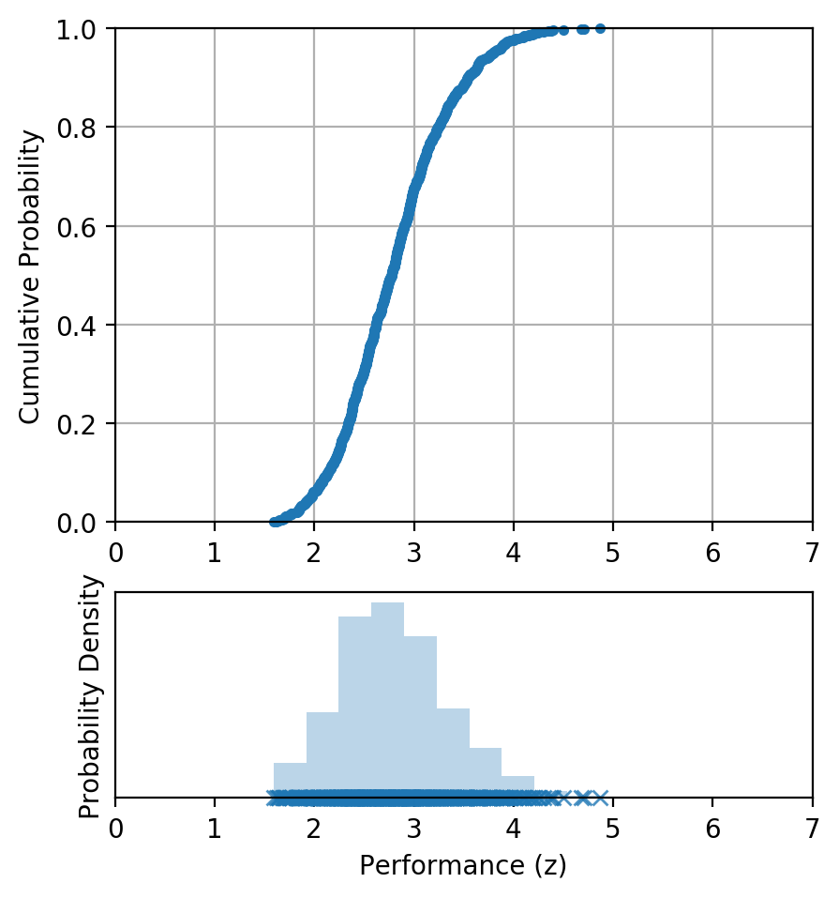


Monte Carlo simulation
Performance function
$$z=f\left(x\right)$$
j = 1 to N
Aleatory: $x_{j}$
MC simulation propagates aleatory uncertainty in model input variables
But this assumes that we know the statistical properties of the input variables (epistemic uncertainty is ignored)…

Slide 24
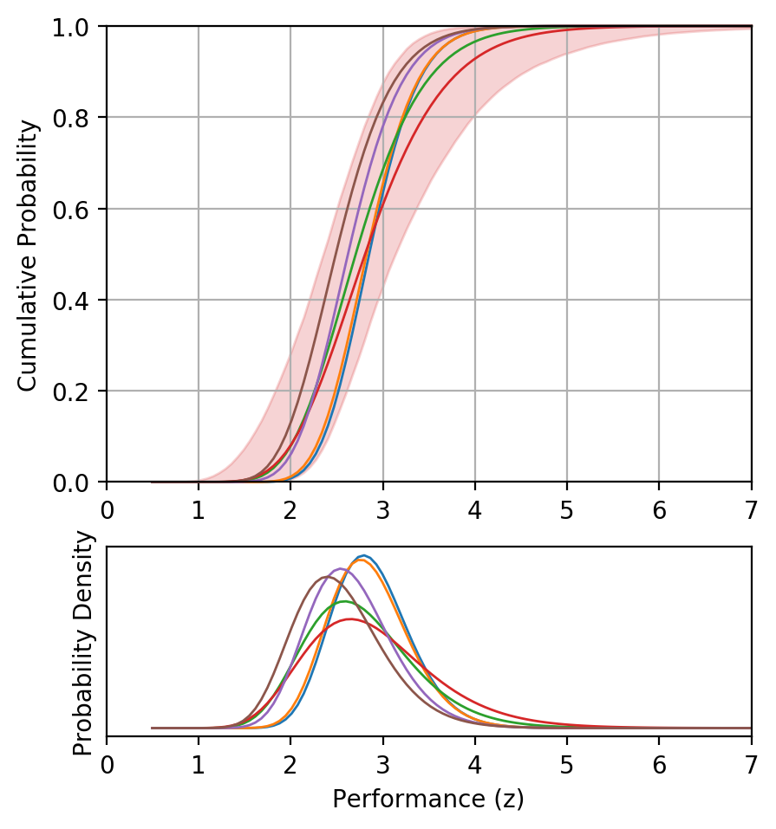



Double-loop uncertainty propagation
Performance function
Uncertainty in performance for given probability
$$z=f\left(x\right)$$
Uncertainty in probability for given performance
j = 1 to N_inner
Aleatory: $x_{j} | μ_{i}, σ_{i}$
i = 1 to N_outer
Epistemic: $μ_{i}, σ_{i}$
Nested Monte Carlo approach quantifies confidence in predictions by separating the effects of aleatory and epistemic uncertainty

Slide 25
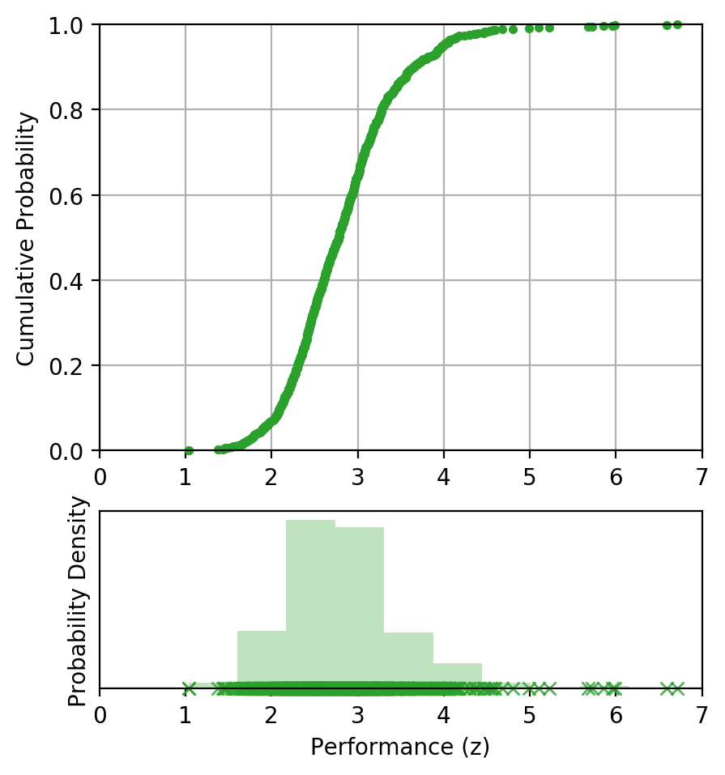



Mixed-loop uncertainty propagation
“Predictive” distribution
Performance function
$$z=f\left(x\right)$$
(a)
Aleatory
Epistemic
i = 1 to N
Aleatory: $x_{i} | μ_{i}, σ_{i}$
Epistemic: $μ_{i}, σ_{i}$
“Mixed-loop” approach combines both uncertainty types into a single probabilistic prediction
(a)
“Auxiliary variable” approach allows evaluation of relative contributions of aleatory and epistemic uncertainty

Slide 26
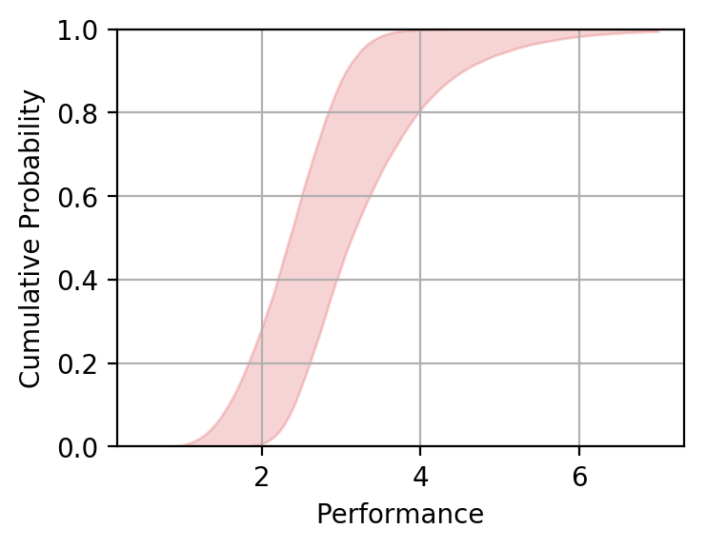
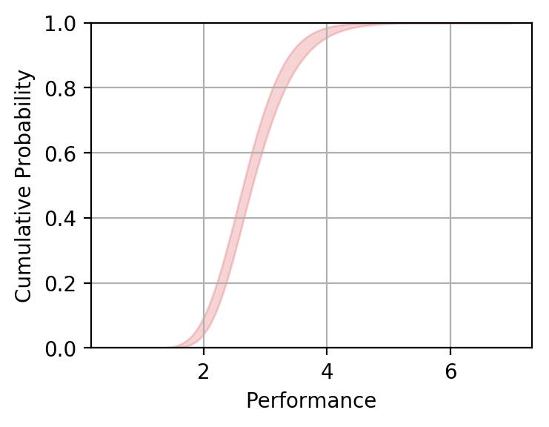
Sensitivity analysis for uncertainty reduction
(a)
(b)
Goal: Identify what new data are needed in order to most efficiently reduce epistemic uncertainty
Example: Have 100 data points for initial flaw size and 20 data points for material properties. What additional data should be collected?
Approach: Novel application of variance decomposition to isolate epistemic uncertainties in probabilistic predictions
J.M. McFarland. "Variance Decomposition for Statistical Quantities of Interest", Journal of Aerospace Information Systems, Vol. 12, Special Section on Uncertainty Quantification (2015), pp. 204-218.

Slide 27
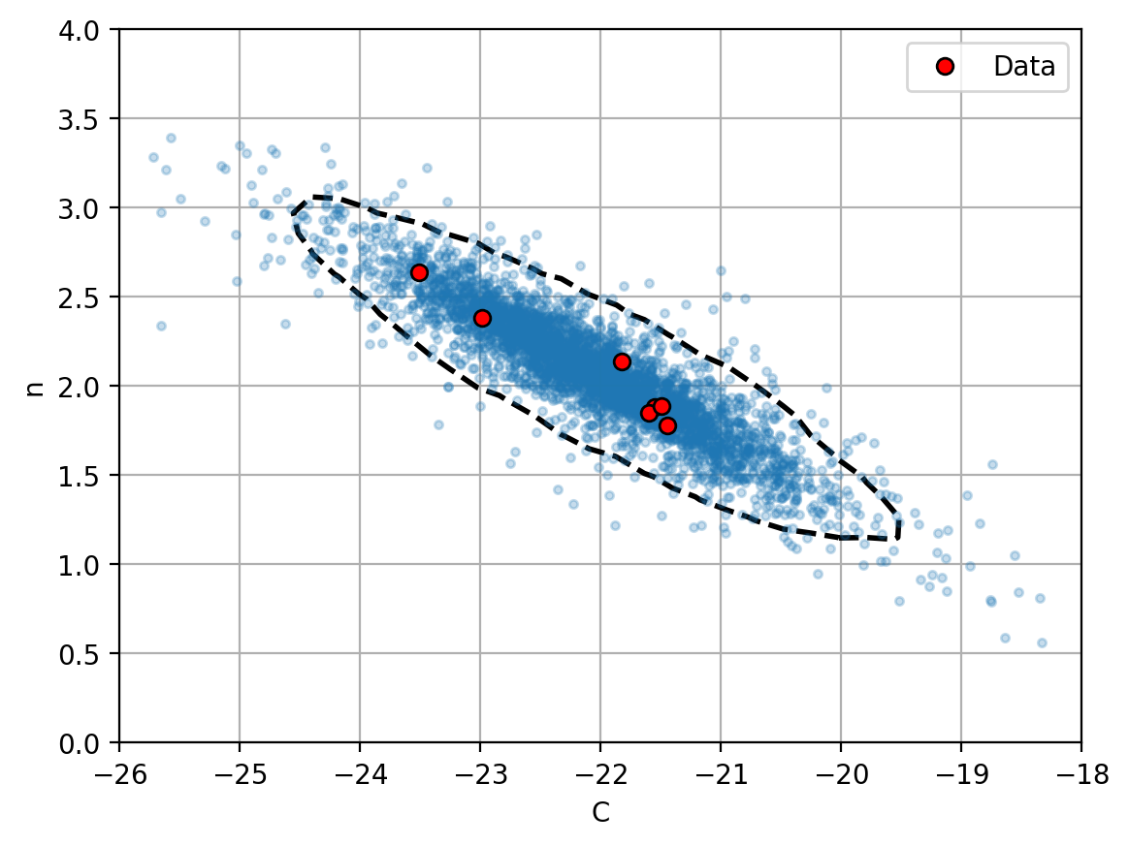
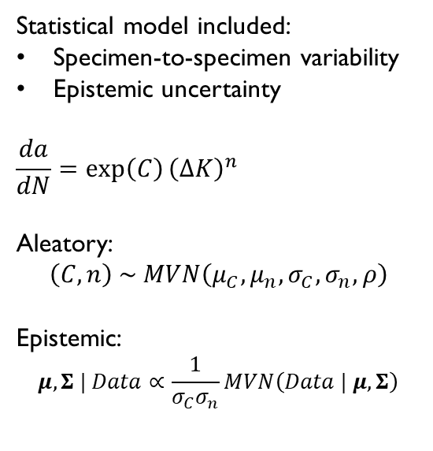
Crack growth rate UQ
Statistical model included:
Specimen-to-specimen variability
Epistemic uncertainty
$$\frac{da}{dN}=\exp\left(C\right){\left(ΔK\right)}^{n}$$
Aleatory:
$$\left(C,n\right) \sim MVN\left(μ_{C}, μ_{n}, σ_{C}, σ_{n}, ρ\right)$$
Epistemic:
$$μ,Σ | Data∝\frac{1}{σ_{C}σ_{n}}MVN\left(Data | μ, Σ\right)$$
Monte Carlo samples and density contours for posterior predictive distribution
(aleatory + epistemic uncertainty)

