Slide 1
PFM analysis code PASCAL-SP for aged piping -New probabilistic evaluation model of weld residual stress-
J. Katsuyama, A. Mano, Y. Yamaguchi, Y. Li
Japan Atomic Energy Agency (JAEA)
3rd International Seminar on Probabilistic Methodologies for Nuclear Applications
(3rd ISPMNA), Oct. 22~24, 2019, Rockville, MD, US

Slide 2
Overview of PFM analysis code PASCAL-SP
PASCAL-SP can evaluate failure probability of pipe considering ageing degradation such as SCC and fatigue.
Target pipes and aging degradation mechanisms
Low carbon stainless steel pipe in BWR water environment: IGSCC*, Fatigue
Ni-based alloy dissimilar weld joint: PWSCC** in PWR primary water env., NiSCC*** in BWR water env., Fatigue
Carbon steel pipe: Fatigue
Cast austenitic stainless steel (CASS) pipe: Fatigue, Thermal embrittlement
Stress conditions
Stress in normal operation
Weld residual stress (WRS)
Cyclic loading in normal operation
Seismic loading
Failure mode
Uncertainty
Penetration, Leak, Rupture
Aleatory, Epistemic
*Intergranular stress corrosion cracking, **Primary water stress corrosion cracking
***Stress corrosion cracking in nickel based alloy
2

Slide 3
Flowchart of PASCAL-SP
Evaluation period
Time step
Pipe geometry, etc.
Input of analysis conditions
Sampling of influence parameters
Crack size
Crack initiation time
Existing or initiated crack
Probability of detection (POD) for a crack
Non-destructive examination (NDE)
Time increment
Stress conditions (WRS, transients)
Stress intensity factor
Crack growth rate
Crack growth evaluation
Judgement of failure
Failure evaluation
(Crack penetration, leak detection, Rupture)
End of sampling loop
Failure probability calculation
3

Slide 4
Purpose of this study
For assessing the structural integrity of piping welds with crack, WRS is one of the most important factors with a great deal of uncertainty.
For more rational assessments, it is important to consider the uncertainty of WRS for evaluating crack growth behavior.
The uncertainty of WRS is from the uncertainties of welding conditions as well as a statistical process of multiple finite element analysis (FEA) results.
This process depends on probabilistic fracture mechanics (PFM) analysis codes or users who perform PFM analysis,
and it may give different uncertainties.
We propose a new WRS evaluation model based on the Fourier transformation, and the model is introduced into PASCAL-SP*.
4

Slide 5
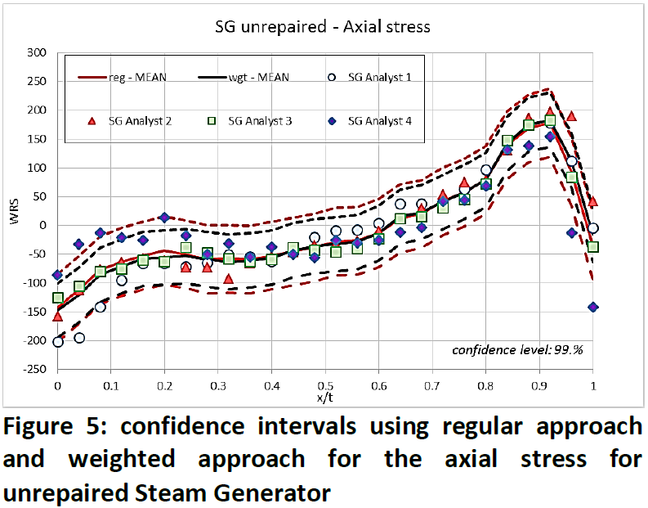
Issues of the existing model on WRS
Examples of general issues;
It is difficult to appropriately set the stress distribution,
For example, axial WRS should be balanced within the wall-thickness,
The appropriate number of sampling positions is unknown.
and the uncertainty of WRS of each location.
PVP2016-63963 (xLPR)
5
Notes:
which should be balanced within the wall-thickness (the integral value of the axial stress through the thickness should be 0)

Slide 6
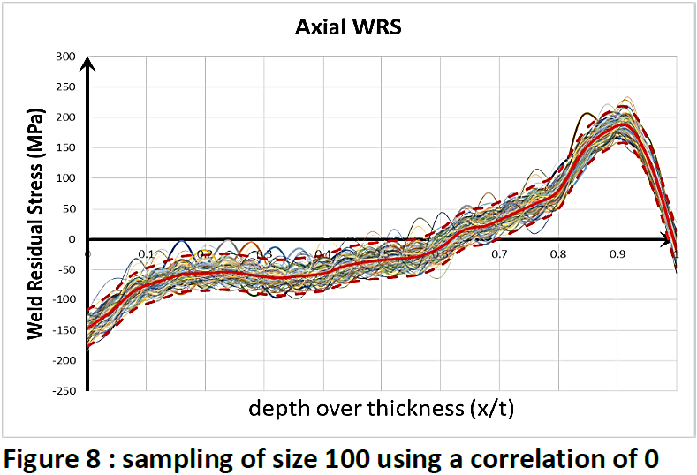
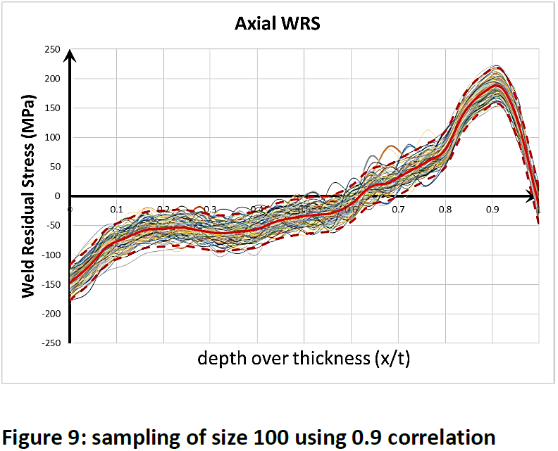
Issues of the existing model on WRS
Examples of general issues;
WRS value sampled independently for each position can become much bumpier than expected. Though this problem can be improved by several treatments, e.g. correlation parameters between each position are considered, these treatments also depend on the code or users.
Code cannot express both distribution and the uncertainty of WRS.
PVP2016-63963 (xLPR)
6

Slide 7
A New Probabilistic Evaluation Model on WRS
Because the WRS has a spatial stress distribution, it can be expressed by a linear combination of base functions. From this perspective, the uncertainty of WRS is expressed by the uncertainty of the coefficient of each base function.
Although there are a number of candidates of base function, we employed the Fourier cosine basis for the following reasons.
The Fourier cosine basis is so familiar that it is easy to be understood and implemented into a PFM code.
The integral value of WRS is easily controllable.
Integration value of WRS can be determined.
The uncertainty of WRS can be determined.
$$f\left(x\right)=\frac{a_{0}}{2}+\sum_{k=1}^{∞}{a_{k}\cos\left[kπx\right]} \left(0≤x≤1\right)$$
…Eq. (1)
$$a_{k}=2\int_{0}^{1}{ f\left(x\right)\cos\left[kπx\right]dx} \left(k=0,1,2,…\right)$$
7

Slide 8
A New Probabilistic Evaluation Model on WRS
First Step - WRS data:
Assume that there are M sets of WRS data are obtained from a number of FEAs.
$σ_{0}^{\left(m\right)},σ_{1}^{\left(m\right)},…,σ_{N}^{\left(m\right)} at x=x_{0},x_{1},…,x_{N}$ ($x_{0}=0, x_{N}=1$)
$$for m=0, 1,…, M−1$$
$$σ_{0}^{\left(0\right)}$$
$$σ_{0}^{\left(1\right)}$$
$$σ_{0}^{\left(M−1\right)}$$
$$σ_{1}^{\left(0\right)}$$
$$σ_{1}^{\left(1\right)}$$
$$σ_{1}^{\left(M−1\right)}$$
x₀
x₁
x₀
x₁
x_{N}
x_{N}
x₀
x₁
x_{N}
…
0
0
1
1
0
1
$$σ_{N}^{\left(1\right)}$$
$$σ_{N}^{\left(M−1\right)}$$
$$σ_{N}^{\left(0\right)}$$
8

Slide 9
A New Probabilistic Evaluation Model on WRS
Second Step - Fourier expansion:
Evaluate eq. (1) for each WRS data.
Fourier coefficients $a_{k}$ are expressed as follows;
Assumption
$$a_{k}^{\left(m\right)}=2\sum_{n=0}^{N−1}{\int_{x_{n}}^{x_{n+1}}{ }\left(α_{n}^{\left(m\right)}x+β_{n}^{\left(m\right)}\right)\cos\left(kπx\right)dx}$$
WRS can be expressed by linear interpolation in each interval as
$$=\sum_{n=0}^{N−1}{\frac{2α_{n}^{\left(m\right)}}{kπ}\left(x_{n+1}\sin\left(kπx_{n+1}\right)−x_{n}\sin\left(kπx_{n}\right)\right)}$$
$$f\left(x\right)=α_{n}^{\left(m\right)}x+β_{n}^{\left(m\right)}$$
$$+\frac{2α_{n}^{\left(m\right)}}{{\left(kπ\right)}^{2}}\left(\cos\left(kπx_{n+1}\right)−\cos\left(kπx_{n}\right)\right)$$
$$α_{n}^{\left(m\right)}=\frac{σ_{n+1}^{\left(m\right)}−σ_{n}^{\left(m\right)}}{x_{n+1}−x_{n}} , β_{n}^{\left(m\right)}=σ_{n}^{\left(m\right)}−α_{n}^{\left(m\right)}x_{n}$$
$$+\frac{2β_{n}^{\left(m\right)}}{kπ}\left(\sin\left(kπx_{n+1}\right)−\sin\left(kπx_{n}\right)\right)$$
When k = 0,
$$a_{0}^{\left(m\right)}=\sum_{n=0}^{N−1}{\left[α_{n}^{\left(m\right)}\left({x_{n+1}}^{2}−x_{n}^{2}\right)+2β_{n}^{\left(m\right)}\left(x_{n+1}−x_{n}\right)\right]}$$
9

Slide 10
A New Probabilistic Evaluation Model on WRS
Third Step – The uncertainty of Fourier coefficients:
Quantify the uncertainties for Fourier coefficients obtained in the previous step.
Since the number of FEA results (M) is limited to model a precise probability distribution functions for$a_{k}$, it may be sufficient to assume normal distribution.
Fourth Step - WRS sampling:
In order to generate WRS samples, we generate $a_{0}, a_{1}, ⋯, a_{k_{max}}$ considering their probability distribution functions.
Then, using eq. (1), we can evaluate the value of WRS at any x $\left(0≤x≤1\right)$, without any further interpolation.
10

Slide 11
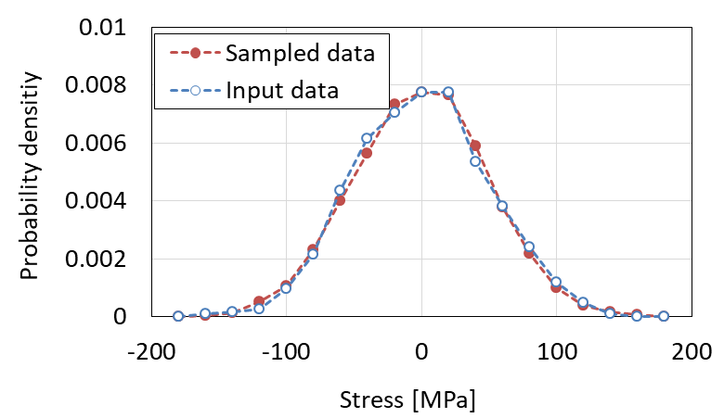
Verification -1
Assumption: Simple stress distributions with uniform values.
From the comparison in probability densities of stress, it is confirmed that sampled stress values agreed well with the input stress data.
We introduced this new probabilistic evaluation model on WRS to PASCAL-SP
11

Slide 12
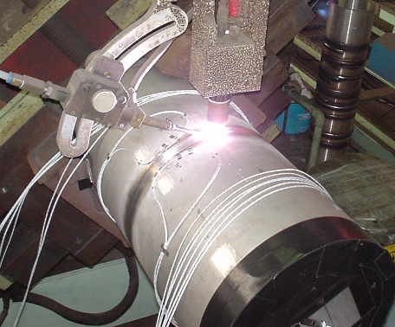
Verification -2: WRS database
Based on a series of parametric FEAs varying welding parameters (heat input and welding speed) for butt-welding for 250A piping.
Axial stress in Inner surface
J. Katsuyama et al.; JPVT Vol. 134 021403-1-9 (2012)
0
12

Slide 13
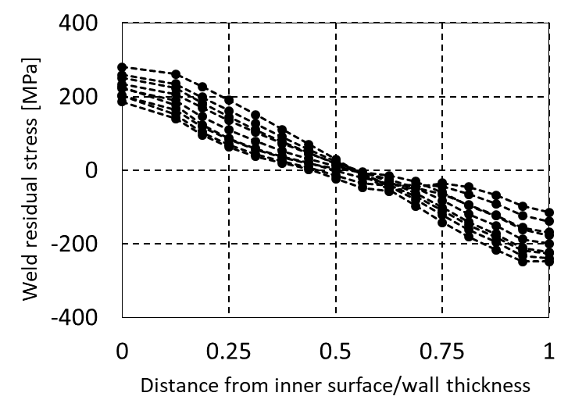
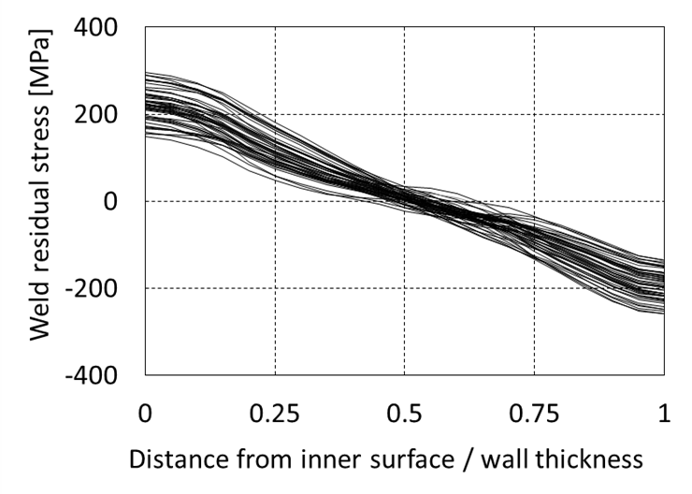
Verification -2: Sampling of WRS
Input WRS
Sampled WRS
Proposed WRS evaluation model can reproduce distribution and the uncertainty of WRS.
It can automatically reproduce the WRS distributions.
13

Slide 14
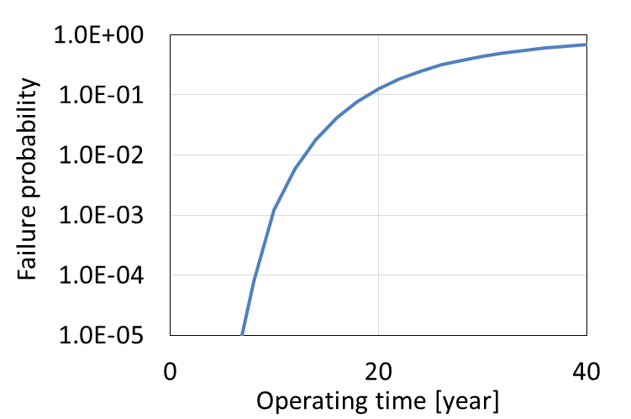
Verification -2: PFM analysis
Analysis conditions
Item | Content
Piping | 300A Sch.100
Material of pipe | Type 316 stainless steel
Aging degradation mechanisms | Inter-granular stress corrosion cracking and fatigue
Stress due to normal operating loads | Inner pressure: 9 MPa (BWR)
Failure probability against operating time obtained from improved PASCAL-SP.
It is confirmed that new WRS evaluation model can be applied to the failure probability evaluation.
Proposed WRS evaluation model is very useful for PFM analysis considering the uncertainties of WRS.
14

Slide 15
SUMMARY
We developed a new WRS evaluation model based on the Fourier transformation, and the model was introduced into PASCAL-SP.
No need for users to perform troublesome processing
Only multiple data of WRS are required.
Through the improvements of the code, the uncertainty of WRS can be set automatically and appropriately by only inputting multiple WRS analysis results directly as input data of PFM analysis.
Proposal of probabilistic evaluation model on WRS in this study was performed under the contract research entrusted from Regulatory Standard and Research Department, Secretariat of Nuclear Regulation Authority.
15

