Slide 1
Effect of Proximity Rule on Conditional Probability of Failure Under PTS Events
3rd International Seminar On Probabilistic Methodologies for Nuclear Applications
October 23th, 2019, Rockville, MD, USA
Masaki NAGAI and Masato YAMAMOTO
Materials Science Laboratory
Central Research Institute of Electric Power Industry, JAPAN

Slide 2
Motivation
Although many variables are incorporated in PFM calculations, they are not necessarily defined as random variables.
There might be remained “conservative deterministic variables” in some cases, when we have no proper way to define them as random variables.
Such conservative deterministic variables may give significant effect on the crack initiation or through-wall crack probabilities.
In this study, we picked up “proximity rule,” which is deterministically defined and controls the transformation of crack from embedded- to surface-braking- flaws, as one example of such a “conservative and deterministic variable.”

Slide 3
What is “deterministic proximity rule?”
Most of PFM codes have deterministic transforming rule from “embedded” to “surface-braking” or “surface-braking” to “semi-infinite” cracks.
S
Proximity rule is one of such rules, which defines a single line at certain distance from surface (S). The crack will be replaced to surface crack when the crack edge propagates through the line.
2a
2c
2c
S: Distance between inner surface and
crack front nearest to inner surface
a： Crack depth
a’ = S + 2a

Slide 4
Outline of present study
In this study,
We checked the location, shape and size of every sampled crack, together with the final results of crack arrest or through-thickness propagation under PTS event.
Effect of “deterministic” proximity rule on conditional probability of failure was investigated.
Crack size/location, fracture toughness, and crack arrest toughness were given as random variables.
PASCAL4 code developed by JAEA was utilized.

Slide 5
PTS transient
Temperature
Heat transfer coefficient
Pressure
We employed a SB-LOCA transient used in the past international benchmark campaign in MAI framework.
Dautreme, E., et al., PVP2014-28212

Slide 6
Fracture toughness
Equations of fracture toughness and crack arrest toughness employed in FAVOR v06.1 were used.

Slide 7
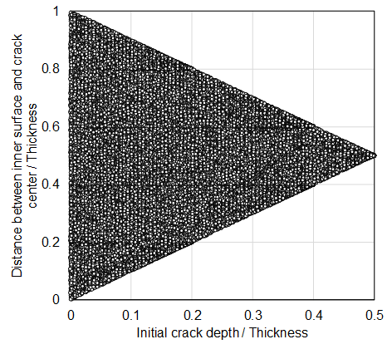
Initial crack size and location
Axial embedded crack in base metal was assumed as initial crack.
Distributions of crack-depth and crack aspect ratio are treated to be normal and log-normal ones, respectively.
Initial crack location is determined according to crack size, because large embedded crack exists within the middle location of thickness.
Outer surface
Distance between inner surface
and crack center / Thickness
2a
Inner surface
Initial crack depth / Thickness

Slide 8
Proximity rule
Deterministic proximity rule by JSME FFS code was employed.
If S < 0.4 a, then embedded crack is transformed to surface crack.
S
2a
2c
Embedded crack
Crack transformation line
Distance between inner surface
and crack center / Thickness
Surface crack transformed
from embedded crack
2c
S: Distance between inner surface and
crack front nearest to inner surface
a： Crack depth
Initial crack depth / Thickness
a’ = S + 2a
Initial crack sizes and locations

Slide 9
Other deterministic conditions
RPV geometry | Inner radius |  | 1,994 mm
 | Clad thickness |  | 7.5 mm
 | Base metal thickness |  | 200 mm
 | Shell height |  | 4,000 mm
Parameters | Chemical composition | Cu | Median：0.0972 wt%，S.D.：0.00 wt%
 |  | Ni | Median：0.72 wt%，S.D.：0.00 wt%
 | Neutron radiation |  | Median：9×10¹⁹ n/cm²，S.D.：0% of median
 | Initial RT_{NDT} |  | Median：－12℃，S.D.：0℃
 | ΔRT_{NDT} |  | S.D.：0℃
 | Proximity rule to infinite crack |  | a/c < 0.1
 | Embrittlement trend curve |  | JEAC4201-2007（2013 Addendum）
 | Neutron flux |  | 5.1×10¹⁰ n/(cm² s)
 | Radiation temperature |  | 287.8℃
 | Flow stress |  | 500 MPa
 | Warm pre-stress |  | Not considered
 | Residual stress |  | Not considered
S.D.: Standard Deviation

Slide 10
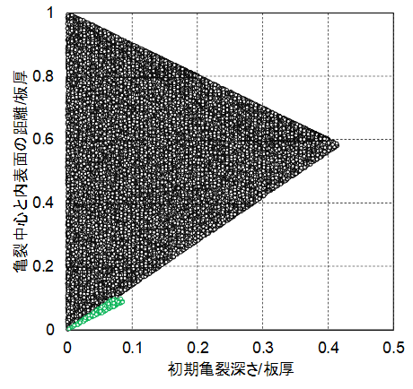
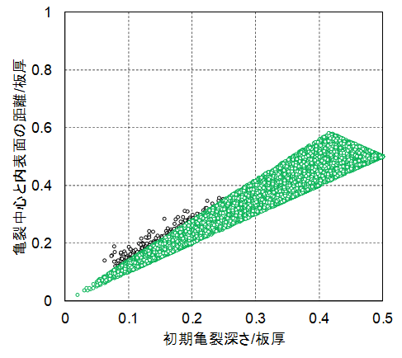
Analysis results
PFM results were CPI = 4.84×10⁻³，CPF = 4.78×10⁻³.
Sampled initial cracks can be classified as either of (1) embedded cracks or (2) surface cracks.
Cracks sampled as
(1) Embedded ones
(2) Surface ones
Crack transformation
line
Crack transformation line
Distance between inner surface
and crack center / Thickness
Distance between inner surface
and crack center / Thickness
Cracks sampled as
(1) Embedded ones
(2) Surface ones
Initial crack depth / Thickness
Initial crack depth / Thickness
Non-failure samples
Failure samples

Slide 11
Analysis results（Non-failure samples）
Type A1: Sampled as embedded flaw
and arrested as embedded flaw
Crack transformation line
Distance between inner surface
and crack center / Thickness
Type A2: Sampled as embedded flaw
and arrested as surface flaw
Initial crack depth / Thickness
Type A3: Sampled as surface flaw
and arrested as surface flaw
Non-failure samples

Slide 12
Analysis results（Failure samples）
Type B1: Sampled as embedded flaw
and went through the thickness
Crack transformation line
Distance between inner surface
and crack center / Thickness
Crack propagates and transformed to surface one.
Type B2: Sampled as surface flaw
and went through the thickness
Initial crack depth / Thickness
Failure samples

Slide 13
Analysis results（Cont’d）
Most of sampled embedded flaws ended as crack arrest, while most of sampled surface braking flaws went through the whole thickness.
Big difference in K between embedded and surface-braking flaws may contribute to the result.
Cracks sampled as
(1) Embedded ones
(2) Surface ones
Crack transformation
line
Crack transformation line
Distance between inner surface
and crack center / Thickness
Distance between inner surface
and crack center / Thickness
Cracks sampled as
(1) Embedded ones
(2) Surface ones
Initial crack depth / Thickness
Initial crack depth / Thickness
Non-failure samples
Failure samples

Slide 14
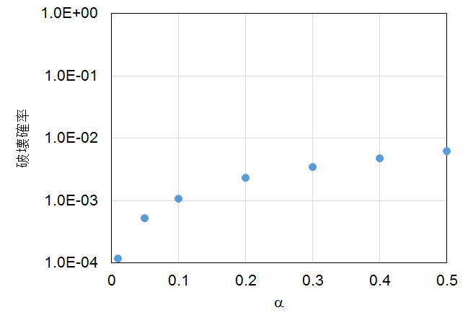
Effect of proximity rule on CPF
S
2a
2c
Basic condition
Conditional probability of failure
2c
α
Proximity rule to transform from embedded
crack to surface crack： S＜αa
a’ = S + 2a
Some analyses were performed when changing parameter of proximity rule.
This result indicates that proximity rule affected on conditional probability of failure.

Slide 15
Summary
In this study, proximity rule was selected as an example of deterministic variables remained in PFM codes.
Crack histories are classified as
  A1: Sampled as embedded flaw and arrested as embedded flaw
  A2: Sampled as embedded flaw and arrested as surface flaw
  A3: Sampled as surface flaw and arrested as surface flaw
  B1: Sampled as embedded flaw and went through the thickness
  B2: Sampled as surface flaw and went through the thickness
Most of samples were classified in A1, A2 and B2. This simply means “embedded initial flaws tend to be arrested” and “surface initial flaws tend NOT to be arrested.”
This presentation gives an example of case, where the “remained conservative deterministic” variables may affect on the final result of probabilities in PFM calculations.

