Slide 1
Probabilistic Fracture Mechanics (PFM) Assessment of PWR Reactor Vessel Bottom Mounted Nozzle (BMN) PWSCC
Presented to:
3rd International Seminar on Probabilistic Methodologies for Nuclear Applications (ISPMNA)
Rockville, MD
Presented by:
K. Fuhr
G. Lenci, J. Kim, G. White, M. Burkardt
Dominion Engineering, Inc.
October 22-24, 2019
Notes:
1

Slide 2
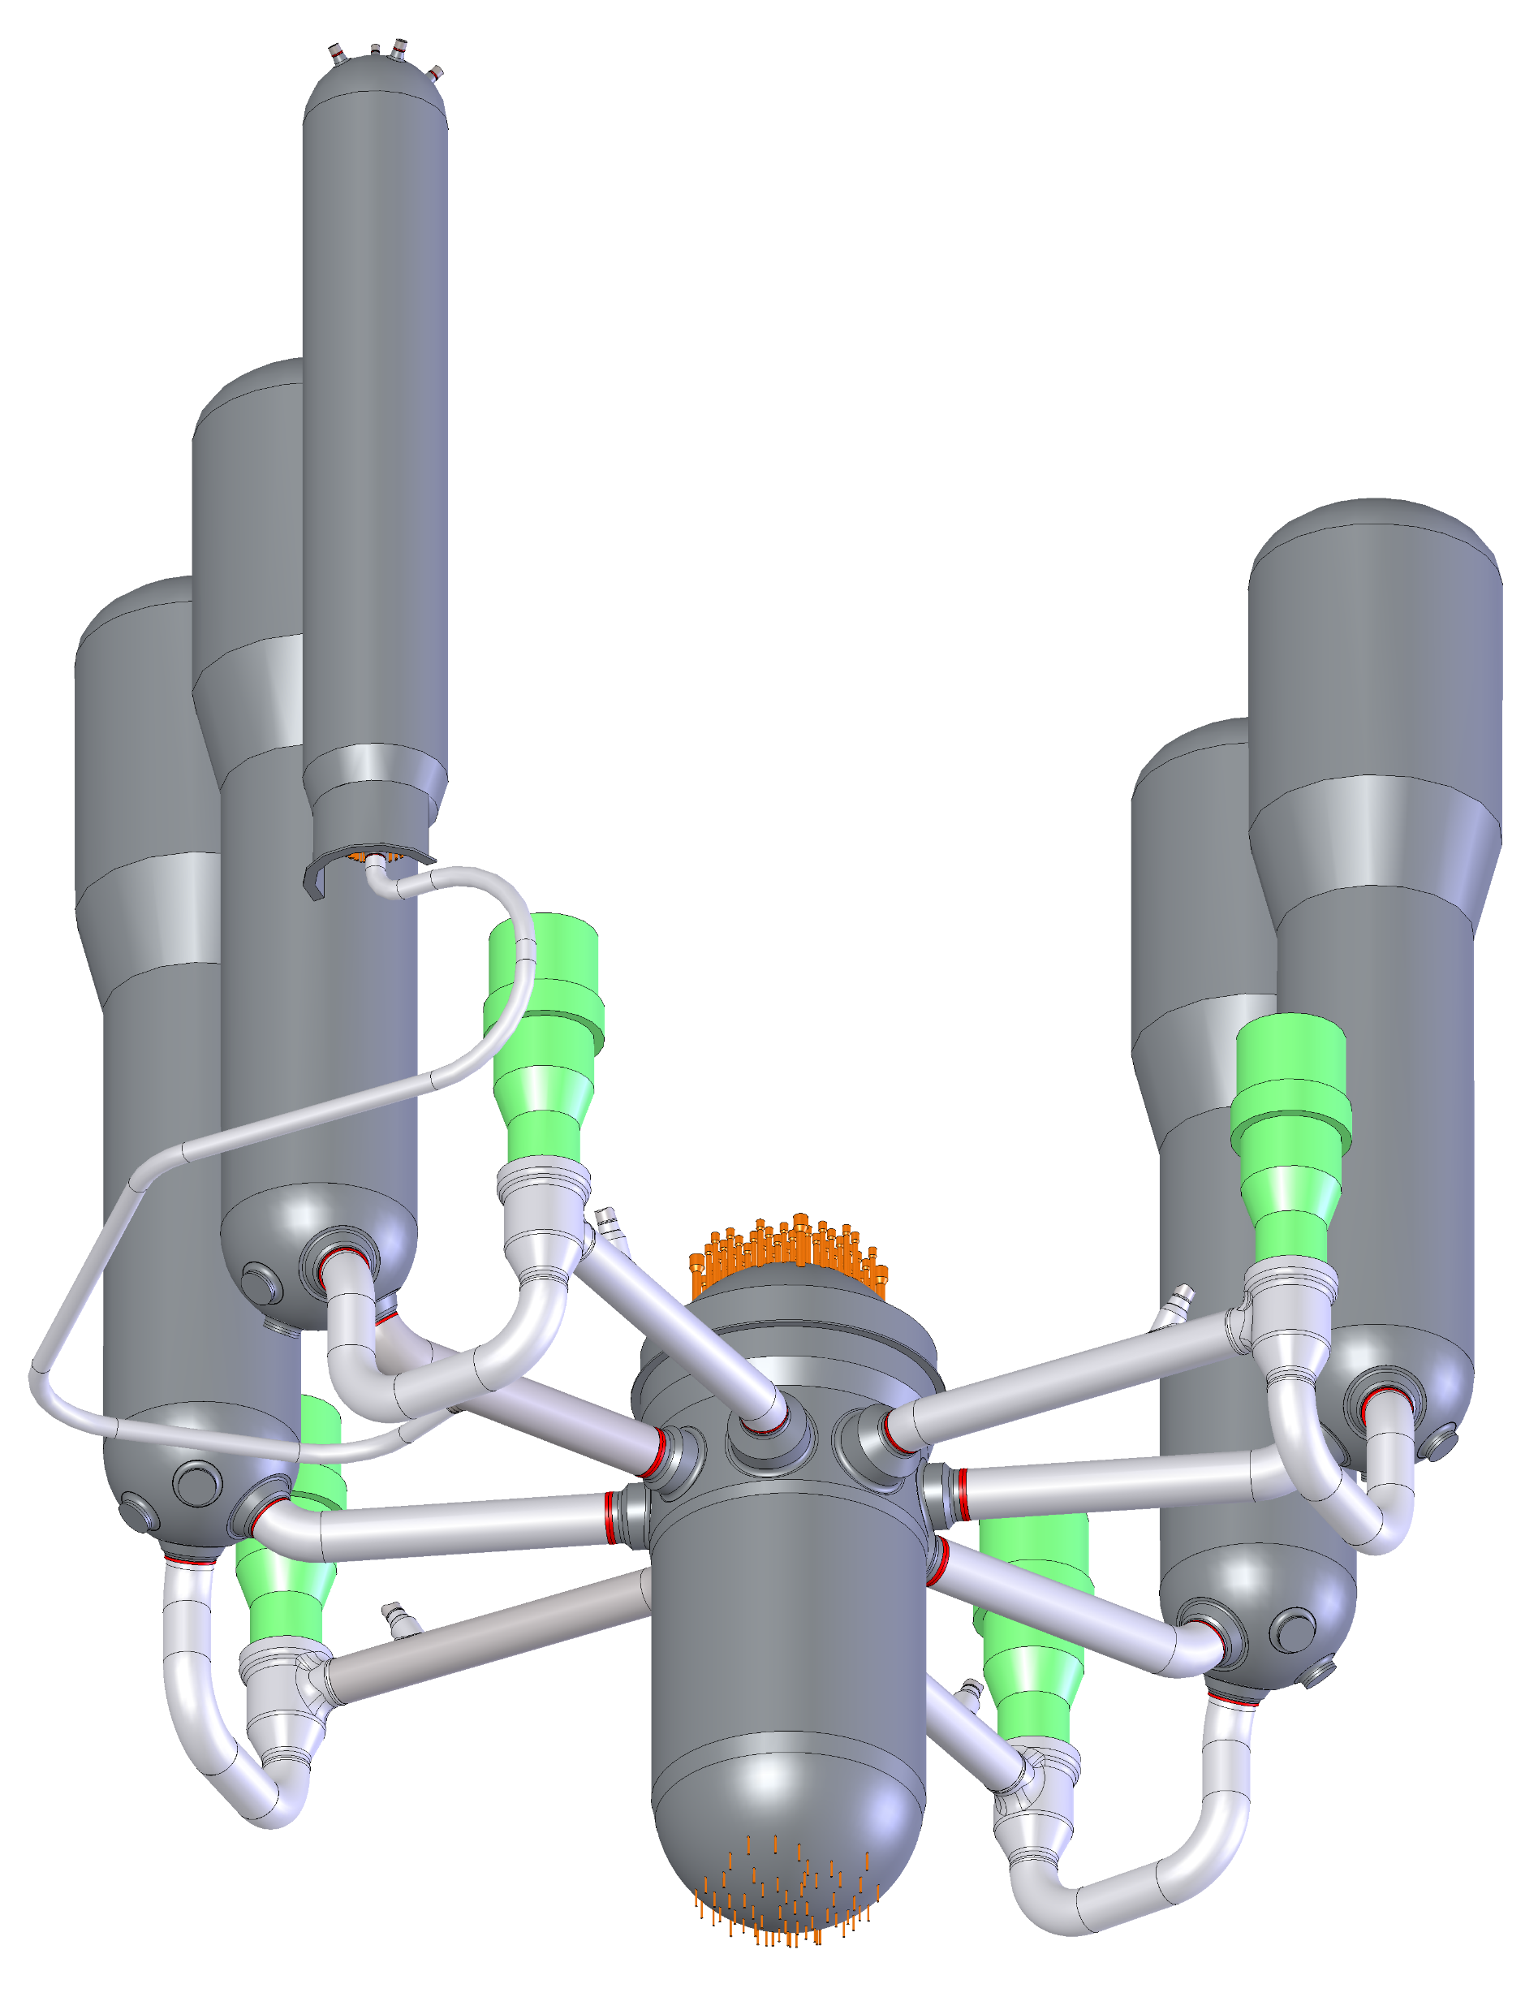
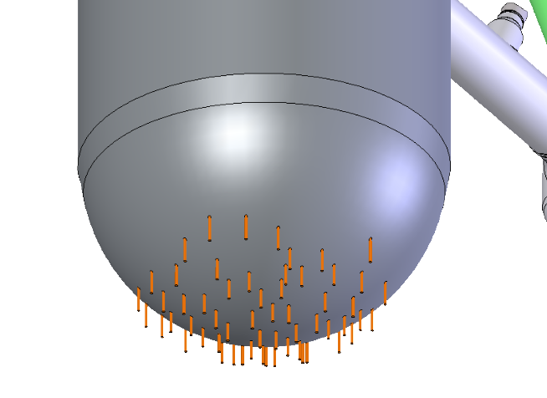
Outline
Introduction
JASPER approach
  PWSCC initiation
  PWSCC growth
Example results
Benefits of PFM approach

Slide 3
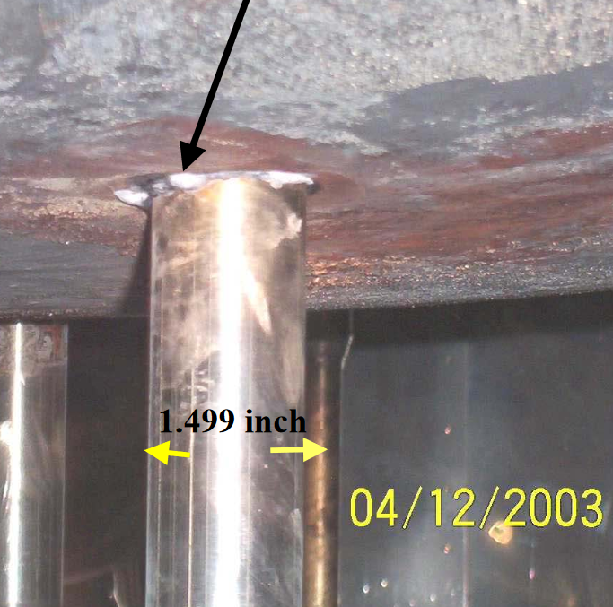
Introduction
BMN Operating Experience
PWSCC indications reported in only 3 BMN penetrations in U.S. PWRs
  Believed to have been promoted by subsurface fabrication defects that became wetted
5 additional confirmed or possible cases of PWSCC in BMNs in international PWRs
About a third of U.S. BMNs have been examined using non-visual non-destructive examination (NDE)
Plant and laboratory experience demonstrate a large benefit of reduced PWSCC susceptibility at cold-leg temperatures (T_{cold}), but some cases are expected as operating time increases
  Some manufacturing defects promote PWSCC, but they are not necessary given sufficient operating time
As-found deposits from leakage of BMN
[https://www.nrc.gov/reactors/operating/ops-experience/pressure-boundary-integrity/bottom-head-issues/bottom-head-files/penetration-dep-view6.pdf]

Slide 4
Introduction
Strategic Management
Strategic management options
  Status quo periodic visual examinations for evidence of leakage with repairs as necessary
  Zinc injection
  Peening mitigation
  Unlike the RPV closure head, replacement with PWSCC-resistant materials is not a feasible option
How zinc injection mitigates PWSCC
  Addition of zinc to the primary coolant shown to notably increase the time to PWSCC initiation
How peening mitigates PWSCC
  Prevents future initiation
  If stress layer developed by peening remains compressive when operating stresses are added, arrests shallow PWSCC flaws within compressive stress layer
Illustrative Comparison of Stress Profiles with the Application of Peening

Slide 5
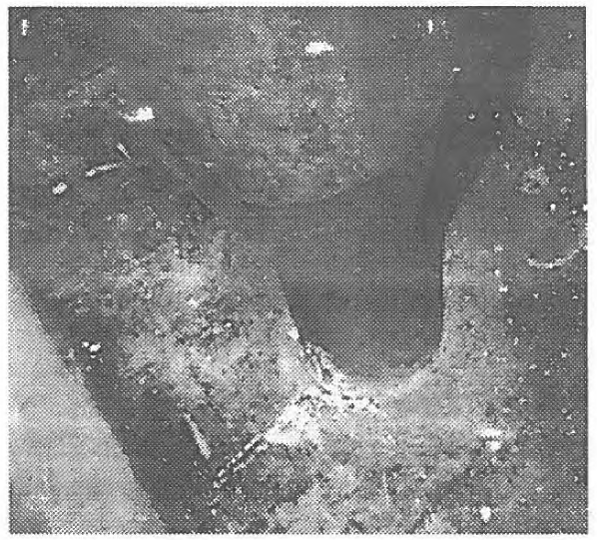
JASPER
J-groove Adapter SCC Probabilistic Evaluation for Reactors
Assists utilities in economic decision-making process
Applies generally to any set of J-groove partial-penetration nozzles in a plant
  Bottom mounted nozzles (BMNs)
  Reactor pressure vessel closure head penetration nozzles (RPVHPNs)
  T_{cold} instrumentation penetration nozzles
The JASPER code has three main components:
  Modeling of flaw initiation using Weibull distributions
  Fracture mechanics modeling of crack growth
  Monte Carlo routine wrapper to handle variability and uncertainty in inputs
As-found deposits from leakage of RCS cold-leg instrument nozzle at CE Plant
[https://lersearch.inl.gov/PDFView.ashx?DOC::3621997001R00.PDF]

Slide 6
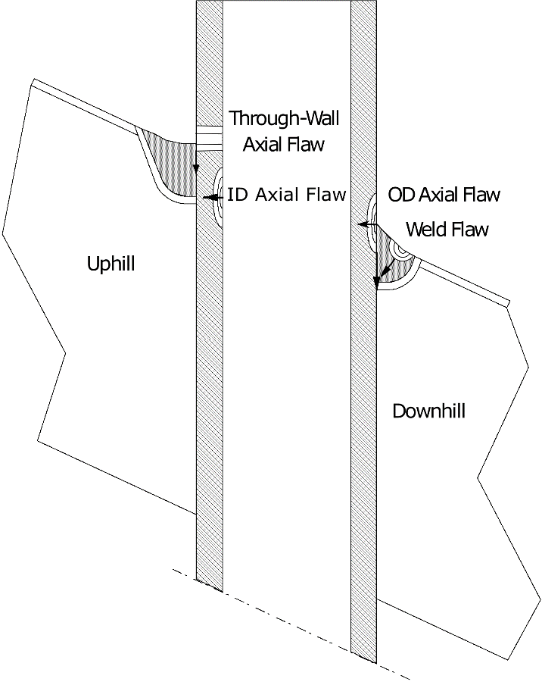
Modeling PWSCC Initiation
Multiple Weibull distributions are applied
  Initiation of first affected BMN in a vessel
  Initiation of successive affected penetrations
Weibull distributions are fit to plant data
normalized for temperature and then
further calibrated within the full PFM model
Separate initiation models applied to nozzle
tube base metal and J-groove weld metal to
consider relevant differences
Options to credit the benefits of:
  Zinc addition
  Peening
  Previous examinations showing lack of cracking or leakage
Weld Material
Tube Material

Slide 7
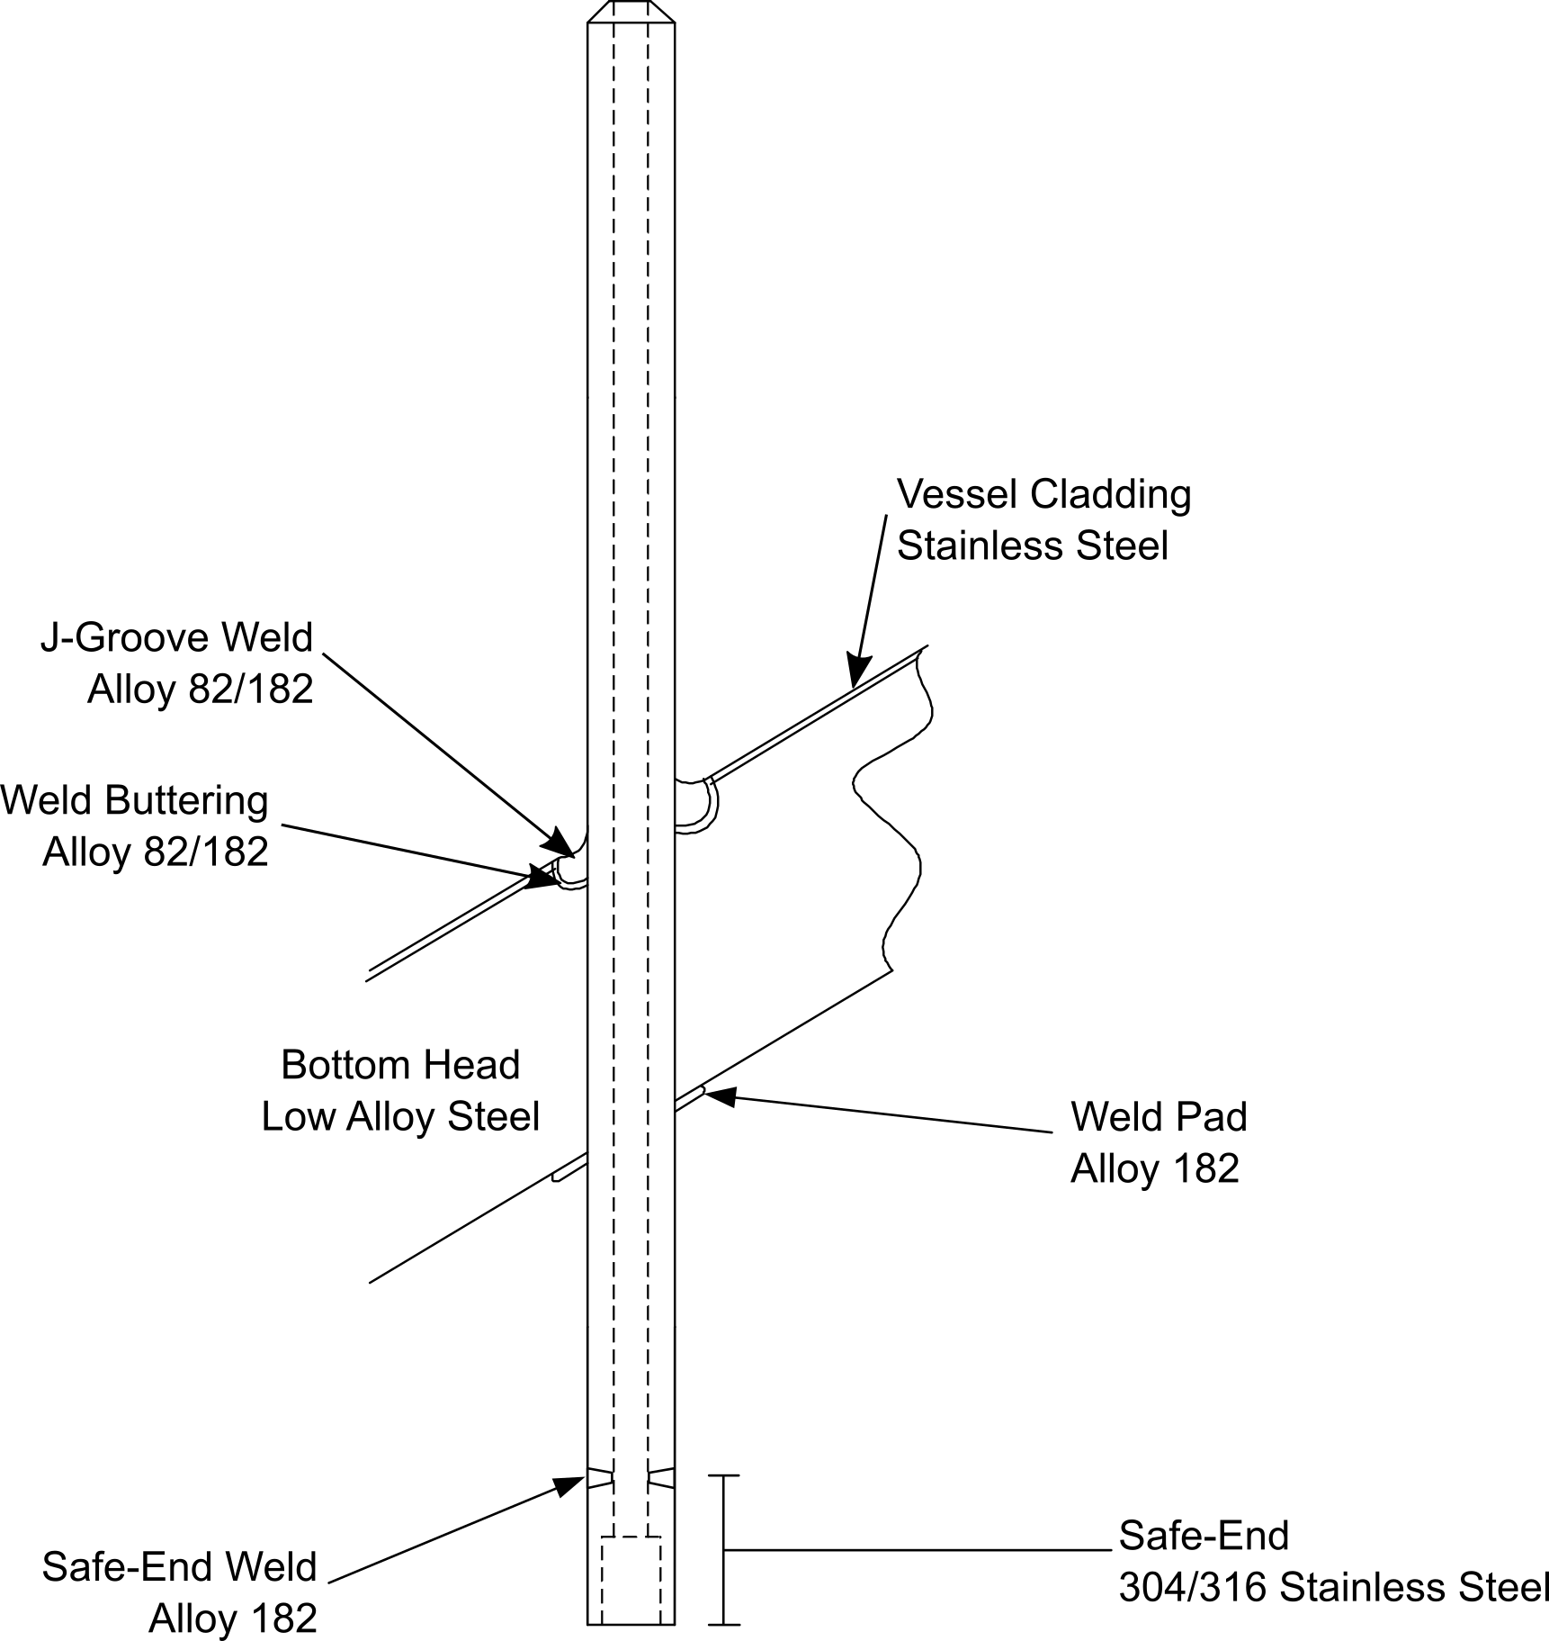
Overview of JASPER Code Structure
Typical BMN Configuration

Slide 8
Modeling of Separate Crack Growth in Base and Weld Metals
Applies MRP-420 R1 crack growth rate (CGR) equations
  Consideration of hydrogen effect resulting in lower predicted CGRs at cold leg temperatures
Calculate stress intensity factor at key points
  Applies detailed FEA modeling of operating and weld residual stresses
Crack propagation simulated until leakage occurs
Option to credit results of prior examinations (e.g., absence of leakage)

Slide 9
Key Outputs
Probability over time of one or more nozzles developing leakage due to PWSCC
Probability over time of one or more nozzles on each head developing PWSCC of a size that is detectable by surface and/or volumetric NDE
Number of nozzles predicted to be affected by PWSCC over time at different confidence levels (i.e., percentiles)

Slide 10
Example Results
Probability of Leakage
Most Recent Visual Inspection

Slide 11
Example Results
Probability of Detectable PWSCC
Start of Zinc Injection

Slide 12
Example Results
Number of BMNs with Detectable PWSCC

Slide 13
Conclusions
JASPER is a flexible PFM tool that can be applied for simulating PWSCC affecting a population of BMNs or other J-groove welded nozzles
PWSCC is inherently a stochastic process, so the PFM approach is key to strategic planning and economic decision-making
  JASPER output is appropriate for input to probabilistic or expected value economic assessments
Applying plant PWSCC experience is the best method to calibrate the PWSCC predictions
Results with and without crediting zinc injection generated considering that weld manufacturing flaws may promote PWSCC
Explicitly models the risk of pre-existing PWSCC at the start of zinc injection or the application peening, with separate handling of crack initiation in nozzle tube and weld materials

