Slide 1
Effect of through-wall toughness distribution on conditional failure probability assessment under PTS events
Materials Science Research Laboratory
Dr. Masato Yamamoto and Dr. Masaki Nagai
3rd International Seminar on Probabilistic Methodologies for Nuclear Applications
October 22nd, 2019

Slide 2
Background and motivation
Most of the PFM codes assume equal initial RT_{NDT} through the RPV thickness based on surveillance data taken from ¼-T material.
After considering neutron irradiation, RT_{NDT} near inner surface increases, which increase the initiation probability.
RPV material possibly has higher initial fracture toughness (lower RT_{NDT}) at near surface.
If we understand the through-wall toughness distribution and use it as PFM input, we can perform more realistic and less overly conservative PFM analyses.
How to determine the toughness distribution?
How big is the effect on crack initiation and failure probabilities?
RT_{NDT}
Inner
Surface
¼-T
½-T
¾-T
Outer
Surface

Slide 3
Contents
How to determine the toughness distribution?
  Outline of Mini-C(T) Master Curve tests
  Through-wall toughness distribution of decommissioned Zion Unit 1 RPV (PVP2019-93964)
How big is the effect on crack initiation and failure probabilities?
  PFM analyses considering through-wall toughness distribution modeled after Zion Unit 1

Slide 4
Outline of Mini-C(T) Master Curve tests
How to determine the toughness distribution? Part 1

Slide 5
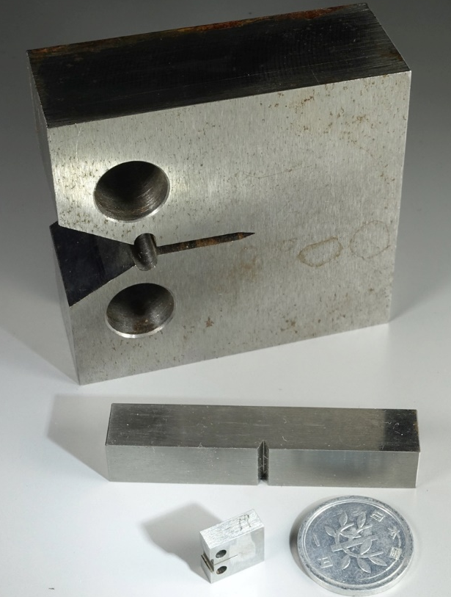
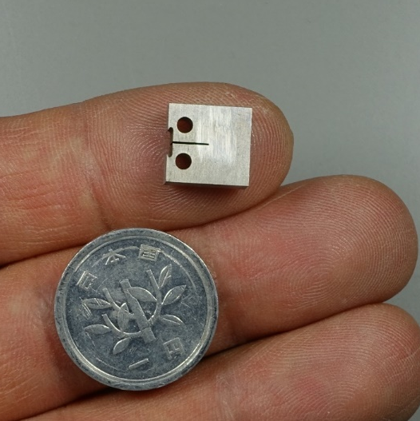
Mini-C(T) Master Curve tests
1T-C(T)
Existing surveillance program employs Charpy specimens.
Master Curve (MC) method enabled the specimen size correction.
If we can use below Charpy size fracture toughness specimens (Mini-C(T)) for MC evaluation, we can directory evaluate the fracture toughness using the material as small as the volume of less than two Charpy specimens.
Mini-C(T) MC also enables detailed characterization of location by location toughness distribution.
Charpy
Mini-C(T)

Slide 6
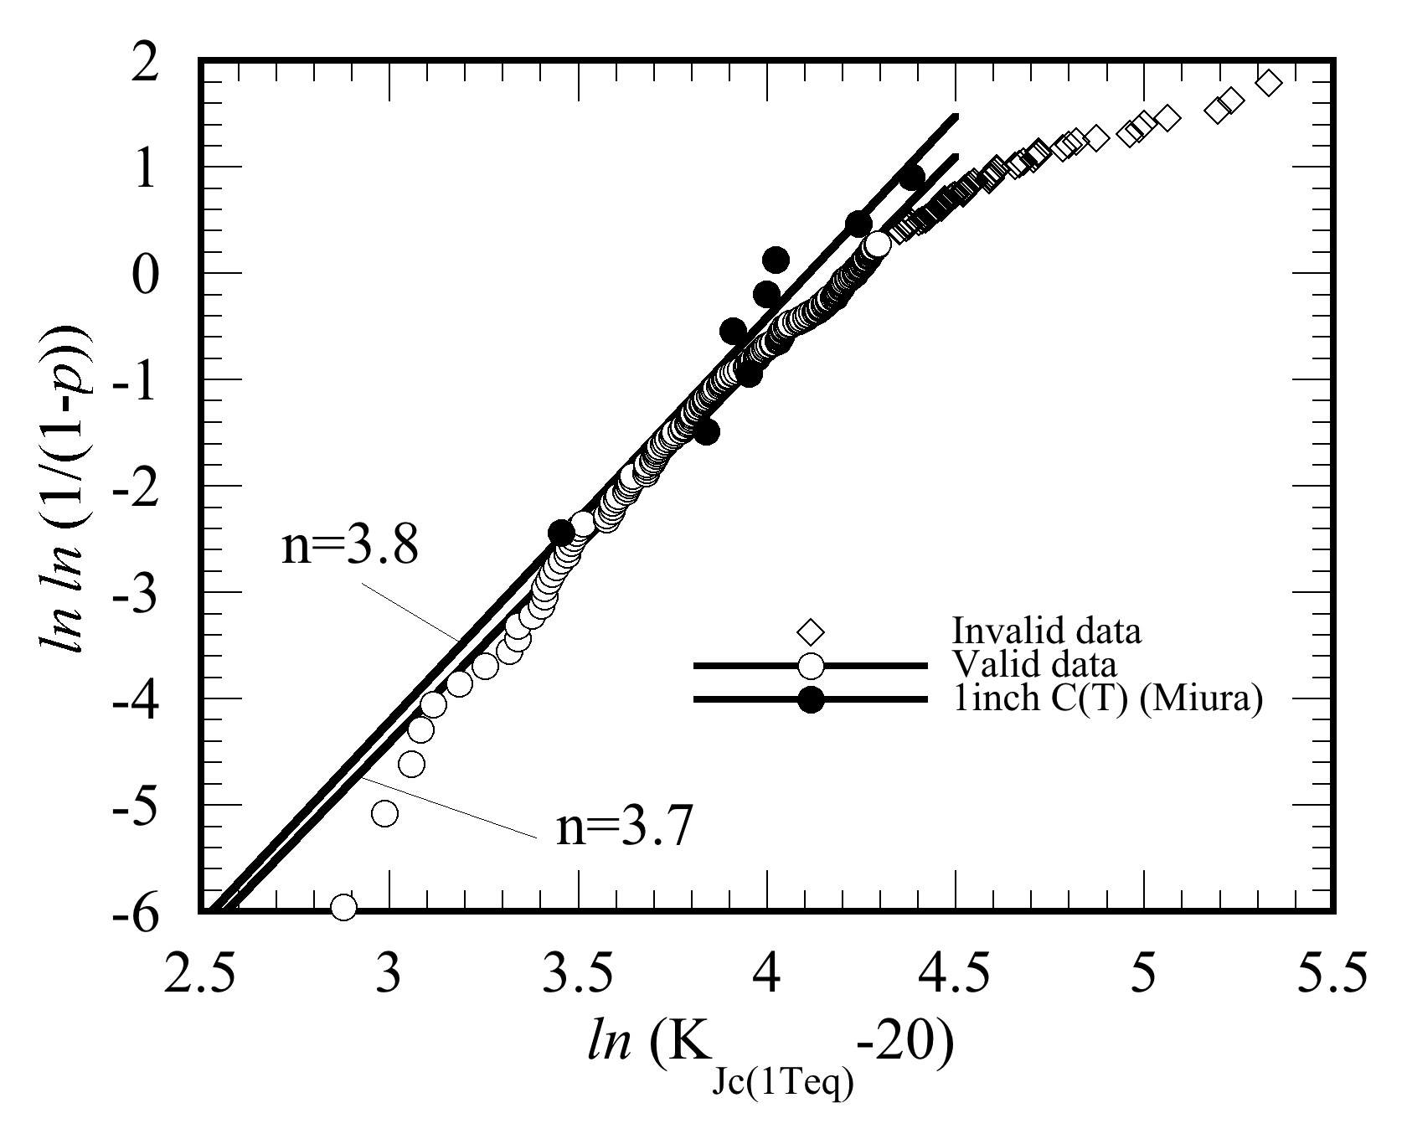
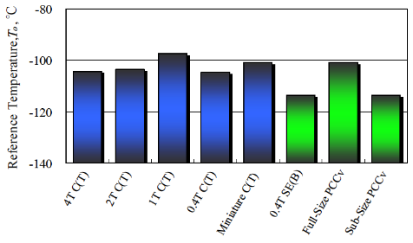
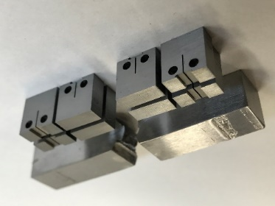
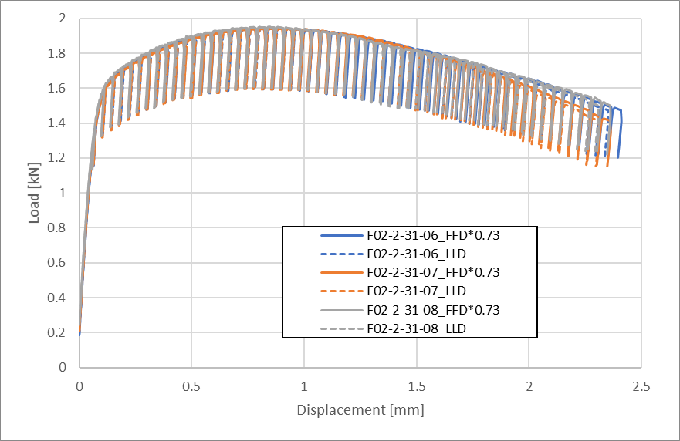

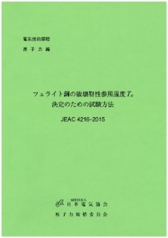
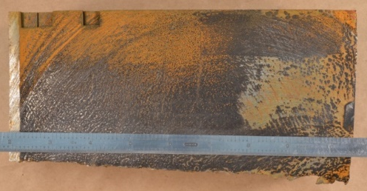
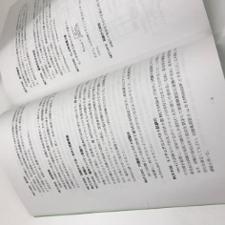
Development steps of Mini-C(T) MC methodology
Miura, Soneda, ASME J. of PVT 134-021402, (2010)
RPV forging material
Master Curve reference temperature, To
ln( ln (1/(1-p)))
Fracture toughness ln(K_{Jc(1Teq)}-20)
Step 1: Development of test technique
Future surveillance program
Utilization of Mini-C(T) for ductile crack evaluation
Application to characterization of actual / decommissioned materials
○: Valid
▲：Rejected
■：Invalid
Step 2: Confirmation of robustness (Round robin tests)
Step 4: Confirmatory study with irradiated materials
Step 3: Revision of testing standards E1921 and JEAC4216

Slide 7

Procedure to characterize through-wall toughness distribution
T_{o (IS)}
T_{o (L2)}
Initial toughness
(T_{o}) distribution
Inner
Surface
¼-T
½-T
¾-T
Outer
Surface
T_{o (OS)}
Unirradiated
archive block
or ultrasonic testing block
of reactor pressure vessels
Small cutout
of each layer less than the volume of two Charpy specimens
(10 (S) x 20 x 40 mm)
Through-wall fracture toughness distribution for plant by plant PFM input
16 Mini-C(T) specimens in each layer to evaluate Master Curve T_{o} values
(T-L or L-S orientation)

Slide 8
Through-wall toughness distribution of decommissioned Zion Unit 1 RPV
(PVP2019-93964)
How to determine the toughness distribution? Part 2

Slide 9
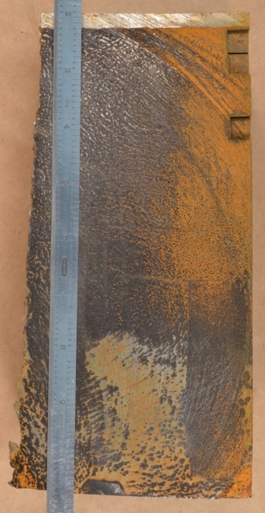
Zion Unit 1 beltline base metal
Zion Unit 1 block F02
(L216 x T73 x S216 mm)
A533B Cl.1 plate base metal
Fluence at clad – base metal interface (CBMI) :
7x10¹⁸ n/cm²(E > 1MeV)
T
L
View from outside of vessel

Slide 10
Through wall T_{o} distribution
Initial toughness distribution
Crack tip location for PTS evaluation
(with higher toughness than ¼-T)
¼-T location for retrieval of surveillance specimens
Toughness difference of 40ºC in T_{o} between ¼-T and near surface was confirmed.
Location of PTS evaluation hold very high toughness even after the full service.

Slide 11
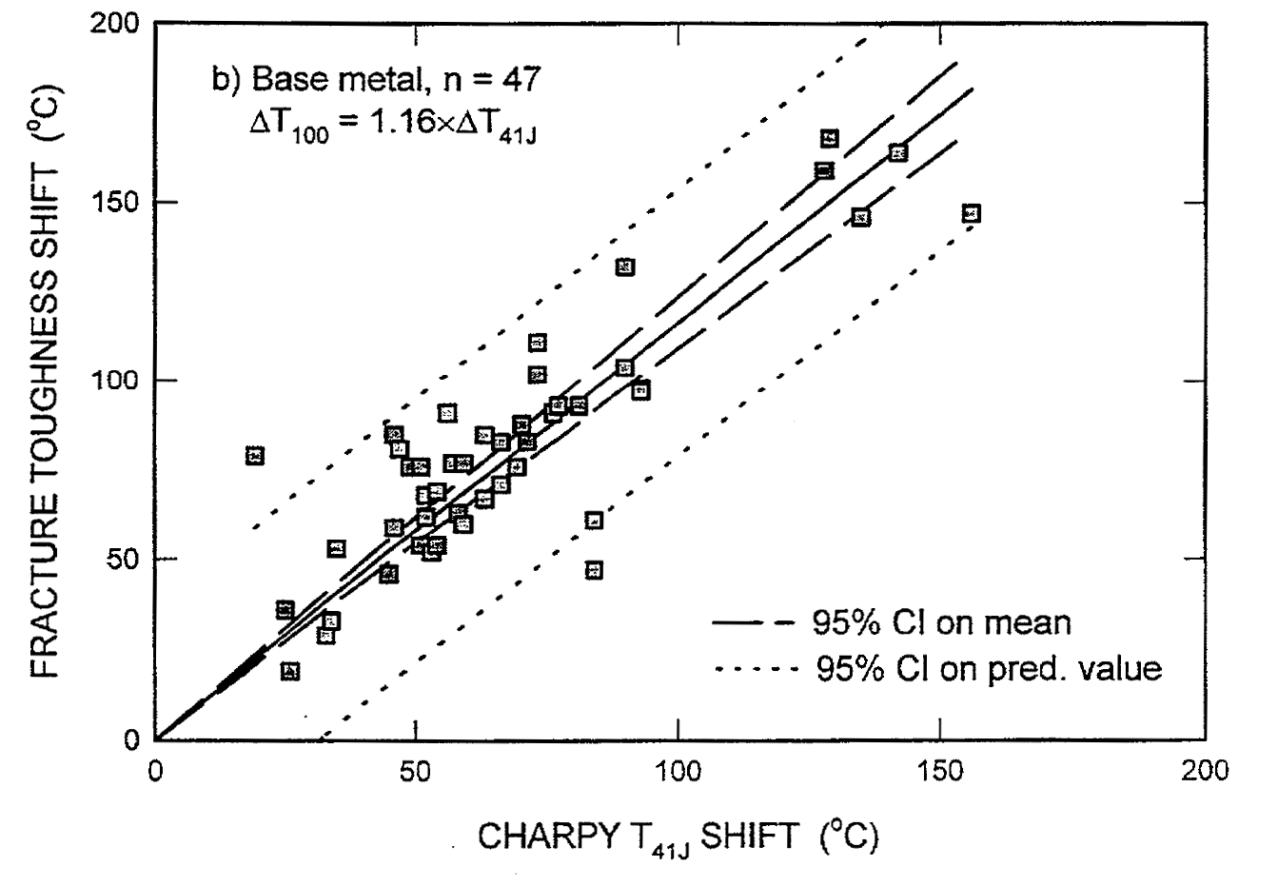
How to estimate initial RT_{NDT} distribution ?
T_{o} (irrad) distribution by Mini-C(T) MC
ΔRT_{NDT} by JEAC4201-2007(2013) and fluence value in surveillance report. Conversion to ΔT_{o} using NUREG/CR-6609 relationship.
T_{o} (initial) distribution by T_{o}(irrad) – ΔT_{o}.
Set vertical axes
T_{o}(initial) = RT_{NDT}, ₀ at 1/4-T.
Re-conversion to RT_{NDT,0} distribution for PFM input.
Sokolov, M. A., Nanstad, R. K., NUREG/CR-6609

Slide 12
Initial toughness estimation for Zion Unit 1
(1)
(2)
(3)
(4)
(5)
Item | Value | Source
T_{o} | -8.3ºC | Step (3)
RT_{NDT} | -28.9ºC | Surveillance report
Shift T_{o} → RT_{NDT} | 20.6ºC | T_{o} - RT_{NDT}

Slide 13
PFM analyses considering through-wall toughness distribution modeled after Zion Unit 1.
How big the effect on crack initiation and failure is?

Slide 14
Outline of PFM analysis
Specialized version of PASCAL-4 software developed by JAEA was used. This version accepts the input of distributed through-wall initial RT_{NDT}.
Actual base metal toughness distribution from Zion Unit 1 was given as initial toughness distribution (DIST cases). The results were compared with the cases, which employed single RT_{NDT} value for whole thickness (NODIST cases) .
13 PTS transients (4 LOCA, 8 SO-1 and 1 MSLB) out of 66 NUREG-1806 transients were selected for CPI and CPF calculation.
Vessel failure probability (but still only base metal and without consideration of circumferential fluence distribution) was determined.

Slide 15
PFM analysis condition
Category | Modeled after | Variable | Mean value / description | Std. deviation | Remark
RPV geometry | Zion spec. | RPV inner radius (to clad surface) | 2192.3 mm | -
 | Zion spec. | clad thickness | 4.8 mm | -
 | Zion spec. | base metal wall thickness | 218.7 mm | -
Material property | Present study, JEAC4201 Zion Surveillance data | RT_{NDT,0} | Fig. 1 | 9.4 | *1
 | Zion surveillance data | Cu content | 0.11 mass% | 0.01 | *1
 | Zion surveillance data | Ni content | 0.50 mass% | - | *2
Neutron irradiation | Zion surveillance data | Full service (15EFPY) fluence at clad inner surface | 7.5E18 n/cm2 | -
 | Zion surveillance data | Flux at clad inner surface Neutron attenuation considered | 1.58E10 n/cm2/s | -
 | JEAC4201 | DRT_{NDT} for 32, 48, 64 and 80 EFPY Neutron attenuation considered | calculated value | 0.0048
Initial cracks | - | geometry | surface braking semi-elliptical flaw | -
 | LLNL report | distribution | Marshall distribution | -
Transient | FAVOR code transients NUREG-1806 | transient number | LOCA: #003, #007, #056, #114 SO-1: #060, #071, #094, #097, #123, #126, #129, #130 MSLB: #103 | -
Other conditions | JAEA guideline
*1: Std. deviation by JAEA guideline
*2: Minimum Ni content in JEAC4201 is employed instead of Zion value (0.49%).

Slide 16
Loss of coolant accident transients
One order or less CPI and CPF in DIST cases than NODIST cases.
Lower percentage of ”crack arrest after initiation” cases in DIST cases.
Smaller differences among 0.2EFPY cases, where small cracks are supposed not to contribute to failure in both of DIST / NODIST cases.
Similar trend in all four selected LOCA cases.
SB-LOCA #003, 114
MB-LOCA #056
LB-LOCA #007

Slide 17
Stuck open valve primary side transients
Similar trend to LOCA
Stuck open valve later reclosure
#60, 71, 97, 123, 126, 129, 130
Stuck open valve no closure #94

Slide 18
Main steam line break transient
For all types of transients, less chance of crack arrest is found in DIST cases.
This is understandable because fracture toughness is decreasing (T_{o} or RT_{NDT} is increasing) with crack extension from surface to mid-thickness.
Similar trend to LOCA and SO-1 cases
MSLB #103

Slide 19
Comparison of CPI between DIST and NODIST cases
Lower CPI in DIST cases than NODIST cases
0.2EFPY conditions are closer to 1:1 line than high fluence data.
In fluence of 12 EFPY or greater, where smaller flaws will also contribute to initiation, CPI in DIST cases are only 5 to 6% of those in NODIST cases.
No significant difference in different transition types observed.
48EFPY
32EFPY
24EFPY
12EFPY
0.2EFPY

Slide 20
Comparison of CPF between DIST and NODIST cases
Lower CPF in DIST cases than NODIST cases
Transient sensitivity can be seen in higher fluence region. SO-1(black) are located to the right of LOCA(red) and MSLB(blue) symbols.
→ Some cracks in SO-1 might be arrested at near outer surface location.
TWCF criterion
0.8 thickness

Slide 21
Vessel failure probability
Transient | Probability of occurrence (1/year)
SB-LOCA(003) | 1.21E-04
LB-LOCA(007) | 1.10E-06
LB-LOCA(056) | 1.52E-04
SO-1(060) | 4.68E-05
SO-1(071) | 8.15E-06
SO-1(094) | 8.33E-05
SO-1(097) | 8.15E-06
MSLB(103) | 1.17E-05
SB-LOCA(114) | 1.21E-04
SO-1(123) | 3.83E-07
SO-1(126) | 3.71E-04
SO-1(129) | 6.25E-05
SO-1(130) | 6.25E-05
The difference between DIST and NODIST cases is large (approximately one order of magnitude) in high fluence conditions of more than 24EFPY.

Slide 22
Summary
A procedure of how to experimentally assess the through-wall initial toughness distribution, and how to use it as PFM input is proposed.
PFM calculation on 13 transients suggests that consideration of through-wall toughness distribution will result in around one order smaller CPI, CPF and vessel failure probability in the present case.
It is suggested that the combination of experimental fracture toughness characterization using the Mini-C(T) Master Curve method and analytical refinement of PFM codes to consider the toughness distribution may provide a more realistic plant by plant assessment of PTS events using a PFM analyses.

