Slide 1
Uncertainty Analysis in Probabilistic Fitness-for-Service Evaluations of Zr-2.5Nb Pressure Tubes: Pilot Study on Probabilistic Leak-Before-Break
Christopher Manu, Leonid Gutkin, Suresh Datla
Kinectrics Inc.
3rd International Seminar on Probabilistic Methodologies for Nuclear Applications
October 22-24, 2019
Rockville, MD, USA

Slide 2
Outline
Introduction
Annex on Uncertainty Analysis for CSA Standard N285.8
Scope
Methodology
Pilot Study on Probabilistic Leak-Before-Break
Major Activities
Results and Summary

Slide 3
Introduction
CSA N285.8 Overview
Canadian Standards Association (CSA) Standard N285.8: “Technical requirements for in-service evaluation of zirconium alloy pressure tubes in CANDU reactors”
Structure of CSA Standard N285.8:
Clauses 1, 2, 3: Scope, references, definitions, nomenclature
Clause 4: General requirements
Clause 5: Evaluation of pressure tube flaws
Clause 6: Evaluation of pressure tube to calandria tube contact
Clause 7: Assessment of reactor core
Deterministic approach
Probabilistic approach
Clause 8: Evaluation of material surveillance measurements

Slide 4
Introduction
CSA N285.8 Annex on Uncertainty Analysis
An informative Annex to CSA Standard N285.8 has been developed by CSA N285.8 Technical Subcommittee to provide guidelines for performing uncertainty analysis in probabilistic evaluations relevant to scope of CSA Standard N285.8.
This Annex defines uncertainty analysis as: the process of identifying and characterizing the influential sources of uncertainty in the probabilistic evaluation, assessing the impact of uncertainties on the probabilistic evaluation results, and developing, to the extent practicable, a quantitative measure of this impact.

Slide 5
Annex on Uncertainty Analysis
for CSA Standard N285.8
Scope
The Annex applies to the following evaluations:
Protection against fracture (Clause 7.2.3)
Pressure tube failure due to degradation mechanisms related to flaws (Clause 7.3.2.3)
Pressure tube failure due to pressure tube to calandria tube contact (Clause 7.3.3.3)
Leak-before-break (Clause 7.4.3)

Slide 6
Annex on Uncertainty Analysis
for CSA Standard N285.8
Overview
Review probabilistic evaluation using bottom-up approach focussing on characterization of uncertainties for influential non-deterministic variables
Stage I: Identification of influential variables
Stage II: Characterization of uncertainties for influential variables
Stage III: Incorporation of uncertainty characterization results into probabilistic evaluation

Slide 7
Annex on Uncertainty Analysis
for CSA Standard N285.8
Methodology (I)
Stage I: Identification of influential variables
Analysis of probabilistic evaluation outputs
Sensitivity Analysis
Expert judgment
Identification of influential variables allows to direct greater effort towards the uncertainty characterization of variables having greater effect on the probabilistic evaluation outcome

Slide 8
Annex on Uncertainty Analysis
for CSA Standard N285.8
Methodology (II)
Uncertainty components in model response:
Originate from different sources in calibrated parametric models and in statistical models
Stage II: Characterization of uncertainties for influential variables
Statistical assessment
Expert judgment
Statistical assessment and expert judgment are recognized as complementary approaches, and either one may be used as the primary approach, on a case-by-case basis
The methodology aims to capture all significant sources of uncertainty, but does not attempt to separate them by nature

Slide 9
Annex on Uncertainty Analysis
for CSA Standard N285.8
Uncertainty components in model response
Variable type | Best estimate obtained using | Uncertainty component
Type A | Parametric model |  | Parametric uncertainty
 |  |  | Uncertainty in numerical representation
 |  |  | Uncertainty due to model form
Type B | Statistical model |  | Residual uncertainty
 |  |  | Uncertainty due to limitations in model-basis data sets
 |  |  | Uncertainty due to model form
Uncertainty due to model form is currently not included in uncertainty analysis. Research and development work is still on-going to establish approach(es) to characterizing this uncertainty component.

Slide 10
Annex on Uncertainty Analysis
for CSA Standard N285.8
Methodology (III)
Stage III: Incorporation of uncertainty characterization results into probabilistic evaluation
Monte Carlo simulation method
Other appropriate methods of uncertainty propagation
Correlations among uncertainties are to be investigated and appropriately accounted for in the probabilistic evaluation

Slide 11
Pilot Study
Pressure Tube LBB
Pressure tube LBB is an evaluation of the overall effectiveness of:
CANDU® reactor’s annulus gas system’s ability to detect a pressure tube leak.
Station’s procedure to shutdown and cooldown a reactor unit in response to a suspected pressure tube leak; i.e., the ability to shutdown and cooldown to prevent pressure tube rupture.

Slide 12
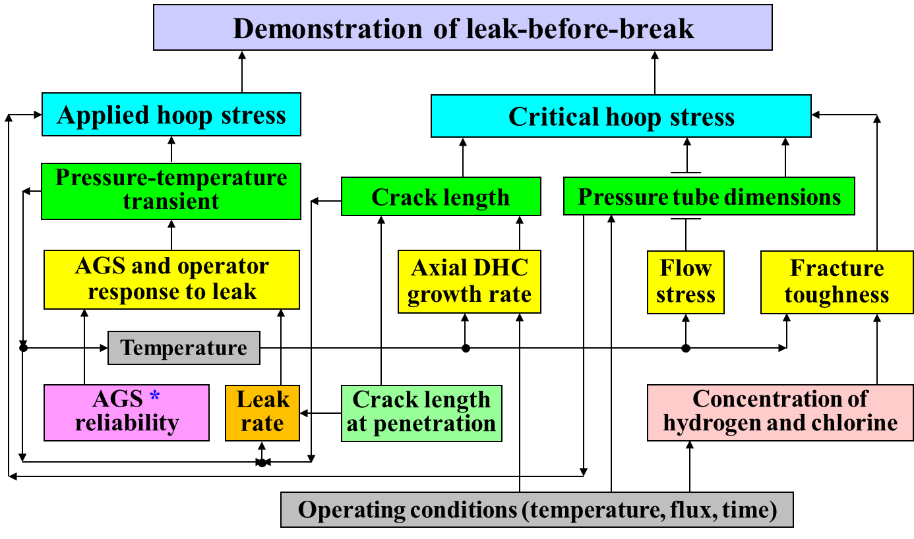
Pilot Study
Pressure Tube LBB

Slide 13
Pilot Study
Computer Code P-LBB
P-LBB was developed by Kinectrics
Capable of performing both deterministic and probabilistic LBB evaluations for CANDU® pressure tubes.
Complies with requirements of CSA Standard N286.7-99 (Quality Assurance of Analytical, Scientific, and Design Computer Programs for Nuclear Power Plants).
All LBB evaluation results shown in this presentation were generated using computer code P-LBB.

Slide 14
Pilot Study
Stage I: Identification of Influential Variables
Sensitivity analysis was used to identify influential variables in the pilot study.
Allowed variables to be ranked using a consistent measure of importance.
Local sensitivity analysis was used.
Sensitivity coefficient can be determined without involving variances in inputs or the output, making it a good choice when performing a first-pass analysis to determine where uncertainty characterization resources should be spent.
Each input variable can also be varied across a large range to assess the linearity of the relationship between the input and output variable.

Slide 15
Pilot Study
Stage I
Sensitivity analysis was performed at the limiting spatial location in the reactor core as determined by a previous LBB evaluation. Results presented are for variables generally treated as non-deterministic.

Slide 16
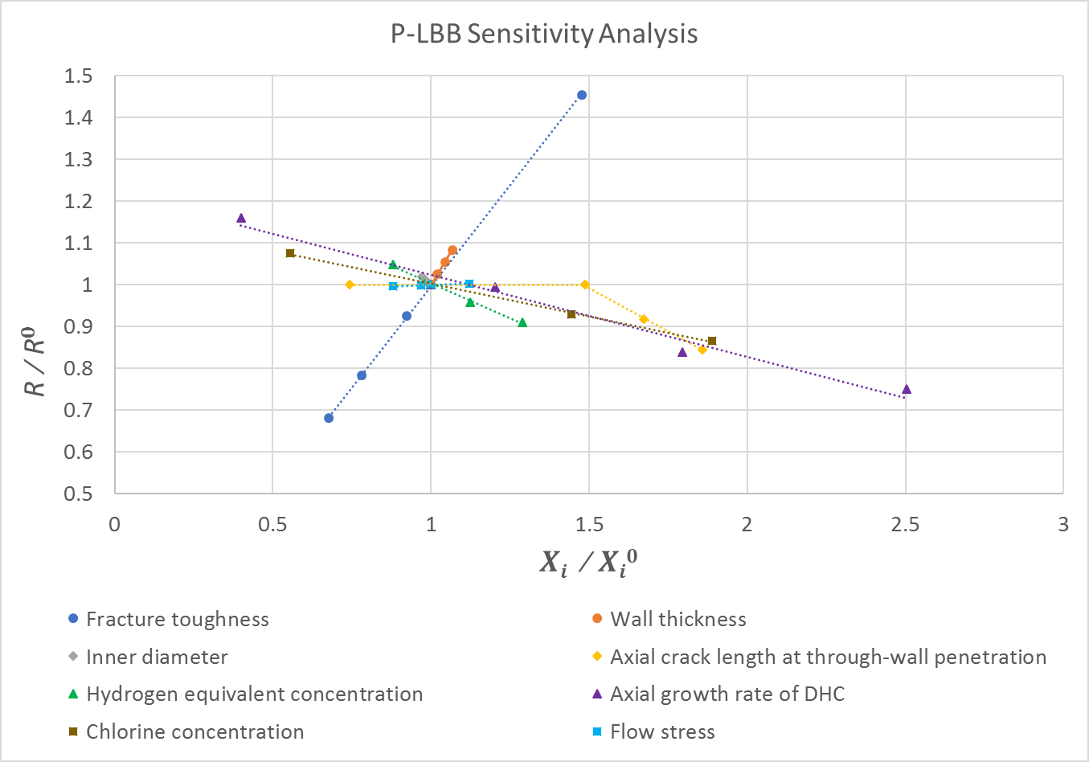
Pilot Study
Stage I

Slide 17
Pilot Study
The Annex on Uncertainty Analysis assumes that the best available models are being used.
The Annex has no provisions regarding model selection.
However, at the outset of the pilot study pressure tube dimensions were being predicted using a conservative approach based on design rates.
Based on the findings of Stage I and the availability of better models, the models used to predict pressure tube dimensions were changed to regression models based on in-service data.
The evaluation performed with the improved models is referred to as the baseline evaluation in this presentation.
A Note About Models Used

Slide 18
Pilot Study
Stage II: Uncertainty Characterization
Uncertainty components originate from different sources for Type A variables (calibrated parametric models) and for Type B variables (statistical models)
Uncertainty characterization efforts focused on Type B variables (most influential variables classified as such)
Statistical assessment and expert judgment are recognized as complementary approaches, and either one may be used as the primary approach, on a case-by-case basis
Uncertainty characterization was largely limited to cases
with statistical assessment used as the primary approach

Slide 19
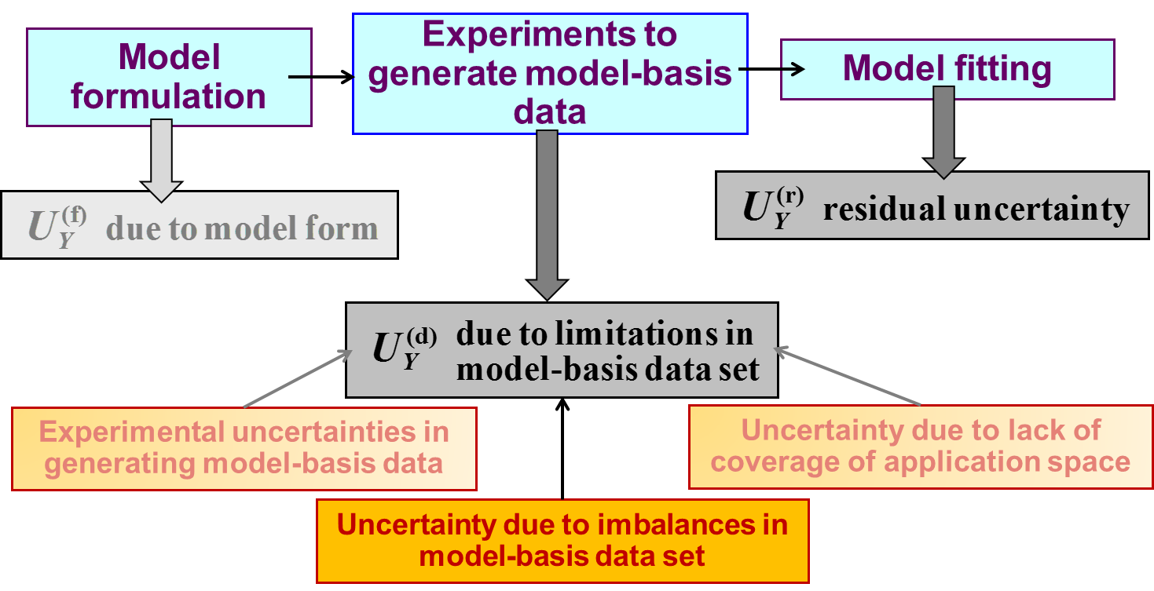
Pilot Study
Stage II
Uncertainties for Type B variables

Slide 20
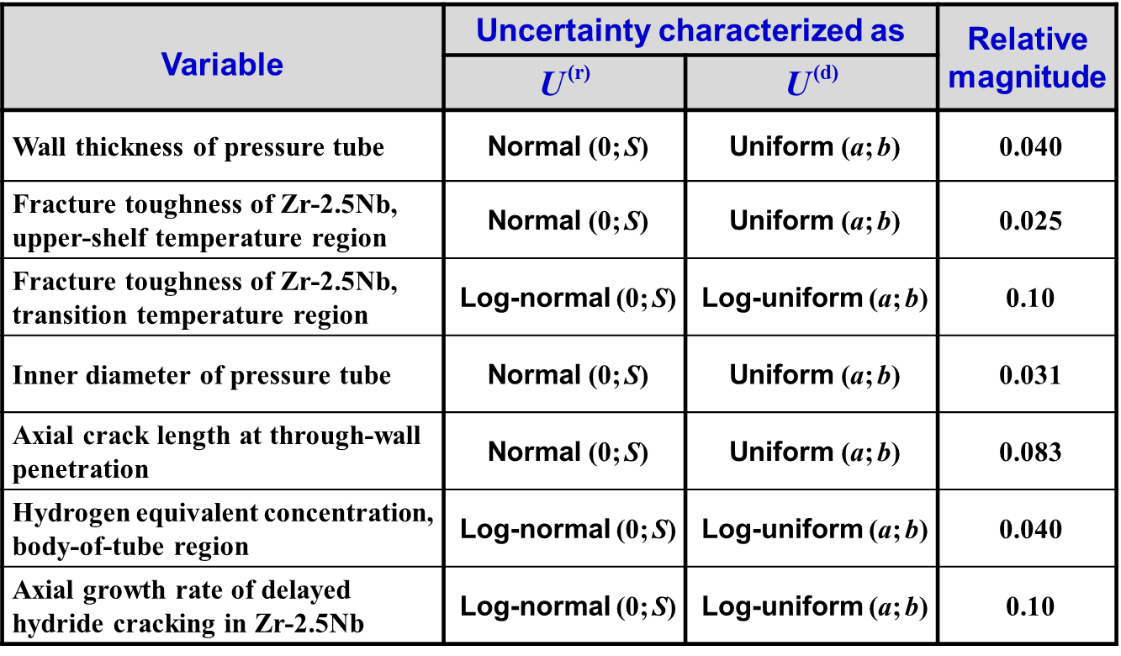
Pilot Study
Stage II
Summary of results for Type B variables
An approach was developed to characterize uncertainty due to imbalances in model-basis data set based on comparing statistical models generated with and without weighted regression

Slide 21
Pilot Study
Stage II/III: Correlations
Correlation between residual uncertainties in pressure tube inner diameter and wall thickness was characterized and incorporated.
Common mode failure probability of the AGS dew point alarm and beetle alarm was characterized and incorporated.

Slide 22
Pilot Study
Stage III: Uncertainty Propagation
Uncertainties characterized were incorporated into the probabilistic evaluation.
Monte Carlo Simulation with random sampling.
Pilot study compared evaluation result obtained with expanded set of uncertainty components to the baseline evaluation.

Slide 23
Pilot Study
Stage III
Baseline evaluation pilot study evaluation:
Incorporated uncertainties due to imbalances in the MBDS for the Type B variables
Incorporated uncertainty due to numerical solution for a single Type A variable
Incorporated parametric uncertainty for Type A variables associated with AGS and operator reliabilities

Slide 24
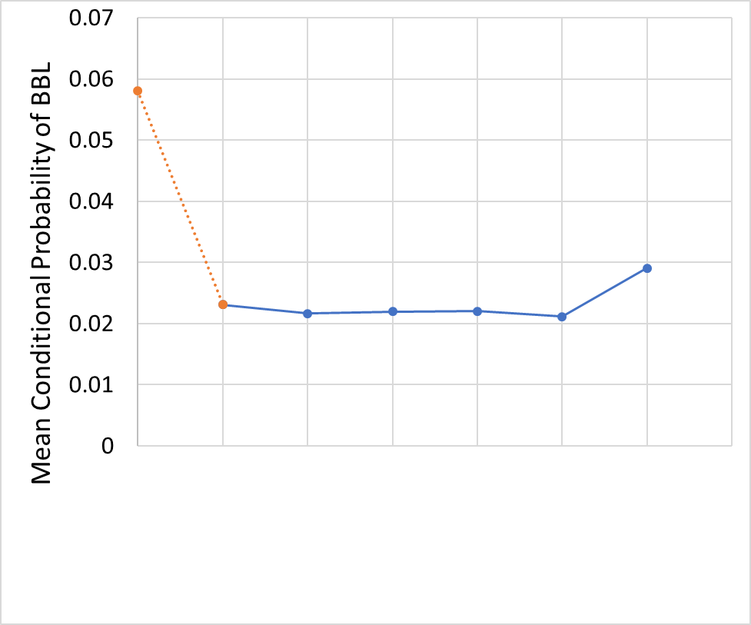
Pilot Study
PT Dimensions Predicted with Design Rates
Stage III
Incorporated parametric uncertainty for Type A variables associated with AGS and operator reliabilities
Baseline with new PT Dimension Models
Incorporated uncertainties due to imbalances in the MBDS for Type B variables and uncertainty due to numerical solution for a single Type A variable

Slide 25
Pilot Study
Summary
Probabilistic LBB results did not change significantly as a result of performing the pilot study.
Effect of newly characterized uncertainties was to increase the result by a factor of 1.26.
Pilot study successes:
First time application of CSA N285.8 Annex on Uncertainty Analysis.
Improved understanding of which variables are influential in the pressure tube LBB evaluation by performing sensitivity analysis.
Improved understanding of uncertainties involved in the pressure tube LBB evaluation gained by applying a structured uncertainty characterization framework.

Slide 26
Pilot Study
Summary
Pilot study challenges:
Unable to investigate all possible correlations relevant to the probabilistic LBB evaluation.
Unable to characterize all components of uncertainty as defined by the Annex on Uncertainty Analysis for all variables.
Some components of uncertainty were found to require expert judgement as the primary approach to uncertainty characterization. These uncertainties are the most challenging to characterize as the formal process for expert opinion elicitation and aggregation is resource intensive.

Slide 27
Acknowledgments
Valuable contributions from members of Task Group of CSA N285.8 Technical Subcommittee responsible for the development of the Annex on Uncertainty Analysis.
The Task Group was comprised of volunteers from utilities, suppliers and the regulator.
Guidance from CSA N285.8 Technical Subcommittee and N285B Technical Committee
Special thanks also to D. Mok, D. Pun-Quach, W. Reinhardt.
Support provided by CANDU Owners Group

Slide 28
CANDU Excellence through Collaboration

Slide 29
Backup Slides

Slide 30
Pilot Study on Uncertainty Analysis
for Probabilistic Leak-Before-Break
Evaluation approach
A leaking through-wall flaw is postulated to grow axially by delayed hydride cracking (DHC) as the reactor transitions from its sustained operating conditions to a cold and depressurized state
Leak-before-break is demonstrated if actual crack length remains below critical crack length at any time during this transient
Equivalently, if applied stress remains below critical stress for flaw instability at any time during this transient
critical hoop stress
fracture toughness
axial DHC growth rate
bulging factor
flow stress
axial crack length

Slide 31
Background
Parametric models
(also referred to as “physics-based” or “mechanistic”)
Example: free diffusion
Uncertainty in diffusivity D(T) is characterized independently
Uncertainty in C is characterized by propagating uncertainty in D through the solution of diffusion differential equation
C : response variable (concentration as a function of t, x )
t, x : explanatory variables (time t, location x)
D(T) : model parameter (a function of temperature T)

Slide 32
Background
Uncertainties in parametric models
Parametric uncertainty due to uncertainties in non-deterministic parameters involved in the model
Uncertainty due to finite precision of computations and finite level of convergence involved in numerical representation of mathematical formulation used in the model
Uncertainty due to assumptions and approximations made when physical phenomenon of interest is represented by mathematical formulation used in the model

Slide 33
Background
Statistical models
(also referred to as “data-driven” or “empirical”)
Example: diffusivity
Uncertainty in diffusivity D is characterized directly without propagating uncertainties in Q_{D} and E_{D}
Uncertainties in Q_{D} and E_{D} may be inferred from uncertainty in D
D : response variable (diffusivity)
T : explanatory variable (temperature)
Q_{D}, E_{D} : non-deterministic model parameters

Slide 34
Background
Uncertainties in statistical models
Residual uncertainty representing observed variation that is not attributable to any of the explanatory variables used in the model
Uncertainty due to limitations in model-basis data set (in terms of balance, coverage, measurement uncertainties)
Uncertainty due to assumptions and approximations made when physical phenomenon of interest is represented by mathematical formulation used in the model

Slide 35
Annex on Uncertainty Analysis
for CSA Standard N285.8
Sensitivity analysis
Sensitivity coefficient S_{j}
Example: Output variable in evaluation of leak-before-break (LBB)

Slide 36
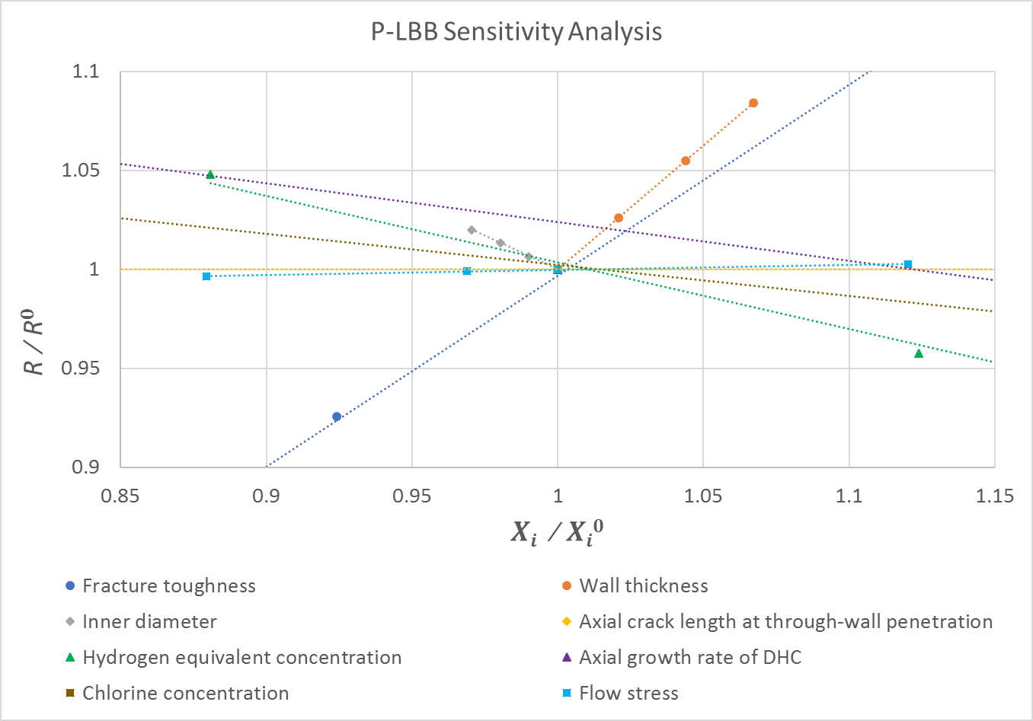
Pilot Study: Stage I Results

Slide 37
Approach
Balanced and imbalanced data sets
Perfectly balanced data set
Imbalanced data set
Run | X₁ | X₂ | Y | W
1 | 1 | 1 | Y₁ | 1
2 | 1 | 0 | Y₂ | 1
3 | 1 | -1 | Y₃ | 1
4 | 0 | 1 | Y₄ | 1
5 | 0 | 0 | Y₅ | 1
6 | 0 | -1 | Y₆ | 1
7 | -1 | 1 | Y₇ | 1
8 | -1 | 0 | Y₈ | 1
9 | -1 | -1 | Y₉ | 1
N = 9 | L₁ = 3 | L₂ = 3 | ∑W_{j} = 9
Run | X₁ | X₂ | Y | W₁ | W₂
1 | 1 | 1 | Y₁ | 1.5 | 0.75
2 | 1 | 1 | Y₂ | 1.5 | 0.75
3 | 0 | 1 | Y₃ | 0.75 | 0.75
4 | 0 | 1 | Y₄ | 0.75 | 0.75
5 | 0 | 0 | Y₅ | 0.75 | 1.0
6 | 0 | -1 | Y₆ | 0.75 | 1.5
7 | -1 | 0 | Y₇ | 1.0 | 1.0
8 | -1 | 0 | Y₈ | 1.0 | 1.0
9 | -1 | -1 | Y₉ | 1.0 | 1.5
N = 9 | L₁ = 3 | L₂ = 3 | ∑W_{1j} = ∑W_{2j} = 9

Slide 38
Annex G Definitions
Best estimate – Estimate of non-deterministic variable of interest, which is associated with the highest confidence of representing the true value of this variable, among all estimates of this variable inferred from the relevant model or analysis.
Parametric uncertainty - Uncertainty in non-deterministic variable of interest, which is due to uncertainties in the non-deterministic parameters involved in the relevant parametric model or analysis.
Residual uncertainty - Uncertainty in non-deterministic variable of interest, which represents its observed variation that is not attributable to any of the explanatory variables used in the relevant statistical model or analysis.
Sensitivity coefficient – Relative change in the output variable associated with a relative change of a small magnitude in the input variable in the relevant mathematical model. Relative changes in the variable of interest are determined as absolute changes in this variable divided by the value of this variable at the evaluation point.
Uncertainty – Variation in non-deterministic (stochastic, random) variables of interest, which is attributable to inherent variability in the physical phenomena described by the variables and/or lack of knowledge about the physical phenomena.
Uncertainty analysis – The process of identifying and characterizing the influential sources of uncertainty in the probabilistic analysis, evaluating their impact on the analysis results, and developing, to the extent practicable, a quantitative measure of this impact.
Uncertainty due to limitations in data set – Uncertainty in non-deterministic variable of interest, which is due to measurement uncertainties associated with the data set used as the basis for the relevant statistical model or analysis, as well as with limited coverage and balance in this data set.
Uncertainty due to model form – Uncertainty in non-deterministic variable of interest, which is due to assumptions and approximations associated with representing the physical phenomenon by the mathematical formulation used in the relevant model or analysis.
Uncertainty due to numerical solutions - Uncertainty in non-deterministic variable of interest, which is due to finite precision of computations and finite level of convergence involved in the numerical representation of the mathematical formulation used in the relevant model or analysis.

