Slide 1
Application of xLPR to leak-before-break and the use of xLPR to support inspection relief in a pressurized water reactor
A. Udyawar, B. Golchert, M. Solmos, S. Sidener, E. Johnson
Westinghouse Electric Company
22 October 2019
3rd International Seminar on Probabilistic Methodologies for Nuclear Applications

Slide 2
Background
Over the years, the nuclear industry has utilized Probabilistic Fracture Mechanics (PFM) analysis techniques to address numerous issues in the operating fleet.
In particular, Westinghouse has historically been involved in PFM activities such as:
Pressurized thermal shock
Risk informed ISI extension
RV ISI extension
Probabilistic pump flywheel investigations
The current trend in the nuclear industry is shifting to analytical approaches which use more probabilistic based techniques to regain margin that was inherent to conventional quantitative deterministic fracture mechanics evaluations.
About a year ago, Westinghouse undertook an investigation as to the applicability of xLPR to a variety of industry issues

Slide 3
Background (continued)
An internal meeting was held to determine potential PFM applications in the nuclear industry
Many applications considered, most tabled, and only two were pursued
Leak before break (LBB) would be the first application investigated using xLPR
This would be a proof of concept to show xLPR provides a cost-effective supplement to existing deterministic LBB analyses
Inspection relief was the second idea looked into using xLPR
Again, a proof of concept approach

Slide 4
Background (conclusion)
To show that xLPR is a viable tool for LBB and inspection relief, efforts were made to use xLPR:
on cases from the working group (RVON and RVIN)
The results were favorable but will not be discussed in this presentation
on the information from existing deterministic LBB and inspection relief calculations
As this is a proof of concept approach, suitably close data from the deterministic models was incorporated into the xLPR models
This work is to qualitatively demonstrate that xLPR can be used for LBB and for inspection relief

Slide 5
Initial thoughts: xLPR evaluation
xLPR advantages
xLPR (or PFM) disadvantages
NRC ‘favors’ xLPR
Can handle a multitude of inputs
Geometries
Loads/transients
Material properties, etc.
Can run relatively ‘quick’
Can be ‘stand-alone’ or used in conjunction with deterministic calculations
May have other applications
Long learning curve
Numerous input requirements
Has had some deficiencies identified in the formulation
Runs sometimes end unexpectedly
Long running times for large numbers of realizations
Ideally, use GoldSimPro to run in parallel
A lot of uncertainty in regard to:
What is needed for PFM submittals
Applying xLPR to something other than LBB
What are the acceptance criteria?

Slide 6
Overly Simplified Deterministic LBB
The acceptance criteria are as follows:
Margin of 10 on the Leak Rate
Margin of 2.0 on Flaw Size
Margin of 1.0 on Loads (using the absolute summation method for faulted load combination)
Deterministic LBB calculates these three criteria most frequently using the most adverse (conservative) conditions
However, deterministic LBB does not have the capability to determine ‘how likely’ these conditions are satisfied
How much margin is available?

Slide 7
Westinghouse Approach to LBB using PFM (xLPR)
Should deterministic methods fail to provide adequate margins, consider using xLPR to determine if there is additional probabilistic margin that could be leveraged for the particular analysis.
This type of analysis would only be done on the most limiting locations/conditions.
This PFM analysis would be an ‘add-on’ to the traditional LBB analysis and would leverage the inputs from the deterministic analysis.
To provide the best possible results, several sensitivity studies will be performed to ensure that a probabilistic approach can provide useful, engineering results.

Slide 8
xLPR Applied to Deterministic LBB Case
The next few slides are calculations for circumferential cracks.
xLPR was applied to the most limiting dissimilar metal weld and to the most limiting similar metal weld in a system
Geometry, transients, and loads were approximated from the deterministic LBB case for large diameter pipes on the hot leg
Most of the data was treated deterministically
Deterministic LBB showed that the system was not challenged→xLPR confirmed this conclusion
Error trap in xLPR: all units are metric while most site specific data is in English units

Slide 9
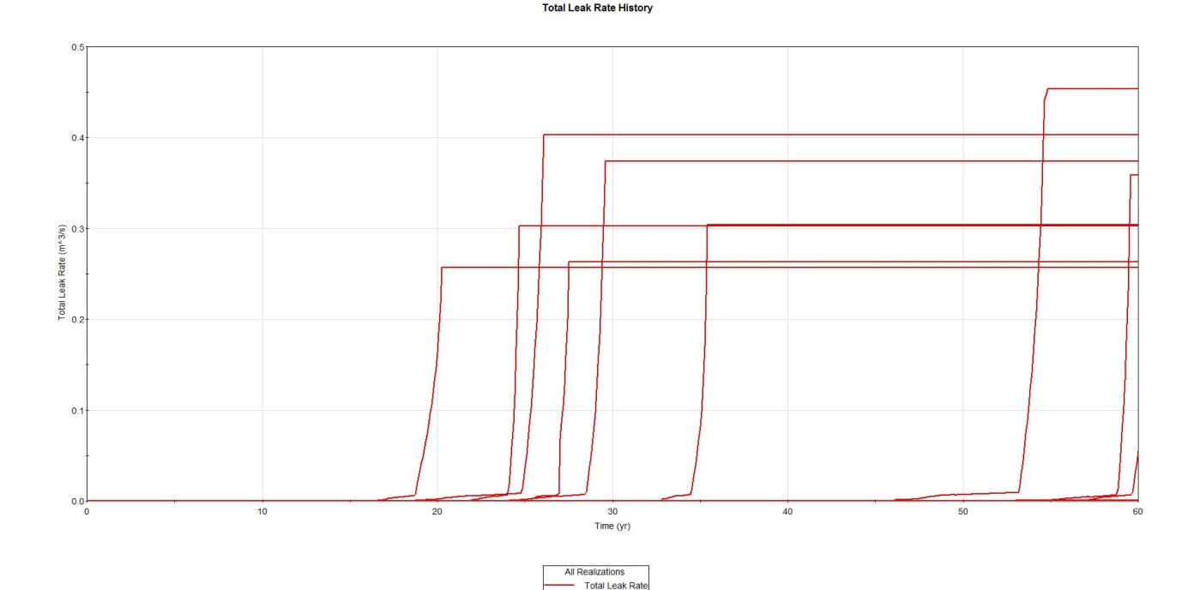
Total Leak Rate for PFM LBB
Total leak rate data can be taken into a statistical analysis program to show the likelihood of exceeding the acceptance criteria

Slide 10
Leak rate as a function of crack size
Several scenarios were sampled with various crack sizes. Selected results are shown here. Only crack 1 was large enough to show leakage.

Slide 11
Comparison of detection methods
xLPR can determine probabilities of detection of crack formation, leaks, and rupture all of which could be used for LBB

Slide 12
Conclusion: xLPR and LBB
xLPR provides ample data to augment LBB analyses
Once an acceptance criterion for LBB is agreed upon, the xLPR data can be interpreted for site specific application
During this initial xLPR effort, WEC determined that one of the limitations of xLPR is that is only applicable to one weld at a time
WEC has developed a couple of methodologies that may potentially model an entire system while leveraging the xLPR formalism

Slide 13
Overly Simplified Inspection Relief
If a plant can extend the time between inspections of welds, the plant save a lot of money
How to justify this extension?
How can this analysis be done cost-effectively?
Ultimately, it must be definitively shown that the probability of ‘failure’ must be significantly low.
What is ‘failure’ (crack formation, leakage, rupture…)?
What is significantly low?
It would be challenging to justify a PFM approach to inspection relief if the above questions are not satisfactorily answered.

Slide 14
Westinghouse Approach to PFM Inspection Relief
This type of analysis would be done on the weld locations/conditions that could provide some inspection relief (based on subject matter expert ‘experience’) and not just every weld
Use xLPR to determine if there is a statistical justification to reduce the inspection frequency for a particular weld.
This PFM analysis could be standalone or in addition to current inspection relief analysis
Several sensitivity studies would need to be performed to ensure that a probabilistic approach can provide defensible engineering results.

Slide 15
Applications of xLPR to Existing Deterministic Analysis
As a proof of concept:
A large diameter weld (RCS) was analyzed using existing plant data
Used approximate geometry, loads and transients
A mid-sized diameter weld (approximately 12” OD) was also analyzed
Used approximate geometry, loads and transients
For each case, determine if the crack formation and leak rate appear to be reasonable (assumes no initial cracks present)
This data could be exported to a statistical data analysis software to provide confidence intervals associated with extending the inspection interval

Slide 16
Large Diameter Line Inspection Relief
Note: plant detection limit ~1 gpm
Even though cracks can form earlier in the plant life, leaks may not occur until much later

Slide 17
Probability of crack formation for mid-sized line
There is a probability that a crack can occur early in the life of the plant but few realizations show this crack formation

Slide 18
Total Leak Rate as a Function of Time for a mid-sized line
If leaks occur early on, the mean total leak rate for the worst realization is low
(0.001 m^3/s) = 16 gal/min

Slide 19
Occurrence of a leak with ISI for a mid-sized line
xLPR can also account for the effect of In-Service Inspection (ISI does not really help the early-in-life crack leaks but reduces the probability of leaks for future cracks)

Slide 20
Conclusion: xLPR and Inspection Relief
xLPR provides ample data to provide a statistical justification for inspection relief
Once an acceptance criterion for inspection relief is agreed upon, the xLPR data can be interpreted for site specific application
WEC was able to show that xLPR can be successfully applied to mid sized lines
As part of this effort, WEC has developed its own internal version of xLPR that addresses some of the issues addressed/discovered by the xLPR working group

Slide 21
Final Conclusions
Westinghouse has determined that probabilistic fracture mechanics (specifically xLPR) can be used for leak before break and inspection relief if:
A general consensus is reached on acceptance criteria for each type of analysis
It was also determined that xLPR has a number of other applications in the nuclear industry and beyond. The industry should work together to investigate these applications.
Thank you for your time!!

Slide 22
Questions?

