Slide 1
3rd International Seminar on Probabilistic Methodologies for Nuclear Applications (ISPMNA)
Application of Probabilistic Leak-Before-Break for WWER-1000 Unit
Yaroslav Dubyk, Sergii Ageiev, Maksym Zarazovskii and Vladislav Filonov
IPP-Centre Ltd, Kyiv, Ukraine
October 22-24, 2019, Rockville, MD

Slide 2
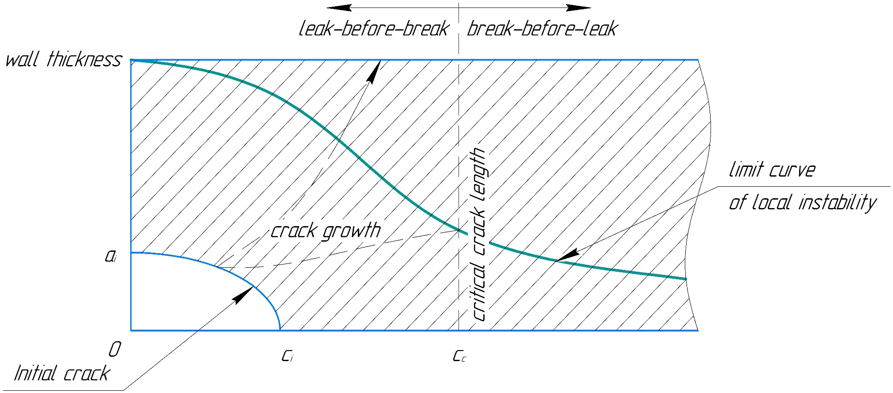
Motivation. LBB
Leak-Before-Break (LBB) is a term that has been used for decades in reference to a methodology that means, that a leak will be discovered prior to a fracture occurring in service

Slide 3
Motivation. From deterministic to probabilistic LBB
In Ukraine deterministic Leak-Before-Break concept applied for:
2 WWER-440 (Rivne NPP-1,2);
10 WWER-1000 (Khmelnitskiy NPP-1,2; Rivne NPP-3,4; South-Ukraine-1,2; Zaporizhia NPP-1,2,3,4)
Currently 3 units of WWER-1000 (South-Ukraine-3; Zaporizhia NPP-5,6) are in process for applying.
This concept is applied for:
Main Circulating Piping (MCP),
Emergency Core Cooling System (ECCS) passive pipelines
Pressurizer piping
The Ukrainian methodology for LBB should be reviewed, and now it is a good time to extend it for probabilistic part.
The main idea of this work is to extend deterministic LBB analysis to probabilistic evaluation, and to investigate the correctness of Leak Rate safety coefficient value of “10”.

Slide 4
Structure of the report
Material properties statistic distribution
Loads for the WWER-1000 Main Circuit
Main equations for SIF, Reference stresses, Crack Opening Area, Leak Rate
Results and Discussion
Conclusion

Slide 5
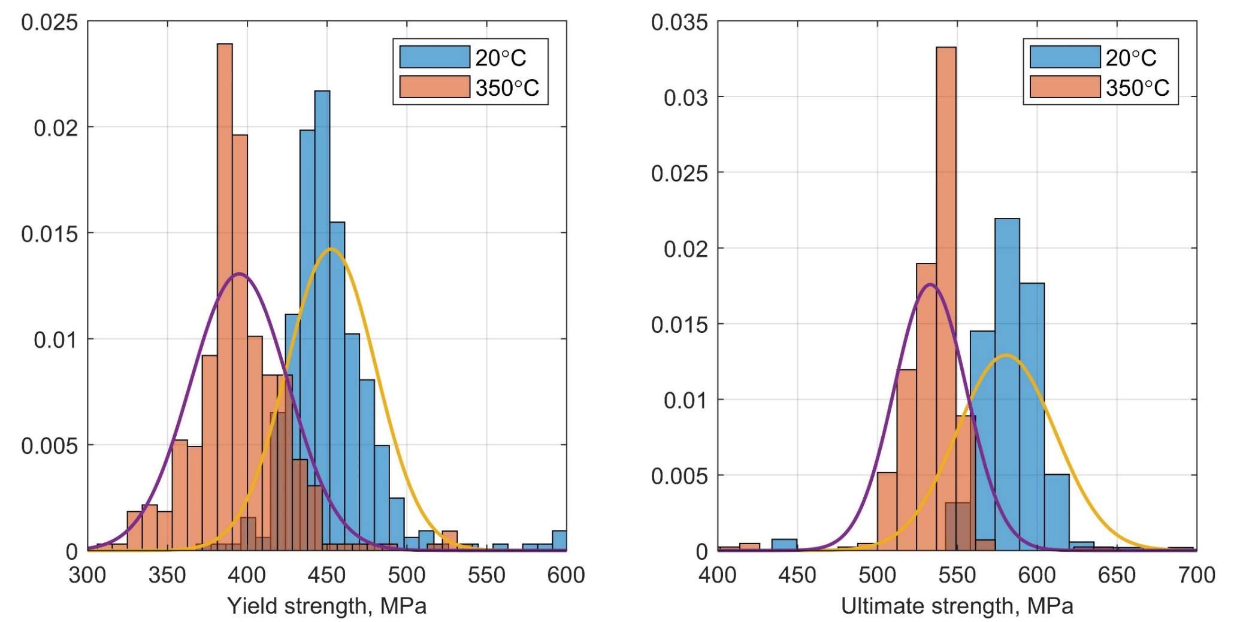
Materials. Yield and Ultimate Strength
Material – ferritic steel 10GN2MFA (10MnNi2MoV)
*Data taken from Zaporizhzhya NPP

Slide 6
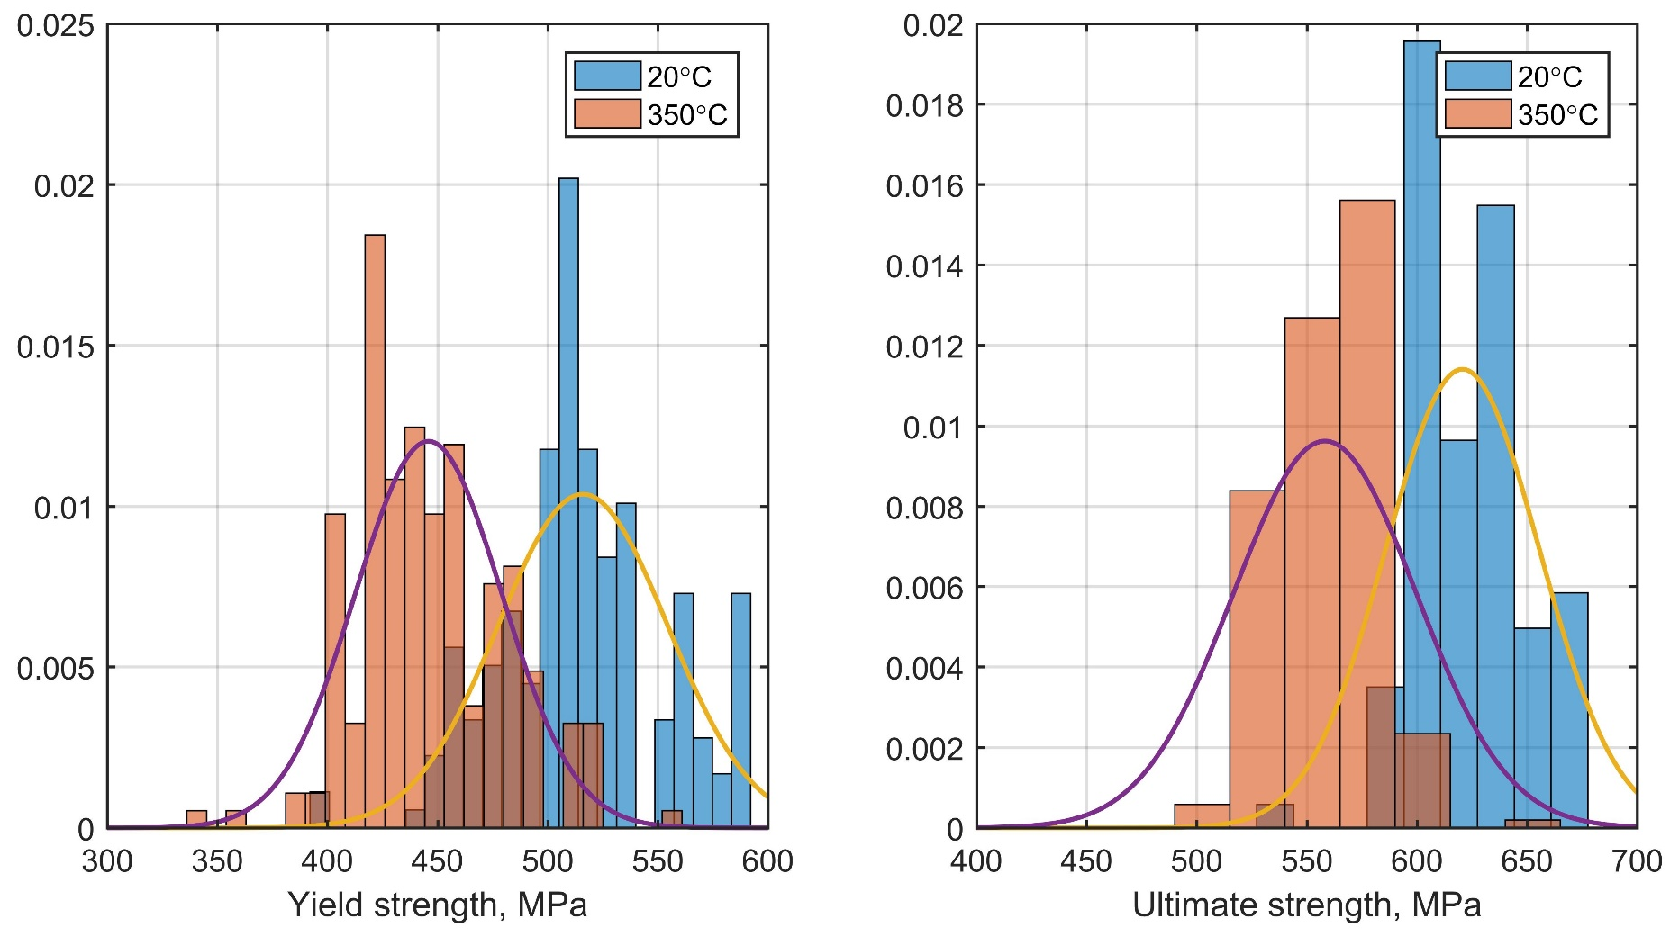
Materials. Yield and Ultimate Strength
Material – welds PT-30
*Data taken from Zaporizhzhya NPP

Slide 7
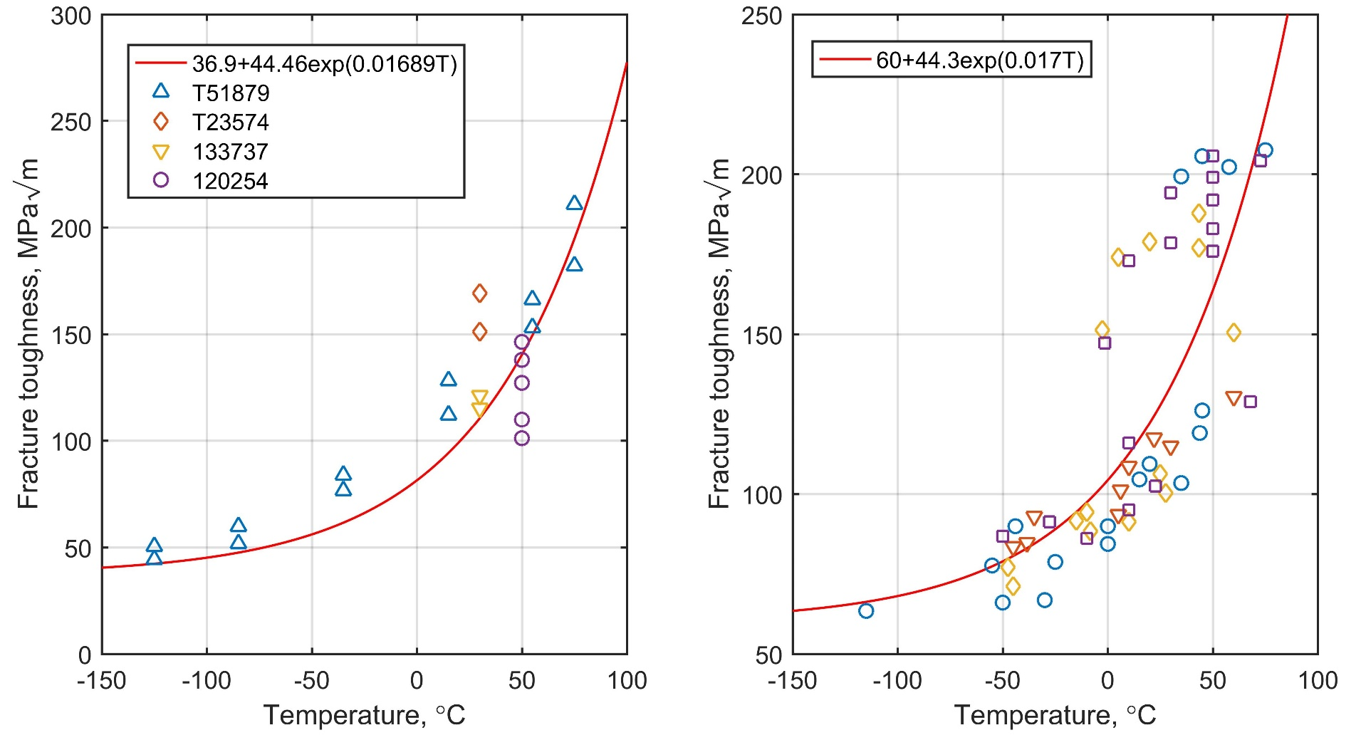
Materials. Fracture toughness
*Timofeev, B. T., Blumin, A. A., Anikovsky, V. V., (2000). Fracture toughness of 10GN2MFA steel and its welds. International Journal of Pressure Vessels and Piping 77(4), 195-201.

Slide 8
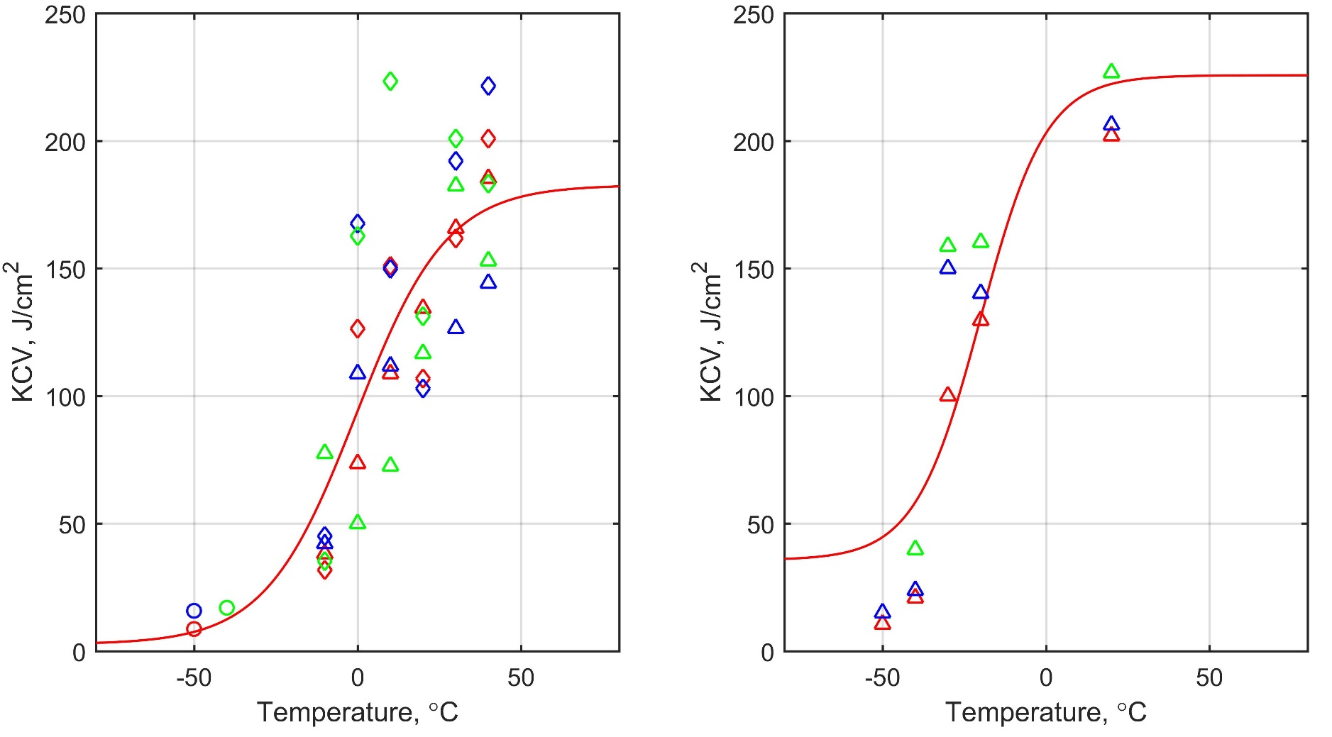
Materials. Critical temperature of brittleness
Critical temperature of brittleness (CTB)
Shift of CTB due to the thermal aging
Shift of CTB due to the neutron fluence
Shift of CTB due to the fatigue
*Data taken from Zaporizhzhya NPP

Slide 9
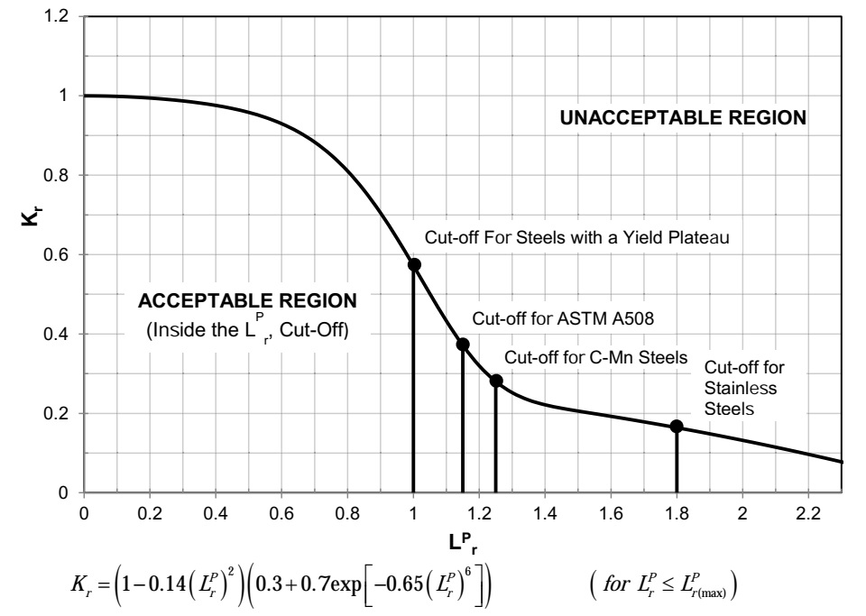
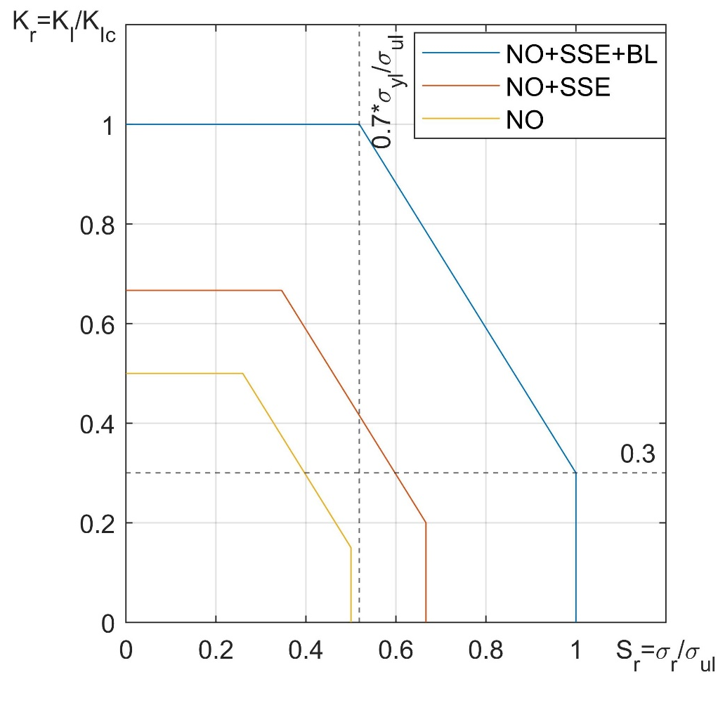
Materials. Failure Assessment Diagram
To distinguish load case, and for sake of conservatism a different safety coefficient were used:
“2” – for Normal Operating conditions
“1.5” – for Hydraulic test and Safety Shutdown Earthquake
“1” – for LOCA accidents - blast loading due to rupture of pipelines that are connected to the considered ones;

Slide 10
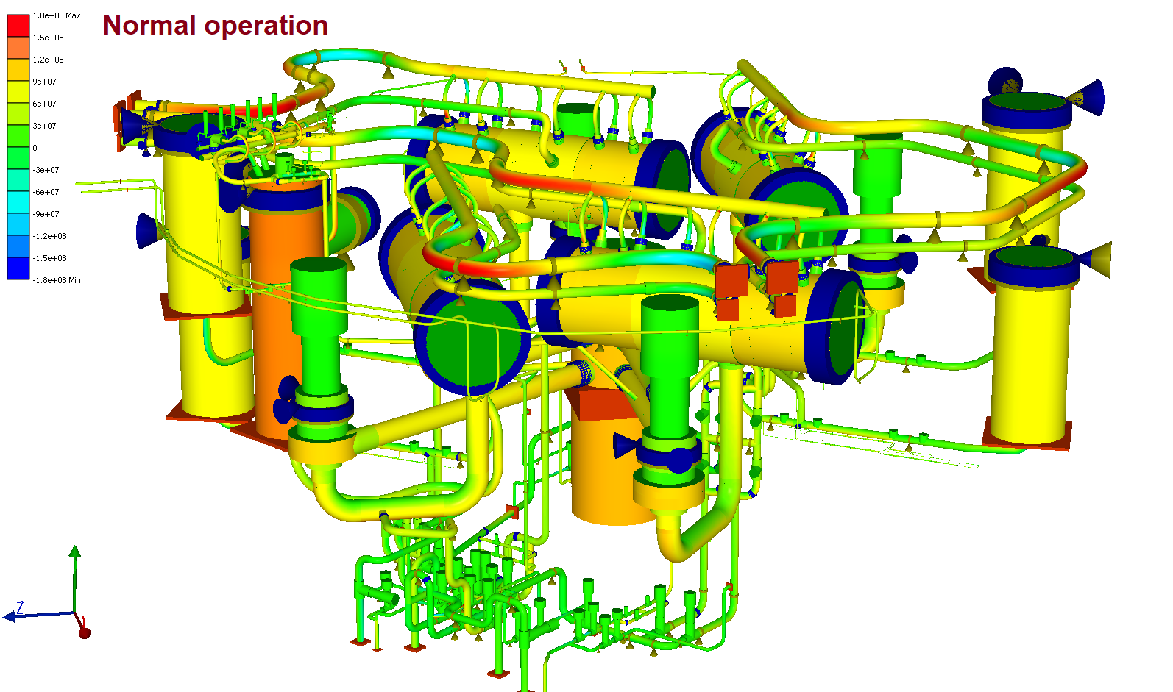
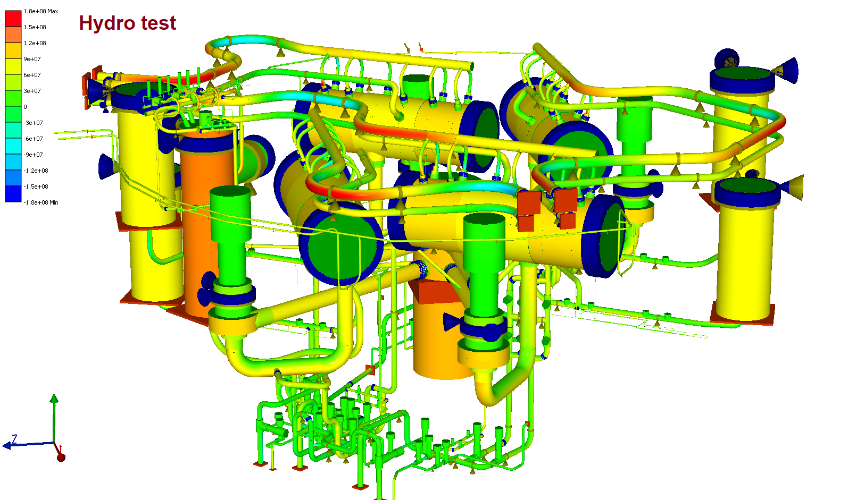
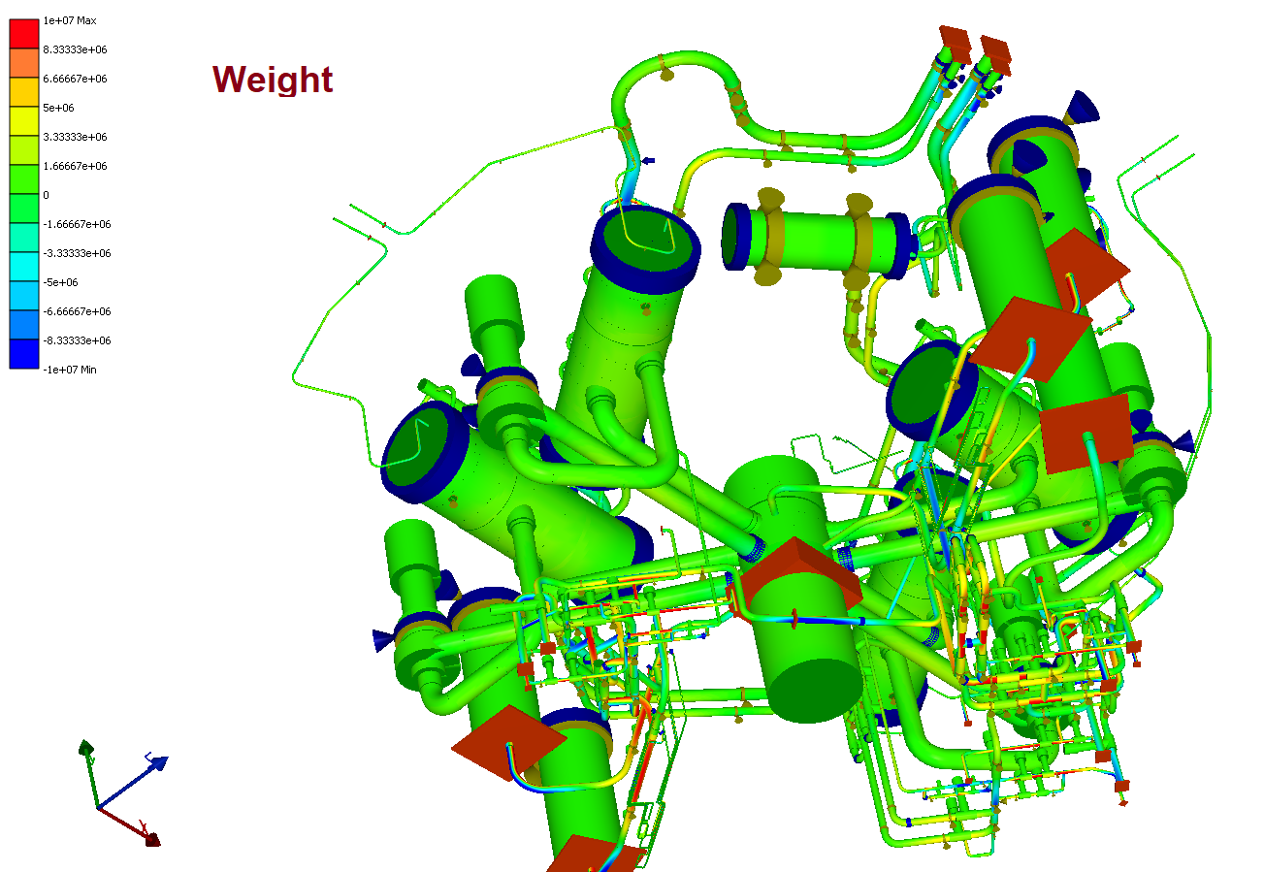
Loads. Operation Conditions

Slide 11
Main equations. SIF (Zahoor*)
Axial crack
SIF
Nominal stress
Geometry correction factor
Circumferential crack
SIF
Nominal stress
Geometry correction factor
*Zahoor, A. (1989). Ductile Fracture Handbook. Reports NP-6301-D, N14-1. Electric Power Research Institute, Palo Alto, CA

Slide 12
Main equations. Reference stress (Zahoor)
Axial crack
Circumferential crack
where
Pipe outer radius, wall thickness, and half crack angle respectively
the level of acting σ_{ref} depends on the yield
strength σ_{yl}, which is methodologically erroneous, since stresses σ_{ref} characterize the load level.
*Zahoor, A. (1989). Ductile Fracture Handbook. Reports NP-6301-D, N14-1. Electric Power Research Institute, Palo Alto, CA

Slide 13
Main equations. Reference stress (API 579-2016)
Axial crack
Circumferential crack
where
Pipe outer radius, middle radius, wall thickness, and half crack angle respectively
the level of acting σ_{ref} depends on the yield
strength σ_{yl}, which is methodologically erroneous, since stresses σ_{ref} characterize the load level.

Slide 14
Main equations. Reference stress for circumferential crack
For circumferential crack we have only case where:
θ
R
θ
t
Force equilibrium
Moment equilibrium
Using the following dimensionless notations for forces
Limit stress for tension or compression
From Treska criterion
System of nonlinear equations solved with respect of θ and φ₀

Slide 15
Main equations. Crack Opening Area
COA for Griffits plate
*Orynyak, I., Yakovleva, E., Dubik, Ya. (2012). The application of the combined method of weight functions for the determination of a through-wall crack opening area in a shell.

Slide 16
Main equations. Crack Opening Area
Defining the coefficients

Slide 17
Main equations. Leak Rate, Henry-Fauske model
The model is based on solving the following system of equations:
We have two main parameters:
G_{c}–mass flux at crack exit plane [kg/s]
p_{c}–pressure at crack exit plane [MPa]
Pressure loss due to
entrance effects:
bends and protrusions:
friction:
area change acceleration:

Slide 18
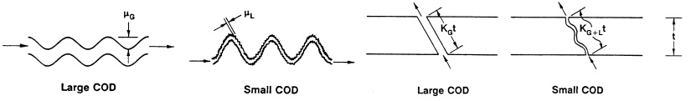
Main equations. Leak Rate, Crack morphology
µ-surface roughness
n_{t} –number of turns
K –flow length parameter
µ_{L}-local roughness
µ_{G}-global roughness
K_{G+L}-global and local path deviation
K_{G}-global path deviation
*Rudland, D. L., Wilkowski, G., Scott, P. (2002). Effects of crack morphology parameters on leak-rate calculations in LBB evaluations. Journal of Pressure Vessel and piping 79, 99-102.

Slide 19


Main equations. Leak Rate, analysis
Evaluation of leak rate crisis characteristics
Analytical models
Differential models
(models like Henry-Fauske)
(Complete set of 7 equations)
Advantages:
Advantages:
Quick evaluation of locking pressure and flow;
Does not require complex computational algorithms;
A huge number of different modifications (including non-equilibrium);
The ability to quickly adapt to specific experimental data
The crisis of the flow is interpreted on the basis of the physical essence (in the countercurrent, the relative velocity of the flow is 0);
They are universal models;
Allow to take into account mechanical and thermal disequilibrium;
Take into account the dynamics of the process;
There are no restrictions on the functional dependence of the mass velocity, as well as the distribution of parameters;
Flexibility to adapt the model, which is based not only on the control of pressure drop, but also on the on / off of physical processes;
Disadvantages:
Based on the mass flow extremum with pressure variation, which in its physical essence is a consequence, not the cause of a current crisis;
Have no translation (water-gas);
Do not account for the dynamics of processes;
Limited functional dependence of the mass content along the length of the channel;
Limited functional dependence (including uncertainties) of the critical mass velocity, which in some cases makes it impossible to adapt models;
Limited thermal setting;
Disadvantages:
Calculation speed (10-100 times) lower than that of analytical models;
Requires the use of special algorithms for solving nonlinear systems of remote control with procedures for the correction of PG (Limited use of explicit time and coordinate schemes);

Slide 20
Results&Discussion. Methodology
Deterministic parameters
Stochastic parameters
Pressure, Temperature
Axial Force
Bending Moment
Loads
Material
K_{1c} σ_{ul} σ_{yl}
Critical Crack Length (CCL)
Monte-Carlo Event Generation
Crack Opening Area (COA)
Leak Rate (LR)
Crack morphology
µ, n_{t} , K
no
LR>38 l/min
(LR>3.8l/min)
yes
LBB not acceptable
LBB acceptable

Slide 21
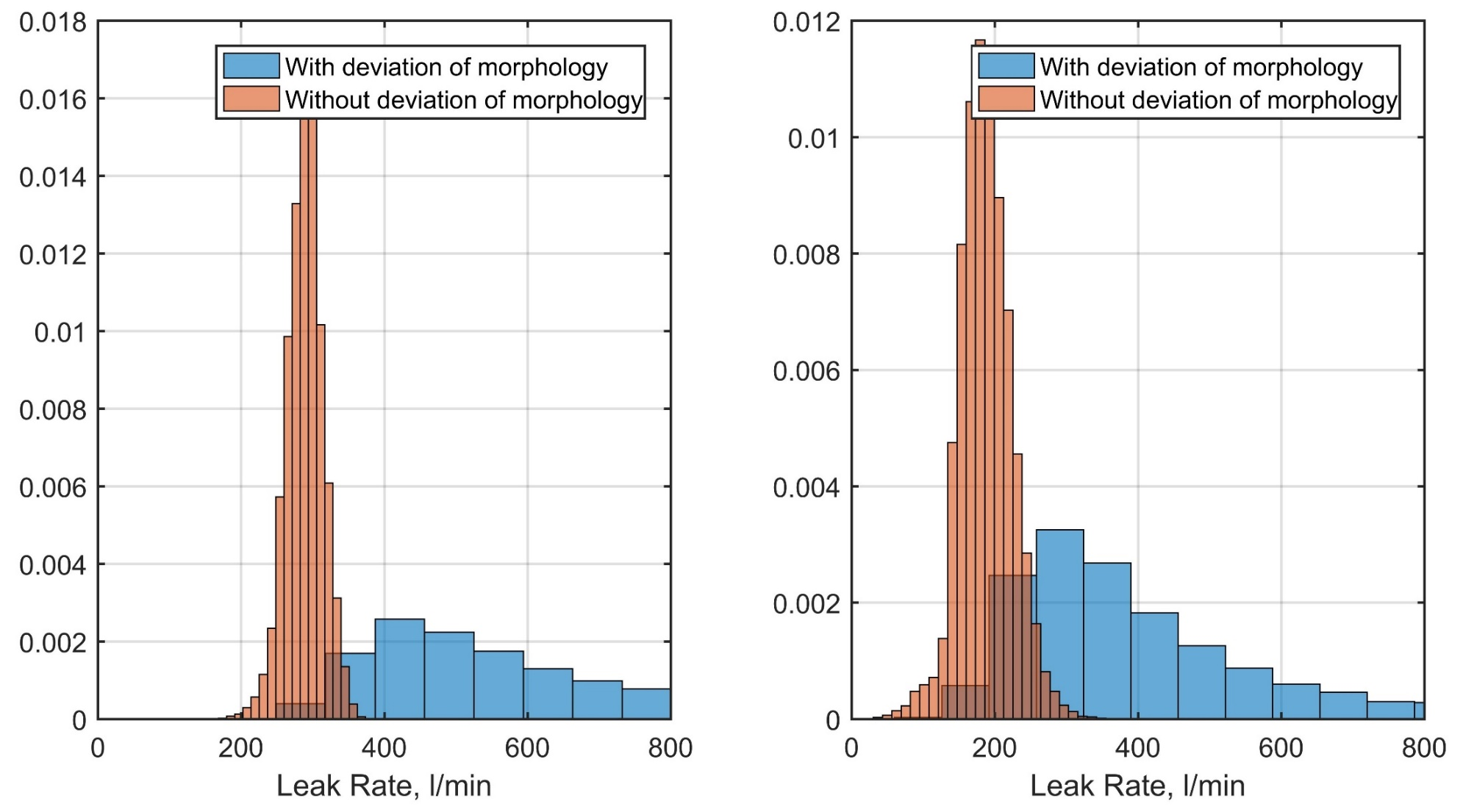
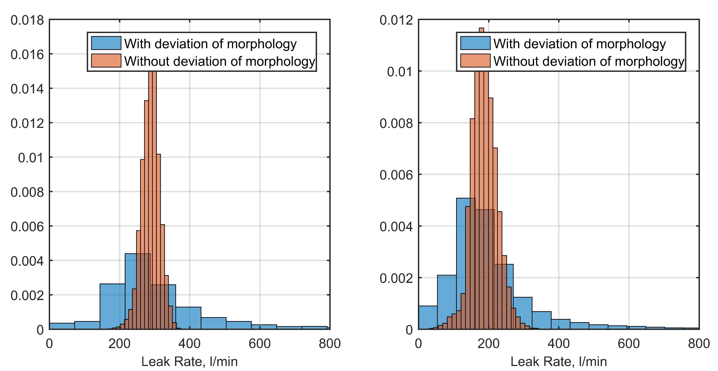
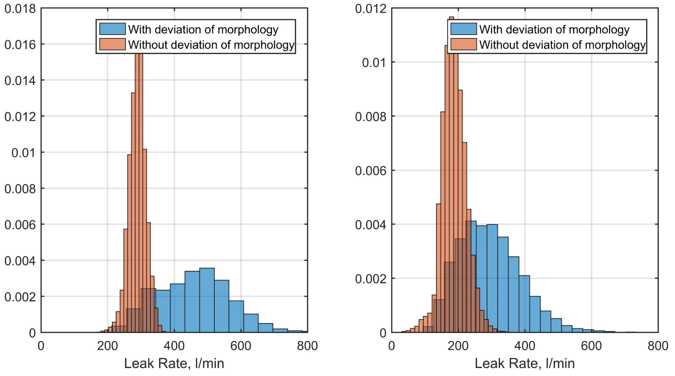
Results&Discussion. Methodology
Intergranular Stress Corrosion Cracking (IGSCC)
Primary water stress corrosion cracking (PWSCC)
Corrosion Fatigue
Crack morphology strongly affects the results scatter, and it is more significant then mechanical properties scatter

Slide 22
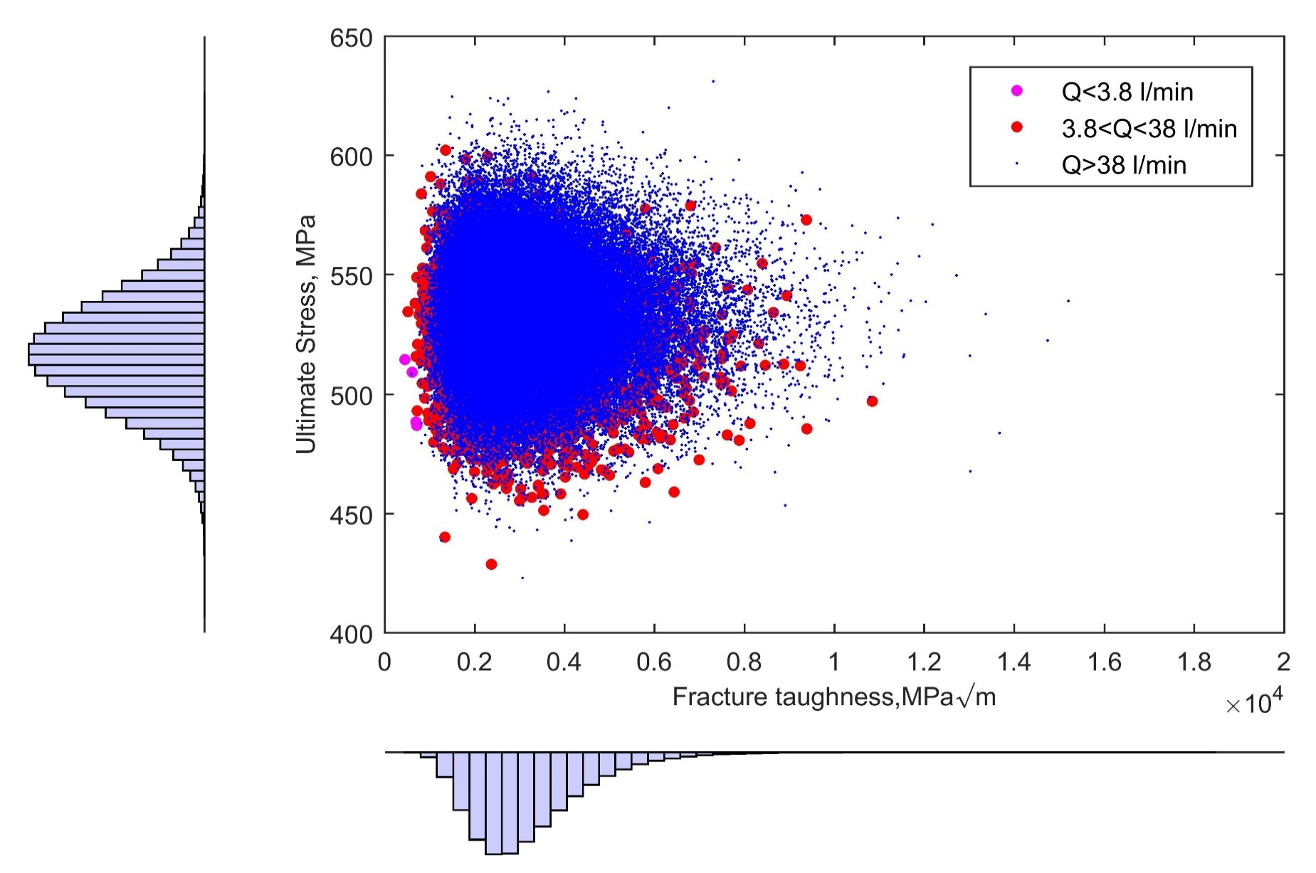
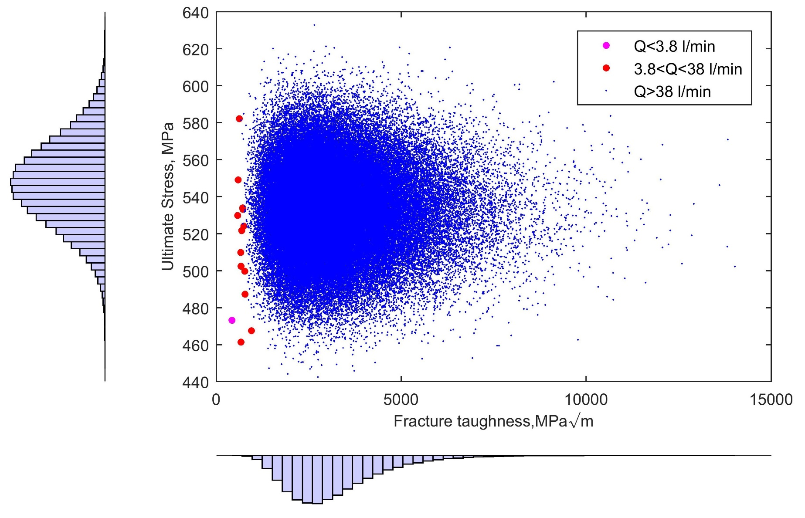
Results&Discussion. Methodology
Among the crack morphology characteristics n_{L}(number of bends and protrusions per mm of flow length) is the most significant parameter, that’s why IGSCC crack type is the most representative in failure analysis.

Slide 23
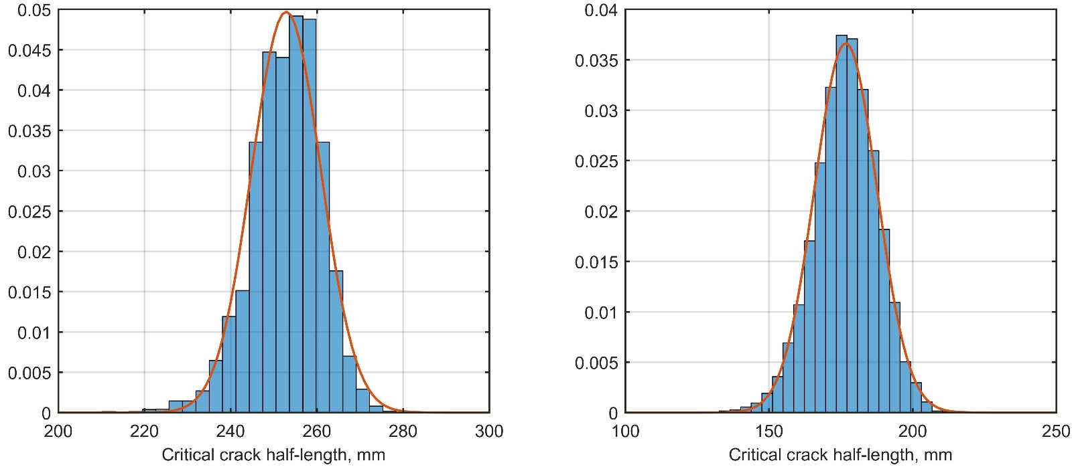
Results&Discussion. Methodology

Slide 24
Conclusions
A probabilistic Leak-Before-Break analysis for WWER-1000 unit was performed based on the Failure Assessment Diagram (FAD), for the following stochastic parameters:
Critical temperature of brittleness and Yield (Ultimate) Stress were fitted by normal distribution, based on experimental data taken from the manufacture documentation found at the Ukrainian NPP.
Crack morphology parameters as a normally distributed random variables, found in the literature.
The statistical behavior of the leak rate and critical crack length for different defect orientation was examined using Monte-Carlo simulation:
Calculations with safety factor of 10 proved to be very conservative, thus a reduction of conservatism is possible for LBB concept.
Crack morphology parameters highly affects the leak rate, the leak rate distribution becomes more scattered.
Among the mechanical characteristic, a Fracture toughness has more influence rather than Ultimate of Yield strength.
For future work a Leak Rate model should be improved, as Henry-Fauske model has a drawback in two-phase physics, because the leak rate characteristics should be treated accurately for nuclear safety.

Slide 25

Question & Answer session

