Slide 1
Target Reliability Informed Design Optimisation
ISPMNA 2019
Peter Reed, Core Stress Engineer
Rob Marshall, Principal Engineer Core Structural Integrity
The information in this document is proprietary and confidential to Rolls‑Royce and is available to authorised recipients only – copying and onward distribution is prohibited other than for the purpose for which it was made available
22 October 2019

Slide 2
Introduction and Background
01
02
Target Reliability Approach
03
Higher Level Safety Case
04
Next Steps, Conclusions, Questions?

Slide 3
01
Introduction & Background

Slide 4
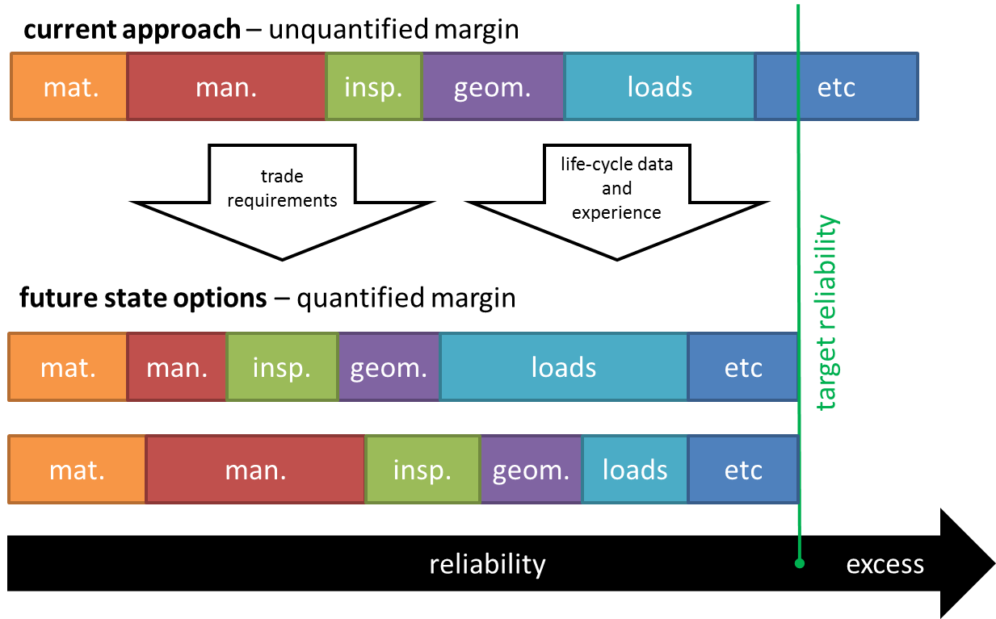
Introduction & Background

Slide 5
Probabilistic Safety Justifications made for in-service product
Introduction & Background
Design
Manufacture
Service Life
Decommissioning
Probabilistic Safety Justifications made at design stage for optimised design
What is the impact of optimisation on the whole system safety case?
Influencing design and optimising through the use target reliability methods

Slide 6
Problem
Introduction & Background
Welded Component (eg. pipe section)
Sharp features in weld underbead.
Justifiable?

Slide 7
“Deterministic” Assessment
Introduction & Background
Material parameters
$$K=f\left(x_{1},x_{2},x_{3}…m_{1}{,m}_{2},m_{3}…p_{1},p_{2},p_{3}\right)$$
Stress Intensity Factor
Geometric parameters
Performance
parameters

Slide 8
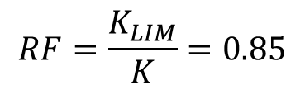
“Deterministic” Assessment
Introduction & Background
Traditional Approach
Set each parameter to its perceived worst case.
Upper or lower bound, based on tolerances or statistical analysis of as-built data
Reserve factor less than 1.00. Crack like geometry not tolerable within the design.
$$K=f\left(L,U,U…U,L,U …U,U,U\right)$$
$$RF=\frac{K_{LIM}}{K}=0.85$$

Slide 9
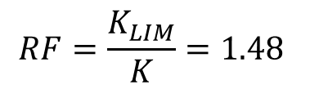
Problem
Introduction & Background
Machining operation can expose buried defects from the welding process.
Machine out weld geometry
Machining operation causes damage to other components
$$RF=\frac{K_{LIM}}{K}=1.48$$

Slide 10
Machining is costly
Cost
Quality
Delivery
Introduction & Background
Machining is time consuming
ALARP/ALARA Safety Case
Machining generates inspection
Desired Performance

Slide 11
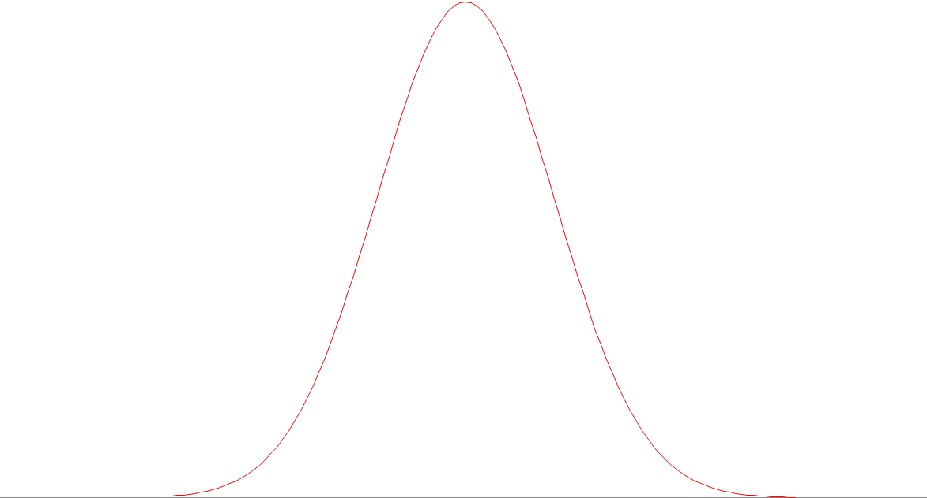
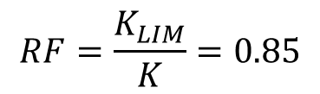
Suitably “Deterministic”?
Introduction & Background
K_{LIM}
K
$$RF=\frac{K_{LIM}}{K}=0.85$$
?
Stress Intensity (MPa √m)

Slide 12
02
Target Reliability Approach

Slide 13





1
?
$$x_{1}$$
Design of Experiments – 256 FE Runs
Target Reliability Approach
$$m_{1}$$
System Representation (Surrogate Model)
Probabilistic Framework (FORM)
$$K$$
$$m_{2}$$
2
$$p_{1}$$

Slide 14
Probabilistic Inputs in the Design Stage, options?
Target Reliability Approach
Use Capability Analysis (Process capability index, Cpk).
Use historic data from previous manufacturing campaigns.
Perform variation studies to guard against “cliff edge” effects.

Slide 15




Assumed Level of Capability
Target Reliability Approach
µ
$$Cpk=\min_{}\left(\frac{USL−μ}{3σ},\frac{μ−LSL}{3σ}\right)$$
LSL
USL- µ
USL
Assuming a nominally centred, normally distributed process
$$3σ$$
$$σ=\frac{USL−μ}{3Cpk}{}$$
$$x_{1}$$
Cpk targets of 1.33 and beyond.

Slide 16
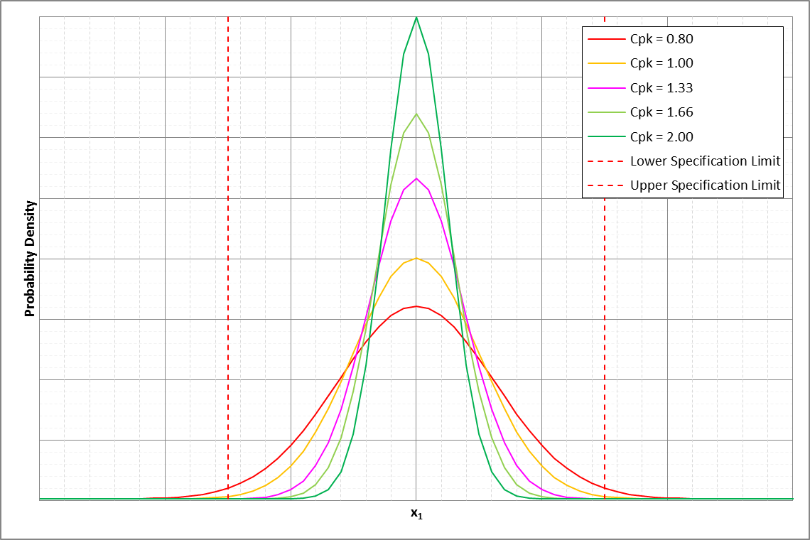
Assumed Level of Capability
Target Reliability Approach

Slide 17
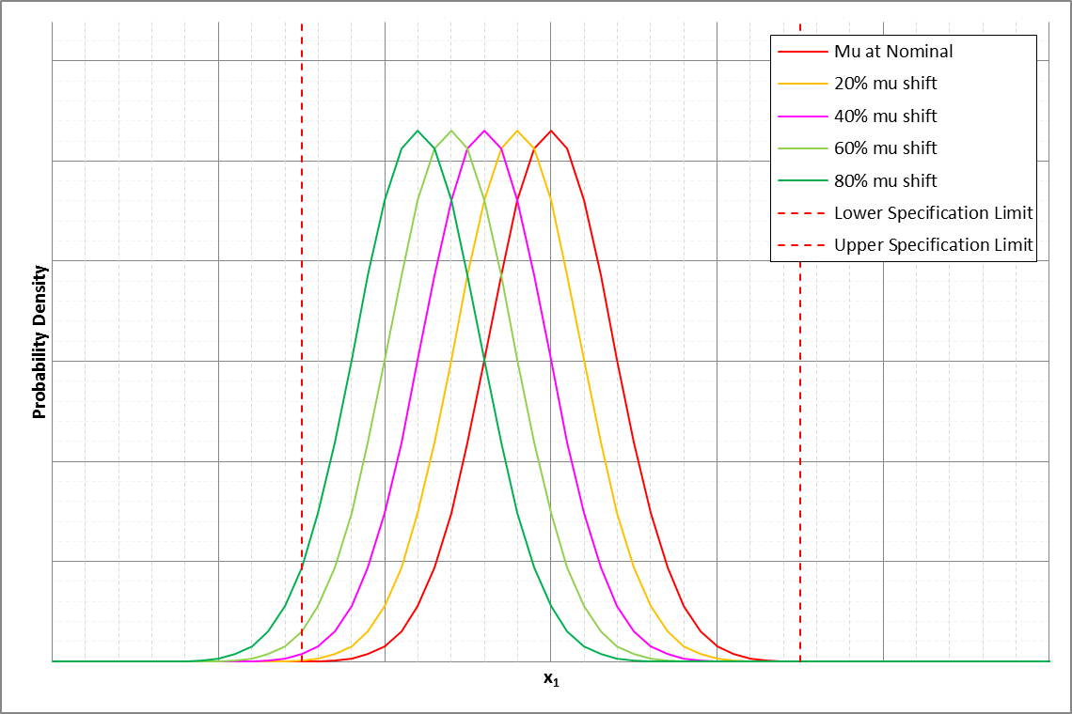
Process Drift Studies
Target Reliability Approach

Slide 18
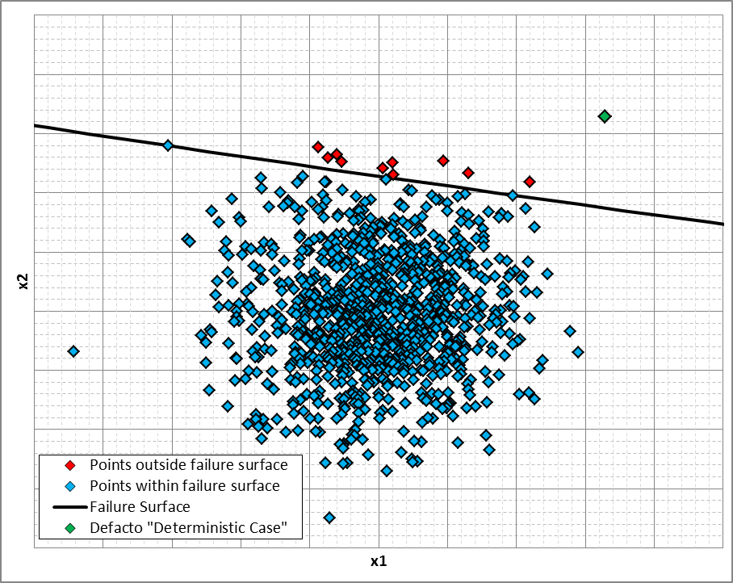
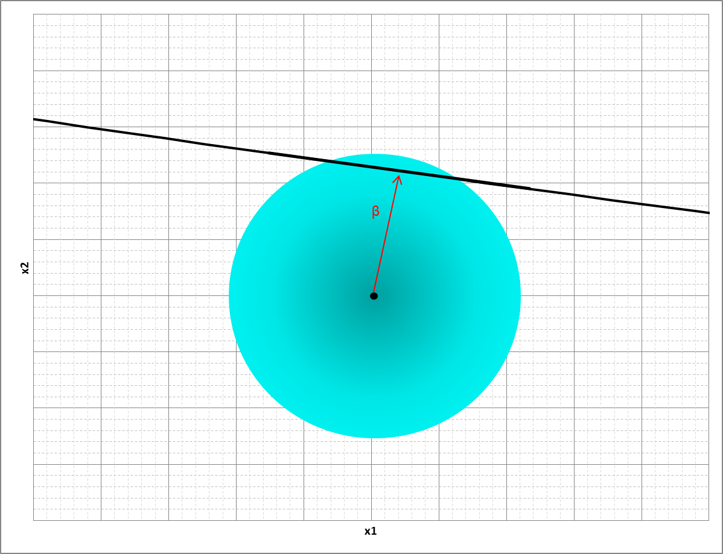
First Order Reliability Method
Target Reliability Approach
Near instantaneous run time. Ideal for sensitivity studies. Validated against Monte-Carlo with near perfect agreement.
Used for
this
assessment
FORM
Rapid, but requires several assumptions
Monte Carlo
Allows complex systems and non-normal distributions

Slide 19
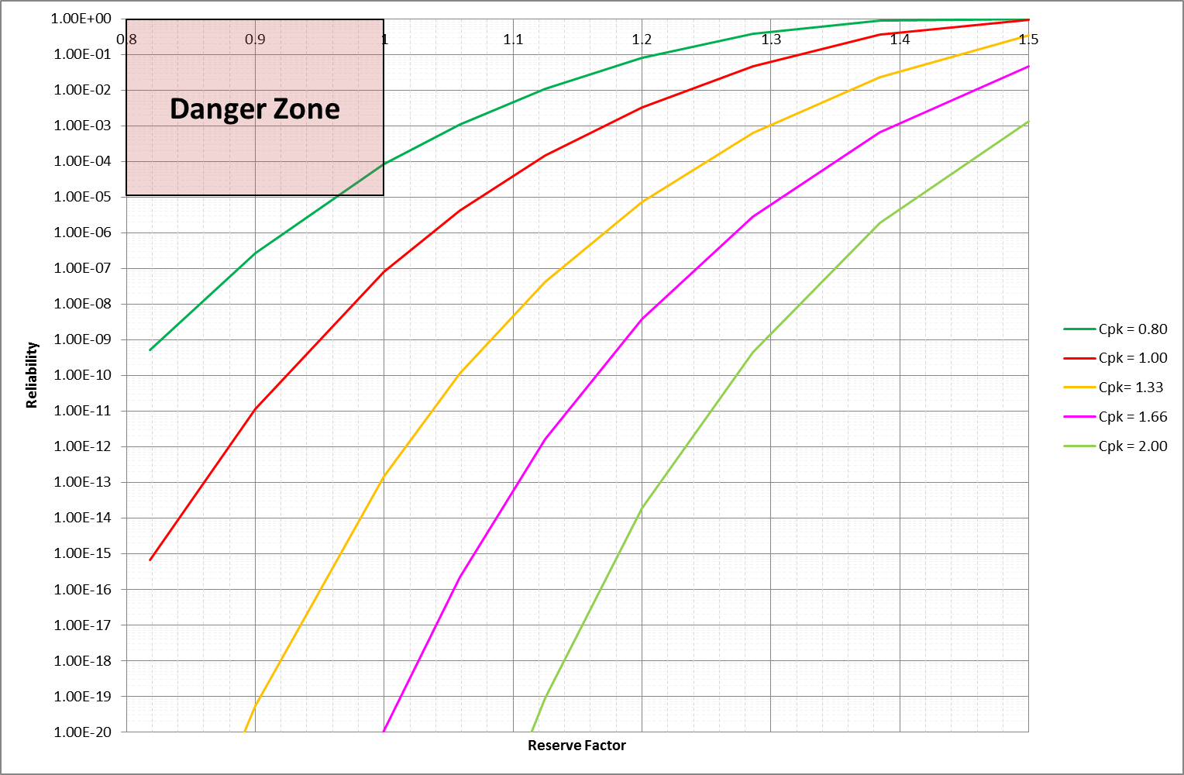
Target Reliability Approach
Un-machined design, RF all > 1.00 at Cpk > 0.8
K
Previous “Deterministic” Case (RF = 0.85)
Probability beyond 1e-20

Slide 20
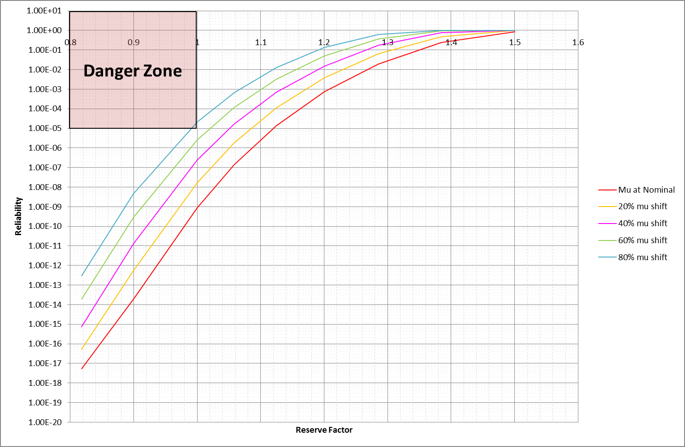
Target Reliability Approach

Slide 21
Summary
Target Reliability Approach
Sensitivity Studies to parameter variation demonstrate tolerance to leaving geometry un-machined.
Machining is being conducted to guard against a failure predicted to be of the order of 1e-13
What is the target reliability?
What is an appropriate level of risk?

Slide 22
03
Higher Level Safety Case

Slide 23
Higher Level Safety Case
Interdependencies between failure modes with variation of the same parameters.
Overall probability of system failure is of concern. How do we aggregate failures?

Slide 24
Systems Approach
Higher Level Safety Case
Review FMEA, identify failure modes and effects.
Understand interdependencies.
Understand links between fracture events and failure.
Understand consequences.

Slide 25
Higher Level Safety Case
Failure Mode 1
Failure Mode 2
Component 1
Failure Mode 3
Failure Mode 4
Overall System Failure
Failure Progression
Structural Failures
Failure Mode 1
Component 2
10⁻⁵
10⁻¹
10⁻⁴
Failure Mode 2
Failure Mode 3
Failure Mode 1
Component 3
Failure Mode 2
Failure Mode 3
10 independent failure modes
Design stage, apportion an equal reliability per failure mode = 10⁻⁵

Slide 26
Higher Level Safety Case
Failure Mode 1
Failure Mode 2
Component 1
Failure Mode 3
Failure Mode 4
Overall System Failure
Failure Progression
Structural Failures
Failure Mode 1
Component 2
10⁻⁵
10⁻¹
10⁻⁴
Failure Mode 2
Failure Mode 3
Bounding Failure progression, different for different failure modes
Failure Mode 1
Component 3
Failure Mode 2
Failure Mode 3
10 independent failure modes
Design stage, apportion an equal reliability per failure mode = 10⁻⁵

Slide 27
Which failure modes are affected by this change?
Higher Level Safety Case
Failure Mode 1
Failure Mode 2
Component 1
Failure Mode 3
Failure Mode 4
Overall System Failure
Failure Progression
Structural Failures
Failure Mode 1
Component 2
10⁻⁵
10⁻¹
10⁻⁴
Failure Mode 2
Failure Mode 3
Failure Mode 1
Component 3
Failure Mode 2
Failure Mode 3
Is the overall risk tolerable?
Is the impact of the design optimisation safe?

Slide 28
Higher Level Safety Case
Failure Mode 1
Failure Mode 2
Component 1
Failure Mode 3
Failure Mode 4
Overall System Failure
Failure Progression
Structural Failures
Failure Mode 1
Component 2
10⁻⁵
10⁻¹
10⁻⁴
Failure Mode 2
Failure Mode 3
Failure Mode 1
Component 3
Failure Mode 2
Failure Mode 3
Overall system failure is improved by design change.

Slide 29
04
Next Steps, Conclusions, Questions?

Slide 30
Conclusions
Next Steps, Conclusions, Questions?
Reliability assuming a Cpk of 1.33 | RF for an un-machined component | RF for a machined component
<< 1e-20 (original ‘deterministic’ case) | 0.85 | 1.48
1e-5 (proposed reliability from an aggregated safety case) | 1.20 | 2.15
Effect on other higher level system reliability | Beneficial | Detrimental

Slide 31
Next Steps
Next Steps, Conclusions, Questions?
Continue to engage with regulatory community.
Monitor manufacturing development with statistical process control.
Live FORM updates based on manufacturing run charts.

Slide 32
Thank you for your attention!
peter.reed3@rolls-royce.com

