Slide 1
Review of probabilistic methods relating to Volume 2 & 3 of the R5 procedure
Olivia Tuck

Slide 2
Introduction
Review of probabilistic methods relating to Volume 2 & 3 of the R5 procedure
Integrated five-year Nuclear Innovation Programme for the UK
Department for Business, Energy & Industry Strategy (BEIS)
Advanced Manufacture and Materials
https://www.gov.uk/guidance/funding-for-nuclear-innovation
EDF Energy
R5 and R6 guidance documents (UK)
Rolls-Royce
Nuclear Structural Integrity Probabilistics Working Group
https://www.fesi.org.uk/news/nuclear-structural-integrity-probabilistics-working-principles/
Literature review to assess the application of probabilistic methods for Volume 2&3 of the R5 procedure

Slide 3
R5 Procedure
Review of probabilistic methods relating to Volume 2 & 3 of the R5 procedure
R5:
“advice for the assessment of the structural integrity of components that operate at temperatures sufficiently high for creep to occur”
Volumes 2&3 – creep-fatigue crack initiation in defect-free structures
Probabilistics appendix
(EDF Energy Nuclear Generation Ltd., Assessment Procedure R5, Volume 2/3, 2014, Issue 3), (EDF Energy Nuclear Generation Ltd., Assessment Procedure R5, Volume 2/3, Appendix A15, 2018, Draft 2)

Slide 4
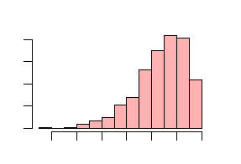
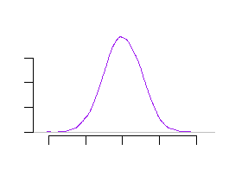
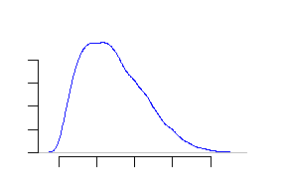
Probabilistic assessment
Review of probabilistic methods relating to Volume 2 & 3 of the R5 procedure
Accounting for uncertainty
Benefits
Incorporate uncertainties
Avoid bounding cases
Disadvantages
Computationally expensive
Regulators / customers
Inputs
Probability of failure

Slide 5
R5 Volume 2 & 3 probabilistic appendix
Review of probabilistic methods relating to Volume 2 & 3 of the R5 procedure
1. Specify information required
2. Distribution choices
3. Failure condition
4. Random sample of inputs
5. Assessment based on random inputs
6. Repeat 4 and 5
7. Calculate failure probability
8. Convergence
10. Impact of correlations
11. Report results
9. Sensitivity analysis

Slide 6
Step 2 - Parameter and distribution choices
Review of probabilistic methods relating to Volume 2 & 3 of the R5 procedure
Uncertainties:
Geometry
Load history and service cycles
Material properties
Distributions:
Continuous distributions
Distributions with set maximum and/or minimum
Raw data
Other things to think about:
Time dependencies
Correlation between parameters
(Kim and Shim, 1998), (Schmitz 2017), (Roy et al., 2010) (Holt and Bradford, 2012), (Zentuti et al., 2018), (Bradford, 2014)

Slide 7
Step 4 - Sampling
Review of probabilistic methods relating to Volume 2 & 3 of the R5 procedure
Monte Carlo
Simple random sampling
Latin hypercube
Orthogonal sampling
x
 | x
 |  |  | x
 |  | x
x
 | x
 |  | x
 |  |  | x
x
 |  | x
 |  |  | x
 | x
(BOMEL Limited for the Health and Safety Executive, 2001), (Olsson et al., 2003)

Slide 8
Step 4 – Sampling (2)
Review of probabilistic methods relating to Volume 2 & 3 of the R5 procedure
“Number of simulations should be at least an order of magnitude greater than 1/P_{f}”
P_{f} = probability of failure
P_{f} of 0.01 requires at least 1000 simulations
(Cannell et al., 2016)

Slide 9
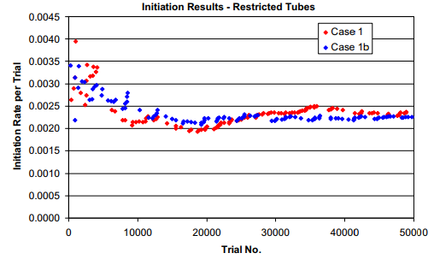
Step 8 - Convergence
Review of probabilistic methods relating to Volume 2 & 3 of the R5 procedure
Confirm convergence:
Monitor convergence as simulation proceeds
Run multiple times and check results
Run with different numbers of simulations
Figure from RAW Bradford and PJ Holt, Int J Pressure Vessels and Piping, 2013.
(Schmitz, 2017), (Bradford and Holt, 2013)

Slide 10
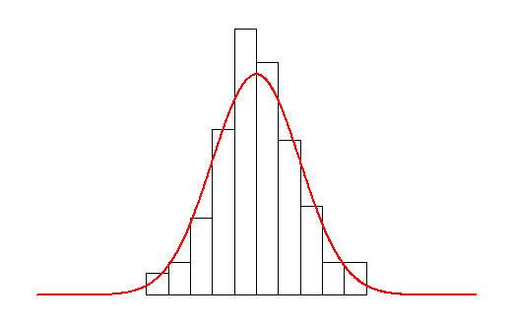
Step 9 – Sensitivity analyses
Review of probabilistic methods relating to Volume 2 & 3 of the R5 procedure
Sensitivity analyses:
Correlations between inputs and outputs
Quantifying effects of changing inputs
Correlations
Other sensitivities:
Tails
Code/implementation
(BOMEL Limited for the Health and Safety Executive, 2001), (Bradford and Holt, 2013), (Zentuti et al., 2017), (Bradford, 2014), (Jhung et al., 2005), (Katsuyama et al., 2014)

Slide 11
Step 11 – Reporting results
Review of probabilistic methods relating to Volume 2 & 3 of the R5 procedure
R5 Vol 2/3 probabilistics appendix:
Parameter distribution information
Assumed correlations
Coding used to implement Monte Carlo
Outcome of convergence tests
Response surface methods
Reduction of variables
Histograms of parameters of interest
Probability of failure
Results on sensitivity studies
Interpretation
(Vojdani et al., 2018)

Slide 12
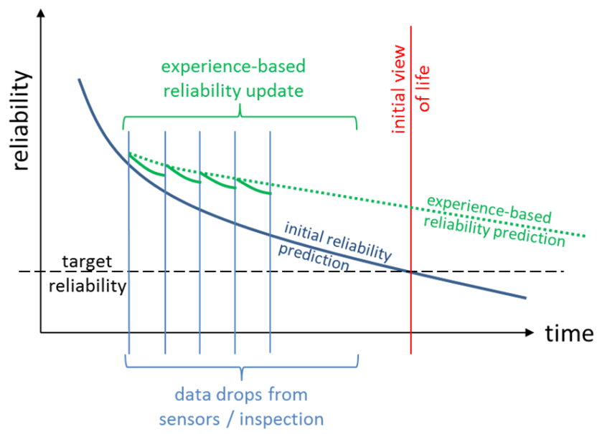
Other
Review of probabilistic methods relating to Volume 2 & 3 of the R5 procedure
Software, implementation and verification
Bayesian techniques
Figure from Nuclear Structural Integrity Working Principles, April 2019, https://www.fesi.org.uk/news/nuclear-structural-integrity-probabilistics-working-principles/
(Bradford, 2014), (Jhung et al., 2005), (Katsuyama et al., 2014), (Nuclear Structural Integrity Probabilistics Working Group, 2019), (Sousa et al., 2019), (Ibisoglu and Modarrres, 2015), (Zentuti et al., 2017)

Slide 13
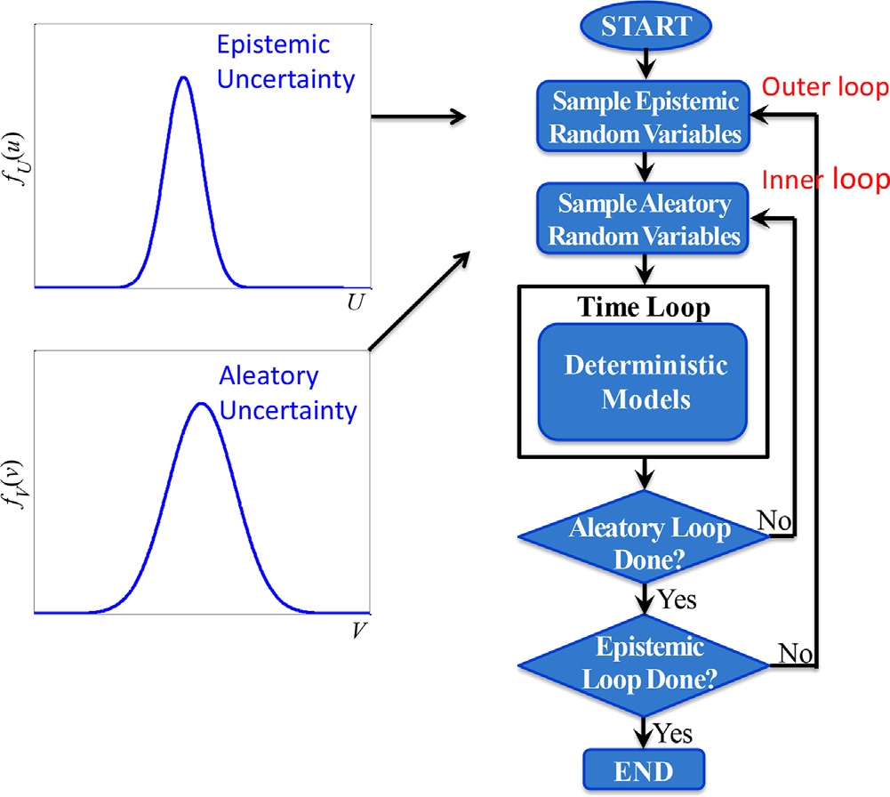
Other (2)
Review of probabilistic methods relating to Volume 2 & 3 of the R5 procedure
Other probabilistic/Monte Carlo methods
Figure from X. Duan et al., Nuclear Engineering and Design 2015
Nuclear vs non-nuclear
(Duan et al., 2015), (Bullough et al. 1999)

Slide 14
Summary
Review of probabilistic methods relating to Volume 2 & 3 of the R5 procedure
Probabilistic appendix: Other:
Distributions
Probability
of failure
Sampling techniques
Coding
Sensitivities
Fixed values
Number of simulations
Convergence
Correlations
Verification

Slide 15
Review of probabilistic methods relating to Volume 2 & 3 of the R5 procedure
Thank you, any questions?

