Slide 1
Optimization of Crack Initiation to Reduce Large Sample Size Runs
Cédric J. Sallaberry, Robert E. Kurth, Frederick W. Brust, Elizabeth A. Kurth-Twombly
Engineering Mechanics Corporation of Columbus (Emc²)
3518 Riverside Drive - Suite 202
Columbus, OH 43221-1735
Phone: (614) 459-3200
Fax: (614) 459-6800

Slide 2
Outline
xLPR presentation
Limitations of traditional Monte Carlo Sampling
Proposed optimization methods on Crack Initiation
Examples
Conclusion

Slide 3
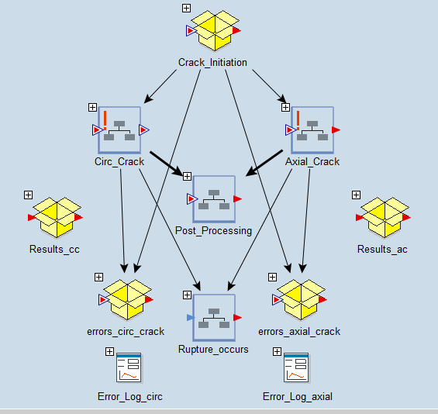
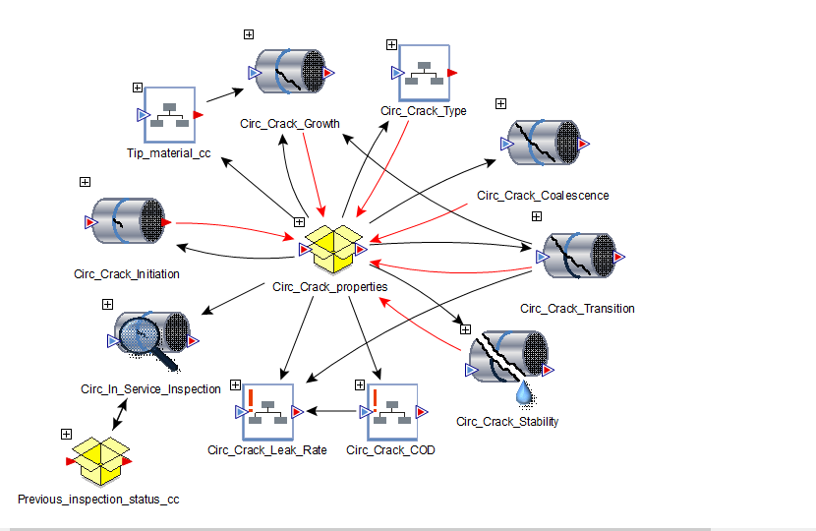
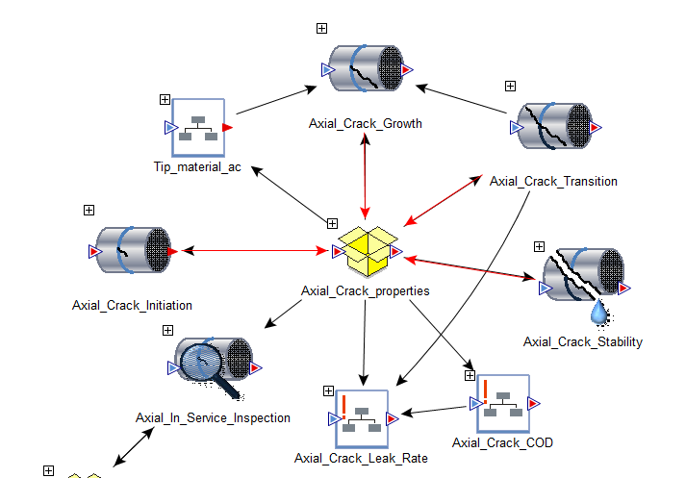
Probabilistic Code xLPR v2.0
Multi layer code with many interactions
Probabilistic loop
Complex deterministic Model

Slide 4
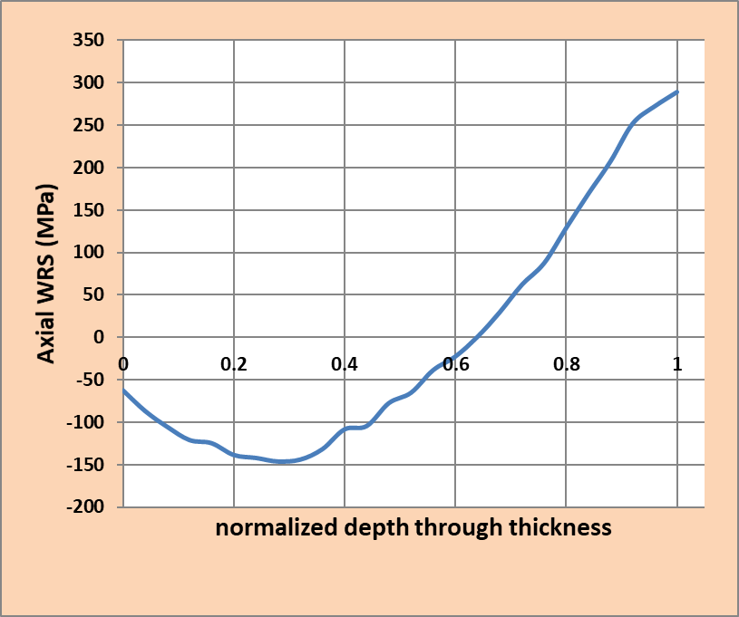
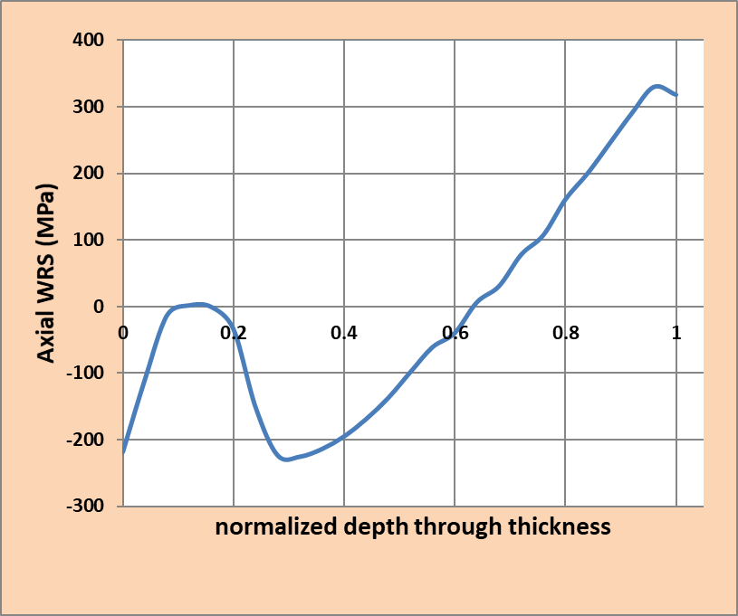
Set up of xLPR example
Generic Reactor Vessel Outlet Nozzle (RVON) for purpose of illustration.
  34” pipe (869 mm) – 2.6” thickness (66.3mm)
  PWSCC degradation only – circumferential cracks
  Temperature : 320.5 °C
  Pressure: 15.41 MPa
  Membrane Stress (from Dead Weight and Thermal): ~ -2.4 MPa
  Bending Stress (from Dead Weight and Thermal) : ~ 147 MPa
Axial WRS
15% repair
Axial WRS
unrepaired

Slide 5
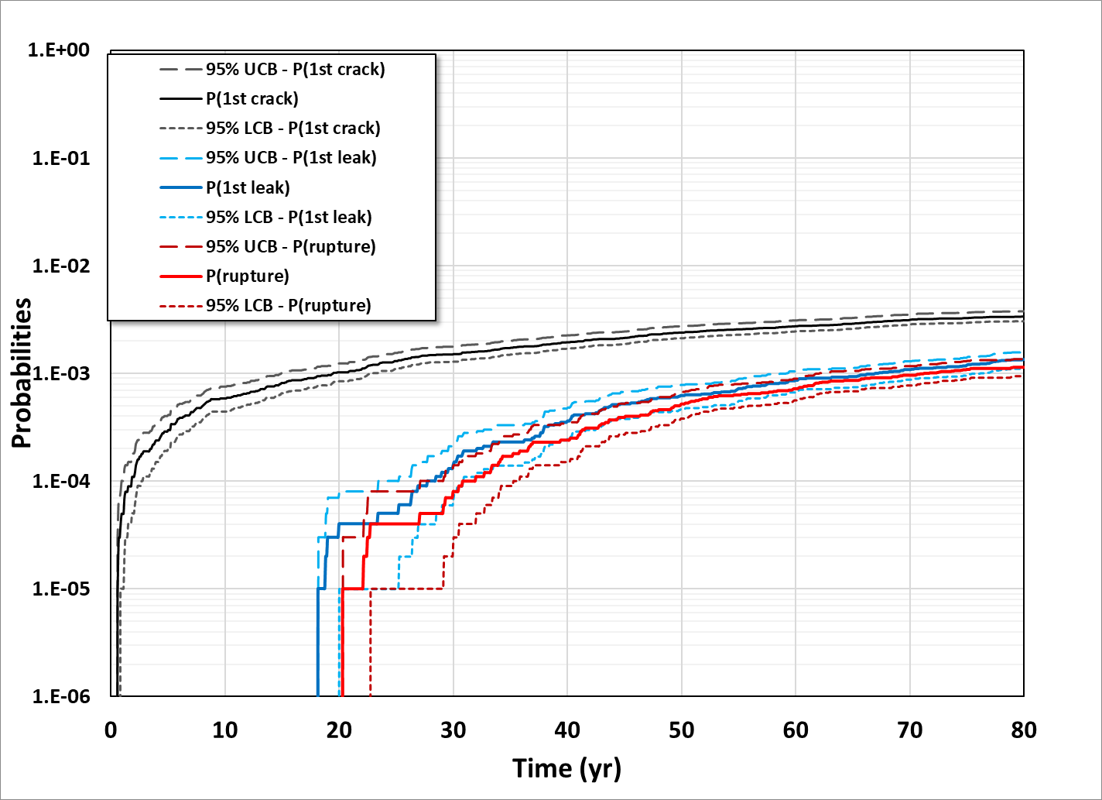

Example of xLPR results
Studying extremely rare events. The occurrence of even a single crack is within the range of 1 in a 100 or 1 in a 1000
$$3×10^{−3}$$
Note: Probabilities of leakage and rupture are estimated without inspection or Leak rate detection

Slide 6
What do these low probabilities mean
Only the purple parts have cracks occurring. All the rest is only used to estimate probability of crack occurrence
1 in 1000
1 in 100

Slide 7

Consequences in the run
Non negligible effort in terms of memory space (all those zeros saved still takes space) and computational time spent for zero results
Results are “choppy” even with large sample size (100K)
$10^{−6}$ occurrence may not be demonstrated with confidence due to the large sample size required (more than 1 million runs)

Slide 8
What to do ?
Importance sampling / adaptive sampling : Usually works if performed with the appropriate knowledge – but requires knowing which inputs drive the probabilities. And may not be enough
Running all the cases that matter (with resampling): xLPR was not developed this way and the resampling may create “holes” in the distributions
Use of initial flaw (flaw at time zero): May not be representative and underestimate or overestimate the risk
Work on the crack initiation model: it needs to work directly with the equations and requires change in the code

Slide 9




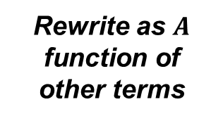
Crack Initiation equation
Initiation as a function of Temperature and Stress, with parameter to fit with observation.
$$t_{INI}=\frac{e^{\left[\frac{Q}{R.T}\right]}}{A.σ^{n}}$$
$A:$proportionality constant
$Q:$activation energy [kJ/mol]
$R:$ universal gas constant [kJ/K-mol]
$T:$ temperature [K]
$σ:$ stress at the ID [MPa]
$n$: stress exponent [unitless]
Rewrite as $A$ function of other terms
$$A=\frac{e^{\left[\frac{Q}{R.T}\right]}}{t_{INI}.σ^{n}}$$
$$t_{INI}≤80 yrs$$
$$⟺$$
$$A≥\frac{e^{\left[\frac{Q}{R.T}\right]}}{t_{80}.σ^{n}}$$
Fitting parameter
Physical quantities

Slide 10


Added complexity
Spatial representation of the proportionality constant. Weld to weld and within weld components
$A_{mult}$- varies from weld to weld
Stresses varies within the circumference
$A_{i}$ varies within a weld
…
…
Weld 1
Weld i
Weld n
$$A_{i,j}=A_{mult,j}×A_{i}$$
For location $i$ of weld $j$

Slide 11





How to solve this: 1st step
Discretization of $A_{mult}$ and estimate of $P(at least 1 crack)$ for each discretized value.
Lognormal distribution. Geometric discretization with increase of 10% of the value
Probabilities can then be summed since all groups are disjoints and cover the whole distribution
CDF
$$P(at least 1 crack)$$
$$A_{mult,i+1}=1.1×A_{mult,i}$$
$$A_{mult,i}$$
$$A_{mult}$$

Slide 12

How to solve it: 2nd step
Let $P\left(c_{i}\right)$ be the probability of having a crack in subsegment $i$ and $P\left(\overline{c_{i}}\right)$ the probability of not having a crack.
$P\left(no crack\right)=P\left(\overline{c_{1}}\right)×P\left(\overline{c_{2}}\right)×…×P\left(\overline{c_{19}}\right)$
$P\left(at least 1 crack\right)=1 −P(no crack)$

Slide 13
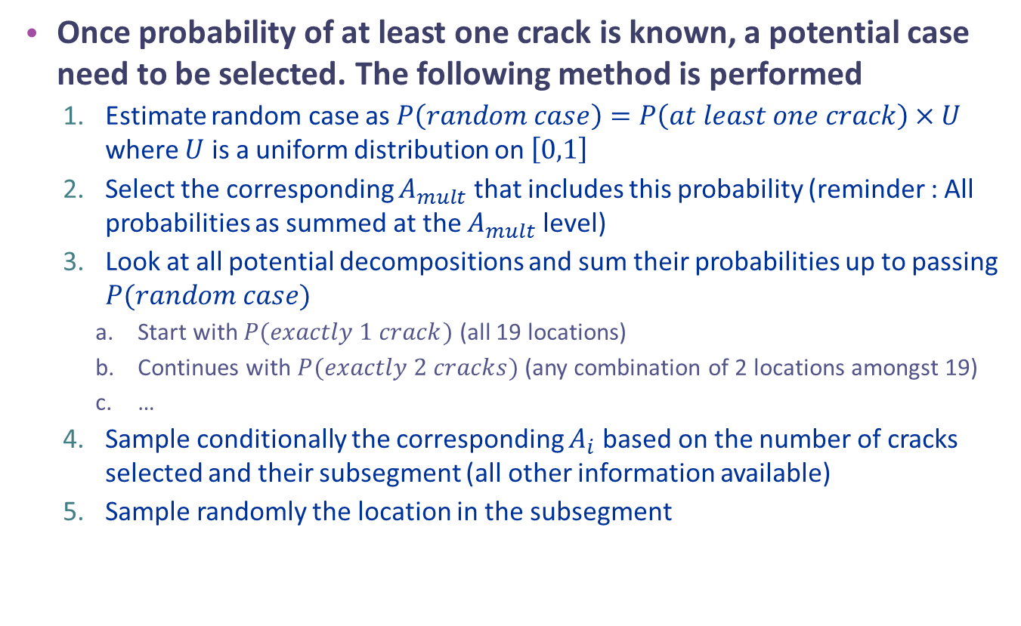
How to select a case?
Once probability of at least one crack is known, a potential case need to be selected. The following method is performed
  Estimate random case as $P\left(random case\right)=P\left(at least one crack\right)×U$ where $U$ is a uniform distribution on $\left[0,1\right]$
  Select the corresponding $A_{mult}$ that includes this probability (reminder : All probabilities as summed at the $A_{mult}$ level)
  Look at all potential decompositions and sum their probabilities up to passing $P(random case)$
    Start with $P(exactly 1 crack)$ (all 19 locations)
    Continues with $P(exactly 2 cracks)$ (any combination of 2 locations amongst 19)
    …
  Sample conditionally the corresponding $A_{i}$ based on the number of cracks selected and their subsegment (all other information available)
  Sample randomly the location in the subsegment

Slide 14
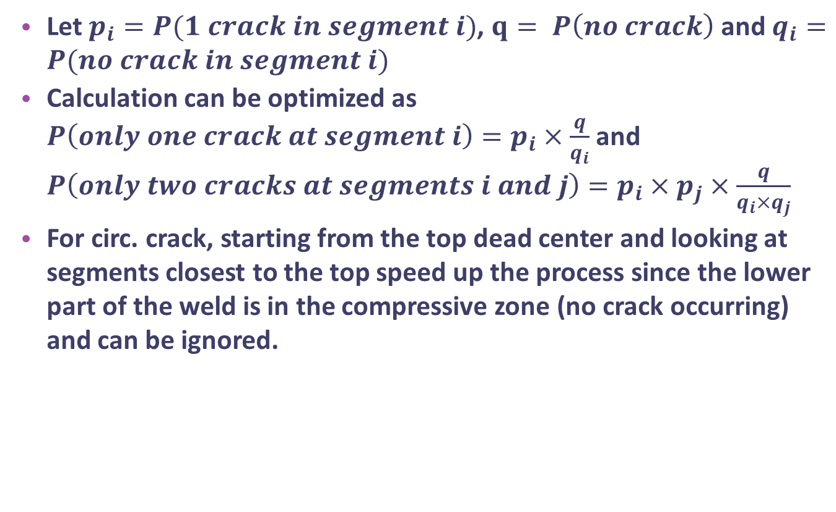
Optimization
Let $p_{i}=P(1 crack in segment i)$, $q= P\left(no crack\right)$ and $q_{i}=P(no crack in segment i)$
Calculation can be optimized as $P\left(only one crack at segment i\right)=p_{i}×\frac{q}{q_{i}}$ and $P\left(only two cracks at segments i and j\right)=p_{i}×p_{j}×\frac{q}{q_{i}×q_{j}}$
For circ. crack, starting from the top dead center and looking at segments closest to the top speed up the process since the lower part of the weld is in the compressive zone (no crack occurring) and can be ignored.
Tensile zone
Compressive zone

Slide 15
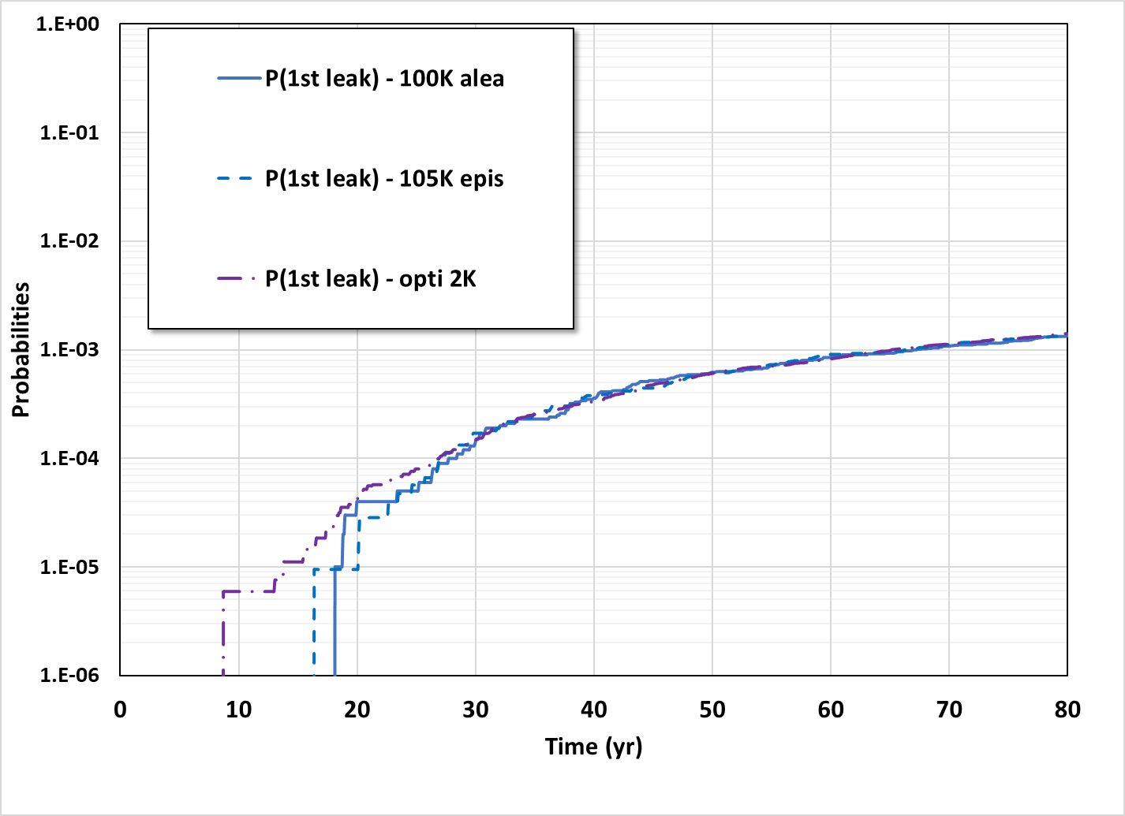
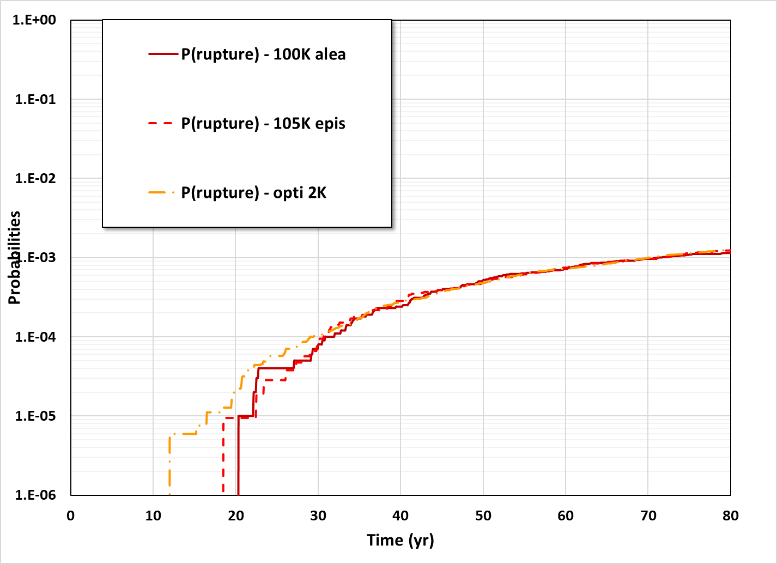
Results (time dependent probabilities)
Probabilities using a smaller sample size (2K) are estimated earlier in time and smoother than traditional Monte Carlo with sample of size 100K)

Slide 16
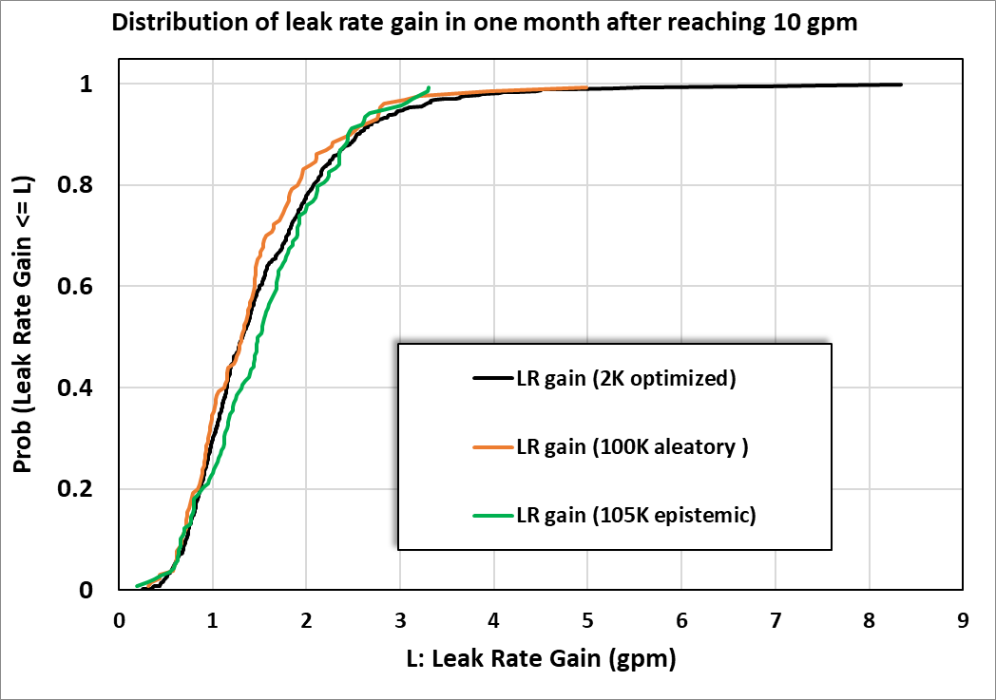
Results – conditional distribution
Conditional distribution is smoother (plain blue line) than traditional sample size 50 times greater (~1.7 orders of magnitude higher)

Slide 17
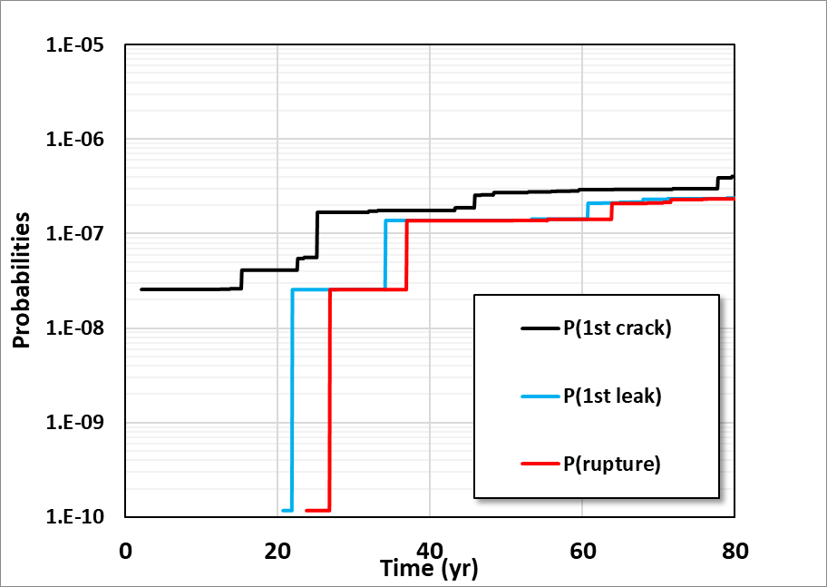
Application to more extreme case
Same problem but with a different WRS strongly negative at ID (15% weld repair).
Probability of first crack lower than 10⁻⁶ over 80 years. Would require more than one million runs with traditional Monte Carlo.
2000 realizations give an answer in the 10⁻⁷ range but results are “choppy”.
WRS at ID so low that sometimes no P(Crack) can be found

Slide 18
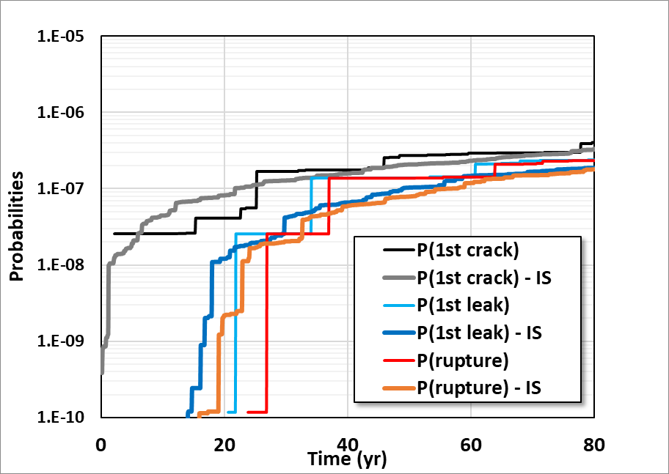
Use of optimization with other techniques
Same problem as the previous slide.
Additional importance sampling used on WRS to generate higher values at ID.
Still optimization of Crack Initiation. Still sample of Size 2,000.
Results (in dash line) are in the same ballpark estimate but a lot smoother

Slide 19
Conclusion
Probabilistic Fracture Mechanics is an important part of any risk analysis or risk-informed approach
Probabilistic Analyses help estimate risk and reduce conservatisms
However, when probabilities are very low classical Monte Carlo sampling may not be practical - A probabilistic analysis is often more than running 1000’s of runs and taking the mean value.
A good understanding of the problem helped point out the weaknesses and develop a mathematical way to solve them.
The presented approach reduces the computational cost by one or more orders of magnitude and helps build confidence in the results.
An added benefit is when an analyst puts enough math and equations in a method, people trust him more and don’t ask questions!

