Slide 1

Preliminary Results by Benchmarking Study of Probabilistic Fracture Mechanics Codes For Piping, PRO-LOCA, P-PIE, PEDESTRIAN
3rd International Seminar on Probabilistic Methodologies for Nuclear Applications
October 22-24, 2019, Rockville, MD, USA
Jeongsoon Park, Chang-sik Oh, Sangmin Lee (KINS),
Masaki Nagai, Masato Yamamoto (CRIEPI)

Slide 2

Contents
Ⅰ
Introduction
II
PWSCC Case
III
Fatigue Case
IV
Conclusions

Slide 3
Introduction

Slide 4
Background
PARTRIDGE-3 program
  Probabilistic Analysis as a Regulatory Tool for Risk-Informed Decision GuidancE-3
  International cooperative project led by Battelle
  Membership: Japan (CRIEPI), Korea (KINS, KEPCO E&C, KHNP), Switzerland (PSI), Canada (CNSC), US (USNRC)
  Main objective: further development of PRO-LOCA
Benchmarking study
  Two members of PARTRIDGE, CRIEPI and KINS has joined and launched a benchmarking study of probabilistic fracture mechanics (PFM) codes for piping.
  Utilized PFM codes: PRO-LOCA, in-house codes (P-PIE, PEDESTRIAN)

Slide 5
Objectives
Improve participant’s understanding about the PFM codes
Set up some recommendations of best practices when applying the PFM codes for piping systems
Find unexpected code behaviors of the PFM codes for future improvements of the codes

Slide 6
Benchmark Problems
Case | Reference Paper | PFM Codes used in Refs. | Crack Growth Mechanism | Notes
1 | PVP2015-45134¹ | xLPR(V2.0) | PWSCC | Circumferential crack + “O-I” WRS
2 | IJPVP 117-118(2014), pp.56-63² | PRAISE-JNES PASCAL-SP | Fatigue | w/o earthquake
3 |  |  |  | with earthquake
D. Rudland, C. Harrington, D. Dingreville, “Development of the Extremely Low Probability of Rupture (xLPR) Version 2.0 Code,” PVP2015-45134, Proceedings of the ASME 2015 Pressure Vessels and Piping Division Conference, July 19-23, 2015, Boston, Massachusetts, USA.
J. Katsuyama, H. Itoh, Y. Li, K. Osakabe, K. Onizawa, S. Yoshimura, “Benchmark Analysis on Probabilistic Fracture Mechanics Analysis Codes Concerning Fatigue Crack Growth in Aged Piping of Nuclear Power Plants,” International Journal of Pressure Vessels and Piping 117-118, pp. 56-63, 2014

Slide 7
Framework of Benchmark Study
Phase 1: Solve benchmark problems with no consideration for both crack and leak detection (on-going)
  Step 1: Generate inputs separately with each organization’s understanding of the problems
  Step 2: Generate inputs based on common and best understanding of the problems
  ➔ Preliminary Results
Phase 2: Solve benchmark problems with consideration for crack and/or leak detection.
  Probability of detection curves and leak detection capability will be defined for the benchmark problem.
Phase 3: Sensitivity study for the benchmark problems
  Several case studies will be performed to study influence of selected input parameters.
Future Works

Slide 8
PFM Codes
PRO-LOCA (PRObabilistic Loss Of Coolant Accident)
  Initially developed for USNRC, circa 2003
  Further developed as part of MERIT and PARTRIDGE programs
    The latest version: Version 6.2 (released Dec. 2018)
  Cracking mechanisms: SCC(PWSCC), Fatigue
P-PIE (Piping Probabilistic Integrity Evaluation)
  Developed for KINS by Chungbuk National University in Korea
  Initially developed in 2010 based on PRAISE and further enhanced in 2013
  Cracking mechanisms: SCC, Fatigue
PEDESTRIAN (Probabilistic Evaluation and Deterministic Evaluation of Structural Integrity for Aging NPPs)
  Being developed by CRIEPI
  Cracking mechanisms: Fatigue, PWSCC(Being developed)

Slide 9
PFM Codes Comparison
For a circumferential crack
⁺ from the publicly available documents
Feature | P-PIE | PRO-LOCA | PEDESTRIAN | PASCAL-SP⁺ | xLPR⁺
Sampling method | Stratified Monte Carlo | Monte Carlo* DPD Importance Adaptive | Monte Carlo Direct sampling with replacement | Stratified Monte Carlo | Monte Carlo LHS DPD Adaptive
Load (Input type) | Stress | Force/Moment | Stress | Stress | Force/Moment
K-solution | PRAISE Raju &Newman | Universal Weight Function Method | JSME FFS (JSME S-NA1-2012) |  | Universal Weight Function Method
Crack growth | SCC Fatigue | SCC(PWSCC included) Fatigue | SCC(PWSCC being included) Fatigue | SCC(PWSCC included) Fatigue | SCC(PWSCC included) Fatigue
TWC criterion | a/t=1 | a/t=0.95 | a/t=0.75 | Unknown | a/t=0.95
TWC Failure criterion | J-T* Net-section yielding | Min(EPFM-LBB.ENG2 or Net-section collapse) | EPFM(Z-factor)* Two parameter method Net-section collapse | EPFM(Z-factor) Net-section collapse | Min(EPFM-LBB.ENG2 or Net-section collapse)
* used in the benchmark study

Slide 10
PWSCC Case (Case 1)
PRO-LOCA, P-PIE

Slide 11
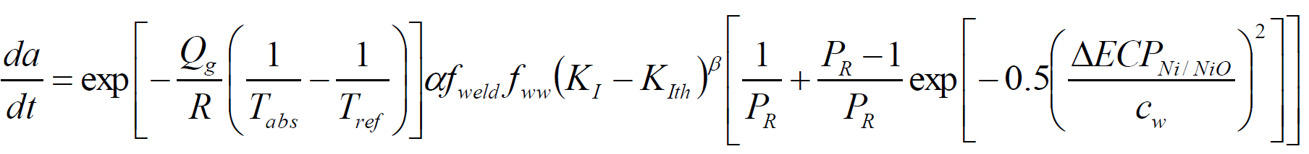

Problem Definition
Reference paper
  D. Rudland et al., “Development of the extremely low probability of rupture(xLPR) version 2.0,” PVP2015-45134
PWSCC problem (Case 1)
  PWR reactor pressure vessel outlet nozzle dissimilar metal (DM) weld
    Geometry: Diameter: 885.8 mm | Wall thickness: 66.7 mm
  Cracking mechanism: PWSCC (circumferential crack)
    MRP-263 PWSCC growth rate equation*
* MRP-302, Models and inputs selected for use in the xLPR pilot study

Slide 12
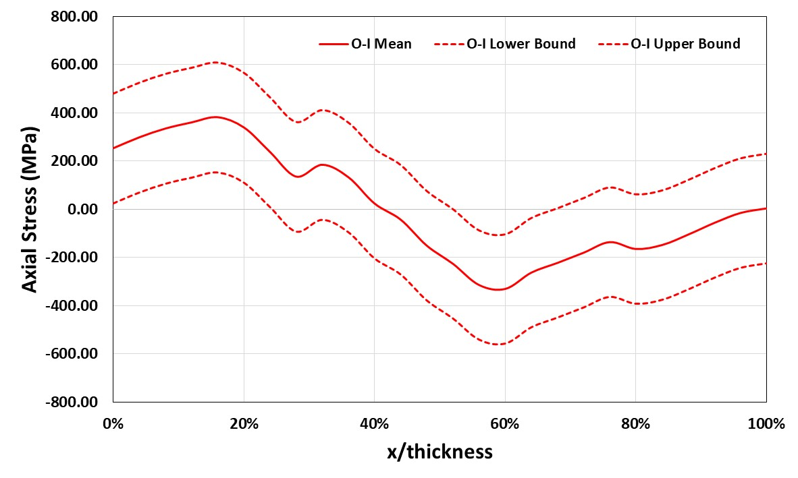
Problem Definition (cont’d)
PWSCC problem (Case 1)
  Load: Typical for Westinghouse four-loop reactor pressure vessel outlet nozzle DM weld
    Dead weight + Thermal expansion
  Normal operating condition: Pressure: 15.5 MPa | Temperature: 325 C
  Weld residual stress: O-I axial stress (ID max.: 380.83 MPa)
    “O-I”: OD repair followed by the ID repair

Slide 13
Input Summary for Reference
Deterministic inputs
  Yield & ultimate strengths, elastic modulus of the base metals
  J-resistance curve exponent of the weld
  PWSCC growth parameters: Hydrogen, constant (α), exponent (β)
Probabilistic inputs (distribution type)
  J-resistance curve, J_{IC} (uniform) and constant (normal) of the weld
  Initial crack length (log-normal) and depth (log-normal)
  WRS (normal)
  Pressure (normal)
  Temperature (normal)
  PWSCC growth parameters
    F_{weld} (log-normal), F_{ww} (log-normal), Q/R (normal), c_{w} (normal), P_{R} (normal)

Slide 14
Input Differences
Unavoidable input differences due to each PFM code’s characteristics
  Crack initiation time
  Weld residual stress
  PWSCC crack growth parameters
  Material properties
    Ramberg-Osgood parameters

Slide 15
Input Differences (cont’d)
Crack Initiation Time
Reference (xLPR)
    Initiation time is dependent on surface stress and temperature
PRO-LOCA & P-PIE
    Distribution of initiation time is approximated to have the same initiation probability with the reference
    Log-normal distribution: mean(1163 month), standard deviation(1702 month)
Initial Crack Size (Random variable)
    Half length: log-normal distribution (Mean: 3.3 mm | SD*: 0.31)
    Depth: log-normal distribution (Mean: 1.6 mm | SD: 0.06)
*SD: standard deviation
Weld Residual Stress (WRS)
Reference (xLPR) & PRO-LOCA
    “O-I” WRS distribution (26 data points through thickness of the weld)
P-PIE
    Linear distribution with the same ID WRS (252.3 MPa)

Slide 16

Input Differences (cont’d)
PWSCC Crack Growth Rate
Reference (xLPR) & PRO-LOCA
    MRP-263 PWSCC crack growth rate model
    Random variables: activation energy (Q_{g}), f_{weld}, f_{ww}, Peak-to-valley ratio (P_{R}),
    characteristic width (c_{w})
    Deterministic variables: hydrogen concentration (H₂), α, β
P-PIE
    General SCC crack growth rate model
    The Coefficient C was analytically approximated by considering the MRP-263 crack growth parameters
        Lognormal distribution: mean (1.12E-12) |
        SD (7.81E-13)
$$\dot{a}={C\left(K_{I}−K_{th}\right)}^{m}$$
MRP-263 PWSCC growth rate equation

Slide 17
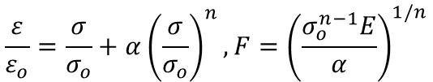
Input Differences (cont’d)
Ramberg-Osgood (R-O) Parameters
Reference (xLPR)
    User inputs (F, n)
PRO-LOCA
    calculated internally using sampled yield and ultimate strengths
$$\frac{ε}{ε_{o}}=\frac{σ}{σ_{o}}+α{\left(\frac{σ}{σ_{o}}\right)}^{n}, F={\left(\frac{σ_{o}^{n−1}E}{α}\right)}^{1/n}$$
P-PIE
    User input(α, n)
    Calculated in accordance with the PRO-LOCA manual

Slide 18
Results
Initiation probabilities

Slide 19
Results (cont’d)
Through-wall crack (TWC) and rupture probabilities

Slide 20
Summary
Both PRO-LOCA and P-PIE predict higher TWC and rupture probabilities than the reference.
  Faster crack growth that results in similar TWC and rupture probabilities
Possible causes
Factors | PRO-LOCA | P-PIE | xLPR
Initial crack placement | Top dead end of the pipe | Top dead end of the pipe | Based on stress/temperature
WRS | “O-I” distribution | Linear distribution with the same ID WRS | - “O-I” distribution - might be interacted with the crack initiation model
PWSCC crack growth law | MRP-263 eq’n | General SCC growth law with the coefficient approximated analytically | MRP-263 eq’n
R-O parameters | R-O parameters determined internally | User input: calculated in accordance with the PRO-LOCA manual | User input

Slide 21
Fatigue Case (Cases 2,3)

Slide 22
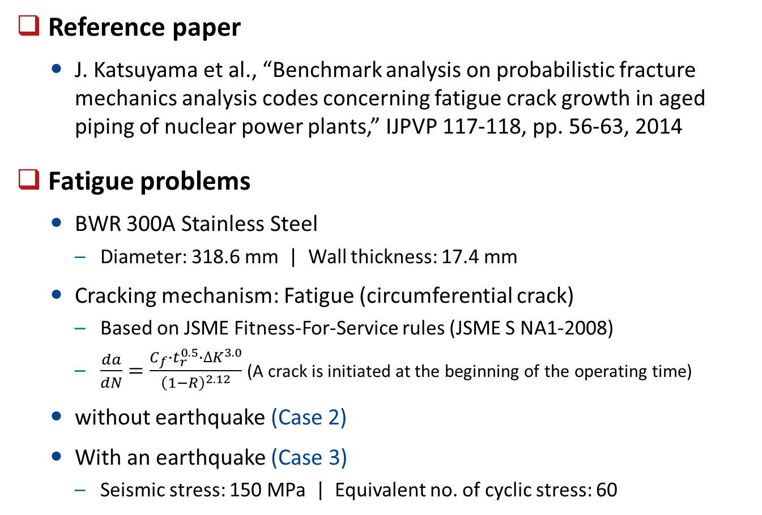
Problem Definition
Reference paper
  J. Katsuyama et al., “Benchmark analysis on probabilistic fracture mechanics analysis codes concerning fatigue crack growth in aged piping of nuclear power plants,” IJPVP 117-118, pp. 56-63, 2014
Fatigue problems
  BWR 300A Stainless Steel
    Diameter: 318.6 mm | Wall thickness: 17.4 mm
  Cracking mechanism: Fatigue (circumferential crack)
    Based on JSME Fitness-For-Service rules (JSME S NA1-2008)
    $\frac{da}{dN}=\frac{C_{f}∙t_{r}^{0.5}∙∆K^{3.0}}{{\left(1−R\right)}^{2.12}}$ (A crack is initiated at the beginning of the operating time)
  without earthquake (Case 2)
  With an earthquake (Case 3)
    Seismic stress: 150 MPa | Equivalent no. of cyclic stress: 60

Slide 23
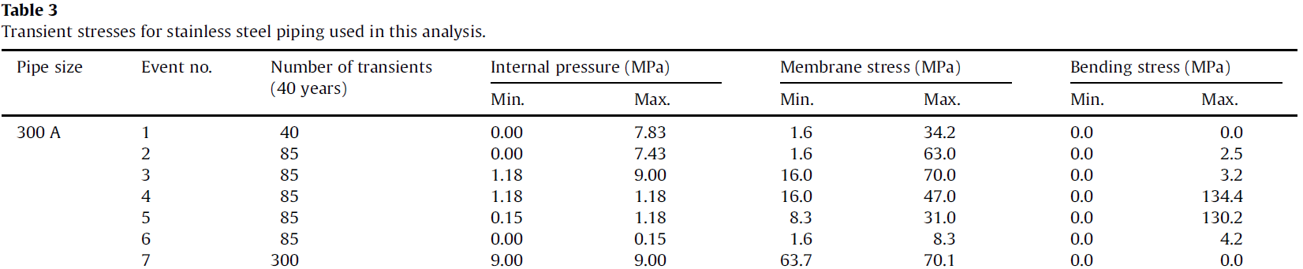
Problem Definition (cont’d)
Fatigue Problems
  Load: Normal operating loads + transient loads
    Internal pressure: 9 MPa
    Membrane stress: 66.9 MPa
    Transient stresses: Table 3 of the reference
  Weld residual stress
    ID max: about 439 MPa

Slide 24
Input Summary for Reference
Deterministic inputs
  Pressure, Temperature
  Elastic modulus
  WRS
  Fatigue crack growth parameter:
    Exponent, rise time (t_{r})
Probabilistic inputs (distribution type)
  Yield and ultimate strengths (log-normal)
  J-resistance curve, J_{IC} (normal) and constant (normal) of the weld
  Initial crack length (log-normal) and depth (log-normal)
  Fatigue crack growth parameters
    Coefficient (log-normal)

Slide 25
Input Differences
Unavoidable input differences due to each PFM code’s characteristics
  Transients
  Weld residual stress
  Earthquake
  Fatigue crack growth rate
  Tensile properties (yield and ultimate strengths)
  J-resistance curve parameters

Slide 26
Input Differences (cont’d)
Transients
PRO-LOCA
    Membrane and bending stresses of the reference were converted into moments.
        Axial force of the transient doesn’t contributed to fatigue crack growth.
    In the crack stability evaluation, the max. moment was considered per transient.
P-PIE & PEDESTRIAN
    Used the membrane and bending stresses from the reference.
    In the crack stability evaluation,
        (PEDESTRIAN) Only bending stresses of transients were considered.
        (P-PIE) In order to consider the effect of the transient stresses, the max. stress of the transients was added to the normal operating stress.
Weld Residual Stress (WRS)
PRO-LOCA : WRS distribution from the reference
(26 data point)
P-PIE: Linear distribution with the similar ID WRS (430 MPa)
PEDESTRIAN
    The reference WRS was approximated by a 3-order polynomial curve corresponding to the SIF solution given in the JSME FFS code.

Slide 27
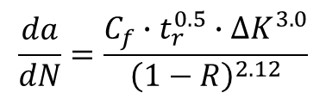

Input Differences (cont’d)
Earthquake (Case 3)
PRO-LOCA
    The seismic bending stress was converted to the moment, deterministic and static load.
        Only used in the crack stability evaluation (not contributed to the crack growth)
        Assumed to occur every month(evaluating time)
P-PIE & PEDESTRIAN
    The seismic bending stress with equivalent cycles of 60 were entered.
        Contributes to both the crack growth and crack stability evaluation
        Assumed to occur every year(evaluating time)
        After checking stability, reset to the crack size before the earthquake
Fatigue Crack Growth Rate
PRO-LOCA & PEDESTRIAN
    C_{f}: log-normal distribution (median: 1.59E-12, SD of ln(C_{f}): 0.355)
    t_{r}: rise time, 1000 s (deterministic)
P-PIE
    C was analytically approximated based on C_{f} and t_{r}
    Stress ratio R(K_{min}/K_{max}) was not considered.
$$\frac{da}{dN}=\frac{C_{f}∙t_{r}^{0.5}∙∆K^{3.0}}{{\left(1−R\right)}^{2.12}}$$
$$\frac{da}{dN}=C{\left(∆K\right)}^{3.0}$$

Slide 28

Input Differences (cont’d)
Tensile Properties
Reference (PASCAL-SP) & PEDESTRIAN
    Flow stress of stainless steel
        Log-normal distribution (median: 302 MPa, SD: 3.69E-2)
        For the crack stability evaluation, EPFM method with the Z factor are used.
PRO-LOCA
    Yield and ultimate strengths are required (Flow stress is determined based on the sampled yield and ultimate strengths).
    Determined to have the same distribution type (log-normal) with similar mean and SD to the reference flow stress, using the type 304 stainless steel base metal properties from the pipe fracture encyclopedia.
J-Resistance Curve Parameters
$$J_{R}=J_{IC}+C{\left(∆a\right)}^{m}$$
Reference (PASCAL-SP) & PEDESTRIAN
    No need to input since the EPFM method with the Z factor was used for the crack stability evaluation
PRO-LOCA & P-PIE
    Data that gives the highest mean value of J_{Ic} (stainless steel base metal) was selected from the pipe fracture encyclopedia.
    LB and UB were determined in accordance with the PRO-LOCA User’s Manual.

Slide 29
Results
(Case 2) Rupture probabilities

Slide 30
Results (cont’d)
(Cases 2 & 3) Rupture probabilities
△ PEDESTRIAN ~ 0
△ PRO-LOCA
△ Reference
△ P-PIE

Slide 31
Summary
PRO-LOCA, P-PIE, and PEDESTRIAN show higher rupture probabilities than the reference, especially at the beginning.
  Implicating the effect of crack growth due to transients on rupture is small.
Trends of the rupture probabilities between the 3 PFM codes are similar.

Slide 32
Summary (cont’d)
Possible causes
Factors | PRO-LOCA | P-PIE | PEDESTRIAN
TWC criterion | a/t=0.95 | a/t=1.0 | a/t=0.75
Crack stability (TWC failure) criteria | Min(EPFM(LBB.ENG2) or Net-section collapse) | EPFM(J-T) | EPFM with Z-factor
YS, US | Determined to have the similar flow stress to the reference | Determined to have the similar flow stress to the reference | Flow stress from the reference
J-R | Highest J-R from the database for stainless steel base metal | Highest J-R from the database for stainless steel base metal | Not used
Fatigue crack growth law | FCG law from the reference | Coefficient of the FCG law was analytically approximated (w/o stress ratio) | FCG law from the reference
WRS | Distribution from the reference | Linear distribution with the similar ID WRS | 3rd order polynomial curve fit

Slide 33
Summary (cont’d)
Possible causes
Factors | PRO-LOCA | P-PIE | PEDESTRIAN
Transients
Crack growth contribution | Yes (Only Moments) | Yes (Membrane and bending stresses) | Yes (Membrane and bending stresses)
Crack stability contribution | Yes (Only moments) | No (But modified in input to consider the max. stress in the transients) | Yes (Only bending stress)
Earthquake
Crack growth contribution | No | Yes (Reset the crack size after checking crack stability due to earthquake) | Yes (Reset the crack size after checking crack stability due to earthquake)
Crack stability contribution | Yes | Yes | Yes

Slide 34
Conclusions

Slide 35
Conclusions
Two member organizations of the PARTRIDGE program have conducted the benchmark study by using the PFM codes for piping, PRO-LOCA, P-PIE and PEDESTRIAN.
The benchmark problems (PWSCC and Fatigue cases) were defined based on the published papers which utilized other PFM codes, xLPR and PASCAL-SP.
The 3 PFM codes show similar trends of resultant TWC and rupture probabilities for the benchmark problems.
  but predict different trend and higher probabilities than the references.
Further research and sensitivity studies will be continued during the remaining phases of the benchmark study.

Slide 36
Acknowledgement
The authors would like to thank Dr. D. Rudland from USNRC and Dr. J. Katsuyama for providing valuable information about their research referenced in this benchmarking study.
The authors would like to acknowledge other organizations (KEPCO E&C and KHNP-CRI) of the Korean Consortium for the PARTRIDGE program for their support and valuable comments on the benchmarking study.

