Slide 1


ISPMNA: BM_003
Comparison of Deterministic and Probabilistic Approaches for LBB
D. Somasundaram, D.J. Shim, D. Dedhia, N. Cofie, C. Harrington
International Seminar on Probabilistic Methodologies for Nuclear Applications
Rockville, MD, USA
Oct 24, 2019

Slide 2
Outline
Background
Methodology and Procedure
Case Study
Results
Summary

Slide 3
Background
Deterministic LBB (SRP 3.6.3)
  Postulated through-wall crack
  No crack growth (no active degradation mechanism)
    Crack growth performed only when mechanical/thermal fatigue mechanism
    is determined to be present but not factored into the determination of LBB margin
  Margin on leakage and critical crack size
Probabilistic LBB (e.g., xLPR)
  Crack initiation and growth (active degradation mechanism)
  Probability of rupture
Difficult to compare two results

Slide 4
Background (cont’d)
Precedent in developing a baseline probabilistic benchmark for the current deterministic LBB procedure
  ProLBB – A probabilistic Approach to Leak Before Break Determination,” SKI Report 2007:43, November 2007

Slide 5
Deterministic LBB in Probabilistic Space
Represent the current deterministic LBB approach in a probabilistic space
  Conditional probability of rupture
    Postulated idealized through-wall crack
    Leak-before-break
    Break-before-leak not considered in deterministic LBB

Slide 6
Overall Methodology
Conceptual determination of the probability of rupture for a single through-wall flaw
xLPR used for PFM analysis

Slide 7
Overall Methodology (cont’d)
Postulate a through-wall or near through-wall flaw
Distribution on materials properties
Uncertainty on leakage based on xLPR
Distributions on leakage crack length (a_{l}) and critical crack length (a_{c}) are calculated from xLPR probabilistic analysis
Calculate LBB margin and conditional probability of rupture
  Probability of rupture is calculated assuming the crack lengths are independent variables (bivariate)

Slide 8
Procedure
Step1:Initial Conditions for xLPR
    Number of flaw: 1
    Flaw type: Circumferential flaw
    Leak rate uncertainty: set to 1 (“ON”)
    Initial surface crack depth: 95% of thickness
    Constant initial surface crack length
    Probability of seismic event: 1
    All relevant input made constant except material data (weld and base materials)

Slide 9
Procedure (cont’d)
Step2: From xLPR runs, determine distribution for
    Leakage crack total length (a_{l})
      For targeted leak rate, determine the corresponding idealized TWC length for each realization. Mean and standard deviation can be calculated from the above information for a targeted leak rate (or targeted leakage factor)
    Critical crack total length (a_{c})
    LBB margin (a_{c}/a_{l}) from each realization

Slide 10
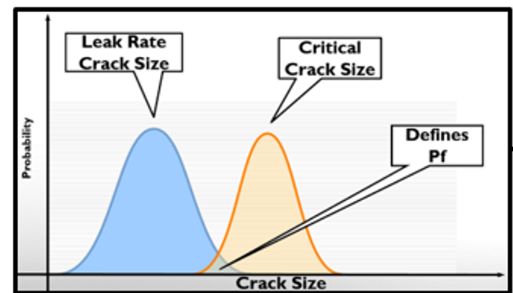
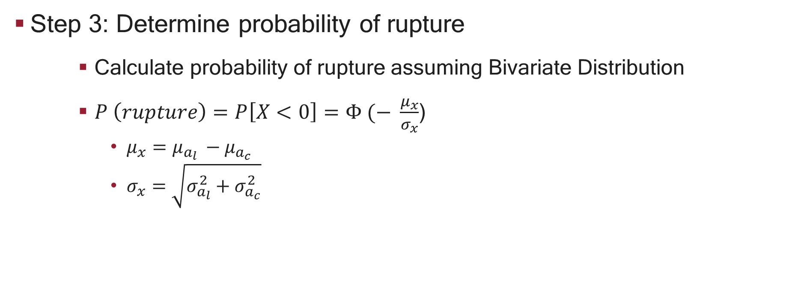
Procedure (cont’d)
Step 3: Determine probability of rupture
    Calculate probability of rupture assuming Bivariate Distribution
    $P \left(rupture\right)=P\left[X<0\right]=Φ (− \frac{μ_{x}}{σ_{x}}$)
      $μ_{x}=$ $μ_{a_{l} }−μ_{a_{c}}$
      $σ_{x}=\sqrt{σ_{a_{l}}^{2}+σ_{a_{c}}^{2}}$
Step 2
Step 2
Step 3

Slide 11
Case Study
RVON
xLPR Inputs
  RPV Outlet Nozzle
  Dimensions and loads (approximated) as per MRP-140 and xLPR Working Group
    Pipe OD: 0.869 m
    Thickness: 0.0663 m (R_{i}/t = 5.55 )
  Distribution on material
  Probability of seismic event set to 1
  Realizations: aleatory: 1000, Epistemic:1
  Constant crack growth rate and initial surface crack length
  Initial surface crack dimensions
    a: 0.0629 m (a/t = 0.95)
    l: 0.126 m (total length)

Slide 12
Case Study: Operating Conditions and Loads
RVON
Operating Conditions
Pressure | MPa | 15.41
Temperature | ºC | 320.5
SSE Loads
Fx (SSE) | kN | 3522.99
Mx (SSE) | kN-m | 319.75
My (SSE) | kN-m | 2237.10
Mz (SSE) | kN-m | 1762.56
Operating Conditions
Fx (Dead Weight) | kN | -4.448
Mx (Dead Weight) | kN-m | 11.298
My (Dead Weight) | kN-m | 14.688
Mz (Dead Weight) | kN-m | -107.3
Fx (Thermal Expansion) | kN | -400.3
Mx (Thermal Expansion) | kN-m | 227.1
My (Thermal Expansion) | kN-m | 676.8
Mz (Thermal Expansion) | kN-m | -4429

Slide 13
Case Study: Calculated Stress – Membrane and Bending
RVON
Pressure
Pressure Stress | MPa | 50.50
Crack Face Pressure | MPa | 15.41
Stress due to Deadweight
DW Membrane Stress | MPa | 0.03
DW Bending Stress | MPa | 143.77
Stress due to Thermal Expansion
TH Membrane Stress | MPa | 2.39
TH Bending Stress | MPa | 43.77
Total Stress due to NOC
Total Membrane Stress | MPa | 68.32
Total Bending Stress | MPa | 147.26
Stress due to SSE Loads
SSE Membrane Stress | MPa | 21.07
SSE Bending Stress | MPa | 91.85

Slide 14
Case Study: Crack Morphology and Leak Rate
RVON
Leak Rate Parameters
Global Roughness, mu_G (PWSCC) | μm | 113.9
Local Roughness, mu_L (PWSCC) | μm | 16.86
Number of Turns, eta_tL (PWSCC) | m⁻¹ | 5940
Global Path Dev Fact,K_G (PWSCC) |  | 1.009
Local Path Dev Fact, K_G_L (PWSCC) |  | 1.243

Slide 15
Case Study: Deterministic Results
RVON
For leak detection rate of 10
Critical flaw size calculated based on SRP 3.6.3 outside xLPR
Critical Flaw Size 2a_{c} (mm) | Leakage Flaw Size 2a_{l} (mm) | Margin a_{c}/a_{l}
542 | 187 | 2.89

Slide 16
Case Study: Probabilistic Results
RVON
Critical Crack Length
  Mean: 0.61 m (a_{c,m}) – approximately 27% of pipe circumference
  Std Deviation: 0.057
Leak Rate (gpm) | Mean Leakage Crack Length, a_{l,m} (m) | Standard Deviation on Leakage Crack Length | LBB Margin, a_{c,m}/a_{l,m} | Conditional P. of Rupture
5 | 0.153 | 4.91E-03 | 4.05 | 4.59E-16
10 | 0.186 | 7.15E-03 | 3.32 | 5.50E-14
15 | 0.212 | 8.57E-03 | 2.91 | 1.78E-12

Slide 17
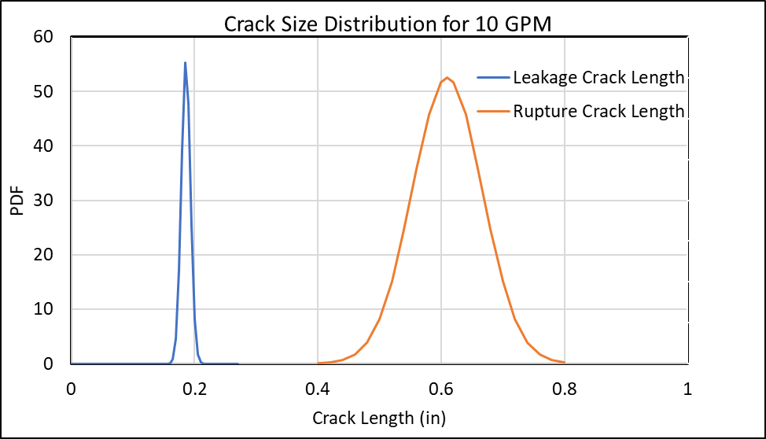
Case Study: Probabilistic Results
RVON- (cont’d)
Low probability of rupture is due to tight distribution on material

Slide 18
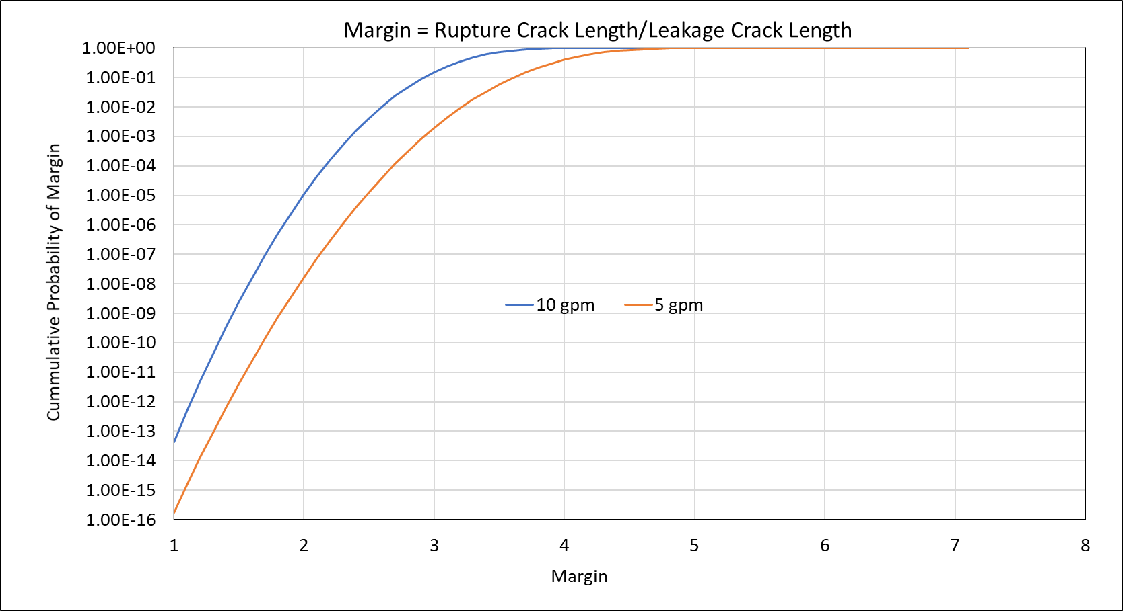
Case Study: Probabilistic Results
RVON- (cont’d)

Slide 19
Summary
An approach was proposed to present the deterministic LBB in probabilistic space.
  Conditional probability of rupture with initial through-wall crack
  Margins on leakage crack size (10 for deterministic LBB) and critical crack size (2 for deterministic LBB) can be evaluated in a probabilistic space
Additional study underway to verify the present approach
Link to full probabilistic analysis
  Including crack initiation, active degradation mechanism, ISI, break before leak, etc.

