Slide 1
IAEA Coordinated Research Project (I31030):
Methodology for Developing Pipe Failure Rates for Advanced Water Cooled Reactors
3rd International Seminar on Probabilistic Methodologies for Nuclear Applications
October 22-24, 2019
Rockville, MD, U.S.A
Presented by:
B.O.Y. Lydell
Sigma-Phase Inc.
Vero Beach, FL, U.S.A.

Slide 2

Presentation Outline
IAEA Coordinated Research Activities (CRA)
The IAEA Coordinated Research Project (CRP) on Piping Reliability Analysis
      Background & Objectives
      Participating Organizations
      Technical Scope & Working Methods
      Framework
      Benchmarks
      Schedule & Project Status
      Concluding Remarks

Slide 3
IAEA Coordinated Research Activities
The IAEA Coordinated Research Activities (CRAs) bring together research institutions from around the world to collaborate on research topics of common interest under IAEA coordinated research projects (CRPs).
This mechanism encourages the acquisition and dissemination of advanced knowledge and expertise in specific areas.
The results of the CRPs are shared with the international scientific community through scientific and technical publications, databases, presentations at conferences, and education & training workshops.

Slide 4
IAEA CRP I30130: 2018-2022
“Methodology for Assessing Pipe Failure Rates in Advanced Water Cooled Reactors”
  To provide Member States with methods & techniques to develop piping reliability estimates that are applicable to advanced WCRs
    Utilization of the existing knowledgebase spanning more than 5 decades of commercial WCR experience
      Piping OPEX
      Materials research
      Reliability & integrity management (RIM)
        ISI & RIISI
        NDE & NDE qualification (POD)Non-destructive examination
        Leak detection
      Ageing management & LTO
      Statistical modelling insights
      Structural reliability modelling insights

Slide 5
Background
Current state-of-knowledge:
  Piping systems in NPP are robustly designed and fabricated to high standards:
    Major failures are rare events, and rare failure events have low frequency of occurrence: <<0.1 failures/plant/year
    Most piping failure incidents are incipient or degraded failures with minor or no immediate impact on plant operation and safety and with relatively high frequency of occurrence: >> 0.1 failures/plant/year
  50+ years of data on piping degradation and failures, and statistical models of piping reliability, on the basis of operating experience of the current WCRs fleet:
    Comprehensive pipe failure event databases
    Analysis tools to explore and analyze the body of service experience with piping from today's well over 15,000 commercial reactor operating years and > 11,000+ records on pipe degradation and failure events
    Deep knowledge of effectiveness of degradation mitigation strategies
    State-of-the-art PFM tools
    Improved understanding of the synergies between OPEX, statistical models & PFM
Apply the existing knowledgebase to Advanced WCRs:
  A successful deployment involves the development of design certification probabilistic safety assessment (PSA) studies that among other aspects must also address piping reliability in multiple contexts
  Limited or no OPEX and no consensus technical approach of how to predict the pipe failure rates in advanced WCRs

Slide 6
Objectives of the CRP
Building on current ‘baseline’ – transfer of the know-how from 50+ years of operating WCRs experience to advanced WCRs fostering national excellence and promoting international collaboration among IAEA Member States through the sharing of expertise and participation in benchmark calculations:
  Provide Member States with an open access to a strong technical basis for establishing plant piping reliability parameters in support of the design certification PSA studies, in-service inspection program development, and operational support
  Enable objective evaluation and the benchmark studies by the participating Member States and thus will lead to new knowledge and sharing of research results relevant to prediction of pipe failure rates in newly deployable advanced WCRs
  Develop a “good practices process” for the performance of context-centric piping reliability analyses while recognizing the strengths & limitations of the different methodologies
    Design certification PSA & PSA applications
    Operability determinations
    RIM program development
    “Other” …….
  Foster national excellence and international cooperation, promote sharing of newly developed knowledge and contribute to capacity building in developing countries

Slide 7
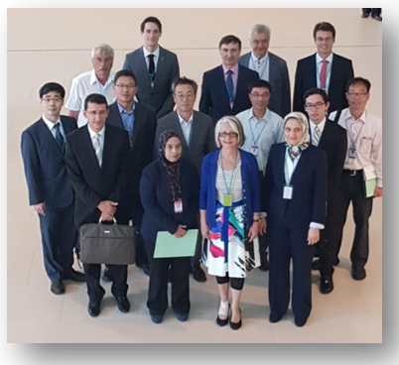
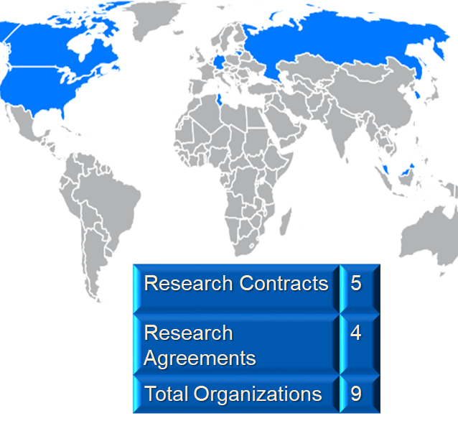
Participating Organizations
Canada
  CANDU Energy Inc.
  Ryerson University
  Canadian Nuclear Safety Commission
Germany
  Gesellschaft für Anlagen- und Reaktorsicherheit (GRS) GmbH
Korea (Republic of)
  Korea Atomic Energy Research Institute (KAERI)
Lithuania
  Lithuanian Energy Institute (LEI)
Malaysia
  Malaysian Nuclear Agency (MNA)
Russia
  Atomenergoproekt, ASE Group
Tunisia
  Tunisian Electric and Gas Company (STEG)
U.S.A.
  University of Illinois Urbana-Champaign (UIUC)
  Sigma-Phase, Inc.

Slide 8
Technical Scope
Four Activities
  On the basis of the current state-of-knowledge, develop a framework for how to implement a piping reliability analysis task
  On the basis of benchmark results, develop insights & recommendations w.r.t. piping reliability analysis in support of AWCR-centric applications
  Document framework and benchmark results
    IAEA TECDOC
    IAEA Nuclear Energy Series Report
  Conduct Education and Training Workshops

Slide 9
Working Methods
General Approach
  Apply different methodologies and computational tools to a well-defined evaluation boundary
  Develop a common understanding of the reliability metrics to be used
  Contrast-and-compare
  Two benchmark analyses
    “Calibration benchmark” based on WCR piping system location for which there exists extensive & well-documented OPEX
        This benchmark was completed in 2019 – evaluation of results is ongoing
    Benchmark based on an AWCR evaluation boundary
      No OPEX
      Degradation resistant material – Alloy 690/52/152
        This benchmark has been initiated and is scheduled to be completed during the 2nd quarter 2020

Slide 10
Analysis Framework
The starting point – to be refined & elaborated by the CRP

Slide 11
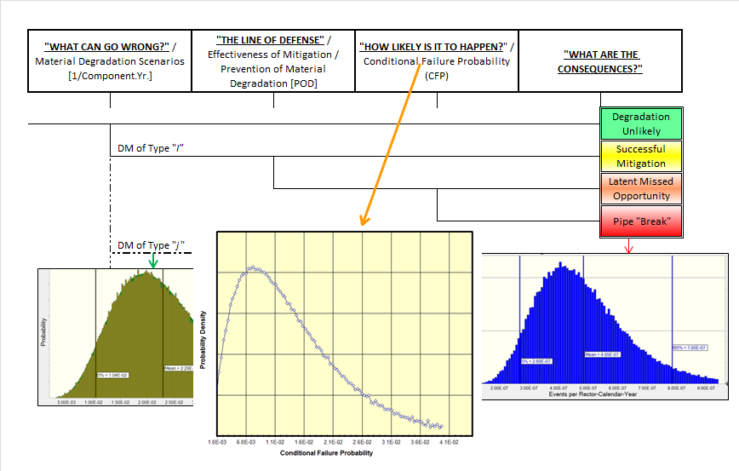
Structural Integrity “Risk Triplet”

Slide 12
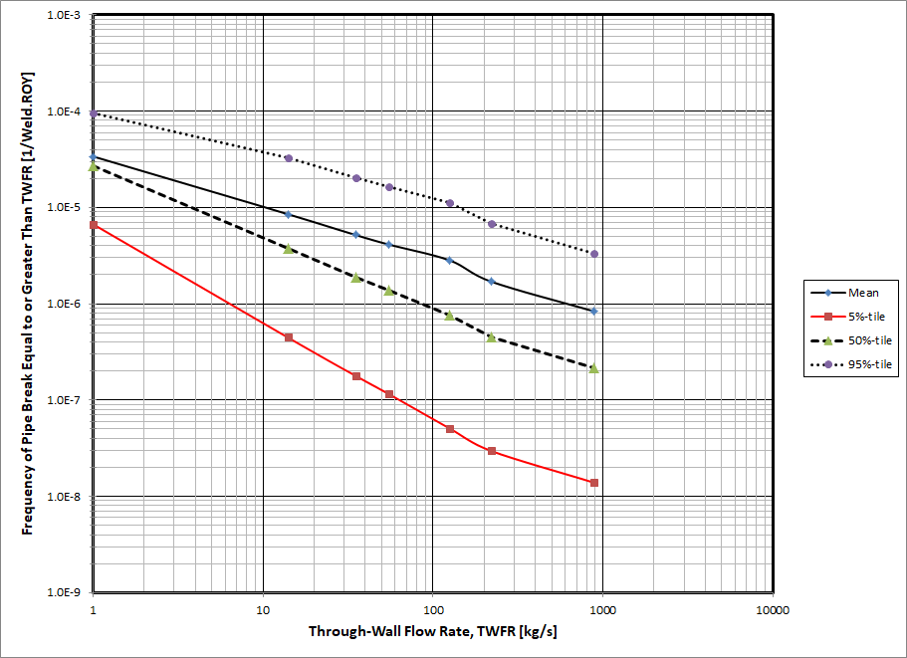
Results Presentation – An Example
Thermal Stratification in PWR Excess Letdown line

Slide 13
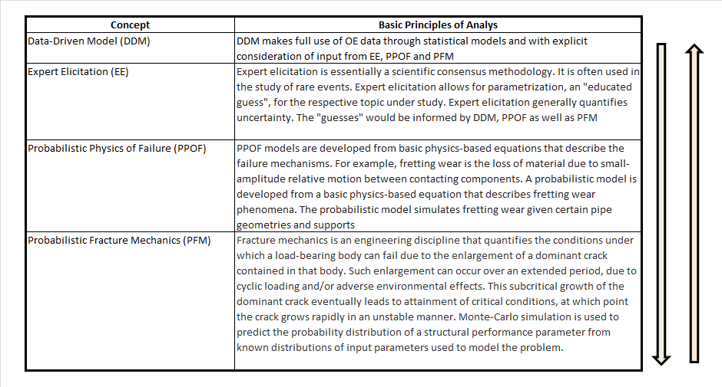
Methods of Piping Reliability Analysis

Slide 14
Benchmark Analyses
Benchmark #1 based on WCR piping system location
        PWR Excess Letdown line – the benchmark is concerned with material degradation caused by thermal stratification. Ample & well documented OPEX, physical phenomenon well understood
Benchmark #2 based on two AWCR evaluation boundaries (e.g. AP-1000)
        RCS Hot Leg dissimilar metal welds
        Pressurizer surge line to RCS Hot Leg branch connection
        The analysis teams are to perform a degradation mechanism assessment as part of the benchmarks

Slide 15
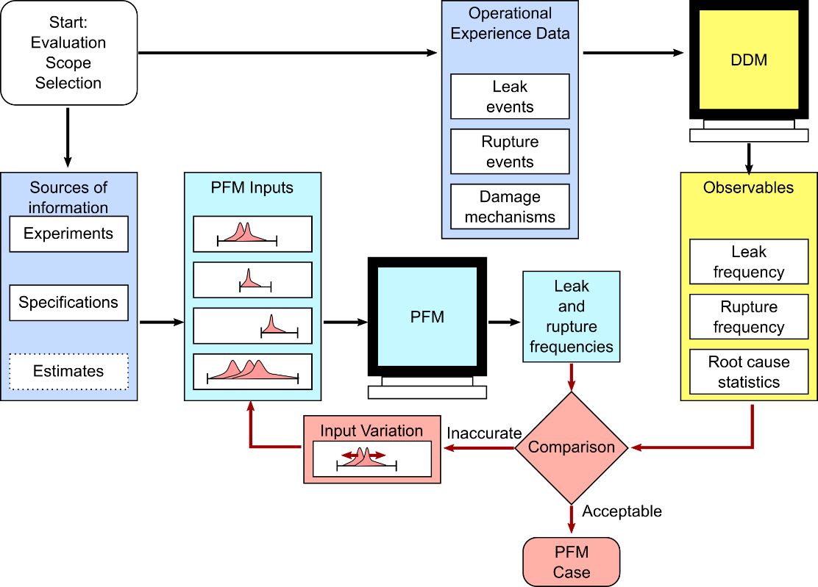
Basic Concept of Benchmark Analyses
CFP Models

Slide 16
Technical Challenges (i)
“Complete” pipe failures are rare events:
  The analytical issues & results interpretation issues are well recognized and have been debated since the dawn of the commercial nuclear industry
  This debate continues to this day
Strengths & limitations of the different analysis techniques
  Uncertainty analysis
  Model validation
  Role of operating experience
Codes & Standards
  Continued (and increased) emphasis on risk-informing structural integrity considerations – reactor regulation incl. plant life extension and new builds
  Consensus guidelines
  Applications
  Decision-making

Slide 17
Technical Challenges (ii)
Inconsistent use of terminology
  Frequency vs. probability
  Pipe “failure” definitions
The “stigma” of not being able to quantify complex material degradation scenarios
“Unfamiliarity” with the structural integrity concepts among non-experts

Slide 18
Schedule & Project Status
March 2017 – IAEA Consultants Meeting to define the CRP technical scope, working methods & Schedule
June 2018 – the first RCM at IAEA
June 2019 – the second RCM at IAEA – presentation of results of 1st Benchmark & initial discussions on 2nd Benchmark definition
June 2020 – the third RCM at IAEA – presentation of results of 2nd benchmark – planning of remaining tasks
Drafting of TECDOC and Nuclear Energy Series report to begin during the 3rd quarter of 2020

Slide 19
Concluding Remarks
The subject IAEA CRP sets out to:
    Develop a good practices framework for the development of pipe failure rates in AWCRs
    The framework reflects a multi-disciplinary approach
        It recognizes the many synergies between different methodologies
        Establishes a consistent piping reliability analysis nomenclature
    The framework utilizes the insights & results of a set of benchmark analyses

Slide 20
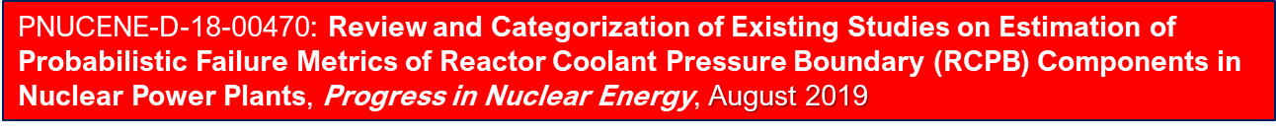
1st CRP OUTPUT

Slide 21
Thank You!
For additional information contact:
T.Jevremovic@iaea.org
M.Krause@iaea.org

